Slide 1
Unit 11: OUR GREENER WORLD lesson 3: A closer look 2
Grade 6

Slide 2
Objectives
By the end of the lesson, students can be able to:
understand and use the article and the first conditional sentence to make correct sentences, and use them in dialogues.

Slide 3
Grammar
Part 1: ARTICLES

Slide 4
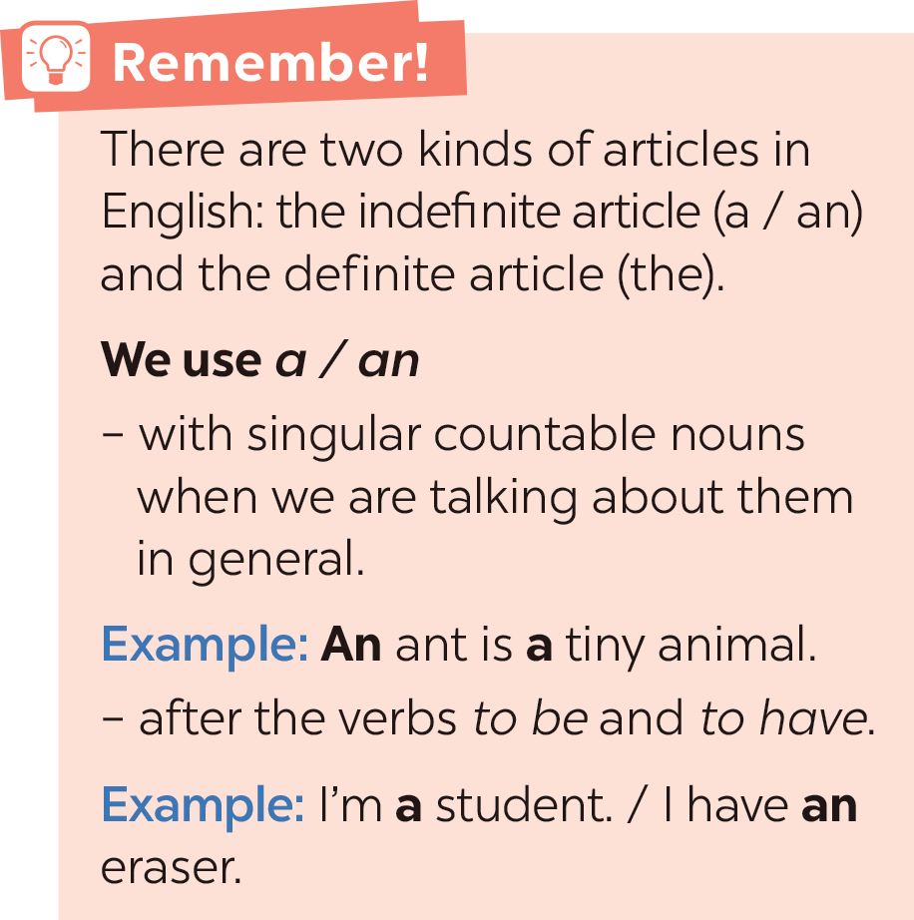
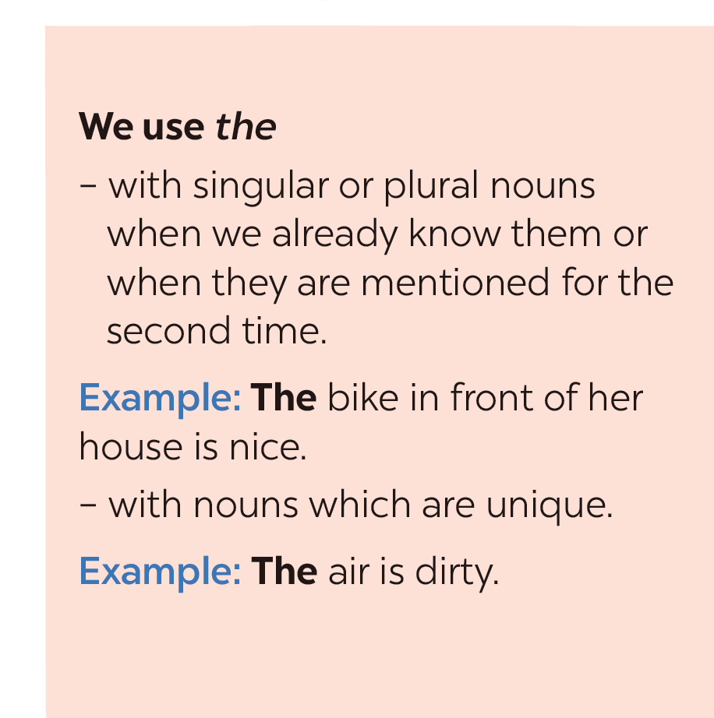

Slide 5

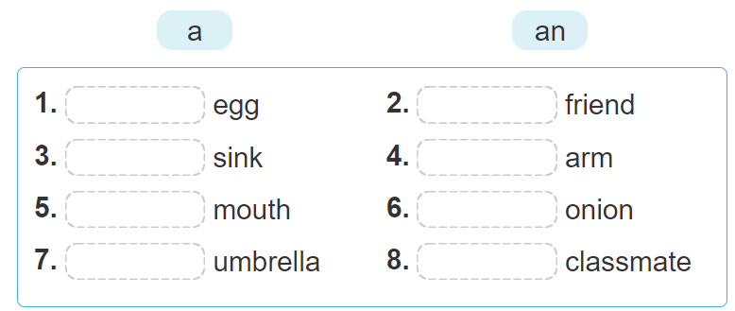
  an
  a
  a
  an
  a
  an
  an
  a

Slide 6
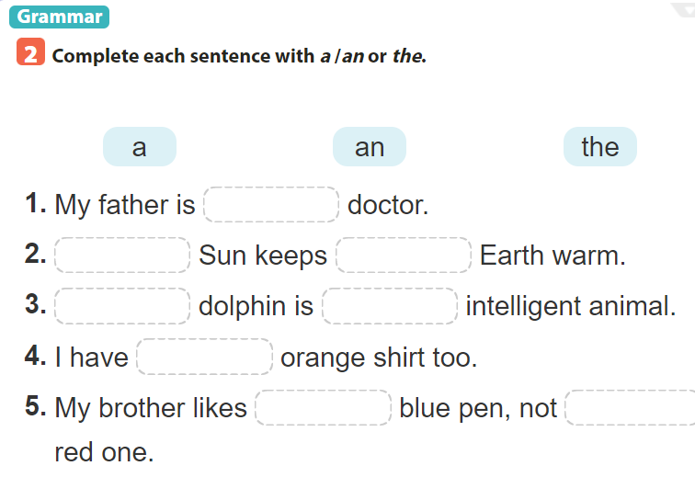

Slide 7

Choose the best answer
Note: click anywhere to run the time.
Click a, b or c to choose the correct answer.

Slide 8


5
1. My father is … doctor.
4
1
3
2
a. a
b. an
c. the

Slide 9
2. ……. Sun keeps………. Earth warm
5
4
1
3
2
b. The - an
b. The - a
c. The - the

Slide 10
5
3. ….. dolphin is …….intelligent animal.
4
1
3
2
a. A - an
b. The - a
c. The - an

Slide 11
5
4. I have ….. orange shirt too.
4
1
3
2
b. a
a. an
c. the

Slide 12
5. My brother likes……. blue pen, not ……. red one.
5
4
1
3
2
b. The - an
b. The - a
c. The - the

Slide 13

  a
  The
  the
  A
  an
  an
  the
  the

Slide 14
Grammar
Part 2: First conditional sentence

Slide 15
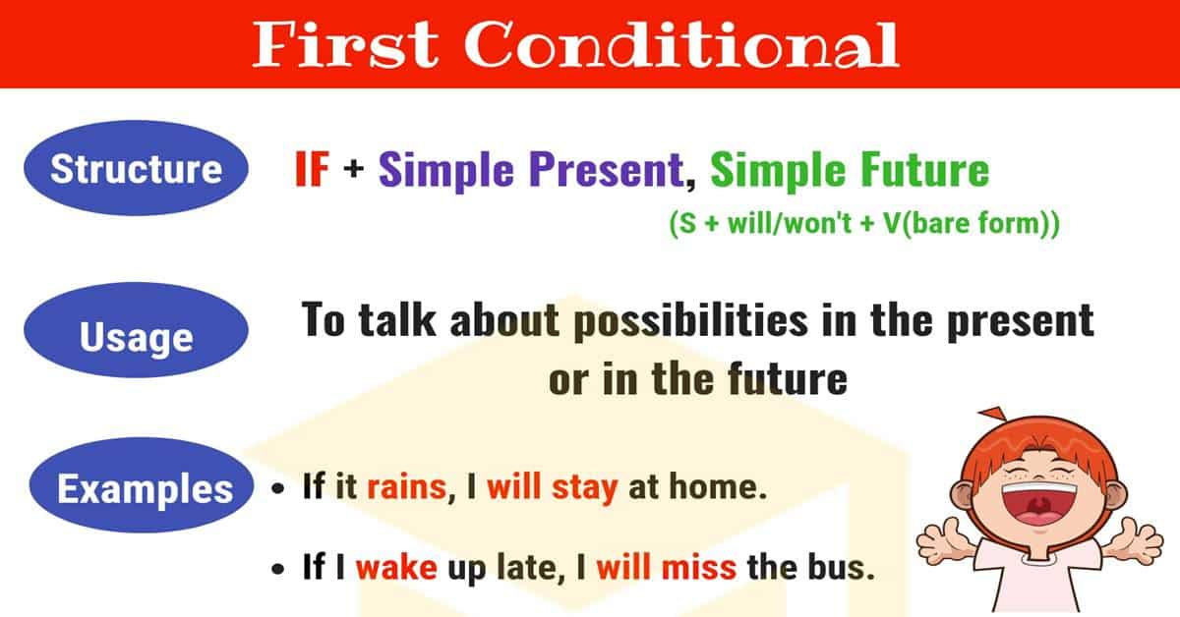

Slide 16

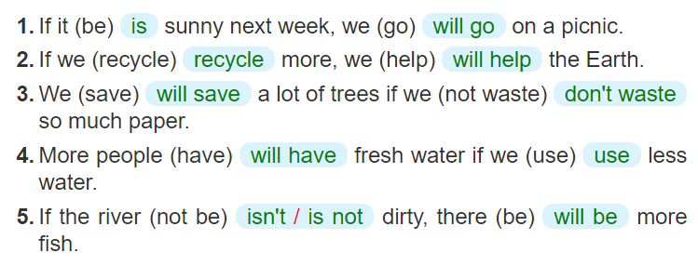

Slide 17
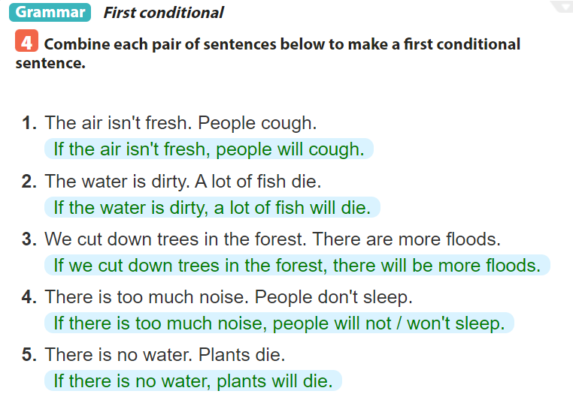
  =>
  =>
  =>
  =>
  =>

Slide 18
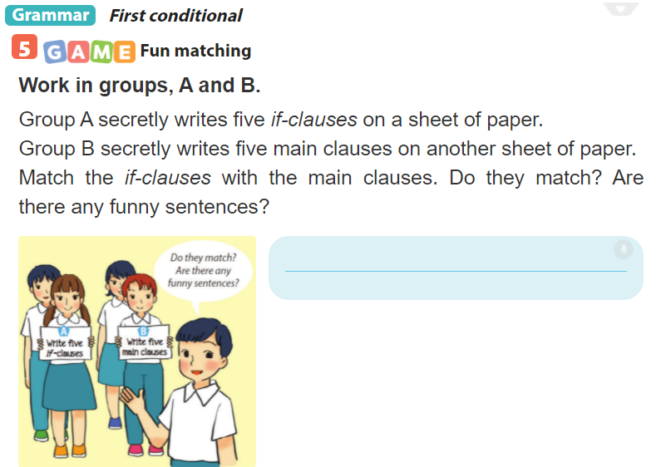

Slide 19
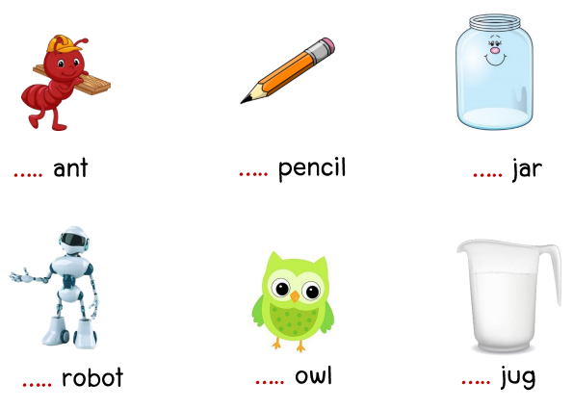
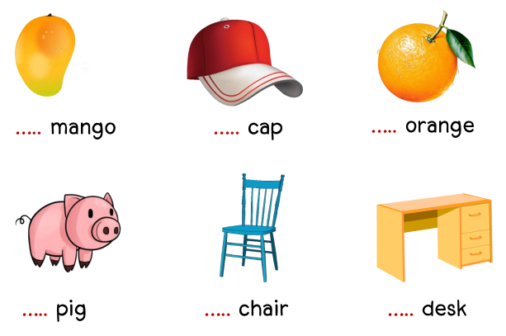
Extra exercise: a / an
a
a
an
a
a
a
a
an
a
a
a
a

Slide 20
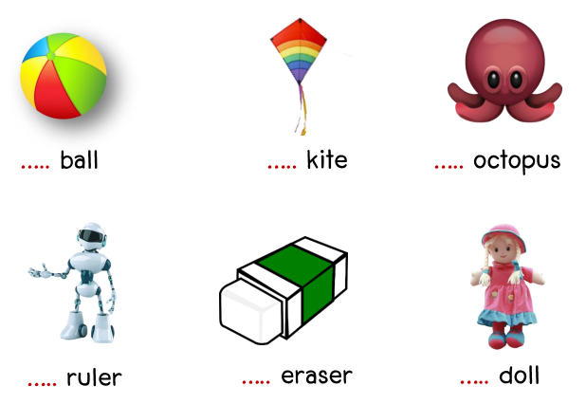
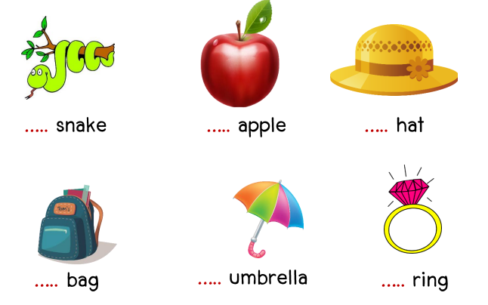
Extra exercise: a / an
a
a
an
a
an
a
a
an
a
a
an
a

Slide 21
Extra exercise:
Make the first conditional
1. If I (go) ……………………….out tonight, I (go)………………………….. to the cinema.
2. If you (get)…………………… back late, I (be) ………………........…….angry.
3. If he (come)………………………….. , I (be)…………………………… surprised.
4. If we (not/see) ……………………………………each other tomorrow, we (see)…………………….. each other next week.
5. If we (wait)………………………… here, we (be)……………………………. late.
go
will go
get
will be
comes
will be
don’t see
will see
wait
will be

Slide 22
SUM UP
By the end of the lesson, students can be able to:
understand and use the article and the first conditional sentence to make correct sentences, and use them in dialogues.
- Do exercise page ……

