Slide 1
Grade 6
Unit 7:
TELEVISION
Part 3: A closer look 2

Slide 2
Objectives
By the end of the lesson, students will be able to:
know how to use Wh-questions and conjunctions in compound sentences: and, but, so correctly.

Slide 3
Question words (Từ để hỏi)
Question words are also called wh questions because they include the letters 'W' and 'H'.
Question words | Meaning | Examples
Why: tại sao | reason | Why do you sleep early? Because I've got to get up early
When: khi nào | time | When do you go to work? At 7:00
How: như thế nào | manner | How do you go? By car
What: cái gì | object, idea or action | What do you do? I am an engineer
Which: cái nào | choice | Which one do you prefer? The red one.
Whose: của ai | possession | Whose is this book? It's Alan's.
Whom: ai | object of the verb | Whom did you meet? I met the manager.
what kind: loại nào | description | What kind of music do you like? I like quiet songs

Slide 4
Question words | Meaning | Examples
Who: ai (hỏi cho chủ ngữ, tân ngữ) | person | Who's that? That's Nancy.
Where: ở đâu | place | Where do you live? In Boston
what time: Mấy giờ | time | What time did you come home?
how many: bao nhiêu + danh từ số nhiều | quantity (countable) | How many students are there? There are twenty.
how much: bao nhiêu + danh từ không đếm được | amount, price (uncountable) | How much time have we got? Ten minutes
how long: bao lâu | duration, length | How long did you stay in that hotel? For two weeks.
how often: thường xuyên ntn | frequency | How often do you go to the gym? Twice a week.
how far: bao xa | distance | How far is your school? It's one mile far.
how old: bao nhiêu tuổi | age | How old are you? I'm 16.
how come= why | reason | How come I didn't see you at the party?

Slide 5
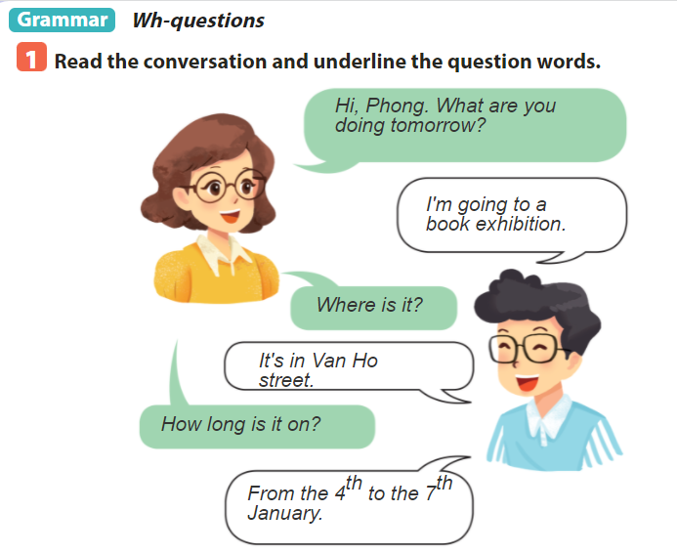

Slide 6
O

Slide 7
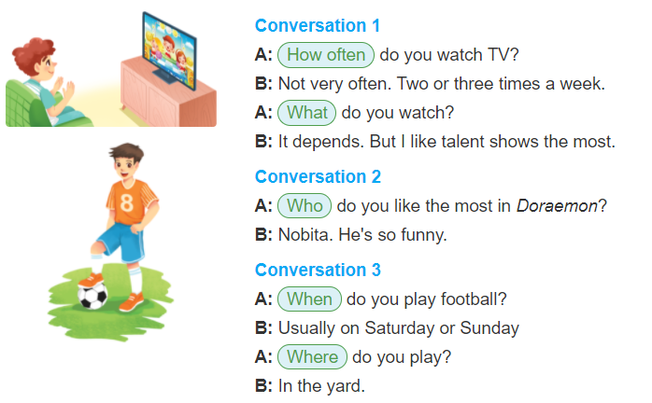
O

Slide 8
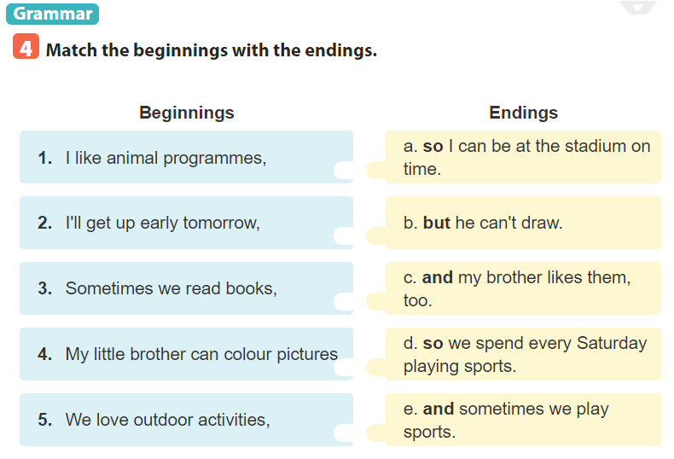
O

Slide 9
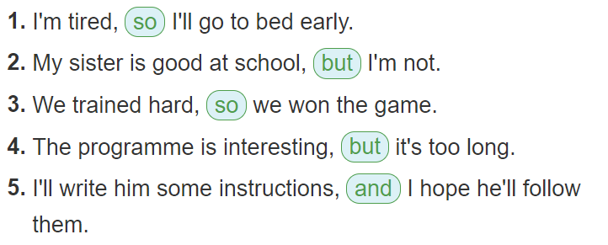
O

Slide 10
Sum up
By the end of the lesson students will be able to:
know how to use Wh-questions and conjunctions in compound sentences: and, but, so correctly.
HOMEWORK:
Do exercises …….. on page . …
Prepare for “Communication” part.

