Slide 1
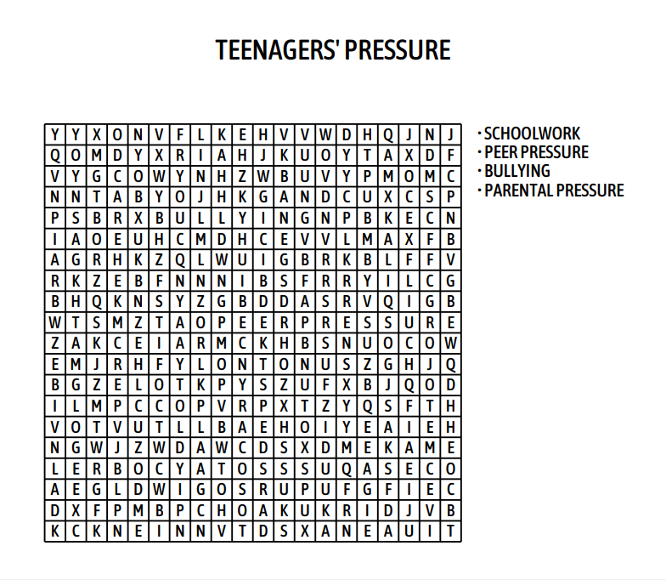
GAME:
WHO IS FASTER?

Slide 3
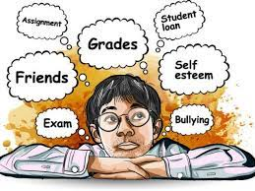
UNIT 3 Teenagers
Lesson 6: Skills 2

Slide 4
OBJECTIVES
01.
02.
After this lesson, students will be able to:
Listening
listen for general and specific information about teen stress
Writing
write a paragraph about the cause(s) of one's stress and solutions to deal with it.

Slide 6
I. Vocabulary

Slide 7
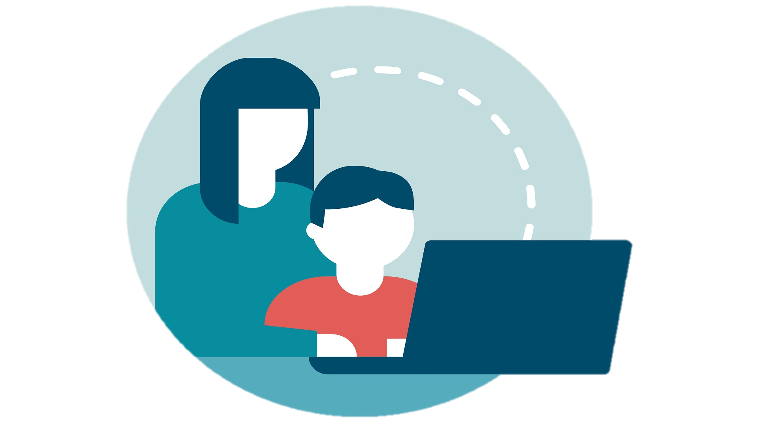
I. Vocabulary
parental (adj)
/pəˈrentl/
liên quan tới bố mẹ

Slide 8
Vocabulary
peer (n)
/pɪə(r)/
người ngang hàng, bạn đồng lứa

Slide 9
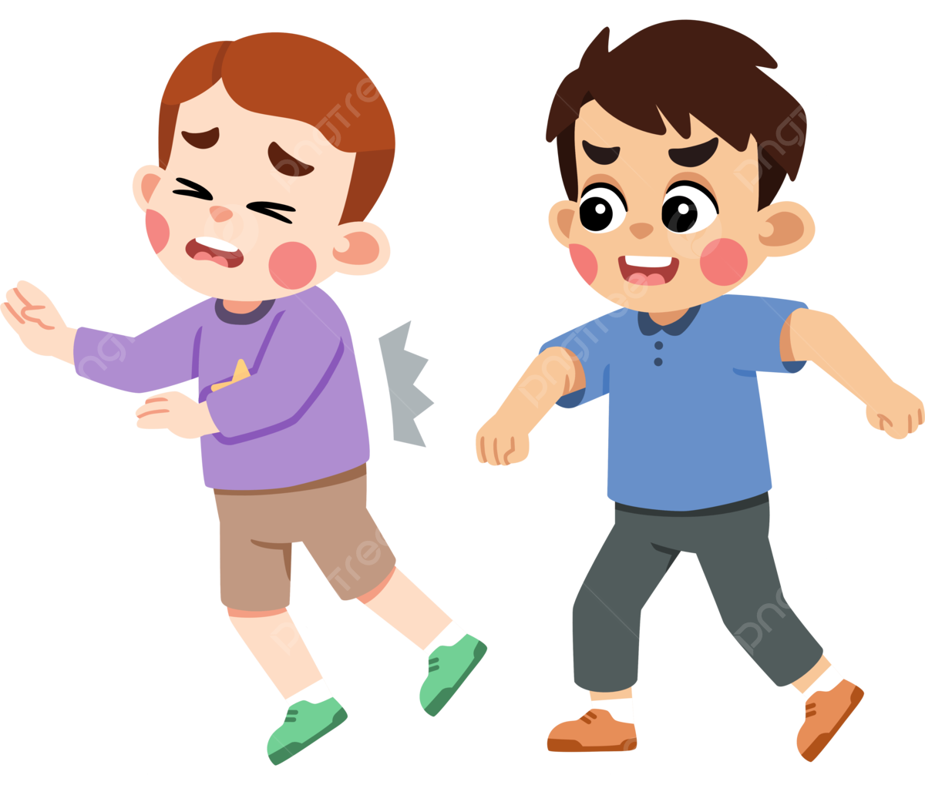
Vocabulary
bully (v)
/ˈbʊli/
bắt nạt

Slide 10
Vocabulary
bully (n)
/ˈbʊli/
kẻ bắt nạt

Slide 11
LISTENING
II.
listen about teen stress

Slide 12
1 (p.34) Which types of pressure below do you think teens face?
pressure from schoolwork
parental pressure
pressure from work
pressure from their clubs

Slide 13
2 (p.34) Listen to a conversation and choose the correct answer to each question.
1. How many students are talking?
A. One. B. Two. C. Three.
2. What are they discussing?
A. Their class forum.
B. Their stress.
C. Their community activities.
Mi: Ms Hoa said we can discuss the stress we have in our lives on the class forum. So, what stress do you have?
Minh: I'm tired of trying to meet my parents' expectations.

Slide 14
3 (p.34) Listen to the conversation again and fill each blank with ONE word.
Problems | Solutions
Minh has pressure from his (1)________. | Minh should tell his parents about his interests and (2) __________.
Ann is unhappy about her (3) _____________. | Ann should feel (4)________ about her body.
Mi doesn’t get on with her (5)________. | She should (6) ______ to her mum.
Let’s listen
N (someone)
N (something)
Adj
N (something)
V
N (someone)

Slide 15
3 (p.34) Listen to the conversation again and fill each blank with ONE word.
Problems | Solutions
Minh has pressure from his (1)________. | Minh should tell his parents about his interests and (2) __________.
Ann is unhappy about her (3) _____________. | Ann should feel (4)________ about her body.
Mi doesn’t get on with her (5)________. | She should (6) ______ to her mum.
Minh: I'm tired of trying to meet my parents' expectations. They want me to study well and be good at many things, so they send me to many classes like maths, English, piano, and karate.
Ann: Why don't you tell them your interests and abilities, Minh? I talked to my parents about this, so they no longer send me to classes I don't like.
N (someone)
N (something)
parents
abilities
Adj
N (something)
V
N (someone)

Slide 16
3 (p.34) Listen to the conversation again and fill each blank with ONE word.
Problems | Solutions
Minh has pressure from his (1)________. | Minh should tell his parents about his interests and (2) __________.
Ann is unhappy about her (3) _____________. | Ann should feel (4)________ about her body.
Mi doesn’t get on with her (5)________. | She should (6) ______ to her mum.
Ann: … Now I just focus on my health and try to lose some weight.
Mi: You look fit, Ann. You should feel good about your body.
Ann: Are you kidding, Mi? I still need to lose a few more kilos.
parents
abilities
Adj
good
Adj
N (something)
weight
N (something)
V
N (someone)

Slide 17
3 (p.34) Listen to the conversation again and fill each blank with ONE word.
Problems | Solutions
Minh has pressure from his (1)________. | Minh should tell his parents about his interests and (2) __________.
Ann is unhappy about her (3) _____________. | Ann should feel (4)________ about her body.
Mi doesn’t get on with her (5)________. | She should (6) ______ to her mum.
Mi: Actually, I don't get on with my sister. She is jealous of anything I have and always starts arguments. So I had to talk to my mum ...
parents
abilities
good
good
weight
weight
V
talk
N (someone)
sister

Slide 18
III.
Writing
write about the cause(s) and solutions of stress

Slide 19
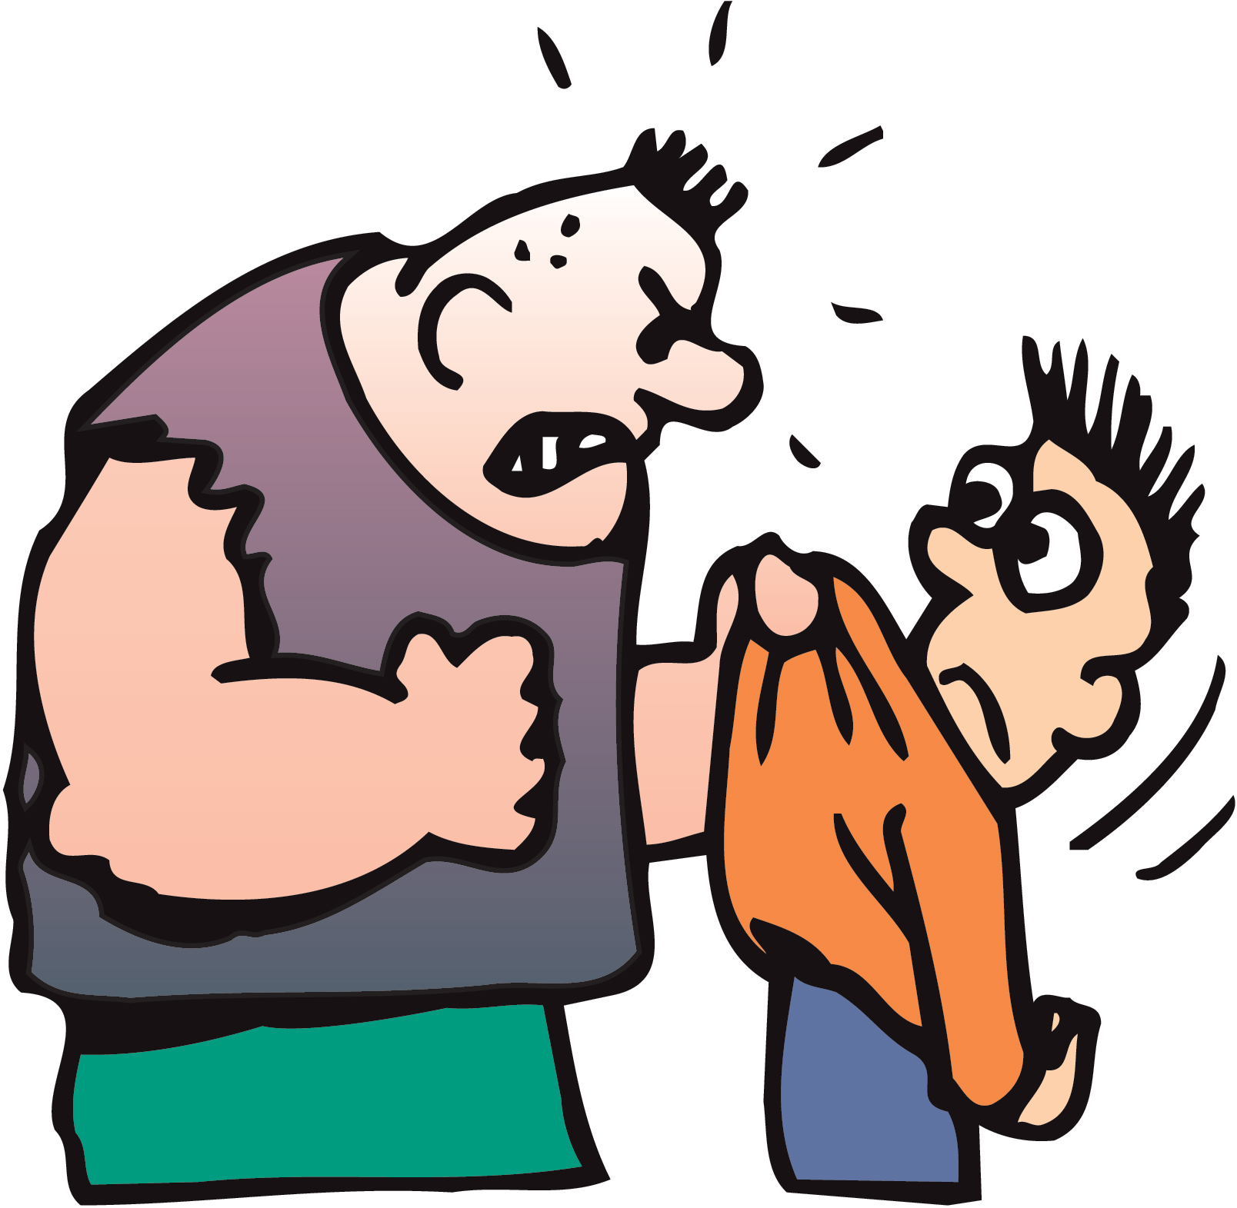
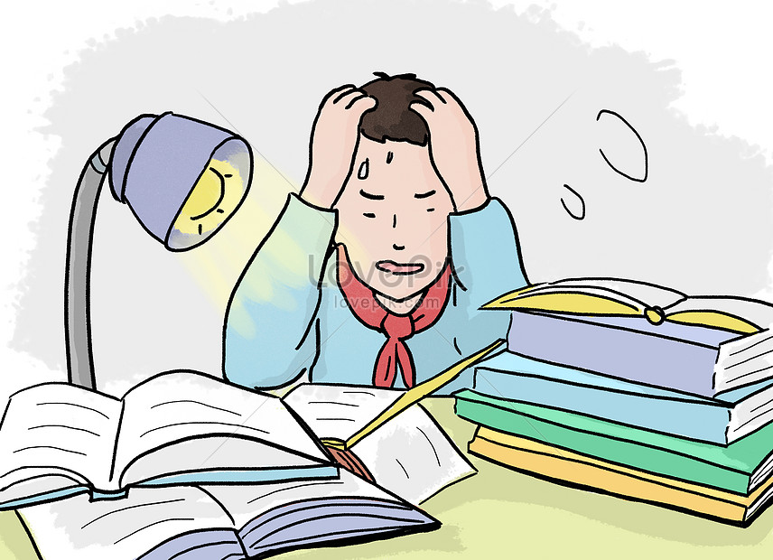
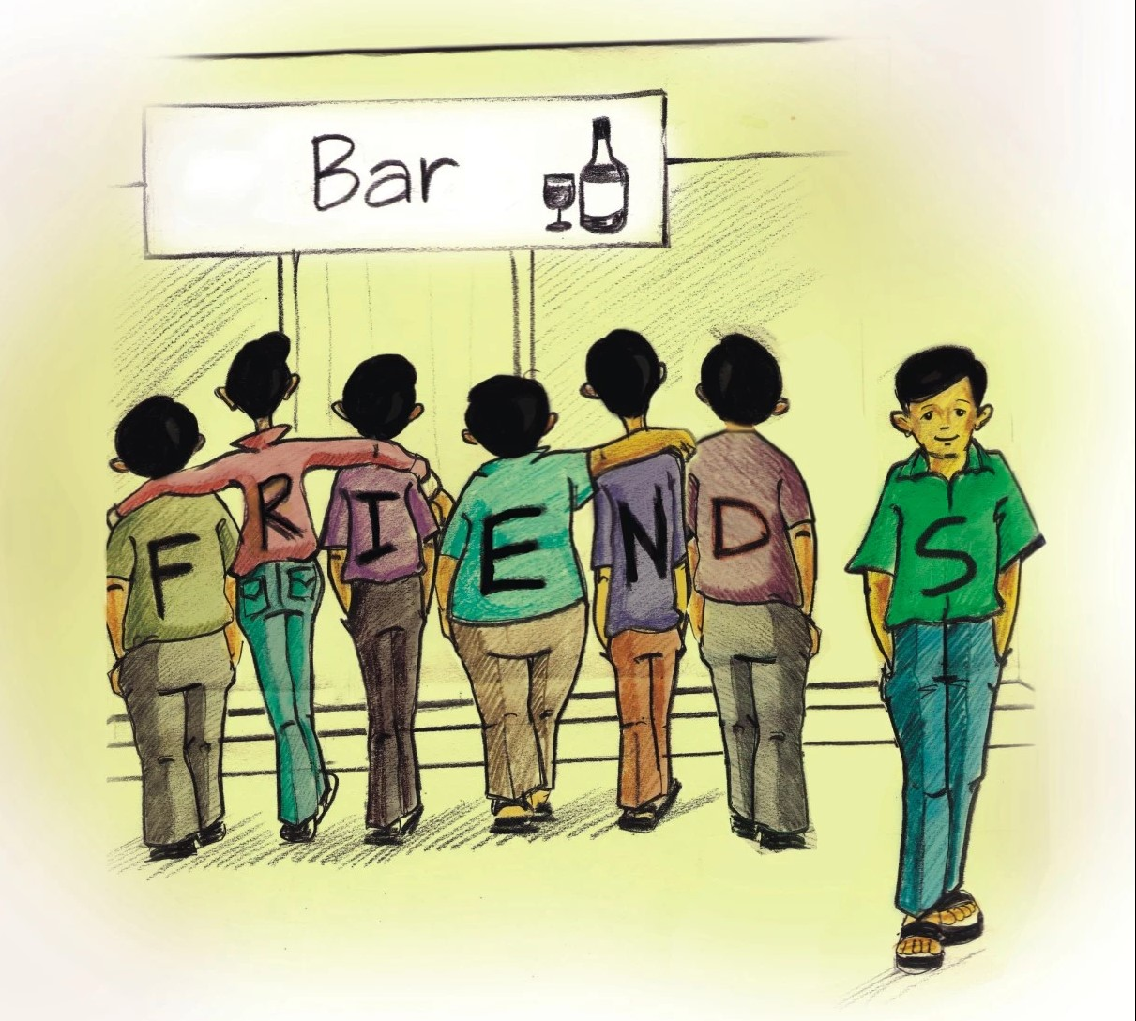
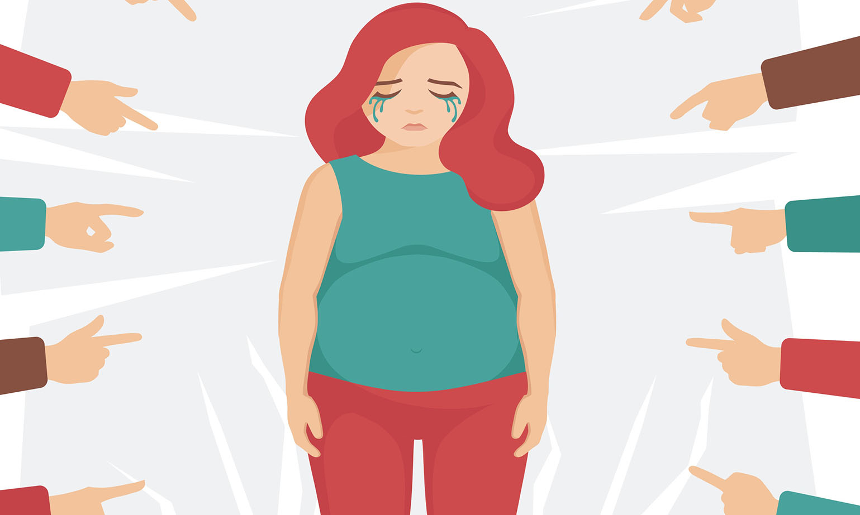
Can you name types of pressure in the following pictures.
1
2
3
bullying
parental pressure
homework pressure
4
5
6
exam pressure
peer pressure
body shaming

Slide 20
4 (p.34) Match the causes of teen stress with the possible solutions. There may be more than one solution to a problem.
Causes of teen stress |  | Possible solutions
peer pressure too much schoolwork spending too much time on social media bullying |  | avoiding bullies wherever possible staying calm and relaxed turning off smartphones talking to teachers

Slide 21
What type of pressure is it?

Slide 22
Complete these sentences to give solutions to schoolwork pressure.
Talking to teachers
Do exercise regularly to stay healthy, sleep enough.
SCHOOLWORK PRESSURE
Ask my friend

Slide 23
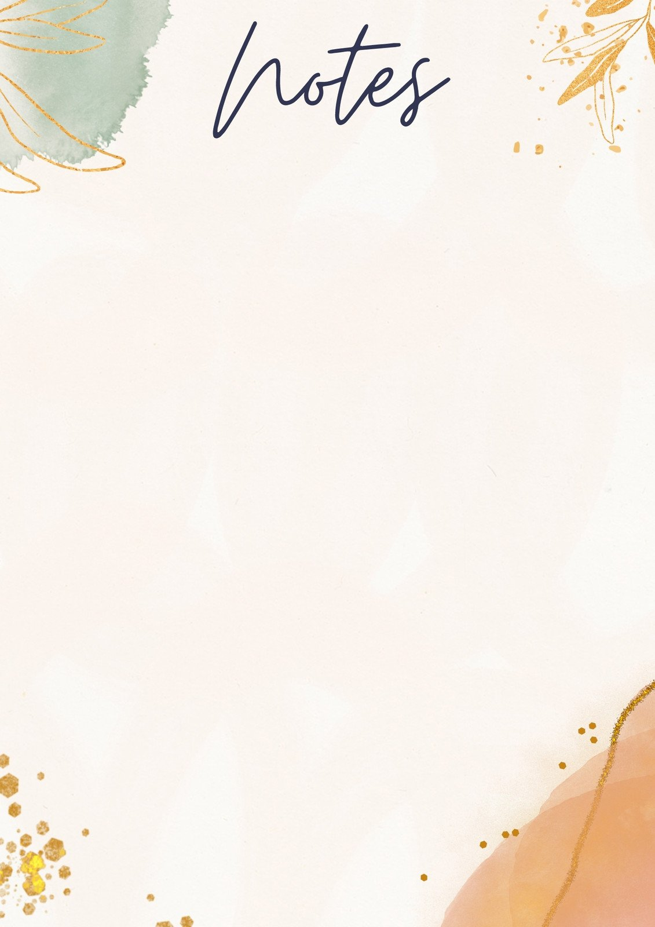
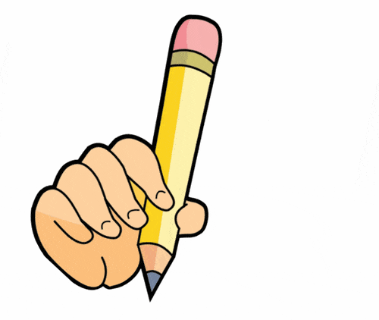
5 (p.34) Write a paragraph (80 - 100 words) about the cause(s) of your stress and offer solutions.
I often feel stressed because of
and here are the ways I deal with my
stress.
Causes of teen stress |  | Possible solutions
schoolwork |  | talking to teachers
I often feel stressed because of _________
____________________________________
and here are the ways I deal with my stress.
__________________________________________________________________________________________
I often feel stressed because of schoolwork, and here are the ways I deal with my stress. Firstly, I try to talk to my teachers about how I feel and what I expect them to help me. Secondly, ……………………………………….
………………………………………………………………..
Finally, I also ………………………………………………

Slide 24
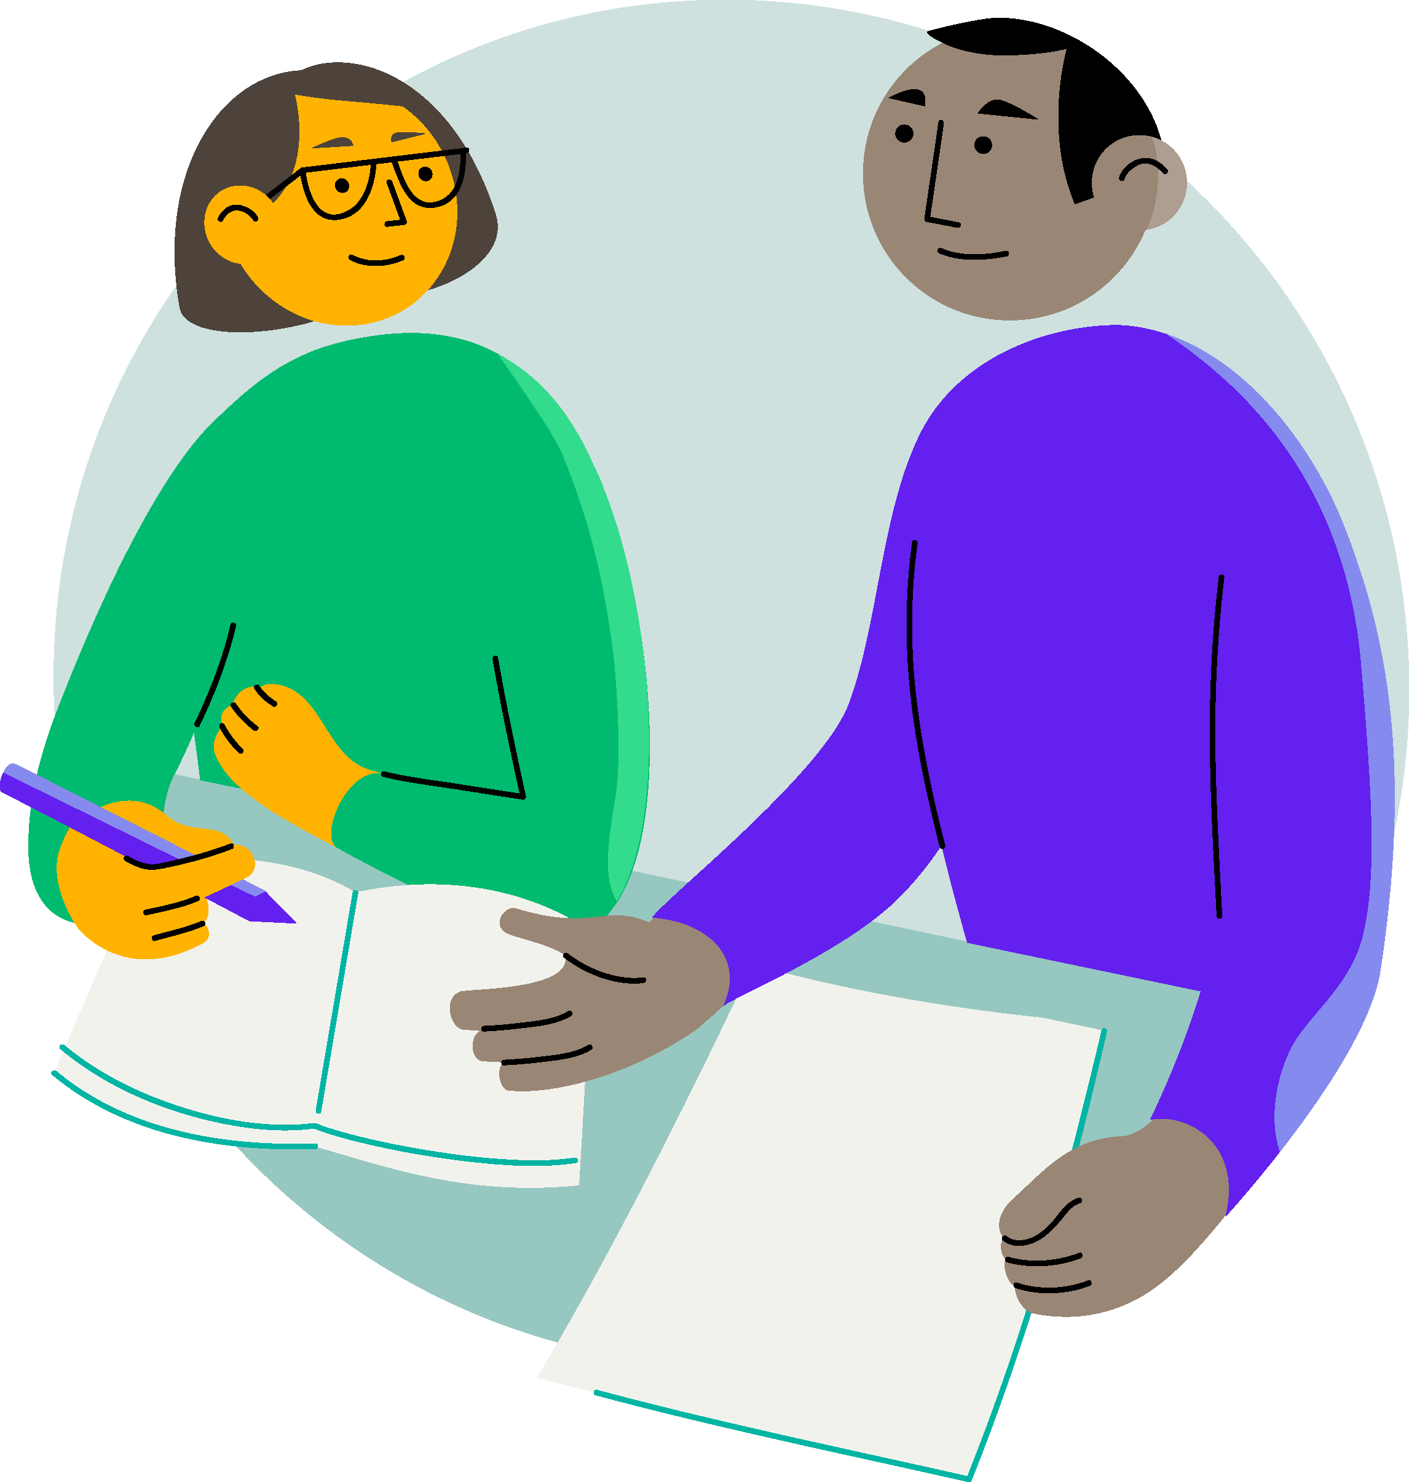
Swap and check.
* Check for spelling
* Check for ideas
Did your friend write about his/ her cause and the solutions to the stress?
* Check for comprehension
Does the writing make sense?
* Check for grammar
Does the writing use the correct tenses and structures?

Slide 25
WRAP UP
In this lesson, students have learned to:
- Listen for general and specific information about teen stress
- Write a paragraph about the cause(s) of one's stress and solutions to cope.
Homework: WB p.34

Slide 26
Thanks!
Do you have any questions?

