Slide 1
UNIT 7: TELEVISION
Lesson 1: Getting started

Slide 2
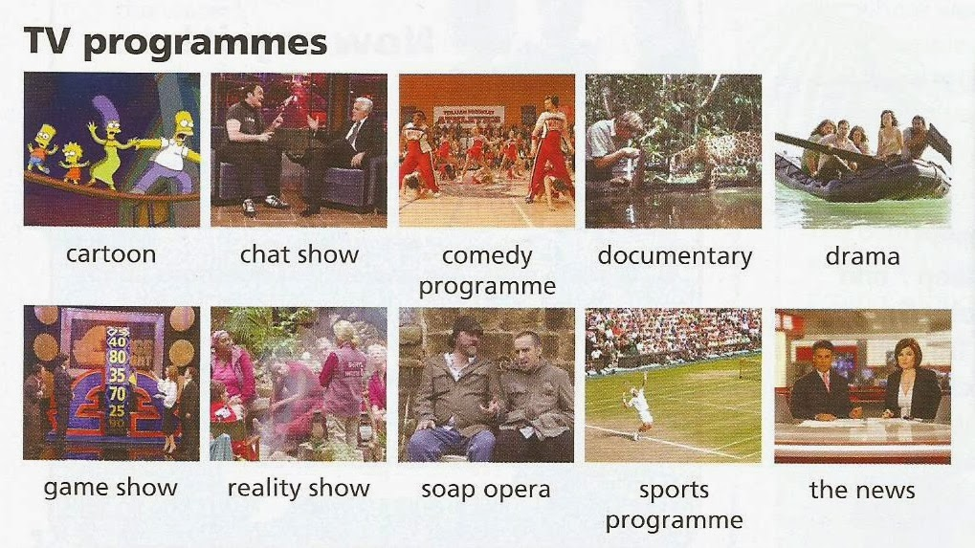
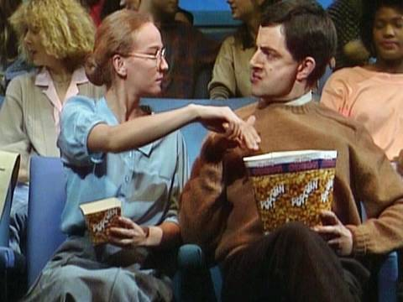
UNIT 7 Television
Leson 1 : Getting started
I. Listen and read
* VOCABULARY
- progamme (n) :
chương trình
- channel (n) /ˈtʃenl/
:
kênh truyền hình
- cartoon (n) :
phim hoạt hình
- schedule (n) :
chương trình, lịch trình
- local (adj) :
thuộc địa phương
- national (adj) :
thuộc quốc gia
- character (n) :
nhân vật
- comedy (n) :
hài kịch

Slide 3
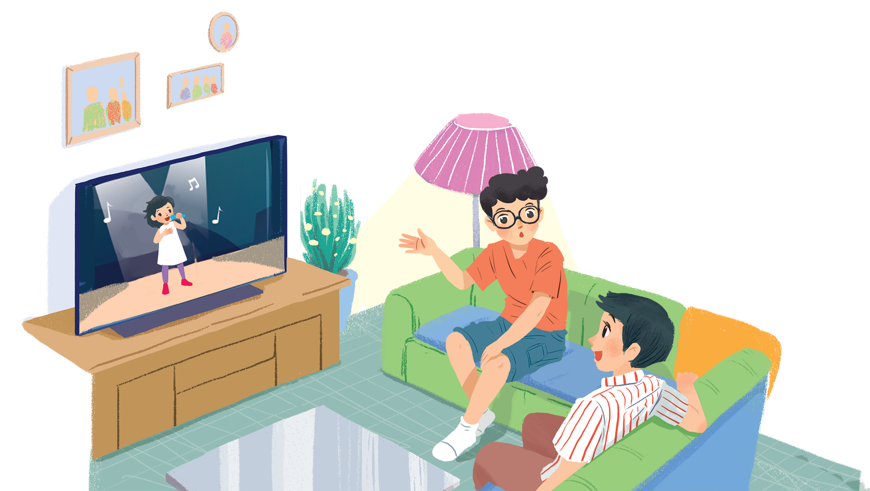
Listen and read.
What’s on today?

Slide 4
What’s on today?
Phong: What are you watching, Hung?
Hung: The Voice Kids.
Phong: That music talent show is very interesting.
Hung: It is. What programme do you often watch, Phong?
Phong: Films. I like animated films like The Lion King.
Hung: I love them, too. They’re wonderful.
Phong: I often watch them with my little brother, but he prefers cartoons.
Hung: Tom and Jerry?
Phong: Ha ... ha ... Yes, he loves Jerry the mouse.
Hung: Jerry’s a clever character. Do you know any English programmes for children?
Phong: Yes. I watch English in a Minute on VTV7.
This channel has many educational programmes.
Hung: Great. I’ll watch it, too.

Slide 5
Choose the correct answer A, B, or C.
1.
Phong and Hung are talking about _______.
A.
The Voice Kids programme
B.
English in a Minute programme
C.
different TV programmes
2.
Phong likes _______.
A.
animated films
B.
cartoons
C.
talent shows
3.
When you’re viewing a TV programme, you say: “I’m _______ TV.”
B.
C.
looking
A.
watching
seeing
4.
When a programme teaches you something, it’s _______.
A.
educational
B.
funny
C.
clever

Slide 6
Read the conversation again and match 1-5 with a-e.
1. The Voice Kids
2. The Lion King
3. Tom and Jerry
4. VTV7
5. English in a Minute
a. animated film
b. channel
c. music talent show
d. educational programme
e. cartoon

Slide 7
Find and write the adjectives in the conversation which describe the programmes and characters below.
1.
The Voice Kids
interesting
2.
animated films
wonderful
3.
Jerry the mouse
clever
4.
programmes on VTV7
educational

Slide 8
Work in groups. Interview your partners about their favourite TV programmes and report to the class.
Example:
In our group, Mai likes sports programmes on TV. Binh likes ...
Weather forrecast (n) dự báo thời tiết
News (n) thời sự
Documentary film (n) phóng sự
Games show (n) chương trình trò chơi trên truyền hình
Story film (n) phim truyện
Adventure film (n) phim thám tử/
Thrilling film (n) phim li kì

Slide 9
HOMEWORK:
Learning by heart new words.
Doing exercises in workbook.
Preparing new lesson: Unit 7: Lesson 2: A closer look 1.

Slide 12
New words:
- talent (adj) tài năng, năng lực /ˈtalənt/
- animated (adj)hoạt hình /ˈaniˌmeitid/
- programme: (n) chương trình /ˈprəuˌɡrem/
- channel (n): kênh /ˈtʃenl/
- cartoon (n): phim hoạt hình /kärˈto͞on/
- cool (adj): dễ thương, mát mẻ /ko͞ol/
- popular (adj) : phổ biến /ˈpäpyələr/
- schedule (n): lịch,thời gian biểu chương trình /ˈskejəl/
- educational (adj): mang tính giáo dục /ˌeđəˈkeis(ə)n(ə)l/
- entertaining (adj): giải trí /ˌen(t)ərˈteiniŋ /
- national (adj): thuộc về quốc gia /ˈnes(ə)n(ə)l/

