Slide 1
WELCOME TO OUR CLASS

Slide 3
MYSTERY BOX

Slide 4
Unit 3: WEATHER
Lesson 1.1
Page 34
Teacher Hanh

Slide 5
Good afternoon! I am Weather Wizard. I lost my power. Please finish the challenge and help me to go to Wonderland.

Slide 6
Round 1:
Fire power

Slide 8
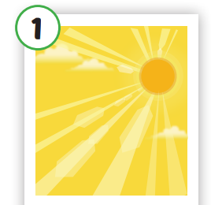
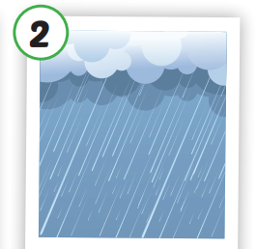
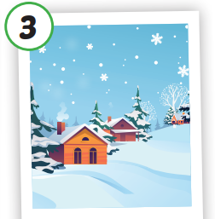
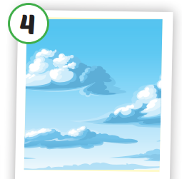
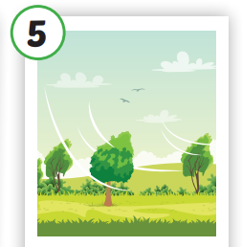
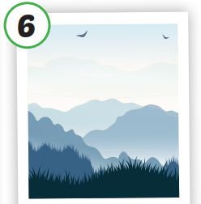
Click each English word to hear the sound.
sunny
rainy
snowy
cloudy
windy
foggy
/ˈsʌni/
có nắng
/ˈreɪni/
có mưa
/ˈsnoʊi/
có tuyết
/ˈklaʊdi/
có nhiều mây
/ˈwɪndi/
có gió
/ˈfɑːɡi/
có sương mù

Slide 10
1. Words
sunny
rainy
snowy
cloudy
windy
foggy

Slide 11
Completed round 1

Slide 12
Round 2:
Water power

Slide 13
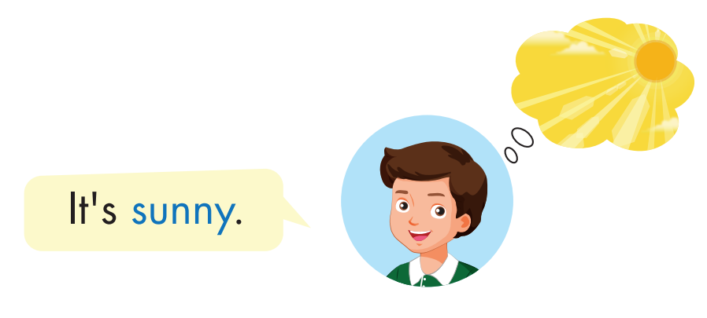
Click each English word to hear the sound.

Slide 14
2. Structures
What’s the weather like today?
It’s sunny.

Slide 15
TIME TO PRACTICE

Slide 16
SPIN

Slide 17
Completed round 2

Slide 18
Round 3:
Air power

Slide 20
QUIZ SHOW
There is a question about weather with 4 answer choices. Choose the correct answer.

Slide 21
Lucy: What’s the weather like today?
Ben: It’s ......
A. sunny
B. cloudy
C. snowy
D. foggy

Slide 22
Lucy: What’s the weather like today?
Ben: It’s ......
A. foggy
B. snowy
C. sunny
D. windy

Slide 23
Lucy: What’s the weather like today?
Ben: It’s ......
A. snowy
B. rainy
C. windy
D. sunny

Slide 24
Lucy: What’s the weather like today?
Ben: It’s ......
A. rainy
B. sunny
C. windy
D. cloudy

Slide 25
Lucy: What’s the weather like today?
Ben: It’s ......
A. windy
B. rainy
C. sunny
D. foggy

Slide 26
Lucy: What’s the weather like today?
Ben: It’s ......
A. windy
B. rainy
C. foggy
D. cloudy

Slide 27
Completed round 3

Slide 28
Round 4:
Earth power

Slide 29
with Weather Wizard

Slide 30
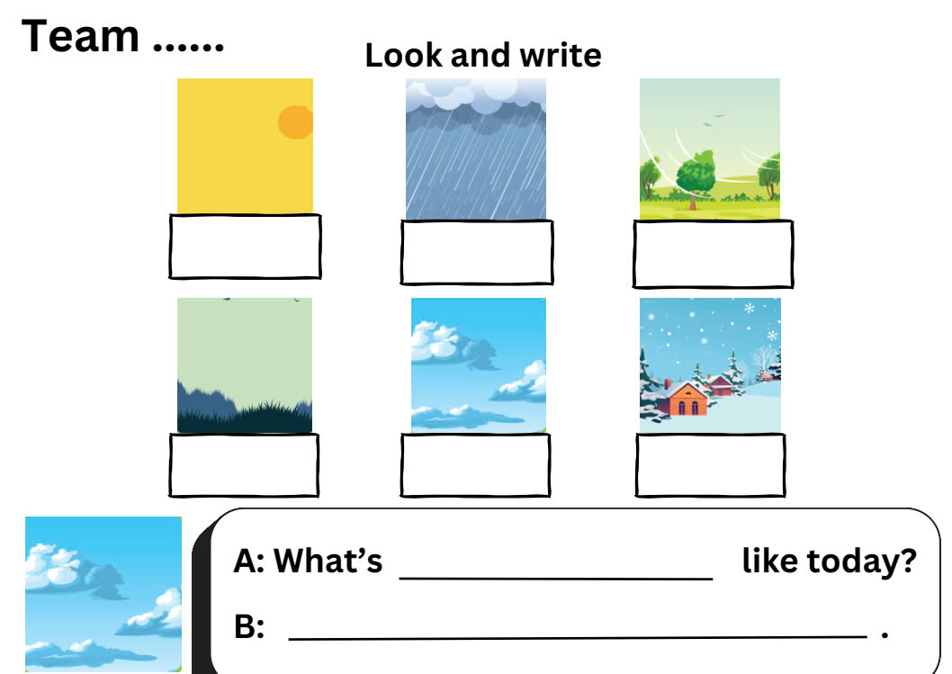

Slide 31
Completed round 4

Slide 32
Today’s lesson
Vocabularies
sunny, rainy, snowy, cloudy, windy, foggy.
Structures/ Sentence patterns
What's the weather like today?
It's sunny.

Slide 33
Homework
Practice the vocabulary and structure; make sentences using the vocabulary learnt in the lesson.
Do the exercises in Tiếng Anh 4 i-Learn Smart Start WB (page 22)
Prepare the next lesson (page 35 SB)

Slide 35
Thank you

