Slide 2
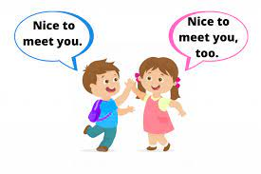
UNIT 1
NICE TO SEE YOU AGAIN
(LESSON 1 & 2)

Slide 3
WARM UP

Slide 4
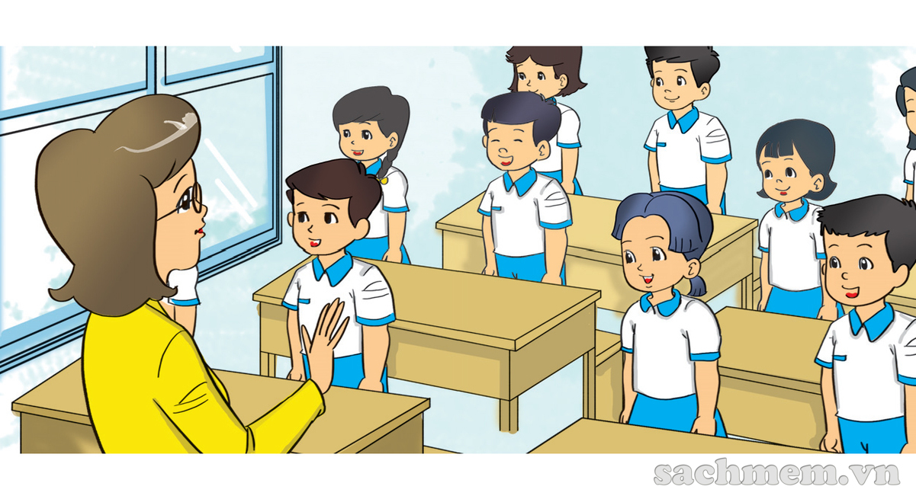

Slide 5
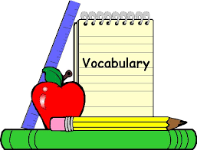
A

Slide 7
Good morning

Slide 9
Good EVENING

Slide 11
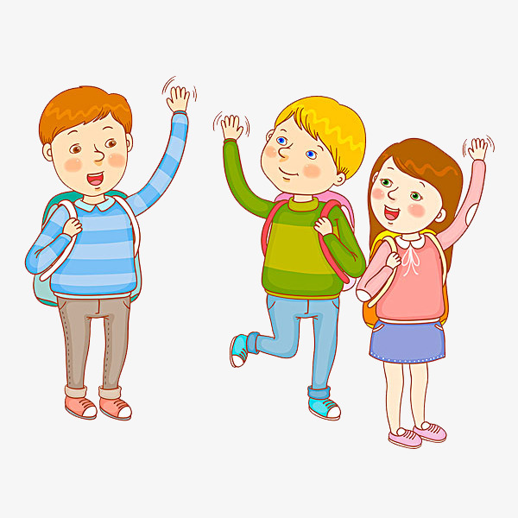

Slide 12
See you tomorrow.
MAI
NAM
See you later.
See you again.

Slide 13
B. Sentence Pattern (Review)
Hỏi- đáp xem bạn khỏe không:
How are you?
I’m fine, thank you
Fine, thanks

Slide 14
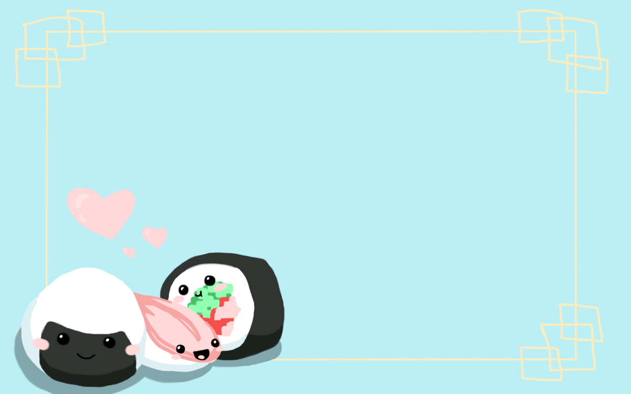
B. PRACTICE LESSON 1

Slide 16
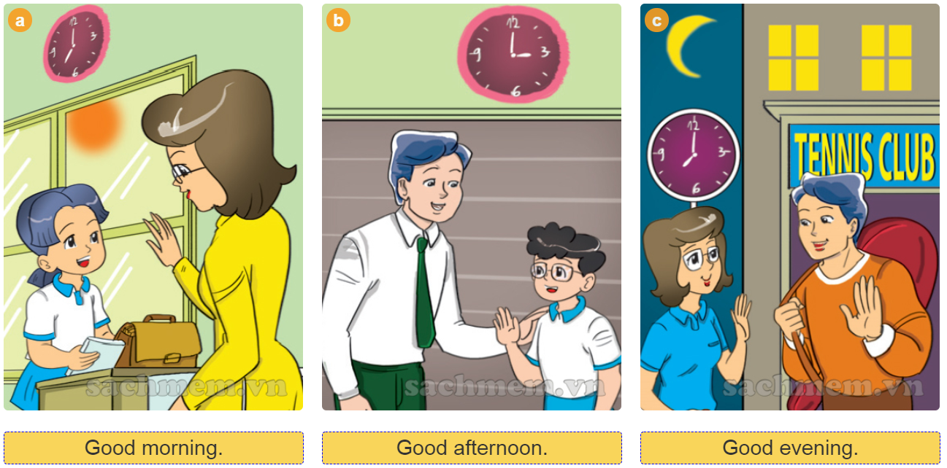

Slide 17
Good morning, Mai
Good morning, Miss Hien

Slide 18
Good afternoon, Phong
Good afternoon, Mr. Loc

Slide 19
Good evening, Mr. Loc
Good evening, Miss Hien

Slide 20
B. PRACTICE LESSON 2

Slide 23
C. LISTENING

Slide 24
SUMMARY
Tuesday, September 7th 2021
Unit 1: Nice to see you again (Lesson 1 &2)
1
Vocabulary
- good morning: chào buổi sáng
- good afternoon: chào buổi chiều
- good evening: chào buổi tối
- goodbye = bye: chào tạm biệt
- good night: chúc ngủ ngon
CONTENTS
Nice to see you: Rất vui được gặp bạn
See you tomorrow: Hẹn gặp bạn ngày mai
See you later: Gặp lại bạn sau
See you again: Hẹn gặp lại

Slide 25
SUMMARY
Tuesday, September 7th 2021
Unit 1: Nice to see you again (Lesson 1 &2)
2
Sentence pattern (Review)
-
Hỏi- đáp xem bạn khỏe không:
How are you?
I’m fine, thank you
- Fine, thanks
CONTENTS

Slide 26
Tuesday, September 7th 2021
Unit 1: Nice to see you again (Lesson 1 &2)
1
Học thuộc từ vựng, mẫu câu.
2
REMEMBER
Hoàn thành BT:
Bài 4 ( sách HS- Trang 7)
Bài 5 ( SHS- Trang 9)
- BT Unit 1 ( Sách BT)
3
Chép bài vào vở (từ vựng, mẫu câu)

Slide 28
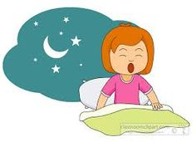
Good moning
Good afternoon
Good night
2

Slide 29
afternoon
morning
night
3

Slide 30
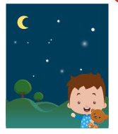
afternoon
morning
night
4

Slide 31
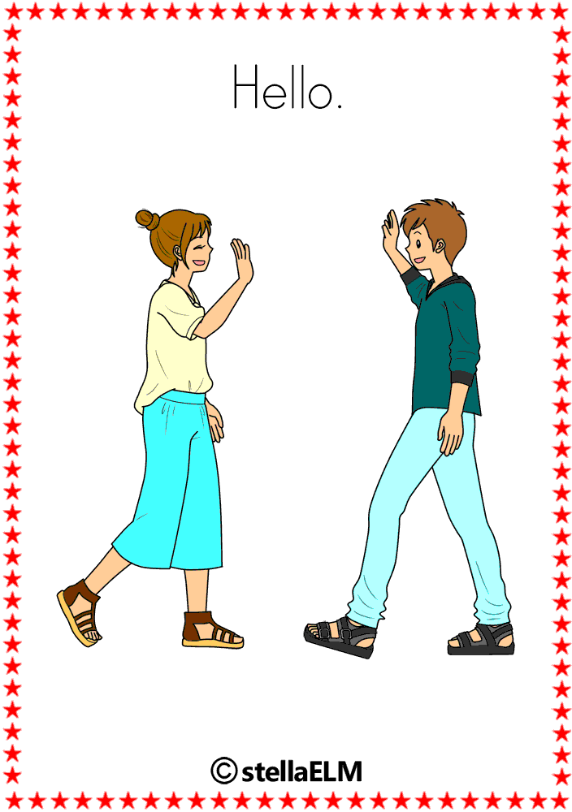
hello
Good bye
bye
5

Slide 32
BYE
GOOD BYE
NICE TO MEET YOU
6

Slide 33
BYE
GOOD BYE
HELLO/ HI
9

Slide 34
Good bye.
See you next week

