Slide 1
WELCOME TO CLASS 11A4

Slide 2
Unit
2
The generation gap
Unit
FAMILY LIFE
LESSON 8
LOOKING BACK AND PROJECT

Slide 3
LESSON 8
LOOKING BACK AND PROJECT
WARM-UP
Game: Whispering
Pronunciation: contracted or full forms
Vocabulary: Solve the crossword
Grammar: Modal verbs
LOOKING BACK
PROJECT
Generational differences among us
CONSOLIDATION
Wrap up
Homework

Slide 4
WHISPERING
Work in 4 teams.
Teacher gives 6 words/ phrases to the last students in line of 4 teams.
Those students will whisper the words to the students sitting in front until the words reach the two first students in lines.
The two first students in line will take turns to go to the board and write down the words they have heard.
Which team finish first with the most correct words is the winner.

Slide 5
WARM-UP
Time to play

Slide 6
WARM-UP
Words/ Phrases
Generation gap
Be in conflict with
Curiosity
Argue with Sb over St
Digital native
Respect

Slide 7
LOOKING BACK
1
Listen and circle what you hear: contracted or full forms.
1. A: You (1) mustn’t/ must not be rude to your parents.
B: Yes, Grandma. But my parents (2) don’t/ do not listen to me.
2. A: (3) It’s/ It is 11 o'clock. Have you done your homework yet?
B: Yes, (4) I’ve/ I have.

Slide 8
LOOKING BACK
2
Solve the crossword.
DOWN
1. Lan lives in a ________ family that consists of her parents and younger sister.
2. The older ________ usually has more traditional views.
ACROSS
3. My father limits my ________. I can only use my laptop and smartphone to watch videos or check social media for two hours a day.
4. I live with my ________ family in a big house, and I'm very close not only to my parents, but also to my grandparents, aunt, and uncle.
5. Teenagers often come into ________ with their parents.
6. My sister is a true ________. She has used computers and smartphones since she was young and is very good at using them.

Slide 9
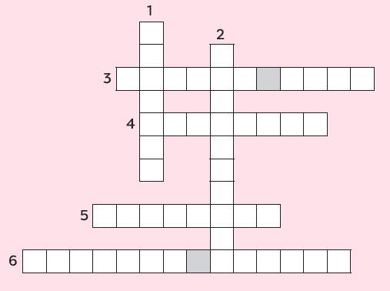
LOOKING BACK
2
Solve the crossword.
DOWN
1. nuclear
2. generation
ACROSS
3. screen time
4. extended
5. conflict
6. digital native

Slide 10
LOOKING BACK
3
Choose the correct answers A, B, C or D.
1. You ________ learn to keep your bedroom tidy. No one can clean it for you.
A. must B. had to C. mustn’t D. shouldn’t
2. Fifty years ago, my grandmother ________ stay at home and do all housework. She couldn’t go to school like her brothers.
A. must B. had to C. didn’t have to D. should
3. You ________ wear shorts to school. It’s against the school rules.
A. should B. have to C. mustn’t D. don’t have to

Slide 11
LOOKING BACK
3
Choose the correct answers A, B, C or D.
4. I think parents __________ compare their children to other’s. They will become less confident in their abilities.
A. should B. have to C. must D. shouldn’t
5. My parents respect my choices. I __________ follow in their footsteps.
A. don’t have to B. mustn’t C. should D. have to

Slide 12
PROJECT
GENERATIONAL DIFFERENCES AMONG US

Slide 13
CONSOLIDATION
1
Wrap-up
What have you learnt today?
- Review the vocabulary and grammar of Unit 2.
- Apply what you have learnt (vocabulary and grammar) into practice through a project.

Slide 14
CONSOLIDATION
2
Homework
Do exercises in the workbook.
Prepare for Unit 3.

Slide 15
Website: hoclieu.vn
Fanpage: facebook.com/tienganhglobalsuccess.vn/

