Slide 1

UNIT 2: MY FAMILY
Lesson 7 – Self Assessment

Slide 2



Let’s sing: Finger family song

Slide 3
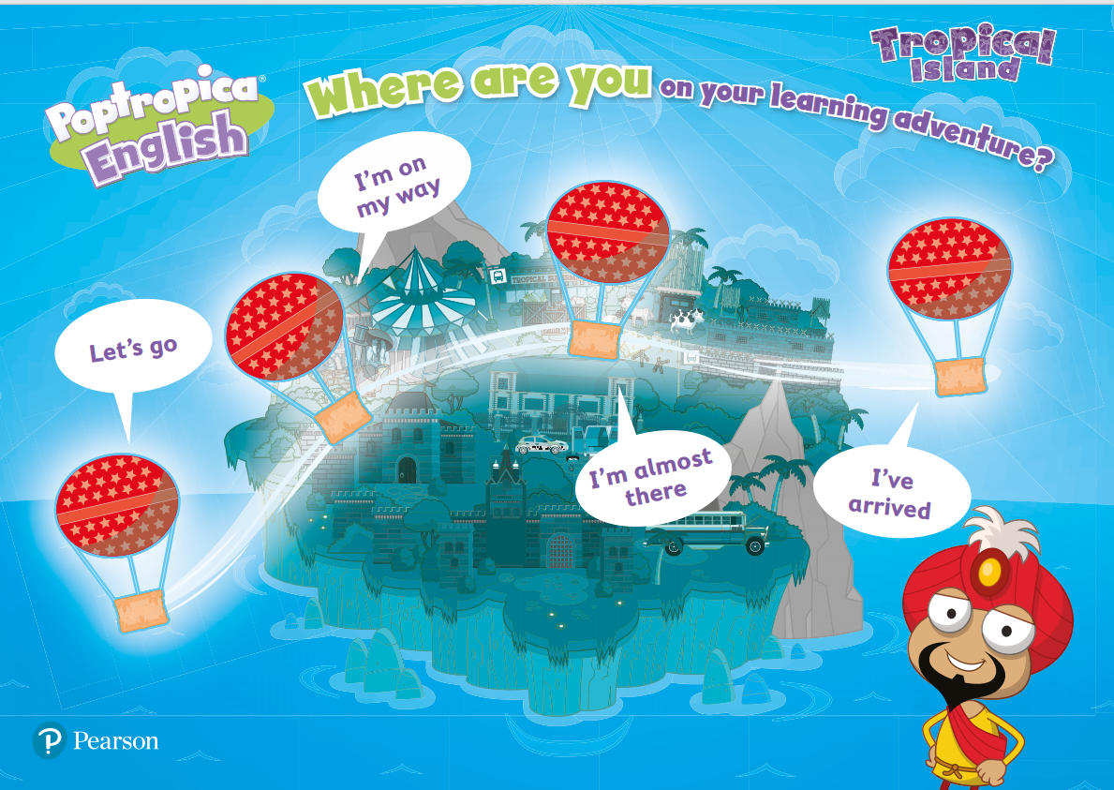
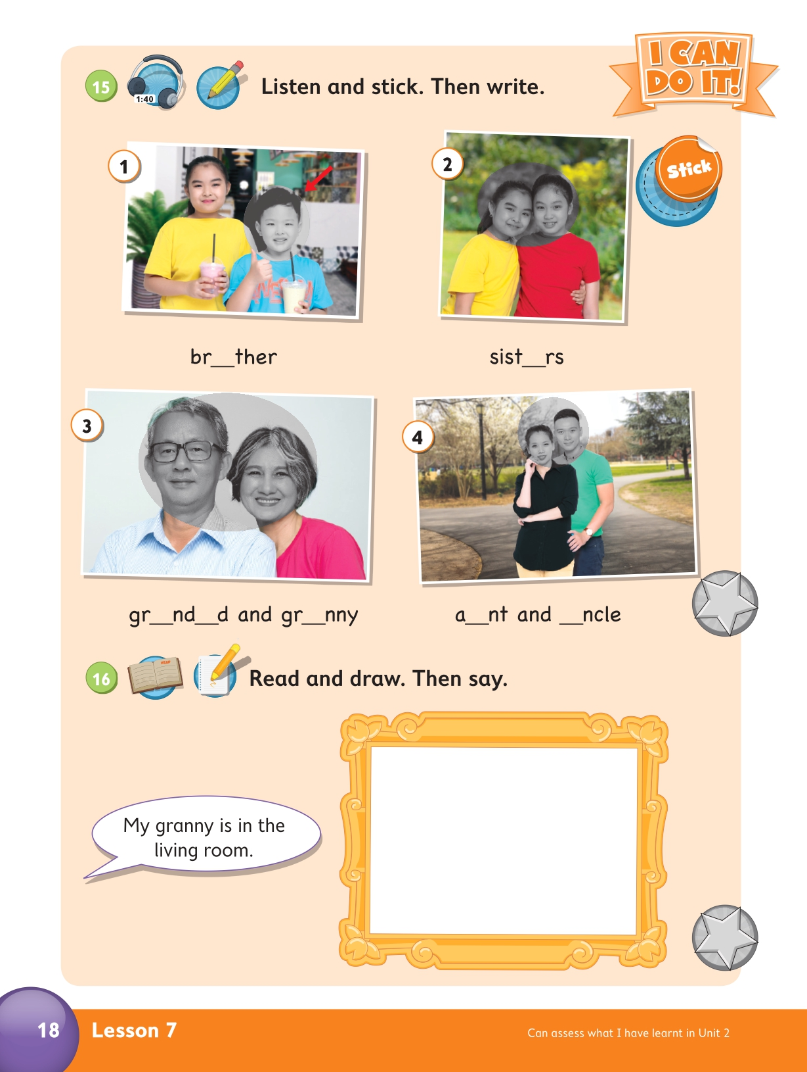

UNIT 2: MY FAMILY
We’re assessing…
What we’ve learned in Unit 2
Notes:
Click on the slide to see the content.

Slide 4

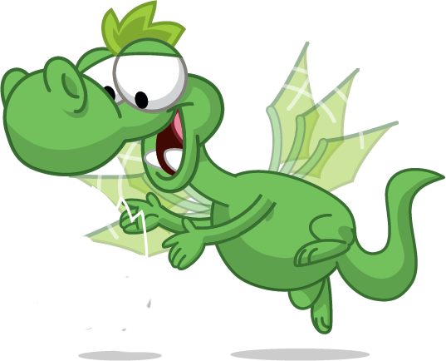
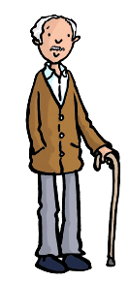
SEE AND TELL
This is my ________ . He’s ______.
grandad
old
WHO? brother, sister
mum, dad
granny, grandad
uncle, aunt
OLD or YOUNG?
PLAY
CHECK
Next
Click on the PLAY and CHECK to show and hide key words.

Slide 5

SEE AND TELL
This is my ________ . He’s ______.
brother
young
WHO? brother, sister
mum, dad
granny, grandad
uncle, aunt
OLD or YOUNG?
PLAY
CHECK
Next
Click on the PLAY and CHECK to show and hide key words.

Slide 6

SEE AND TELL
This is my _______ . She’s ______.
sister
young
WHO? brother, sister
mum, dad
granny, grandad
uncle, aunt
OLD or YOUNG?
PLAY
CHECK
Next
Click on the PLAY and CHECK to show and hide key words.

Slide 7
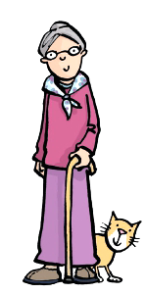
SEE AND TELL
This is my _______ . She’s ______.
granny
old
WHO? brother, sister
mum, dad
granny, grandad
uncle, aunt
OLD or YOUNG?
PLAY
CHECK
Click on the PLAY and CHECK to show and hide key words.

Slide 8
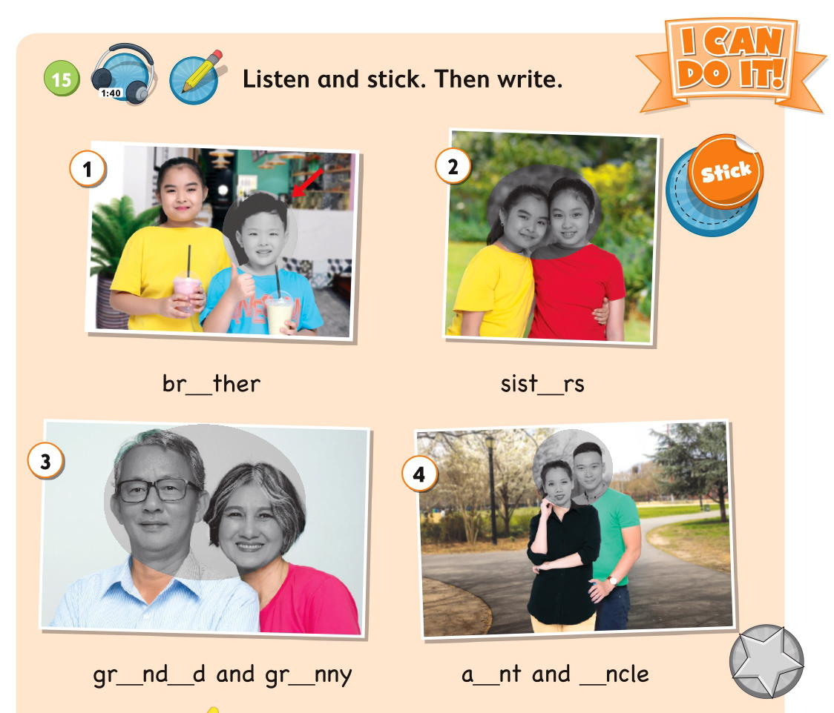
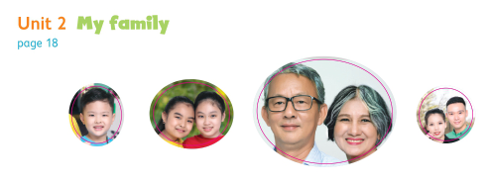
PB page 18 – Act 15
Get the stickers
Notes:
Set the scene.

Slide 9

PB page 18 – Act 15
Listen and point
Notes:
Set the scene.

Slide 10

PB page 18 – Act 15
Task 2: Listen and stick
CHECK
Notes:
Set the scene.

Slide 11
PB page 18 – Act 15
Task 3: Write
CHECK
Notes:
Set the scene.

Slide 12
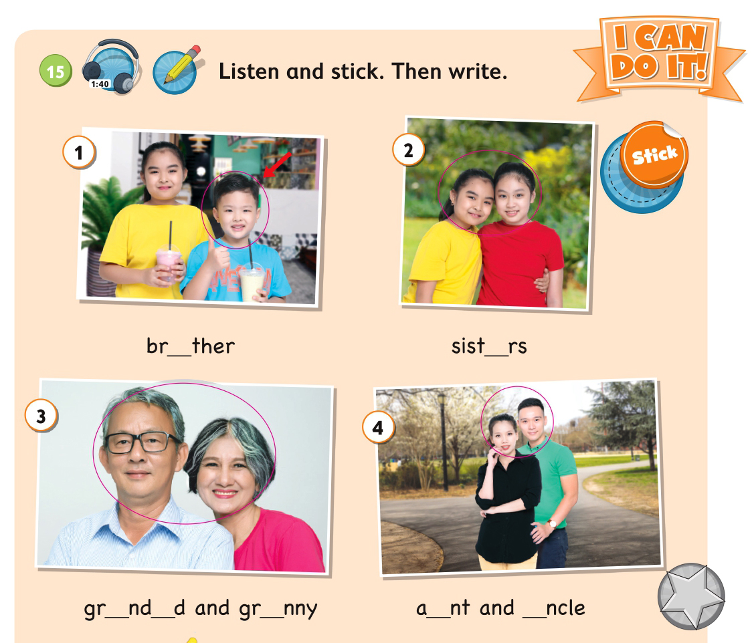
PB page 18 – Act 15
Task 1: Listen and stick
CHECK
o
e
Task 2: Write
CHECK
a
a
a
u
u
Notes:
Set the scene.

Slide 13
Who?
BLOCK GAME
Where’s
HOW TO PLAY: Remove the blocks
to see the picture.
Answer the question.
START

Slide 14
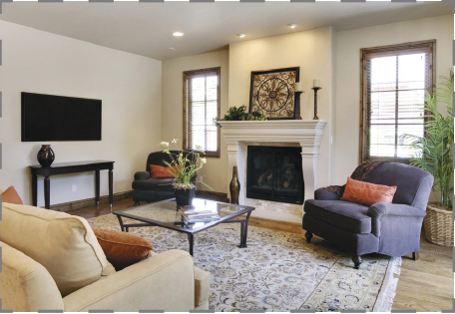
Where’s my sister?
She’s in the living room.
CHECK
NEXT

Slide 15
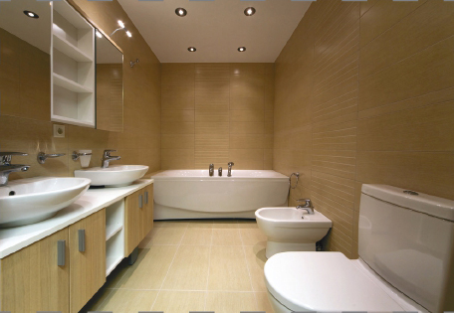
Where’s my brother?
He’s in the bathroom.
CHECK
NEXT

Slide 16
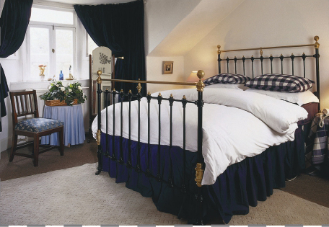
Where’s my granny?
She’s in the bedroom.
CHECK
NEXT

Slide 17
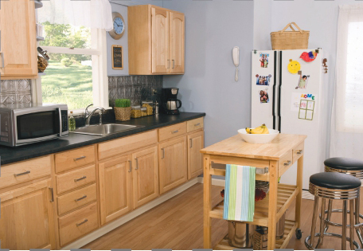
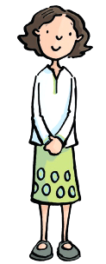
Where’s my mum?
She’s in the kitchen.
CHECK
NEXT

Slide 18

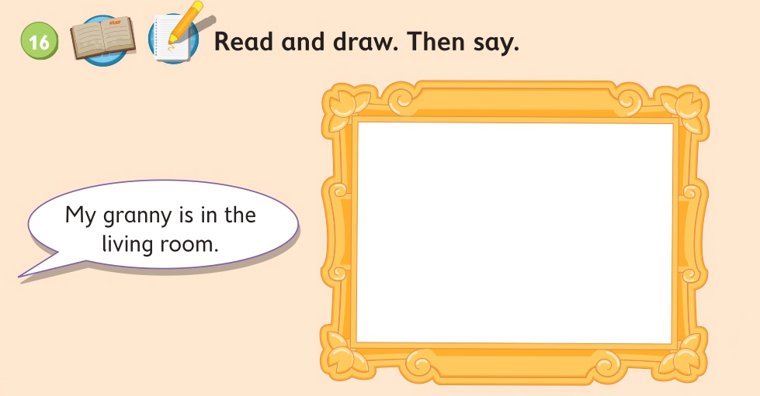
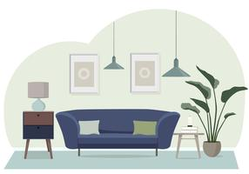
PB page 18 – Act 16
living room
granny
Click when you see this icon
Notes:
Set the scene.

Slide 19
PB page 18 – Act 16
A: Where’s my ………….?
B: She’s in the ……………
Click when you see this icon
Notes:
Set the scene.

Slide 20
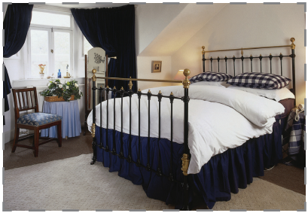

PB page 18 – Act 16
My grandad is in the bedroom
Click when you see this icon
Notes:
Set the scene.

Slide 21
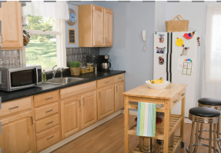

PB page 18 – Act 16
My sister is in the kitchen
Click when you see this icon
Notes:
Set the scene.

Slide 22



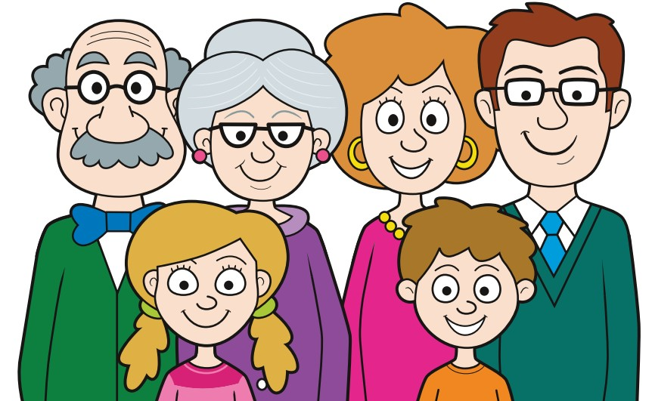
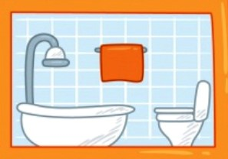
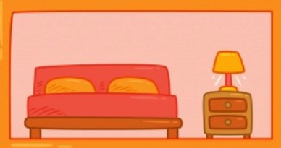
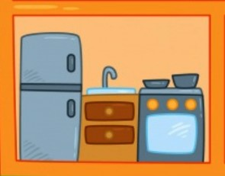
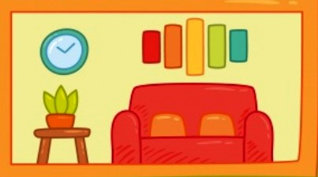
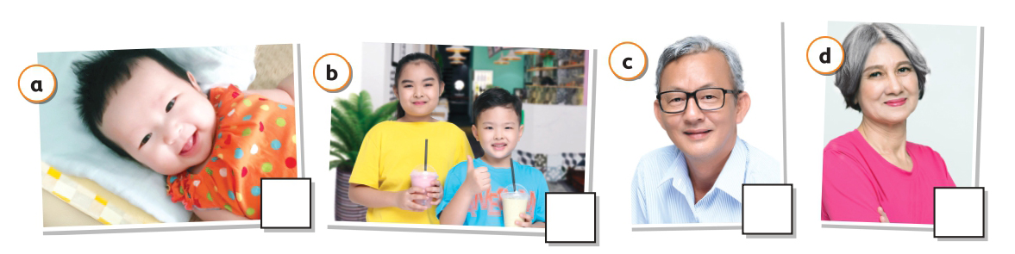
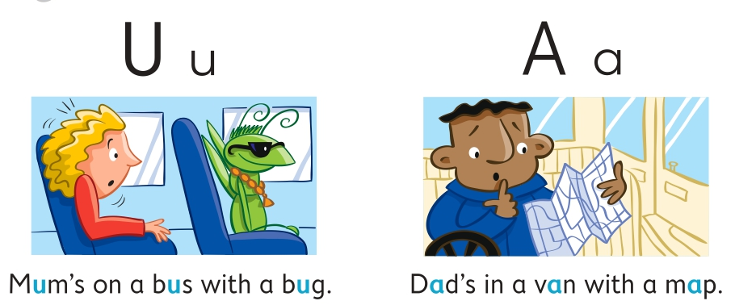
MY LEARNING ADVENTURE
Look, choose the faces for you.
FAMILY
ROOMS
STRUCTURES
Who’s this? This is my (sister). Where’s my (dad)
He’s/She’s in the (kitchen).
SOUNDS FUN
SOCIAL SCIENCE
baby old young
I know it
I don’t know it
Notes:
Set the scene.

Slide 23

UNIT 2: Lesson 7
We’ve assessed Unit 2
LEARNING ADVENTURE

Slide 24
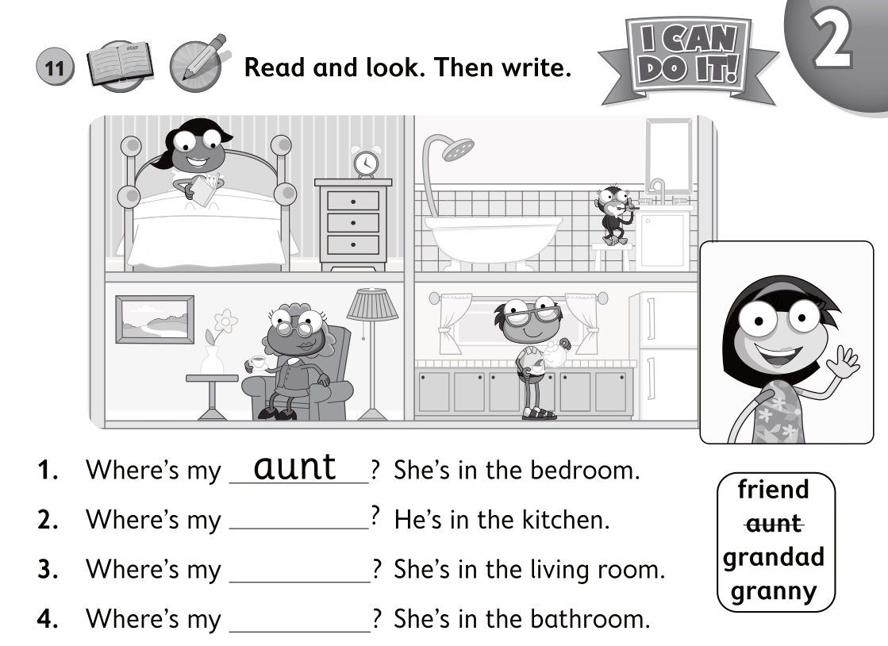
AB page 17 – Act 12
CHECK
grandad
granny
friend
Notes:
Set the scene.

Slide 25
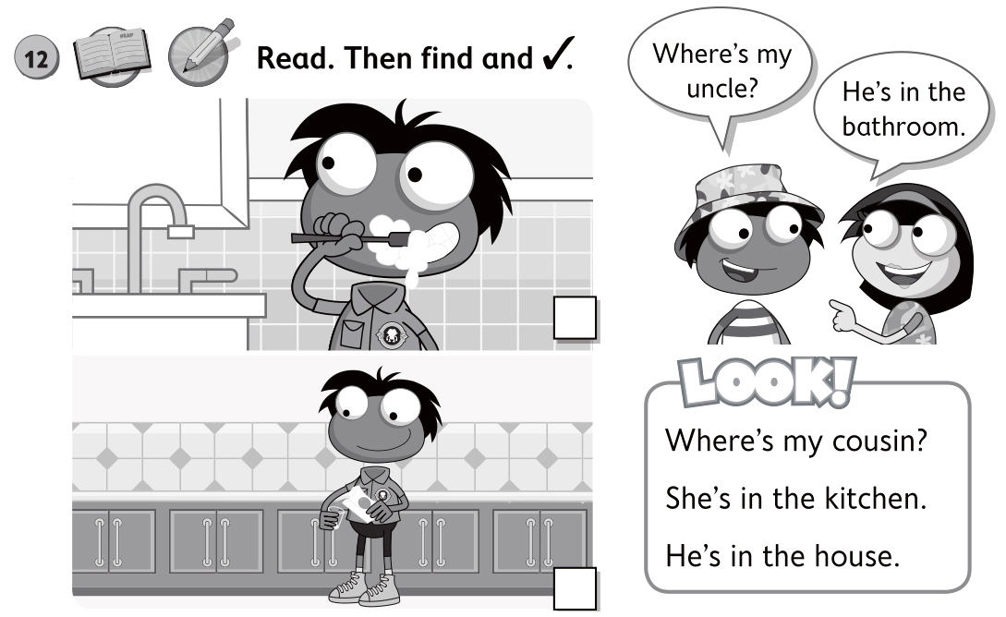

AB page 17 – Act 12
CHECK
Notes:
Set the scene.

