Slide 1
Good morning class!!!

Slide 2
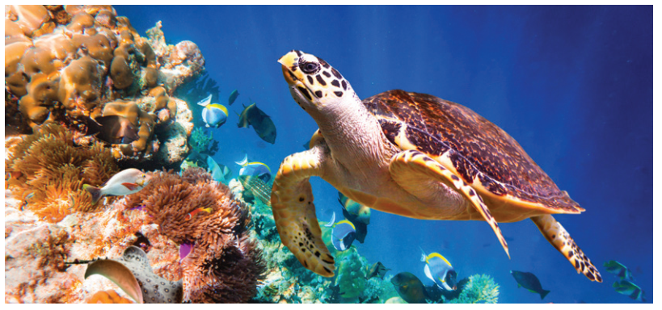
* WARM-UP
1
Work in groups. Look at the picture and say what you see.
The animal in the picture is a sea turtle.
Sea turtles are endangered animals.

Slide 3
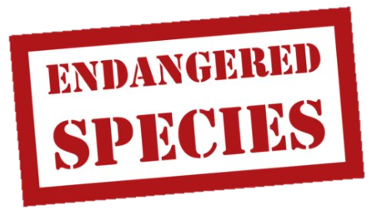
* WARM-UP
1
Then list the names of some endangered species you know.
BLUE WHALES
SEA LIONS
TIGERS
SAOLAS
DUGONG
POLAR BEARS
PANDAS
PENGUINES

Slide 4
PERIOD 59 : Unit 7
ENVIRONMENTAL PROTECTION
LESSON 5: SKILLS 1
1

Slide 5
* VOCABULARY
contain (v):
chứa đựng
/kənˈteɪn/

Slide 6
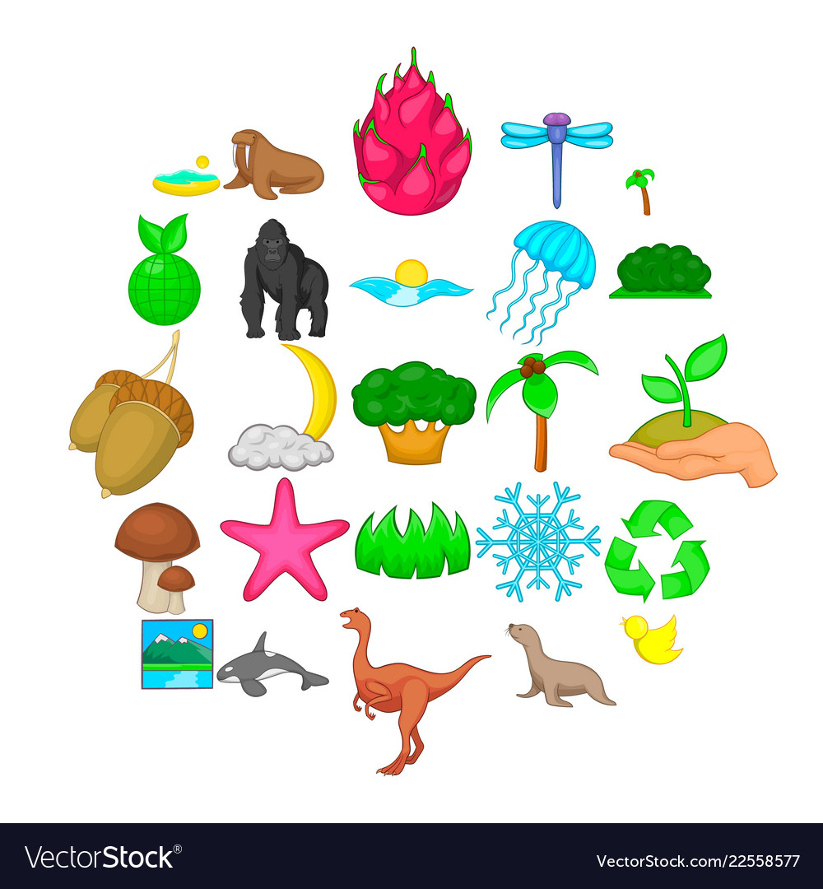
* VOCABULARY
- diverse (adj):
phong phú
/daɪˈvɜːs/

Slide 7
* VOCABULARY
medicinal plant
Cây thuốc
- medicinal (adj):
Thuộc về thuốc
/məˈdɪsɪnl/

Slide 8
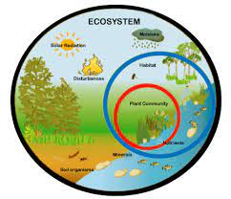
* VOCABULARY
- Ecosystem (n) :
hệ sinh thái
/ˈiːkəʊsɪstəm/

Slide 9
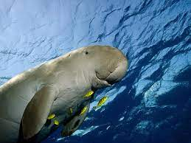
* VOCABULARY
- dugong (n):
con cá húi, bò biển
/ˈdjuː.ɡɒŋ/

Slide 10
* VOCABULARY
New words | Pronunciation | Meaning
1. contain (v) | /kənˈteɪn/ | chứa đựng
2. diverse (adj) | /daɪˈvɜːs/ | phong phú
3. medicinal (adj) | /məˈdɪsɪnl/ | (cây) thuốc
4. Ecosystem (n) | /ˈiːkəʊsɪstəm/ | hệ sinh thái
5. dugong (n) | /ˈdjuː.ɡɒŋ/ | bò biển

Slide 11
* Checking vocabulary
Phong phú
chứa đựng
diverse
contain
cây thuốc
medicinal plant
hệ sinh thái
Bò biển
Ecosystem
dugong

Slide 12
* READING
2
Read the text and choose the words or phrases to make the following statements correct.
1. There are 34 national parks / nations’ parks in Viet Nam now.
2. The conservation / ecosystem in Con Dao is very diverse.
3. The dugong is a(n) dangerous / endangered animal.
4. National parks play a key role in saving the environment / small islands.

Slide 13
* READING
2
Read the text and choose the words or phrases to make the following statements correct.
Today, there are national parks all over the world, and the number is rising all the time. A national park is a special area for the protection of the environment and wildlife.
In Viet Nam, there are now 34 national parks. Con Dao National Park is one of them. It became a national park in 1993. The park is in Con Dao District, Ba Ria-Vung Tau Province. It contains 16 small islands covering 20,000 hectares. The ecosystem here is very diverse with thousands of species, including marine animals. Many species of corals as well as sea turtles, dolphins, and endangered dugongs live here as well. The park is also home to a lot of valuable kinds of woods and medicinal plants. Three ancient trees in the park were named “Vietnamese Heritage Trees”.
Con Dao National Park, like other national parks, plays a key role in saving endangered species as well as protecting the environment and natural resources. It also helps raise the awareness of local residents about the importance of nature.

Slide 14
* READING
3
Read the text again and choose the correct option A, B, or C.
1. What is the best title for the passage?
A. National Parks in Viet Nam
B. Con Dao National Park
C. The Protection of Wildlife
2. National parks are areas for ______.
A. the protection of the environment
B. the management of marine life
C. the sale of animal products

Slide 15
3
Read the text again and choose the correct option A, B, or C.
3. What is the area of Con Dao National Park?
A. 34 hectares
B. 16 hectares
C. 20,000 hectares
4. Con Dao National Park has many kinds of ______.
A. valuable plants
B. ancient trees
C. natural values

Slide 16
3
Read the text again and choose the correct option A, B, or C.
5. Which of the following is NOT true, according to the passage?
A. There are more and more national parks in the world. B. Con Dao National Park is rich in animal species.
C. Con Dao National Park’s mission is to help other national parks.

Slide 17
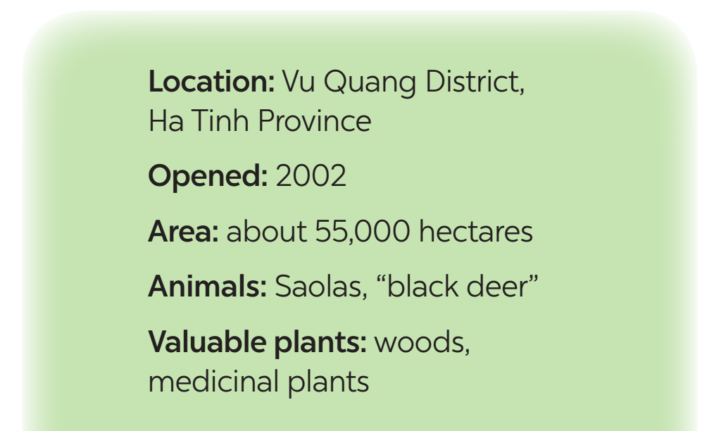
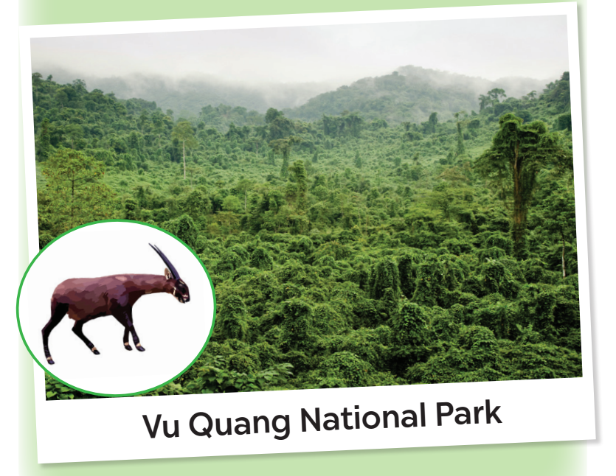
* SPEAKING
4
Work in pairs. Ask and answer about Vu Quang National Park.
Look at the facts.
A: Where is Vu Quang National Park?
B: It’s in Vu Quang District, Ha Tinh Province

Slide 18
* SPEAKING
4
Work in pairs. Ask and answer about Vu Quang National Park. Look at the facts.
A: Where is Vu Quang National Park?
B: It's in Vu Quang District, Ha Tinh Province.
A: When did Vu Quang National Park open?
B: It's opened in 2002.
A: What is the area of Vu Quang National Park?
B: About 55,000 hectares.
A: What kind of species does Vu Quang National Park has?
B: It has Saolas, "black deer" and also valuable plants, woods, medicinal plants.

Slide 19
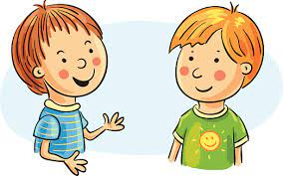
5
Work in groups. Talk about Vu Quang National Park, using the answers in 4.
Vu Quang National Park is in …
It was opened in ...
It has ...
It’s about …

Slide 20
5
Work in groups. Talk about Vu Quang National Park, using the answers in 4.
Vu Quang National Park is located in Vu Quang District, Ha Tinh Province. It opened in 2002. The area of National Park is about 55,000 hectares. It has so many kind of species such as saolas, "black deer" as the animals. And the park also has valuable plants, wood, medicinal plants.

Slide 21
* CONSOLIDATION
What have we learnt in this lesson?
Reading about Con Dao National Park
Talking about Vu Quang National Park

Slide 22
* Homework
Do exercises in the workbook.
Prepair lesson 6 – Skills 2

Slide 23
Thank you!
Goodbye!

