Slide 1
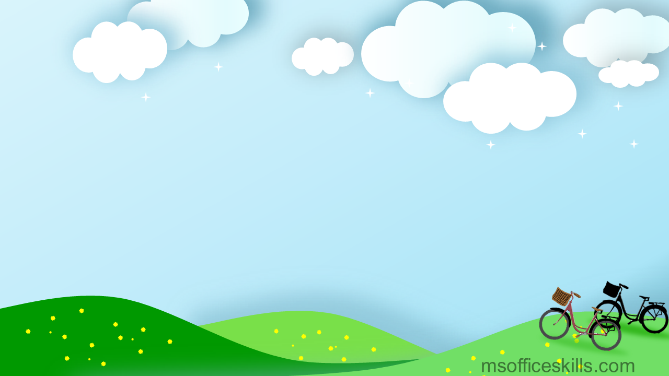
Hello everyone !!!

Slide 2
PERIOD 58 : Unit 7
ENVIRONMENTAL PROTECTION
LESSON 4: COMMUNICATION

Slide 3
* WARM-UP
1. Mi: And what do you mean by ‘in the wild’?
2. Linda: That means animals that live in their natural habitats, not in zoos.
3. Mi: Oh, I get it now. Thanks, Linda.
JUMBLED CONVERSATION
4. Linda: Endangered species are animals
in the wild that face a high risk of extinction.
5. Mi: Hey, Linda. What does ‘endangered species’ mean?

Slide 4
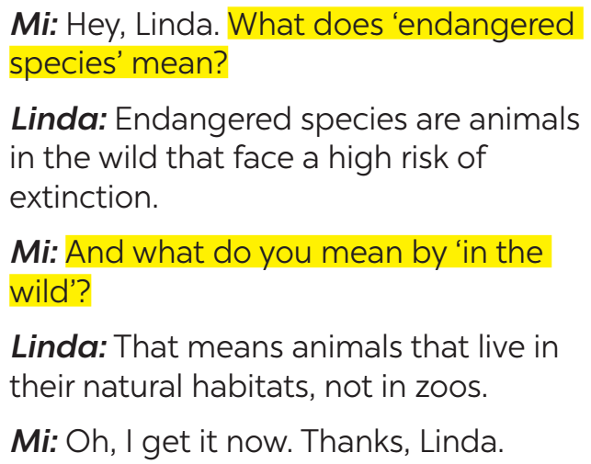
* EVERYDAY ENGLISH
1
Listen and read the conversations. Pay attention to the highlighted sentences.
*Asking for clarifications:
What does S mean?
What do you mean by …?
* Giving clarifications:
It means … /
S is /are …
That means …

Slide 5
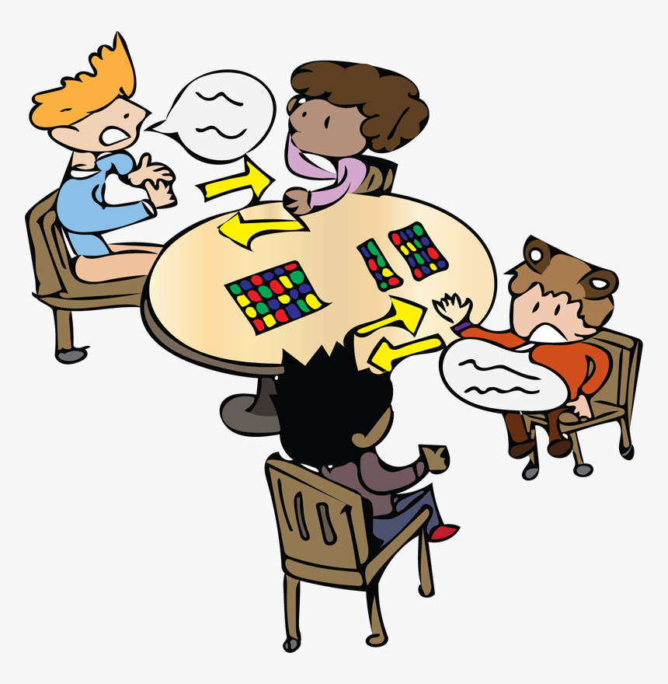
* EVERYDAY ENGLISH
2
Work in pairs. Make similar conversations to ask for and give clarification.
SINGLE-USE PRODUCT:
A: What does it mean by ‘single-use products’?
B: ‘Single-use products’ are products made to be used once only.
A: Oh, thank you.
GLOBAL WARMING:
A: What do you mean by ‘global warming’?
B: It is the increase in the atmosphere’s temperatures caused by the rise of gases, especially carbon dioxide.
A: Oh, thank you.

Slide 6
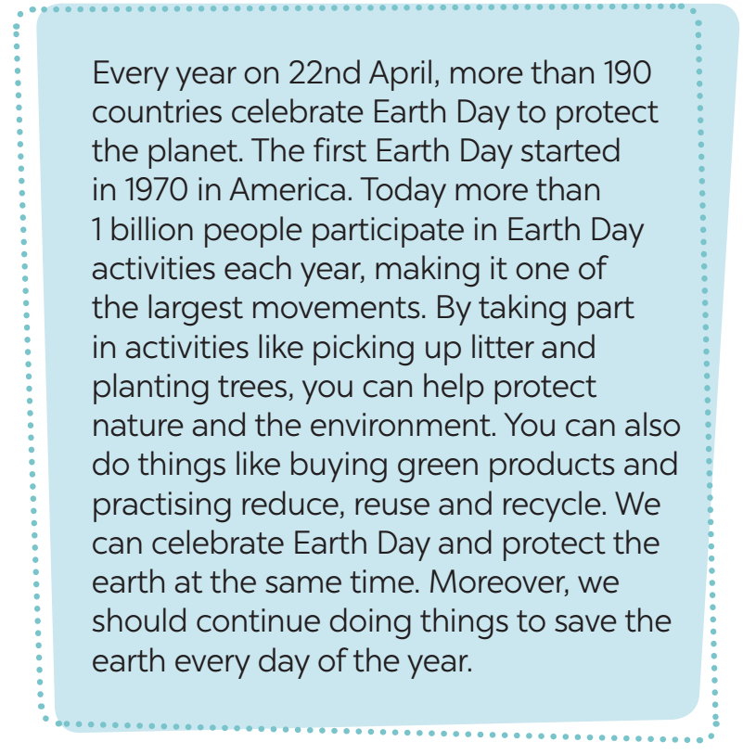
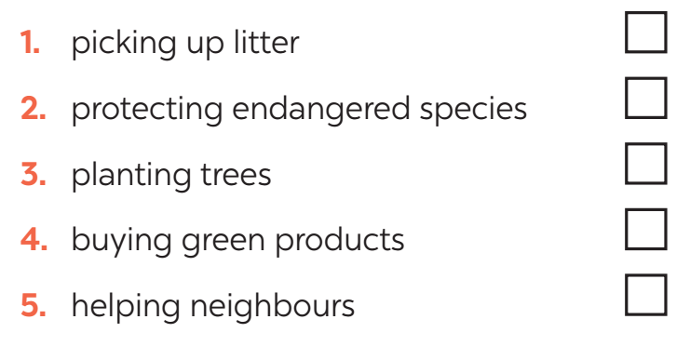
* EARTH DAY
3
Read the passage and tick the correct answers.
WHAT ACTIVITIES DO PEOPLE DO ON EARTH DAY?

Slide 7
* EARTH DAY
4
Match the activities people do on Earth Day with their results.

Slide 8
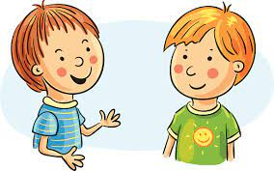
* EARTH DAY
5
Work in pairs. Ask and answer about the things you and your friends do on Earth Day.
We pick up litter and clean the
streets. And you?
What do you do on Earth day?
…

Slide 9
* EARTH DAY
A: What do you do on Earth Day?
B: My family turn off the light for 2 hours.
A: What do you do on Earth Day?
B: My friends and I decided to go to the park and planted trees.

Slide 10
* CONSOLIDATION
What have we learnt in this lesson?
Asking for clarification

Slide 11
* Homework
Do exercise in the workbook.
Prepair lesson 5 – skills 1

Slide 12
Goodbye.
See you again

