Slide 1
ENGLISH 9
Hello everyone !!!

Slide 2


Unit
11
ELECTRONIC DEVICES
LESSON 7: LOOKING BACK & PROJECT

Slide 3

WARM-UP
1 minute to start
BRAIN
STORMING
Write as many electronic devices as possible

Slide 4
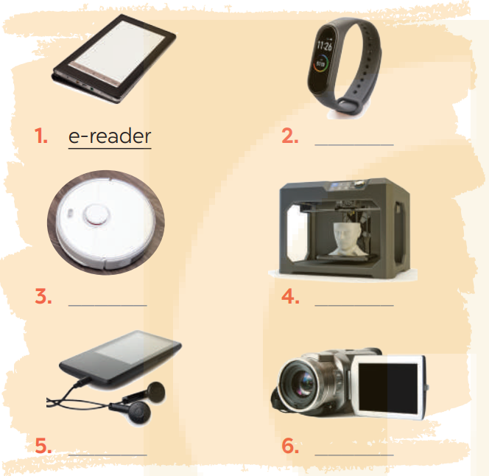
VOCABULARY
1
Write the name of an electronic device under each picture.
smartwatch

Slide 5
VOCABULARY
1
Write the name of an electronic device under each picture.
robotic vacuum cleaner
3D printer

Slide 6
VOCABULARY
1
Write the name of an electronic device under each picture.
portable music player
camcorder

Slide 7
2
Complete the sentences with the words from the box.
3D printer copper plastic e-reader smartwatch
1. We often use ________________ to make power lines and electrical wires because it is a good conductor of electricity.
2. I can adjust the text size and font to suit my reading preferences on my ____________.
3. My ________________ can track my physical activity, heart rate, and sleep patterns, so it can help me monitor my overall health and fitness.
4. We often use ________________ to make toys for children because it’s durable, lightweight, and easy to mold into different shapes.
5. If I need a replacement part for a machine or device, I can use my ______________to create a new one that is a perfect fit.
Game

Slide 8









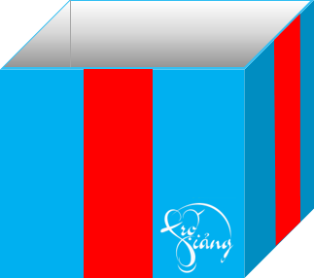

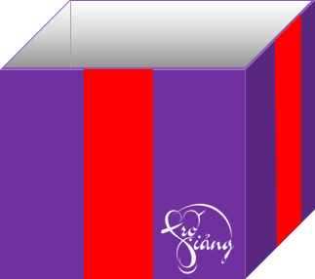


Game
Gift box secret game

Slide 9
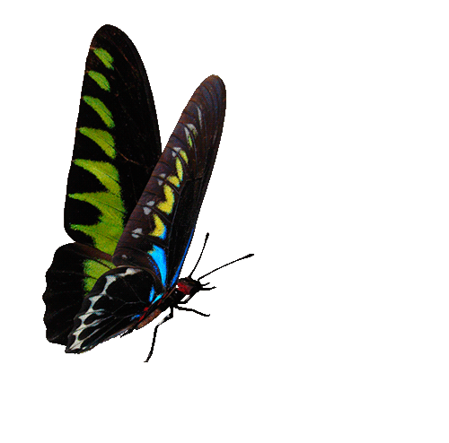






2
Complete the sentences with the words from the box.
3D printer copper plastic e-reader smartwatch
copper
1. We often use _______________ to make power lines and electrical wires because it is a good conductor of electricity.
You are given 3 candies
GO HOME

Slide 10

2
Complete the sentences with the words from the box.
3D printer copper plastic e-reader smartwatch
2. I can adjust the text size and font to suit my reading preferences on my ____________.
e-reader
GO HOME
You are given 2 candies

Slide 11
2
Complete the sentences with the words from the box.
3D printer copper plastic e-reader smartwatch
smartwatch
3. My _______________ can track my physical activity, heart rate, and sleep patterns, so it can help me monitor my overall health and fitness.
You are given 10 mark
GO HOME

Slide 12
2
Complete the sentences with the words from the box.
3D printer copper plastic e-reader smartwatch
plastic
4. We often use _______________to make toys for children because it’s durable, lightweight, and easy to mold into different shapes.
You are given 5k
GO HOME

Slide 13
2
Complete the sentences with the words from the box.
3D printer copper plastic e-reader smartwatch
5. If I need a replacement part for a machine or device, I can use my ______________to create a new one that is a perfect fit.
3D printer
You are given 5k
GO HOME

Slide 14
2
Complete the sentences with the words from the box.
copper
1. We often use ________________ to make power lines and electrical wires because it is a good conductor of electricity.
2. I can adjust the text size and font to suit my reading preferences on my ____________.
3. My ________________ can track my physical activity, heart rate, and sleep patterns, so it can help me monitor my overall health and fitness.
4. We often use ________________ to make toys for children because it’s durable, lightweight, and easy to mold into different shapes.
5. If I need a replacement part for a machine or device, I can use my ________________ to create a new one that is a perfect fit.
e-reader
smartwatch
plastic
3D printer

Slide 15
3
Choose the correct answer A, B, C, or D.
1. My teacher advised I ______ harder to pass the exam.
A. studies B. study C. studying D. to study
2. The professor suggested he should______ the research before March.
A. submit B. submitting C. submits D. would submit
3. Her leader suggested ______ on time.
A. be B. being C. is D. to be
4. Linh recommended that Nam ______ a new e-reader.
A. should buy B. bought C. buying D. will buy
5. The coaches advised that we ______ a Facebook group.
A. creating B. created C. to create D. create

Slide 16
GRAMMAR
4
Fill in each blank with the correct form of the verb in brackets
1. I recommend that you (reduce) _____________ your screentime.
2. It’s so cold outside. We suggest (close) _____________ the window.
3. My teacher advised that I (look) __________ for a part-time job to earn more money.
4. Henry has recommended (choose) _____________ a better smartwatch for your dad.
5. The government advised (travel) _______________ by bus to reduce environmental pollution.
(should) reduce
closing
(should) look
choosing
travelling

Slide 17

PROJECT

Slide 18
PROJECT
A COMPETITION FOR DESIGNING LEAFLETS ON ELECTRONIC DEVICES
You are taking part in a competition for designing leaflets on electronic devices. Work in groups.
1. Choose an electronic device and design a leaflet to promote it, including
name of the electronic device
its appearance, main parts, key features, etc.
its benefits
pictures or photos to illustrate the electronic device
2. Present your leaflet to the other groups
3. Vote for the best leaflet.

Slide 19

CONSOLIDATION
What have we learnt in this lesson?
Review the vocabulary and grammar of Unit 11
Apply what they have learnt (vocabulary and grammar) into practice through a project.

Slide 20

Homework
- Complete the project
- Prepare for the next lesson: Unit 12

Slide 21

THANK YOU FOR ATTENTION!

