Slide 1
Song Ve secondary school.
Hello everyone !!!

Slide 2
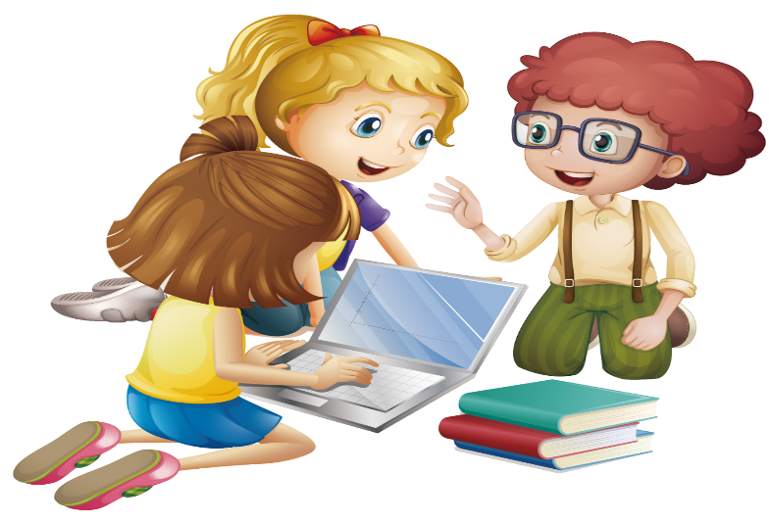
WARM UP
1
Work in pairs. Discuss the following questions
1. What electronic device do you use most often?
2. What do you use it for?
I use my smartphone most often for a variety of purposes.
I use it to stay connected with friends, family, and others through calls, texts, email and social media platforms.
I usually listen to music, watch film, play game, take photos and go shopping on it. My smartphone also serves as a useful tool for learning. I frequently use it to search, take notes, read news articles, and access educational resources.

Slide 3
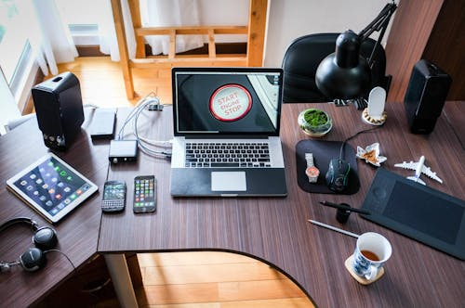
Unit
11
ELECTRONIC DEVICES
LESSON 5: SKILLS 1
1

Slide 4
READING

Slide 5
VOCABULARY
stylish (adj)
/ˈstaɪ.lɪʃ/
sành điệu
fashionable; elegant and attractive

Slide 6
VOCABULARY
privacy (n)
sự riêng tư
/ˈpraɪ.və.si/
the state of being not watched or disturbed by other people

Slide 7
VOCABULARY
New words | Pronunciation | Meaning
1. stylish (adj) | /ˈstaɪ.lɪʃ/ | sành điệu
2. privacy (n) | /ˈpraɪ.və.si/ | sự riêng tư

Slide 8
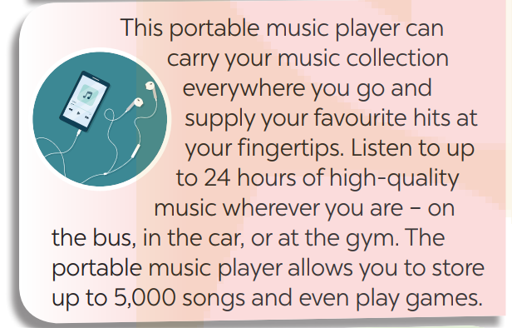
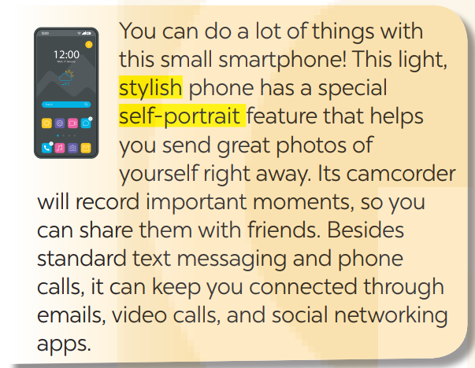
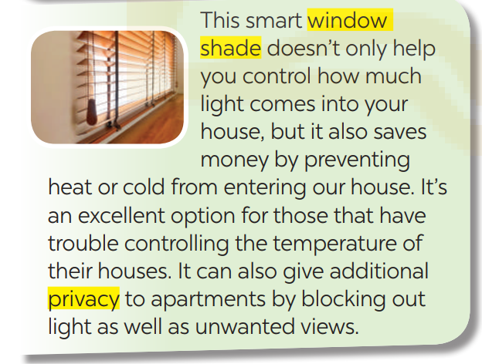
2
Read the following leaflets and match the highlighted words with their meanings.

Slide 9
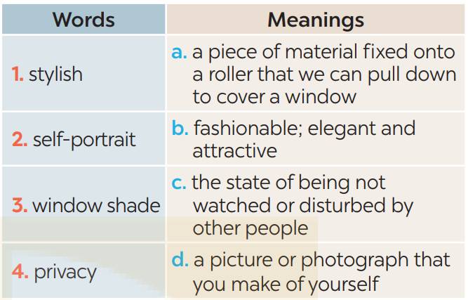
2
Read the following leaflets and match the highlighted words with their meanings.
* Keys:
1. b 2. d 3.a 4.c

Slide 10
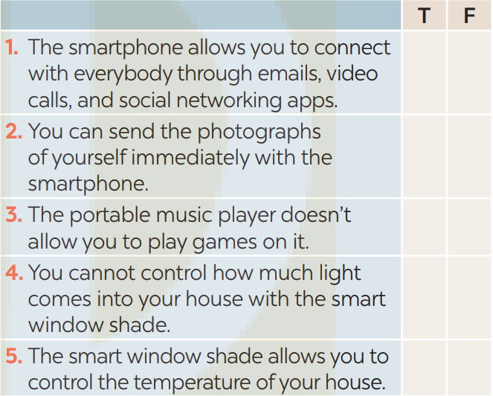
3
Read the leaflets again and tick T (True) or F (False).
X
X
X
X
X

Slide 11
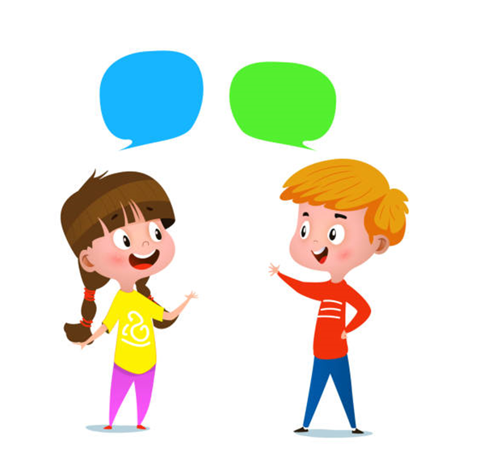
SPEAKING

Slide 12
4
Work in pairs. Ask and answer the following questions about an electronic device which is important to you. Make notes of your partner’s answers.
1. What electronic device is important to you? 2. How long have you had it? 3. What does it look like? 4. When do you use it?
5. Why is it important to you?

Slide 13
4
Work in pairs. Ask and answer the following questions about an electronic device which is important to you. Make notes of your partner’s answers.
1. What electronic device is important to you? 2. How long have you had it? 3. What does it look like? 4. When do you use it?
5. Why is it important to you?
My laptop.
I've had it for about three years.
It's a silver laptop with a 15-inch screen. ….
I use it throughout the day, both for learning and personal activities.
It helps me study more effectively, productively and economically. It contains all my important documents, and presentations. It helps me to stay connected with others, access information, and entertain myself.

Slide 14
5
Work in groups. Take turns to talk about the electronic device that is important to your partner.
I talked with Hung about the smartphone that is important to him. He’s had this smartphone for almost three years now. It's a sleek black smartphone with a vibrant touchscreen display. The back has a glossy finish, and it's not too big, making it easy to hold. Hung uses his smartphone during the day for various purposes. It's his alarm clock in the morning, his communication tool to stay connected with his family and friends, a quick way to check emails and notifications, and even a source of entertainment during his free time. This smartphone is important to him for several reasons. It's not just a communication device; it's like a mini personal assistant. It helps him stay organized with his schedules, assignments, and reminders. It's also his primary source of information and a quick way to search for anything he needs to know.

Slide 15
5
Work in groups. Take turns to talk about the electronic device that is important to your partner.
I talked with Quynh about her electronic device that is important to her – her laptop. She has had it for about five years, and it's been an essential part of her daily routine. It's a silver laptop with a 15-inch screen. It has a minimalist design with a black keyboard and a touchpad, and the small logo of the brand on the top cover.She uses it throughout the day, both for learning and personal activities. She uses it to do my homework, take online courses and refer to study materials. In her freetime, she often utilizes it for leisure activities like watching movies, browsing the internet, online shopping or chatting with friends.When asked why this laptop holds such importance, my friend explained its crucial role in every aspect of her life. It helps her study more effectively, productively and economically. It contains all her important documents, and presentations. Moreover, it enables her to stay connected with others, access information, and entertain herself.

Slide 16
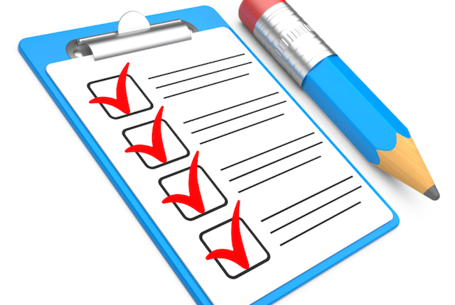
CONSOLIDATION
What have we learnt in this lesson?
Reading about electronic devices
Talking about an electronic device which is important to you.

Slide 17
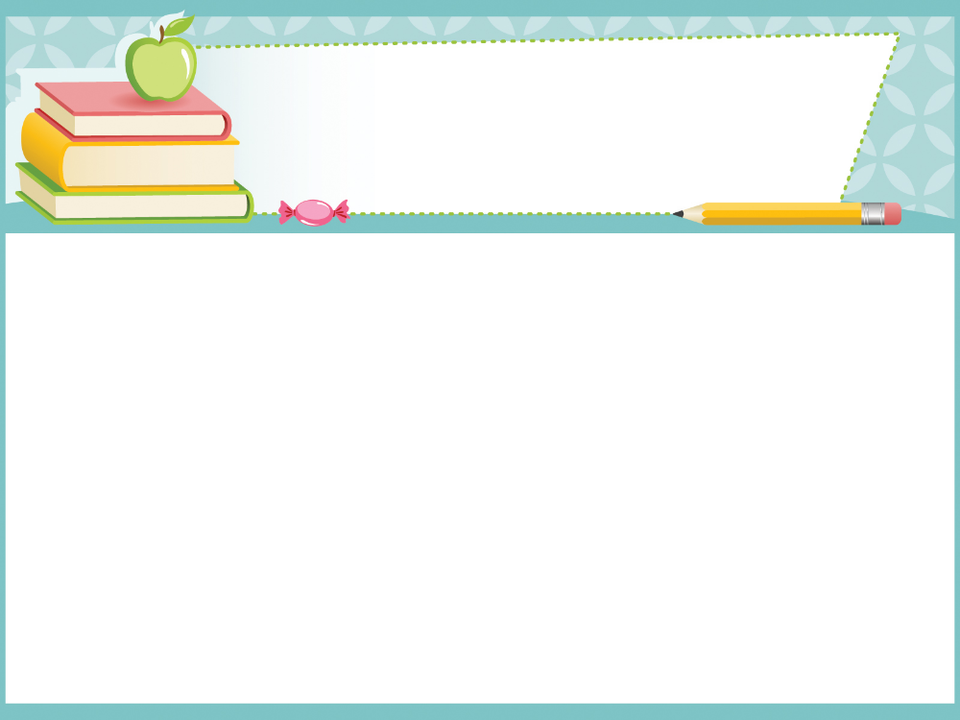
Homework:
Do exercises in the workbook.
Prepair lesson 6- Skills 2

Slide 19
WARM-UP
WATCH THE VIDEO
VIDEO
WATCHING

Slide 20
WARM-UP
APPLE’S NEW IPHONE 15

