Slide 1
Song Ve secondary school.
ENGLISH 9
Hello everyone !!!

Slide 2
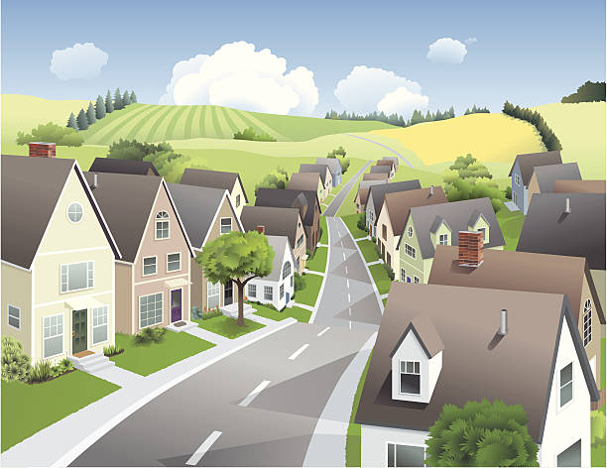
Unit
11
ELECTRONIC DEVICES
LESSON 4: COMMUNICATION

Slide 3
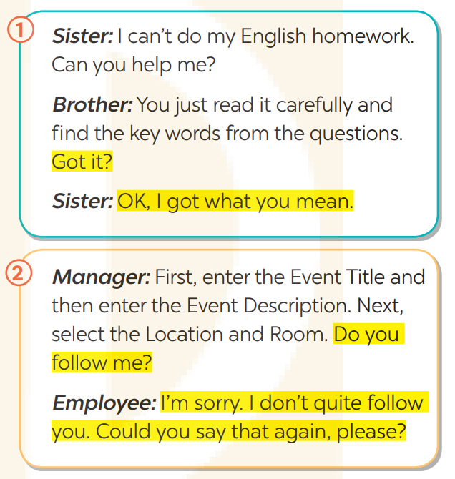
1
Listen and read the conversations. Pay attention to the highlighted sentences.
Got it?
Do you follow me?
I'm sorry. I don't quite follow you. Could you say that again,
Checking understanding and responding

Slide 4
EVERYDAY ENGLISH
2
Work in pairs. Make similar conversations for the following situations.
1. Your friend asks you to explain the rules of a game. You explain the rules to him / her and check if he / she understands what you are saying. He / She answers that he / she understands it.
Example:
A: I don’t know how to play hide-and-seek. Can you explain the rule of it to me?
B: One player closes his or her eyes for a brief period (often counting to 100) while the other players hide. The seeker then opens his eyes and tries to find the hiders; the first one found is the next seeker. Got it?
A. OK, I got what you mean.

Slide 5
EVERYDAY ENGLISH
2
Work in pairs. Make similar conversations for the following situations.
2. A stranger asks you the way to the nearest hospital. You tell him / her the way and check if he / she could follow you. He / She answers that he / she doesn’t quite follow you and asks you to repeat it.
Example:
A: Excuse me! Could you tell me the way to the nearest hospital please?
B: First go ahead and then turn right at the second set of traffic light. Cross the railway and go straight about 300 metres then turn left. It’s on your right. Do you follow me?
A: I’m sorry. I don’t quite follow you. Could you say that again please.

Slide 6
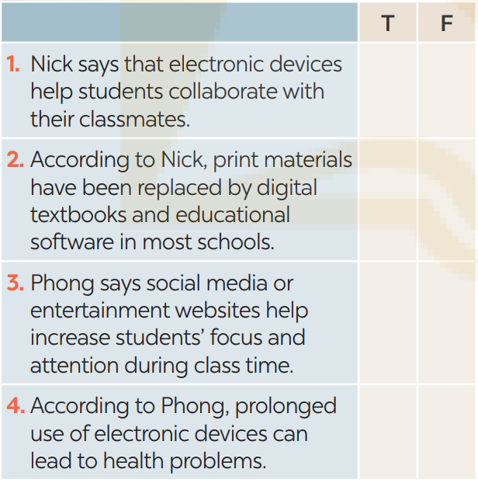
ELECTRONIC DEVICES IN MODERN CLASSROOMS
3
Read Nick’s and Phong’s ideas about the use of electronic devices in modern classrooms and tick 1-T (True) or F (False).
Nick: Nowadays, electronic devices are becoming more and more popular in modern classrooms. Teachers can use electronic devices to teach interactive lessons, provide real-time feedback to students, etc. Students can use them to access online resources, cooperate with their classmates, and complete assignments online. Some schools use digital textbooks and educational software instead of traditional print materials.
X
X

Slide 7
ELECTRONIC DEVICES IN MODERN CLASSROOMS
3
Read Nick’s and Phong’s ideas about the use of electronic devices in modern classrooms and tick 1-T (True) or F (False).
Phong: There are some disadvantages
of using electronic devices in modern
classrooms. Students may become
distracted by non-educational content
such as social media or entertainment
websites. Additionally, constant use of
electronic devices may cause eye strain,
headaches, and poor posture, as well as
other health problems.
X
X

Slide 8
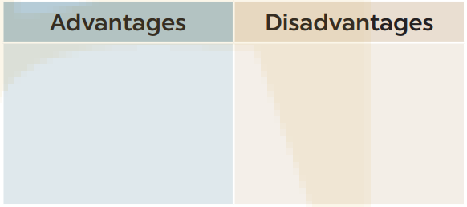
4
Work in pairs. Put the advantages and disadvantages of using electronic devices in modern classrooms (1 – 6) in the suitable column.
1. Using electronic devices in classrooms can help students stay engaged and motivated.
2. Relying too much on electronic devices for information can lead to a decrease in critical thinking, problem-solving, and creativity skills.
3. Using electronic devices in classrooms can help students develop technology skills and better prepare them for future careers.
4. Electronic devices can be expensive, and schools may need to invest more to purchase and maintain them for students..
6. Electronic devices can help students store, organise, and access their notes and assignments..
5. Electronic devices can be used by students to cheat on tests and assignments.

Slide 9
5
Work in groups. Take turns to give your opinions about the use of electronic devices in modern classrooms.
Suggested answer:
I think that the use of electronic devices in modern classrooms is convenient. First, using electronic devices in classrooms can help students stay engaged and motivated. Second, electronic devices can help students store, organise, and access their notes and assignments. Moreover, using electronic devices in classrooms can help students develop technology skills and better prepare them for future careers. Overall, the convenience they bring to the educational environment is remarkable, transforming the way we learn and interact within the classroom.

Slide 10
CONSOLIDATION
What have we learnt in this lesson?
Checking understanding and responding.
Advantages and disadvantages of electronic devices.

Slide 11
Homework
Do exercises in the workbook.
Prepair lesson 5(skills 1)

