Slide 1
Hello every one !!!

Slide 2
* WARM-UP
CHATTING
Have you ever shopped online?
What do you need to shop online?
→ Shopping online is simple; all you need is access to the internet and a payment method.
- You need to have a smartphone/ a laptop

Slide 3
PERIOD 67: UNIT
: 8 : SHOPPING
LESSON 6: SKILLS 2
1

Slide 4
* VOCABULARY
access (n):
quyền truy cập vào
/ˈækses/

Slide 5
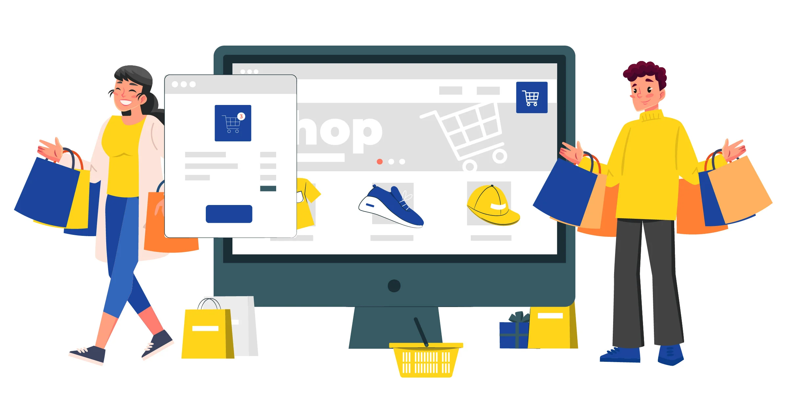
* VOCABULARY
- purchase (v):
mua sắm
/ˈpɜːtʃəs/

Slide 6
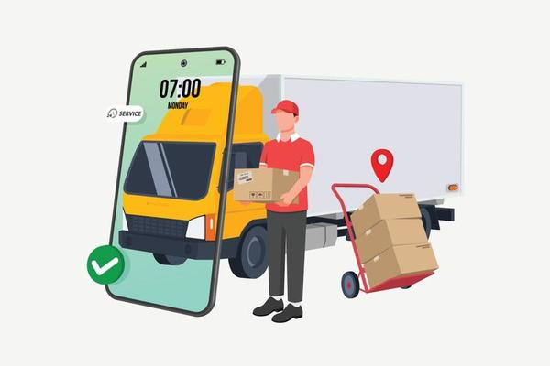
* VOCABULARY
- shipping (n):
việc chuyển hàng,
giao hàng
/ˈʃɪpɪŋ/

Slide 7
* VOCABULARY
overshopping (v):
mua sắm quá đà
/ˈəʊvə ˈʃɒpɪŋ/

Slide 8
* VOCABULARY
New words | Pronunciation | Meaning
1. access (n) | /ˈækses/ | quyền truy cập vào
2. purchase (v) | /ˈpɜːtʃəs/ | mua sắm
3. shipping (n) | /ˈʃɪpɪŋ/ | việc chuyển hàng, giao hàng
4. overshopping (v) | ˈəʊvə ˈʃɒpɪŋ/ | Mua sắm quá đà

Slide 9
* Checking vocabulary
New words | Meaning
1. | quyền truy cập vào
2. | mua sắm
3. | việc chuyển hàng, giao hàng
access (n)
purchase (v)
shipping (n)
4. | Mua sắm quá đà
overshopping (v)

Slide 10
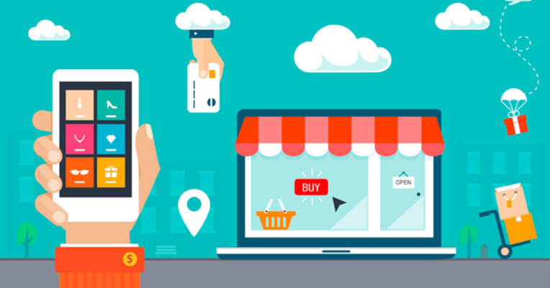
* LISTENING
1
Work in pairs. Discuss and tick the things related to online shopping.
1. Internet access
2. travelling
3. a smartphone/ laptop
4. a credit card

Slide 11
* LISTENING
2
Listen to a talk about online shopping and fill in each blank with a suitable word.
1. You can buy a product or ___________ online.
2. When shopping online, you visit a _________ website.
3. Online shopping helps you save time and ___________.
4. If you return a product, you still must pay for the ___________.
5. Shopping online can make you become a ___________.
Game

Slide 12
LUCKY NUMBER!
2
3
1
4
8
7
5
6

Slide 13
* LISTENING
2
Listen to a talk about online shopping and fill in each blank with a suitable word.
1. You can buy a product or ___________ online.
service

Slide 14
* LISTENING
2
Listen to a talk about online shopping and fill in each blank with a suitable word.
2. When shopping online, you visit a _________ website.
seller’s

Slide 15
* LISTENING
2
Listen to a talk about online shopping and fill in each blank with a suitable word.
3. Online shopping helps you save time and ___________.
money

Slide 16
* LISTENING
2
Listen to a talk about online shopping and fill in each blank with a suitable word.
4. If you return a product, you still must pay for the ___________.
shipping

Slide 17
* LISTENING
2
Listen to a talk about online shopping and fill in each blank with a suitable word.
5. Shopping online can make you become a ___________.
shopaholic

Slide 18
UNLUCKY NUMBER

Slide 21
* LISTENING
2
Listen to a talk about online shopping and fill in each blank with a suitable word.
1. You can buy a product or ___________ online.
2. When shopping online, you visit a _________ website.
3. Online shopping helps you save time and ___________.
4. If you return a product, you still must pay for the ___________.
5. Shopping online can make you become a ___________.
service
seller’s
money
shipping
shopaholic

Slide 22
* LISTENING
2
Listen to a talk about online shopping and fill in each blank with a suitable word.
1. You can buy a product or ___________ online.
2. When shopping online, you visit a _________ website.
3. Online shopping helps you save time and ___________.
4. If you return a product, you still must pay for the ___________.
5. Shopping online can make you become a ___________.
service
seller’s
money
shipping
shopaholic
Game

Slide 23
3
Listen again and choose the correct answer A, B, or C.
1. When you shop online, you can pay______ ways.
A. one B. two C. three
2. The talk does NOT describe online shopping as_______.
A. convenient B. ease C. interesting
3. The talk is mainly about _______ of online shopping.
A. always B. sometimes C. rarely

Slide 24
* WRITING
4
Work in pairs. Choose a type of shopping from the list. Discuss and take notes of its advantages and disadvantages.
1. Shopping online
Advantages: easy, convenient, save the trouble of travelling, time, and money.
Disadvantages: the products you receive might not exactly be what you expect, you can return an item, but you have to pay for the shipping, and you can easily become a shopaholic.
2. Shopping at a supermarket
Advantages: easy, convenient, availability of many goods under one roof, a lot of promotions, don’t have to bargain, safe from heat and rain, no need to travel to multiple shops.
Disadvantages: unnecessary shopping because of discounts and convenience.
3. Shopping at an open-air market
Advantages: you can bargain, sellers can share advice about the things you buy, you can taste what you buy (bread, fruits…), develop close relations between sellers and buyers.
Disadvantages: limited operating hours, the number of sellers depends on weather, not easy to return items, affected by the weather (hot, rainy, snowy…), often lacks parking lots.

Slide 25
* WRITING
5
Write a paragraph (80-100 words) about the advantages or disadvantages of a type of shopping. Use the ideas in 4.
You can use the suggestions below:
Shopping … is interesting/ convenient/ safe/ …
Firstly, …
Secondly, …
Writing

Slide 26
* Sample writing:
I often go shopping at the open-air market near my house. However, there are some things I do not like about it. Firstly, it is outdoor. On rainy or hot days, it is uncomfortable to shop. Secondly, the sellers usually ask for a higher price than the value of the goods, so you have to bargain. It is not easy if you do not know the actual price of an item. Another disadvantage is hygiene. Fresh products like vegetables are often not very clean.

Slide 27
* CONSOLIDATION
What have we learnt in this lesson?
Listen about online shopping
Write a paragraph about advantages or disadvantages of a kind of shopping.

Slide 28
* Homework:
Do exercise in the workbook
Rewrite the paragraph in the notebook.

