Slide 1
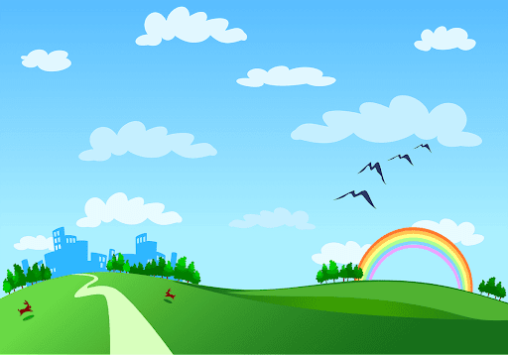
Good morning class!!!

Slide 2
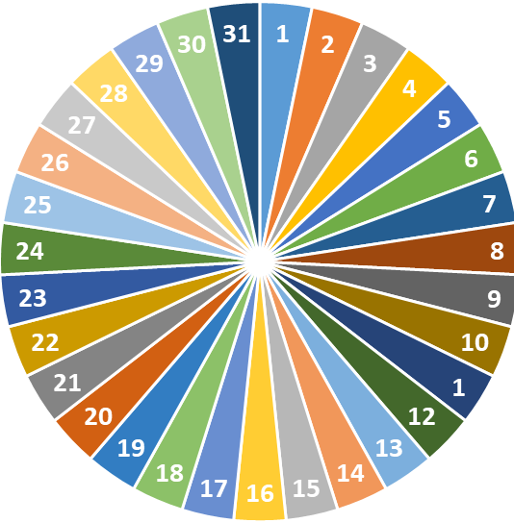
* Check - up
1
2
3
SPIN

Slide 3
* Choose the correct adverb of frequency to describe each activity
Not once in his life has my father shopped online.
A. never
B. sometimes

Slide 4
* Choose the correct adverb of frequency to describe each activity
2. The convenience shop opposite my house is open every day.
A. always
B. frequently

Slide 5
* Choose the correct adverb of frequency to describe each activity
3. I'm not interested in going shopping, so I just go a few times a year.
A. sometimes
B. rarely

Slide 6

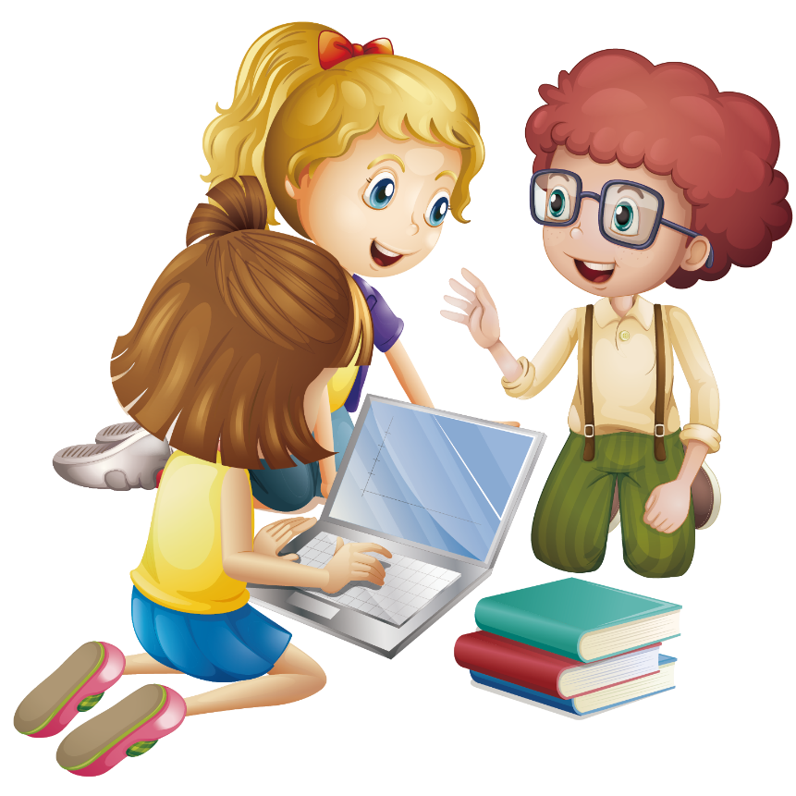
PERIOD 65 : UNIT 8 : SHOPPING
LESSON 4: Communication
1

Slide 7
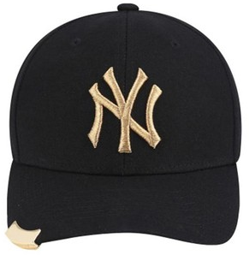
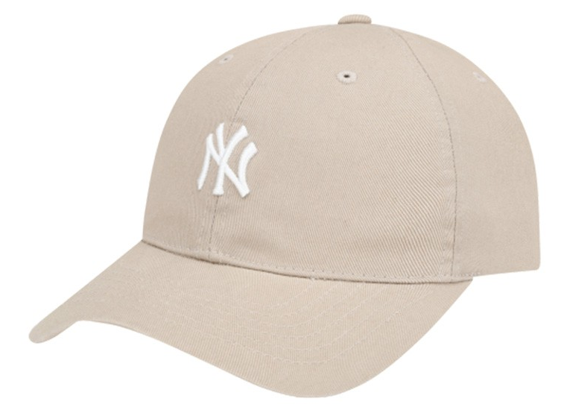
CHATTING
The hat you ordered
Supposing you ordered a hat online, but when you got it, it didn’t have the same color as you ordered. What would you do in that case?
The hat you received
MAKING COMPLAINTS

Slide 8

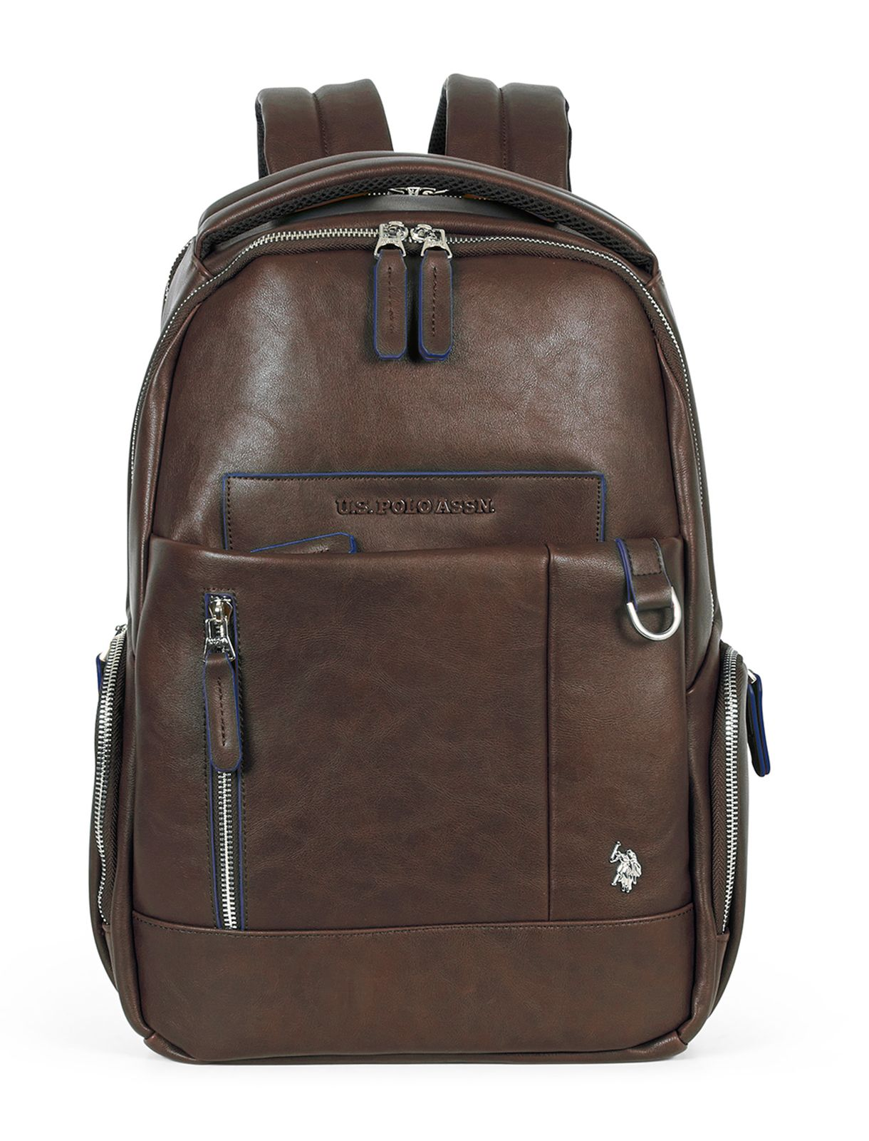
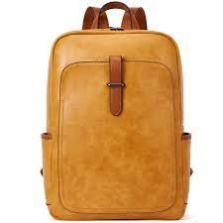
* EVERYDAY ENGLISH
1
Listen and read the conversation. Pay attention to the highlighted parts.
Tom: I’m calling to make a complaint about the SMART backpack I ordered from you last week. I got it this morning, and it’s smaller than the one you advertised online.
Trang: Well … Let me check it.
Tom: And I’m not happy with the colour, either. In your picture, it’s dark brown, and this one is yellowish brown.
Trang: I’m sorry about that. I’ll send you another one.

Slide 9
2
Work in pairs. In turn, make complaints about the situations below.
1.The cans of fish you bought at the shop expired five days ago.
2. An assistant at the shop was not very helpful.

Slide 10
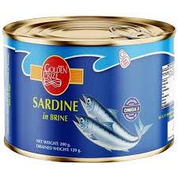
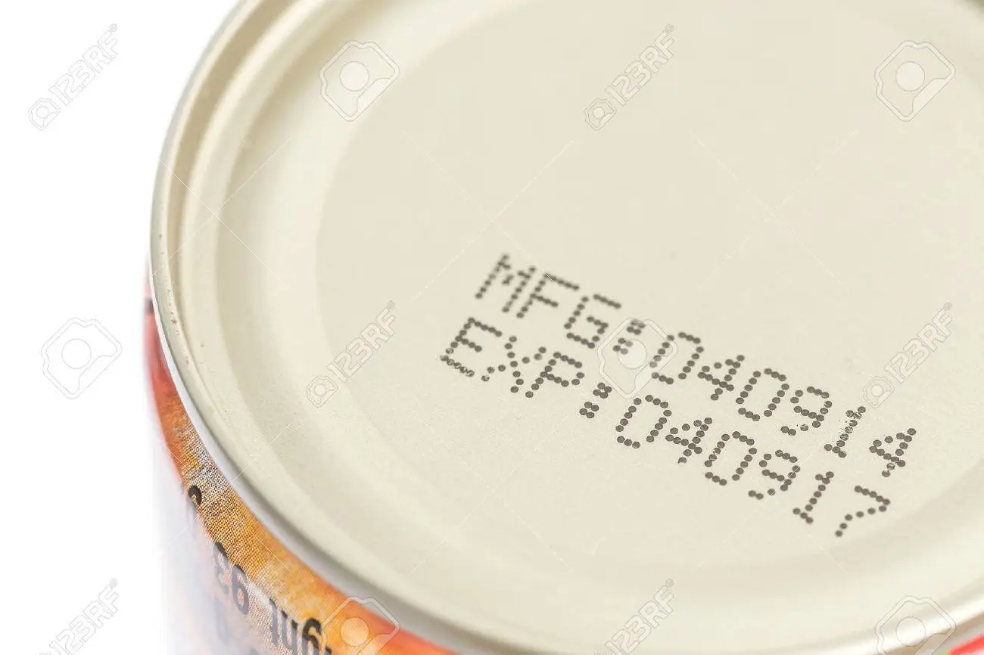
2
Work in pairs. In turn, make complaints about the situations below.
hết hạn
The cans of fish you bought at the shop expired five days ago.
A: I'm calling to make a complaint about the can of fish I bought at the shop. It expired five days ago.
B: Well ... Let me check it.
A: I'm waiting.
B: I'm sorry about that. I'll send you another one.

Slide 11
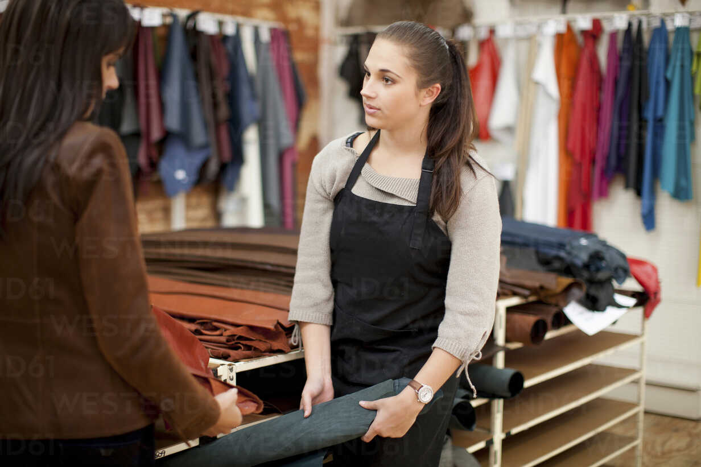
2
Work in pairs. In turn, make complaints about the situations below.
2. An assistant at the shop was not very helpful.
A. I’m not happy with an assistant at the shop. She was not very helpful.
B . I'm really sorry to hear that. Can you please provide me her name?
A. I don't know her name but she / he has long curly hair and she / he wears glasses.
B: Oh. I got it. I'm really sorry, I will solve this problem and it will definitely not happen again in the future

Slide 12
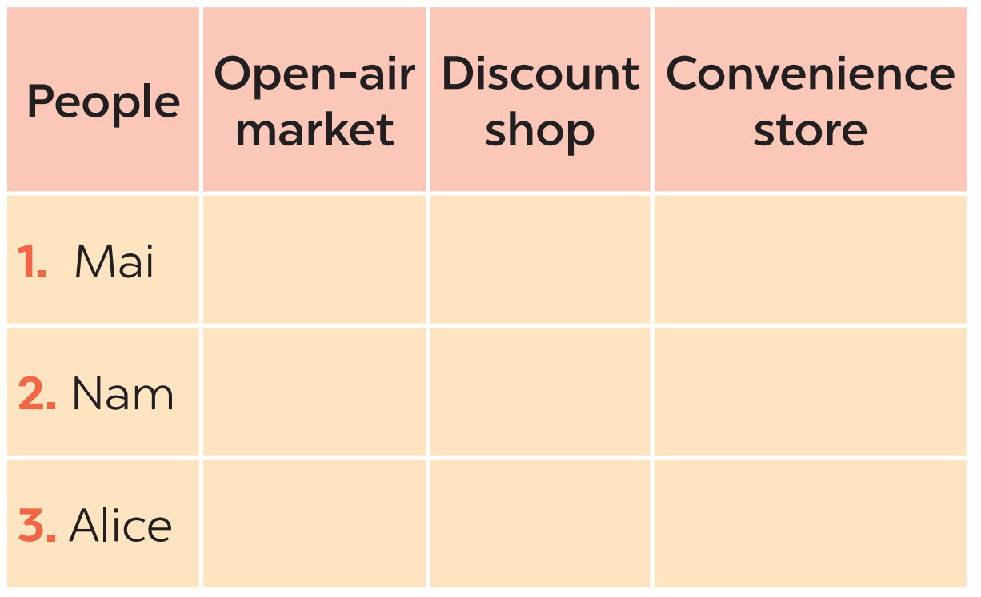

MY FAVOURITE SHOPPING PLACE
3
Listen to three people talking about their favourite shopping places and tick the place they mention.

Slide 13
Audio script
1. Mai
I often go to the open air market in my village. Most of the products there are home grown or homemade. The market goers know one another and they chat happily while selling and buying.
2. Nam
When I need something, I go to a convenience store. They are easy to find because they are all over the place. The prices may be a bit higher than in supermarkets, but they can save you time.
3. Alice
I love shopping at discount shops. There is a wide range of goods there and everything is cheaper than at other places. Yesterday I bought a Christmas dress for half the price of one in a speciality shop.

Slide 15
MY FAVOURITE SHOPPING PLACE
4
Work in pairs. Take turns to ask and answer what each person in 3 likes about their shopping place.
The products are home-grown and home-made. The market goers know one another. They chat happily while selling and buying.
1. Mai
2. Nam
3. Alice
They are convenient because they are everywhere. You can save time.
There is a wide range of goods there. Everything is cheaper than at other places.
A: What does Alice like about shopping at discount shops?
B: She likes discount shops because everything is cheaper than at other places.
Example:
A:What does Nam like about shopping at a convenience store?
B: It saves him time.
A: What does Mai like about shopping at an open-air market?
B: She likes it because the shoppers know one another and chat happily while shopping.

Slide 16

MY FAVOURITE SHOPPING PLACE
5
Work in groups. Share your favourite shopping place with your group.
You can include:
The name of the place
The reason(s) why you like it

Slide 17
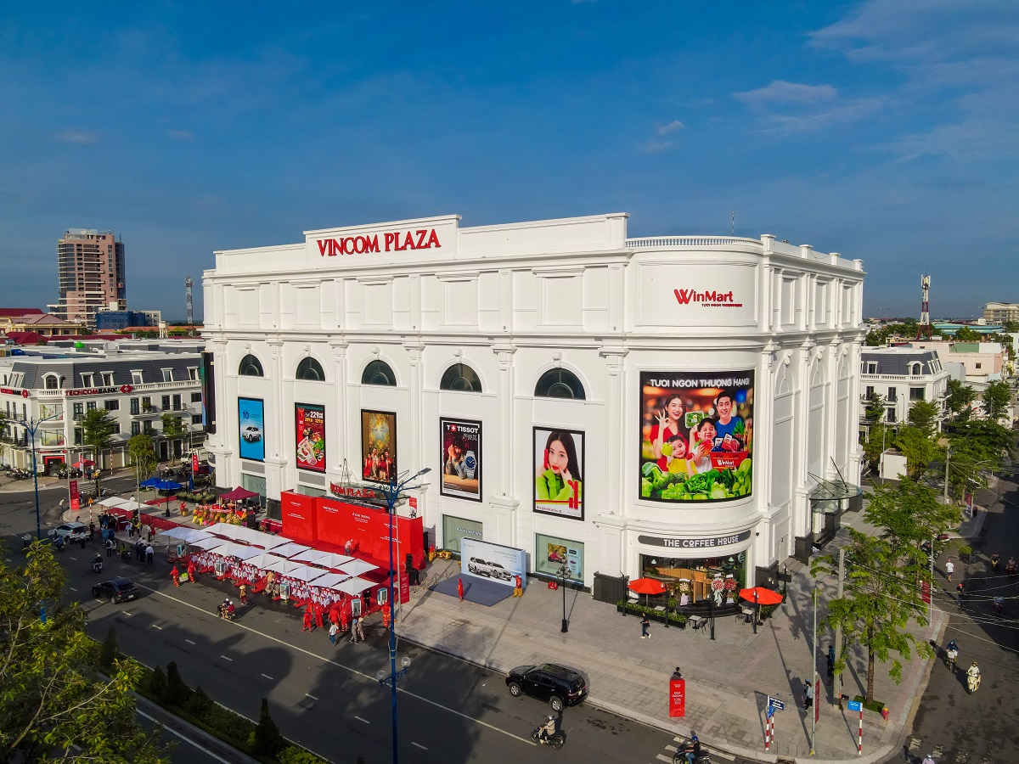
MY FAVOURITE SHOPPING PLACE
5
Work in groups. Share your favourite shopping place with your group.
My favorite shopping place is "Vincom." It is a shopping mall. I really like it because it has many stores with nice clothes, toys, and yummy food. When I go there, I feel happy seeing all the colorful things and the bright lights. There's a big play area where I can have fun, and my family can shop together. Vincom is my favorite place to visit on weekends!

Slide 18
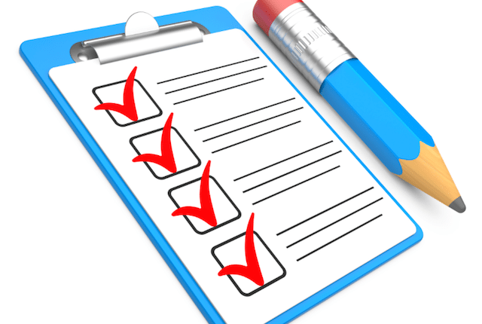
* CONSOLIDATION
What have we learnt in this lesson?
Making complaints
Some favourite shopping places

Slide 19

* Homework
Learn the ways to make complaints by heart.
Write a paragraph of 50-70 words about your favourite shopping place.
Do exercise in the Workbook

Slide 20
