Slide 1
GOOD MORNING
EVERYONE !!!

Slide 2
CHECK - UP
Huy
Tí
DÒ BÀI
Bủm
Bé
ku
Hương
DÒ BÀI
Mộng Hải

Slide 3
CHECK - UP
* Answer some questions:
+ What is your favourite TV programme?
+ Can you tell me what it is about?
+ Could you give me some adjectives to describe it?”

Slide 4
CHECK - UP
* Answer some questions:
+ What is your favourite TV programme?
+ Can you tell me what it is about?
+ Could you give me some adjectives to describe it?”

Slide 5
PERIOD 61 :Unit 7:
TELEVISION
LESSON 7
SKILLS 2

Slide 6
* Vocabulary
Put the words in the box in the correct column. Add more words if you can.
educational
English in a Minute
interesting
animated films
sports
popular
wildlife
funny
Programme | Adjectives describing programmes
sports
educational
wildlife
interesting
English in a Minute
popular
animated films
funny

Slide 7
Complete the sentences with the words / phrases in the box.
viewers
funny
educational
sports
animal
VTV1 is a popular TV channel in Viet Nam. It attracts many (1) because it has interesting programmes.
The (2) programmes show tigers and giraffes in nature. People watch races or football matches on (3) programmes. Comedies make people laugh because they are (4) . Game shows are both fun and (5)
viewers
animal
sports
funny
educational.
.

Slide 8
* Grammar
Complete each question with a suitable question word.
1.
_________ days a week do you go to class?
I go to class five days a week.
2.
_________ did you watch on TV last night?
I watched The Fox Teacher.
3.
______ do you like the Wildlife programme?
Because I love animals.
4.
_______ is your favourite person on TV?
I like Minh Phong in The Gift of Music.
5.
_________ hours a day do you watch TV?
About half an hour a day. I watch more at the weekend.
Game: Lucky
number

Slide 9
LUCKY NUMBERS
1
2
3
4
5
6
7
8
GA
2
4
6
8
10
12
14
GB
2
4
6
8
10
12
14

Slide 10
LUCKY NUMBER!

Slide 11
LUCKY NUMBER!

Slide 12
LUCKY NUMBER
YOU GET A GIFT

Slide 13
Complete each question with a suitable question word.
How many
1. _________ days a week do you go to class?
I go to class five days a week.

Slide 14
Complete each question with a suitable question word.
2.
What
I watched The Fox Teacher.
_________ did you watch on TV last night?

Slide 15
Complete each question with a suitable question word.
3.
Why
______ do you like the Wildlife programme?
Because I love animals.

Slide 16
Complete each question with a suitable question word.
4.
Who
_______ is your favourite person on TV?
I like Minh Phong in The Gift of Music.

Slide 17
Complete each question with a suitable question word.
How many
5.
_________ hours a day do you watch TV?
About half an hour a day. I watch more at the weekend.

Slide 18
* Grammar
Complete each question with a suitable question word.
How many
1.
_________ days a week do you go to class?
I go to class five days a week.
2.
What
I watched The Fox Teacher.
_________ did you watch on TV last night?
3.
Why
______ do you like the Wildlife programme?
Because I love animals.
4.
Who
_______ is your favourite person on TV?
I like Minh Phong in The Gift of Music.
How many
5.
_________ hours a day do you watch TV?
About half an hour a day. I watch more at the weekend.

Slide 19
Use the conjunctions provided to connect the sentences.
1. Ocean Life is on at 7.30. Laughing out Loud comes next at 8.00. (and)
→ Ocean Life is on at 7.30, and Laughing out Loud comes next at 8.00.
2. I like The Seven Kitties very much. I watch it every day. (so)
→I like The Seven Kitties very much, so I watch it every day.
3. BBC One is a British channel. VTV6 is a Vietnamese channel. (but)
→ BBC One is a British channel, but VTV6 is a Vietnamese channel.
4. Along the Coast is a famous TV series. I don’t like it. (but)
→ Along the Coast is a famous TV series, but I don't like it.
5. I have a lot of homework tonight. I can’t watch Eight Feet Below. (so)
→I have a lot of homework tonight, so I can't watch Eight Feet Below.

Slide 20
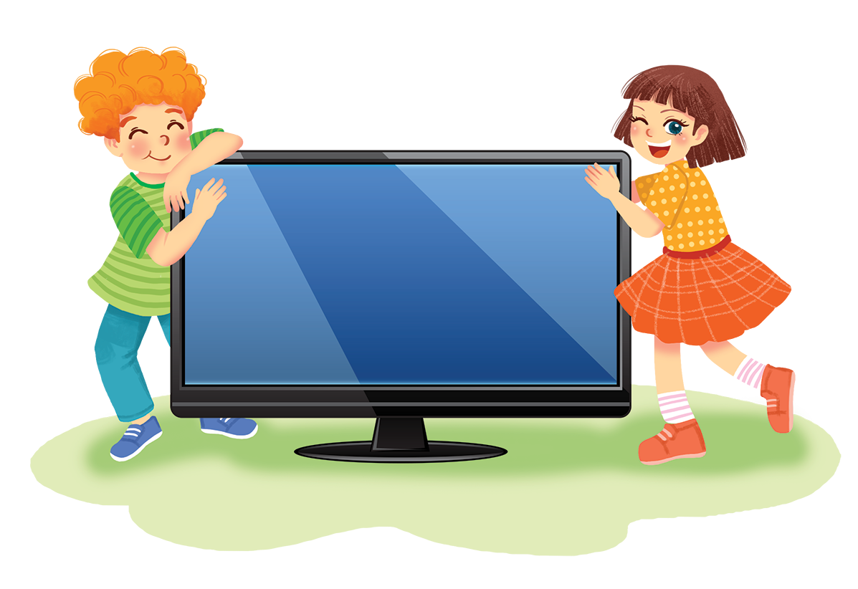
Work in groups. Interview your friends, using the questions below. Take notes of their answers and then report the results to the class.

Slide 21
1.
What do you do in your free time?
A.
Going out.
B.
Reading books.
D.
Surfing the facebook
C.
Watching TV.
Other: ______
2.
Where do you prefer to get information from?
A.
Books.
B.
Friends.
D.
Internet
Other: ______
C.
Televion.
3.
How many hours a day do you watch TV?
A.
One hour.
B.
Two hours.
C.
More than two hours.
D.
Other: ______
less than one hour

Slide 22
4.
Why do you watch TV?
A.
Because I have nothing else to do.
B.
Because my parents want me to.
C.
Because I like it.
D.
Because I have online lessons on TV
Other: ______
5.
How long do you think you can live without TV?
A.
Just one day.
B.
Up to a week.
C.
Up to a month.
D.
I can live without TV
Other: ______

Slide 23
* Report the results to the class.
Hello everyone! I interviewed six members in my group and these are the results. In their free time, Mai and Nam go out, Minh reads books, Trung and Phong watch TV, but Nhi surfs the Internet. Mai, Nam, Trung prefer to get information from books, and Minh, Phong, Nhi prefer to do that from the Internet. All of them watch TV more than two hours a day because they they like it. Mai and Nhi think they can live without TV up to a month, but Nam, Minh , Trung, Phong think they can live without TV just one day.

Slide 24
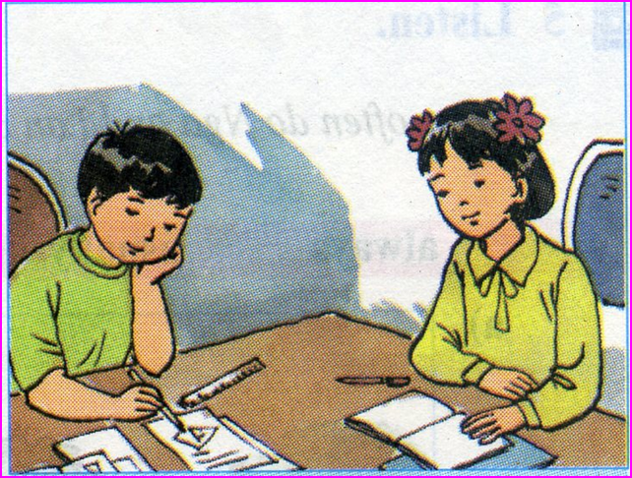
Homework:
- Do exercise in workbook.
- Complete the project
- Prepare for the next lesson: Unit 8 –Lesson 1. Getting started.

Slide 25
Liên hệ Côi Nguyễn nhé.
Thank you!
Have a nice day!

