Slide 2
Unit
11
TRAVELLING IN THE FUTURE
LESSON 4: COMMUNICATION
Unit
HOBBIES

Slide 3
OBJECTIVES
By the end of the lesson, students will be able to:
learn how to how to make predictions.
practise using some grammar points and vocabulary related to the topic.

Slide 4
LESSON 4: COMMUNICATION
WARM-UP
Game: CHATTING
Making predictions
PRESENTATION
Everyday English
Task 1: Listen and read the conversation.
Task 2: Make similar conversation.
Tips for a healthy life
Task 3: Complete the conversation between Mark and Lan with the questions and answers from the box.
Task 4: Choose one means of transport below and make a similar conversation as in 3.
PRACTICE
PRODUCTION
Task 5: Choose one means of transport that you would like to use to travel to school. Give reasons.
CONSOLIDATION
Wrap-up
Home work

Slide 5
LESSON 2: A CLOSER LOOK 1
Game: CHATTING
WARM-UP
Aims of the stage:
To revise the old lesson and introduce the new lesson.

Slide 6
LESSON 2: A CLOSER LOOK 1
WARM-UP
Game: CHATTING
Making predictions
PRESENTATION
Aims of the stage:
- To introduce to Ss how to make predictions
– To have Ss practise the conversation of making predictions

Slide 7
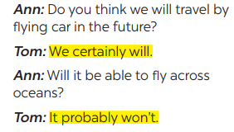
PRESENTATION
1
Listen and read the conversations. Pay attention to the highlighted sentences.

Slide 8
PRESENTATION
- We certainly will/ won’t …
- It probably won’t/ will …

Slide 9
LESSON 4: COMMUNICATION
WARM-UP
Game: CHATTING
Making predictions
PRESENTATION
Everyday English
Task 1: Listen and read the conversation.
Task 2: Make similar conversation.
Tips for a healthy life
Task 3: Complete the conversation between Mark and Lan with the questions and answers from the box.
Task 4: Choose one means of transport below and make a similar conversation as in 3.
PRACTICE

Slide 10
PRACTICE
1
Everyday English
Aims of the stage:
To help Ss practise making predictions.

Slide 11
PRACTICE
2
Make similar conversations.
Situation 2: Travelling to other planets for holidays.
Situation 1: Travelling long distances by hyperloop.

Slide 12
LESSON 4: COMMUNICATION
WARM-UP
Game: CHATTING
Making predictions
PRESENTATION
Everyday English
Task 1: Listen and read the conversation.
Task 2: Make similar conversation.
Tips for a healthy life
Task 3: Complete the conversation between Mark and Lan with the questions and answers from the box.
Task 4: Choose one means of transport below and make a similar conversation as in 3.
PRACTICE

Slide 13
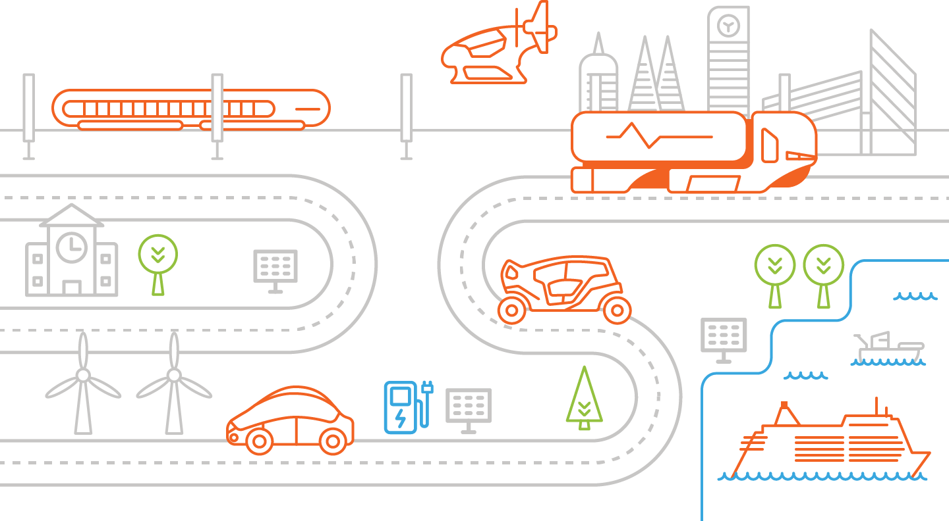
PRACTICE
HOW WILL CHILDREN GO TO SCHOOL?
Aims of the stage:
- To help Ss learn more about what information they can discover when talking about a means of transport
– To help Ss practise asking and answering questions about a future means of transport.

Slide 14
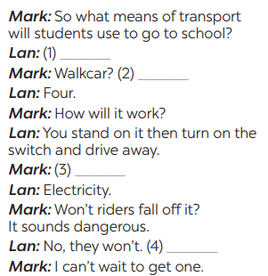
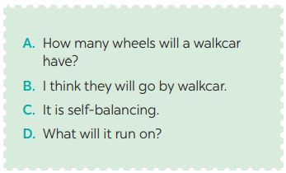
PRACTICE
3
Complete the conversation between Mark and Lan with the questions and answers from the box.
B. I think they will go by walkcar.
A. How many wheels will a walkcar have?
D. What will it run on?
C. It is self – balancing.

Slide 15
PRACTICE
4
Choose one means of transport below and make a similar conversation as in 3.

Slide 16
LESSON 4: COMMUNICATION
WARM-UP
Game: CHATTING
Making predictions
PRESENTATION
Everyday English
Task 1: Listen and read the conversation.
Task 2: Make similar conversation.
Tips for a healthy life
Task 3: Complete the conversation between Mark and Lan with the questions and answers from the box.
Task 4: Choose one means of transport below and make a similar conversation as in 3.
PRACTICE
PRODUCTION
Task 5: Choose one means of transport that you would like to use to travel to school. Give reasons.
CONSOLIDATION
Wrap-up
Home work

Slide 17
PRODUCTION
Aims of the stage:
To help Ss practise talking about which means of transport they would like to use to travel to
school
– To help Ss practise giving reasons
– To help Ss practise reporting

Slide 18
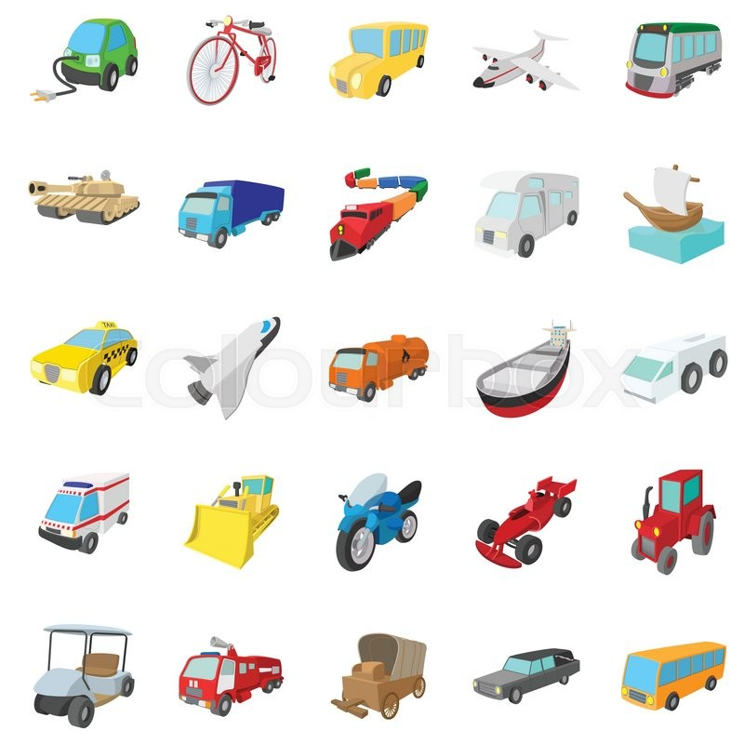
PRODUCTION
5
Choose one means of transport that you would like to use to travel to school. Give reasons.

Slide 19
LESSON 4: COMMUNICATION
WARM-UP
Game: CHATTING
Making predictions
PRESENTATION
Everyday English
Task 1: Listen and read the conversation.
Task 2: Make similar conversation.
Tips for a healthy life
Task 3: Complete the conversation between Mark and Lan with the questions and answers from the box.
Task 4: Choose one means of transport below and make a similar conversation as in 3.
PRACTICE
PRODUCTION
Task 5: Choose one means of transport that you would like to use to travel to school. Give reasons.
CONSOLIDATION
Wrap-up
Home work

Slide 20
CONSOLIDATION
1
WRAP-UP
In this lesson, we have learn to:
learn how to how to make predictions.
practise using some grammar points and vocabulary related to the topic.

Slide 21
CONSOLIDATION
2
HOMEWORK
Do exercises in the workbook.

