Slide 1



Slide 2

* Question forming:
What....
How often...
What time...
TV programme
Why....
….
When....
* Example:
1. What’s your favourite TV programme?
2. Why do you like it?
3. What time is it on?
4. How often do you watch it?
5. When do you watch it?

Slide 3

PERIOD 58:UNIT 7:
TELEVISION
LESSON 4 : COMMUNICATION

Slide 4



Everyday English
Asking for and giving information about TV programmes

Slide 5



Listen and read the conversation. Pay attention to the highlighted words.
A: What’s your favourite TV programme?
B: The animal programme.
A: Why do you like it?
B: Because I can see the animals in their real life.

Slide 6

Work in pairs. Make a similar conversation about your favourite TV programme.
A: What's your favourite TV programme?
B: …………………………………………………………….
A: Why do you like it?
B: ………………………………………………………..
A: What time is it on?
B:…………………………………………………………………..
A: How often do you watch it?
B: ………………………………………………
It’s cartoon Netwwork.
Because the cartoons are very funny and they make me happy.
It’s on at 7:30 p.m. on Disney Channel.
I watch it every weekend.

Slide 7

Work in groups. Discuss and complete the facts with the countries in the box.
The USA
Viet Nam
Japan
Iceland
* Facts
1. Pokemon cartoons are from ___________ .
2. Bibi in ___________shows international and Vietnamese cartoons.
3. In ___________, there was no TV on Thursdays before 1986.
4. Discovery Channel makes education fun for children in____________.
Japan
Viet Nam
Iceland
The USA

Slide 8


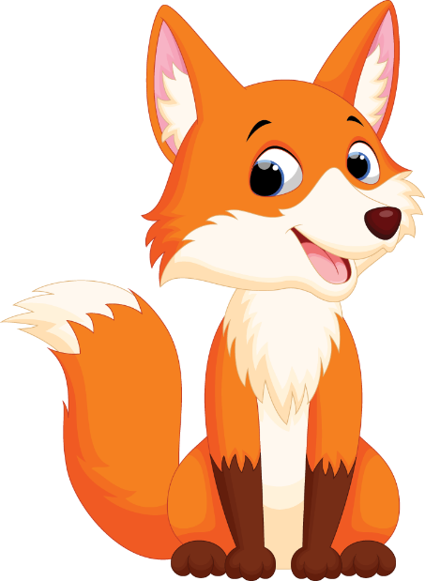
Read about the two TV programmes and tick () the correct programme in the table. You may tick both.
Let’s Learn is an educational TV programme. It makes learning fun. Children love it. It has cute characters and fun songs. People in 80 countries watch it today. Both children and their parents like it.
Hello Fatty is a popular TV cartoon. It’s about a clever fox called Fatty and his friend. Together they go to different places. Children around the world enjoy this programme. It’s funny and educational.

Slide 9
* Tick () the correct programme in the table.
 | Let’s Learn | Hello Fatty
1. It’s educational.
2. It has viewers from 80 countries.
3. Its main character is a clever fox.
4. Both parents and children enjoy it.
5. It’s a cartoon.







Slide 10

Work in groups. Tell your group which programme in 4 you prefer and why.
Example:
I like Let’s Learn because it has cute characters and fun songs.

Slide 11
Work in groups. Tell your group which programme in 4 you prefer and why.
Example:
I prefer Hello Fatty because it is funny and educational.

Slide 12

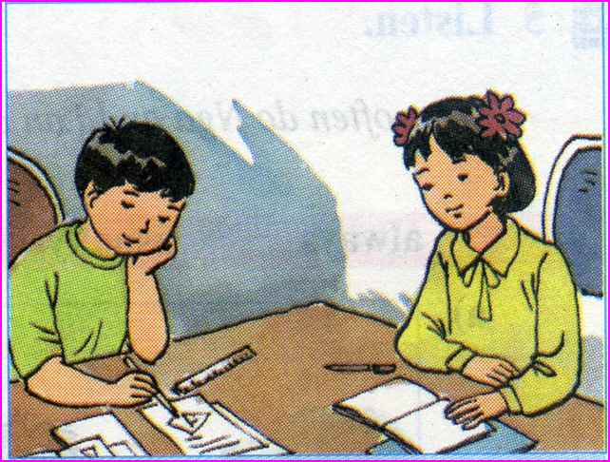
Homework:
- Do exercise in workbook.
- Prepare lesson 5- Skills 1

Slide 13

Liên hệ Côi Nguyễn nhé.
Thank you!
Have a nice day!

