Slide 2
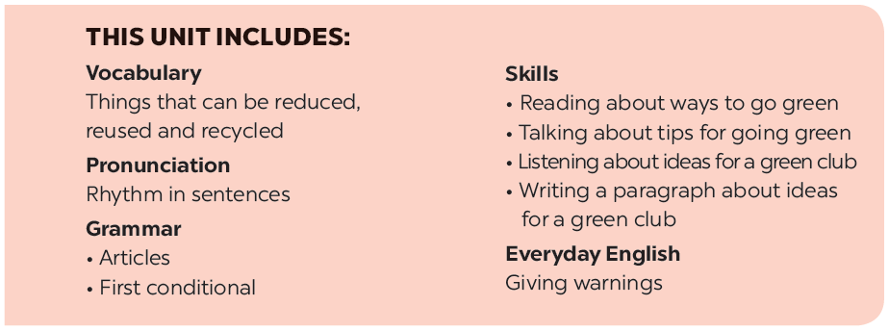

Slide 3
Reading
Speaking
A reporter is interviewing Nam, a member of the 3Rs Club. Read the interview. Find these words or phrases and underline them.
Nam mentions the following tips in the interview. Work in groups and discuss to put the tips in order from the easiest to the most diff icult.
Match the words / phrases with their meanings.
Tip f tells you to find creative ways to reuse old items. Can you think of any ways to reuse
Read the text again. Answer the questions.

Slide 4
Reading

Slide 5
A reporter is interviewing Nam, a member of the 3Rs Club. Read the interview. Find these words or phrases and underline them.
instead of
exchange
recycling bins
reusable
charity

Slide 6
instead of
exchange
recycling bins
reusable
charity
Reporter: Can you share with us some tips to make your school greener?
Nam: Sure. Firstly, we put recycling bins in every classroom.
Reporter: What about old books and uniforms?
Nam: We exchange them with our friends or give them to charity. We don’t throw them away.
Reporter: Anything else?
Nam: We borrow books from the school library instead of buying new ones.
Reporter: Great! You can save much paper.
Nam: And there’s another tip. We bring reusable water bottles to school. Reporter: I see lots of trees in your school. Is planting trees a good tip?
Nam: Yeah. It makes our school greener.
Reporter: Thanks for sharing. Do you want to add anything?
Nam: Finally, we usually find creative ways to reuse old items before throwing them away.
...

Slide 7
Match the words / phrases with their meanings.
e. in the place of somebody or something
a. give something to a person and receive something from him / her
1. instead of
d. giving things to people in need
b. can be used again
2. charity
a. give something to a person and receive something from him / her
c. containers for things that can be recycled
3. exchange
b. can be used again
4. reusable
d. giving things to people in need
c. containers for things that can be recycled
5. recycling bins
e. in the place of somebody or something

Slide 8
Read the text again. Answer the questions.
1.
What is the interview about?
Ways to become greener at school
2.
What will they put in every classroom?
Recycing bins
3.
What can they do with their old uniforms?
Exchange old uniforms with friends or give them to charity
4.
What do they do instead of buying new books?
Borrow books from the library
5.
What type of water bottles do they bring to school?
Reusable water bottles

Slide 9
Speaking

Slide 10
Nam mentions the following tips in the interview. Work in groups and discuss to put the tips in order from the easiest to the most difficult.
a.
Putting recycling bins in every classroom.
b.
Exchanging old books and uniforms with friends or giving them to charity.
c.
Borrowing books from the school library instead of buying new ones.
d.
Bringing reusable water bottles to school.
e.
Planting trees at school.
f.
Finding creative ways to reuse old items before throwing them away.
Can you add more tips to the list?

Slide 11
Tip f tells you to find creative ways to reuse old items. Can you think of any ways to reuse
a.
used gift wrap?
b.
used water bottles?
c.
used books?

