Slide 1


Slide 2
THI SƠN SECONDARY SCHOOL
Welcome to our class
6A

Slide 3
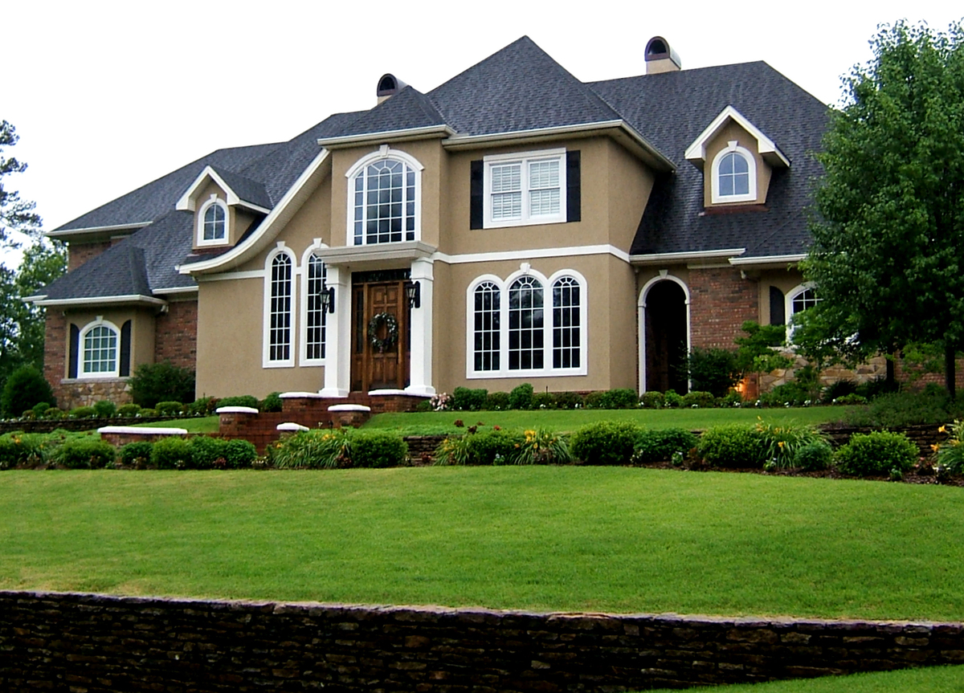
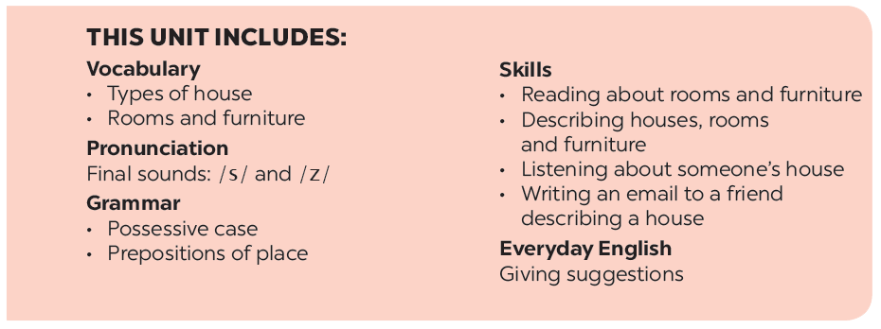
UNIT 2: MY HOUSE
LESSON 5

Slide 4
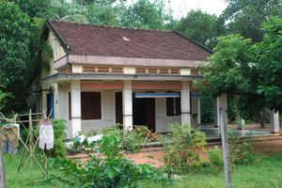
What type of house is this?
Country house

Slide 5
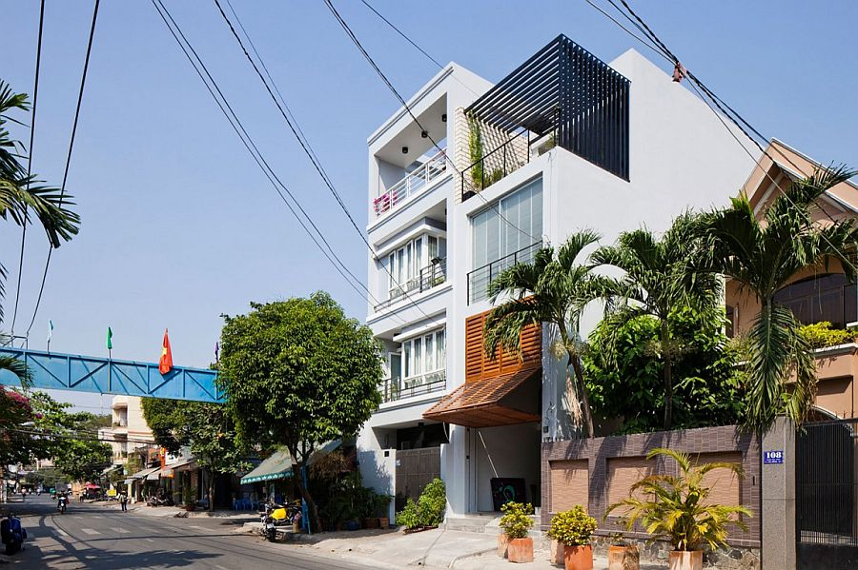
What type of house is this?
Town house

Slide 6
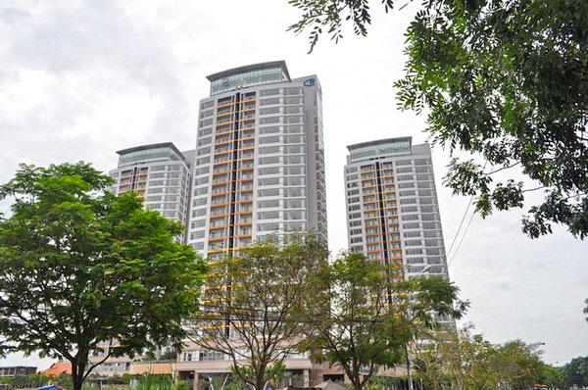
What type of house is this?
flat = apartment

Slide 7
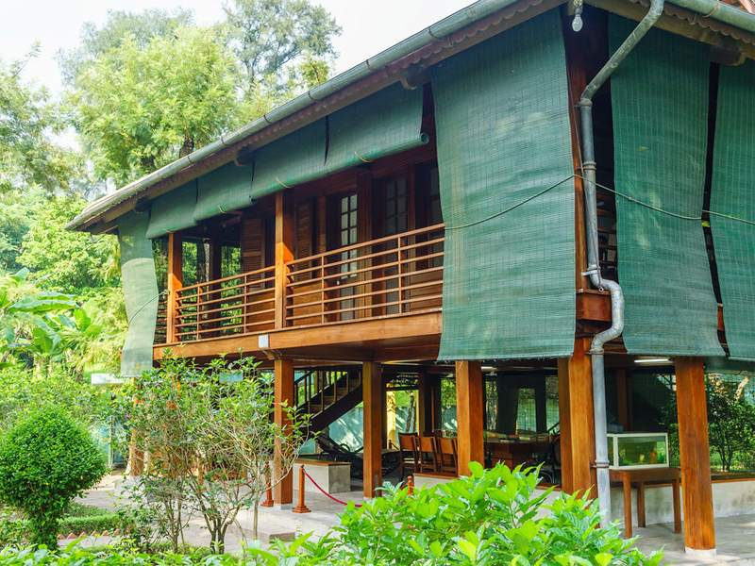
What type of house is this?
Stilt house

Slide 8
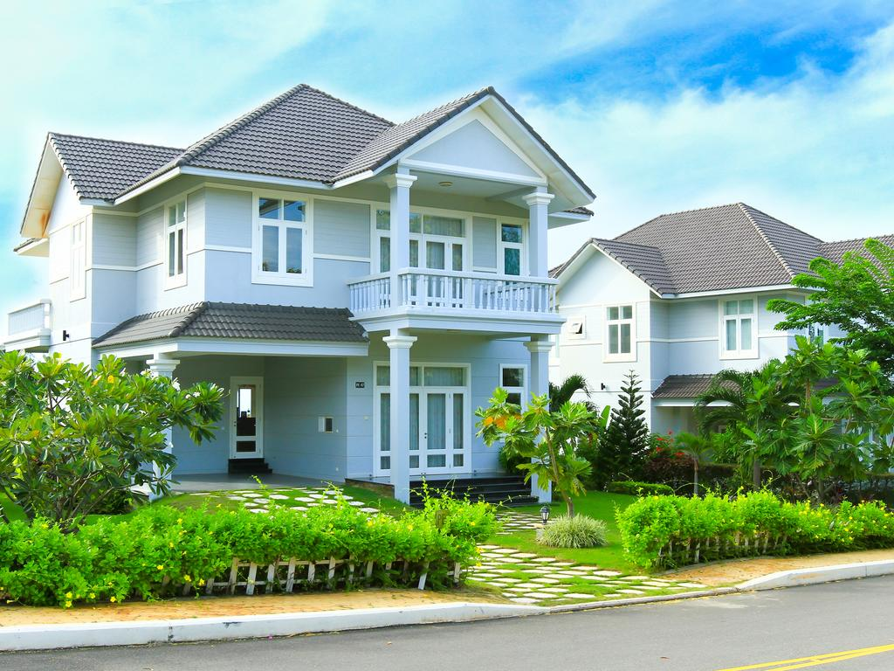
What type of house is this?
Villa

Slide 9
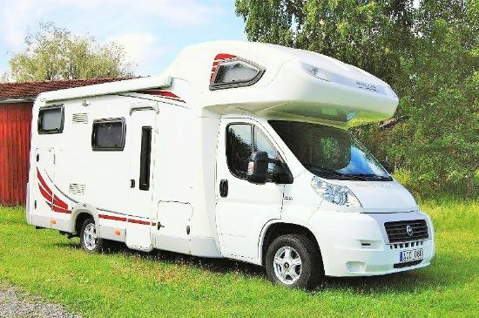
What type of house is this?
Mobile house

Slide 10
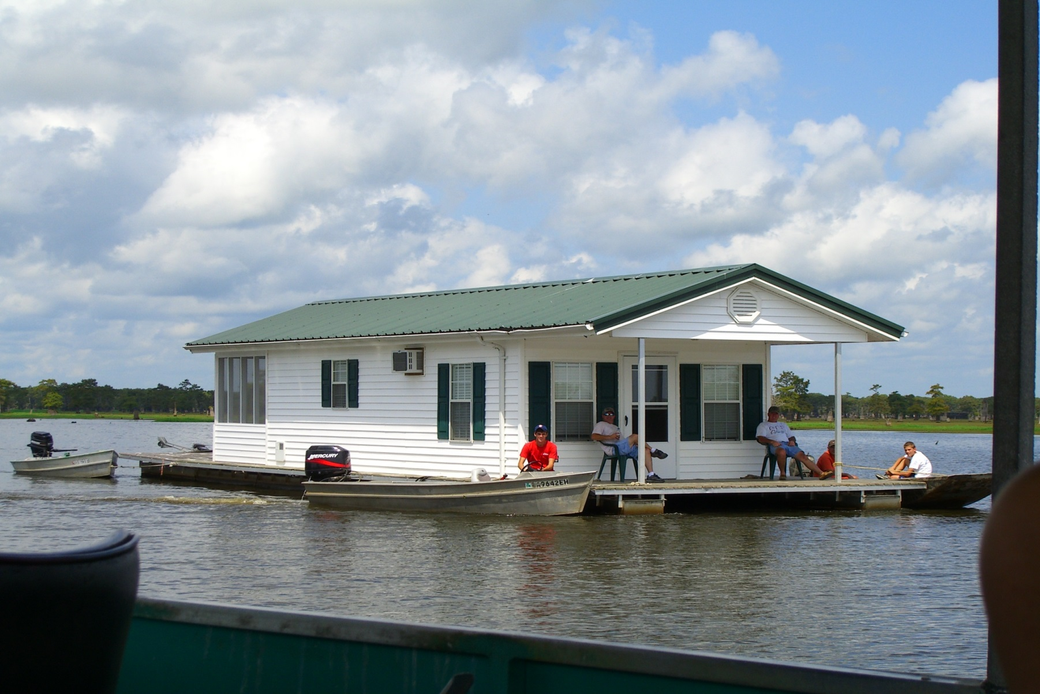
What type of house is this?
Houseboat

Slide 11
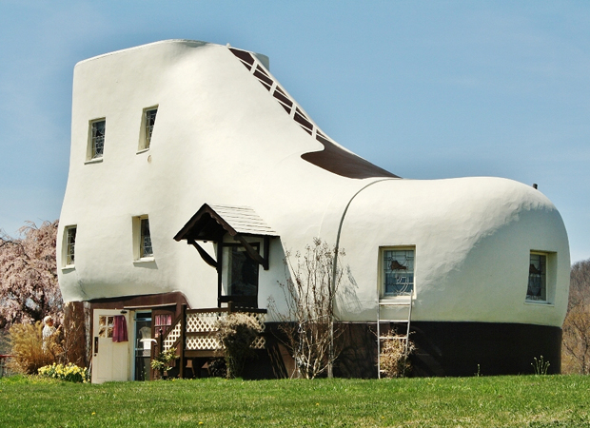
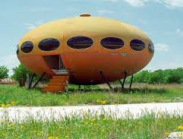
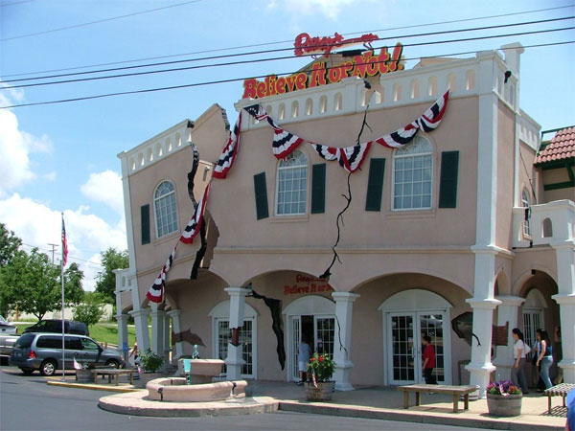
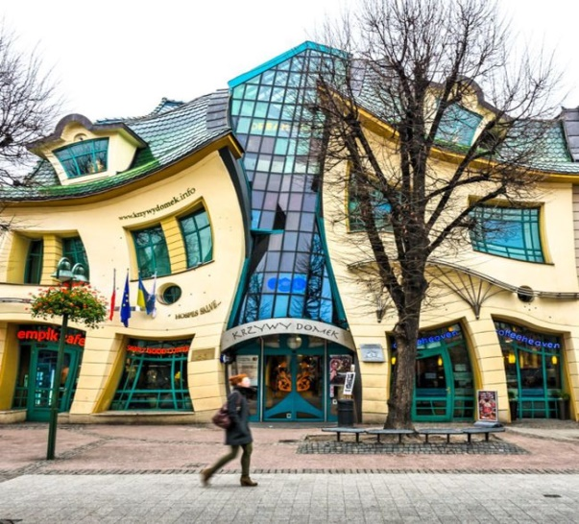
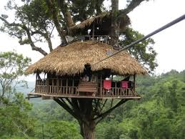
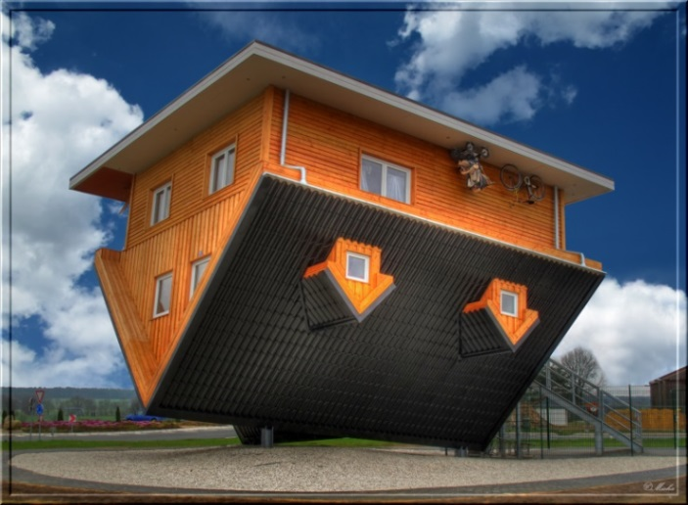
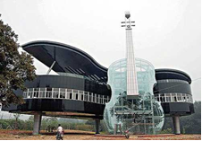
- How are the houses?
  - They are strange (crazy) houses.

Slide 12
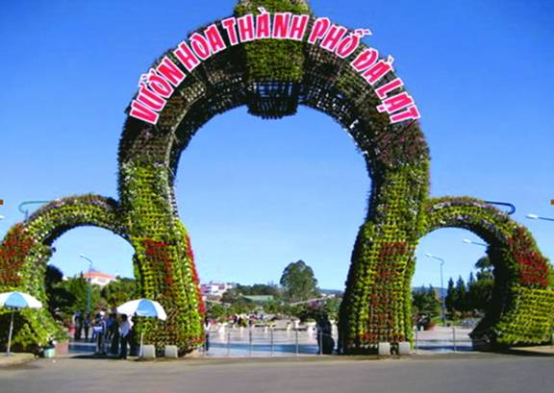


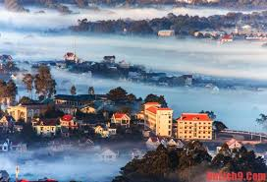
Do you know where these pictures are?
They are in Da Lat.

Slide 13
What do you know about Da Lat?
City of Lam Dong Province in Vietnam
Located on the Langbiang Plateau in the southern parts of Central Highlands region.
Da Lat
Popular tourist destination;
“City of flowers”
Mild temperatures

Slide 14



UNIT 2: MY HOUSE
LESSON 5
I/ Reading

Slide 15
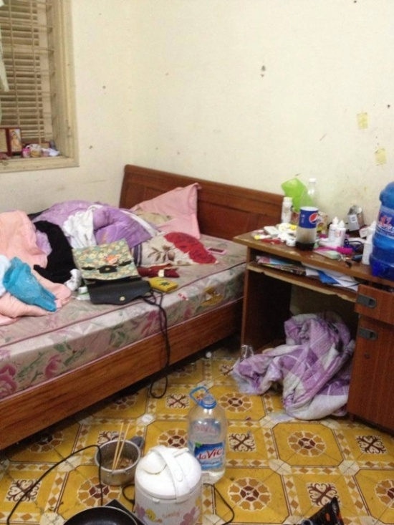
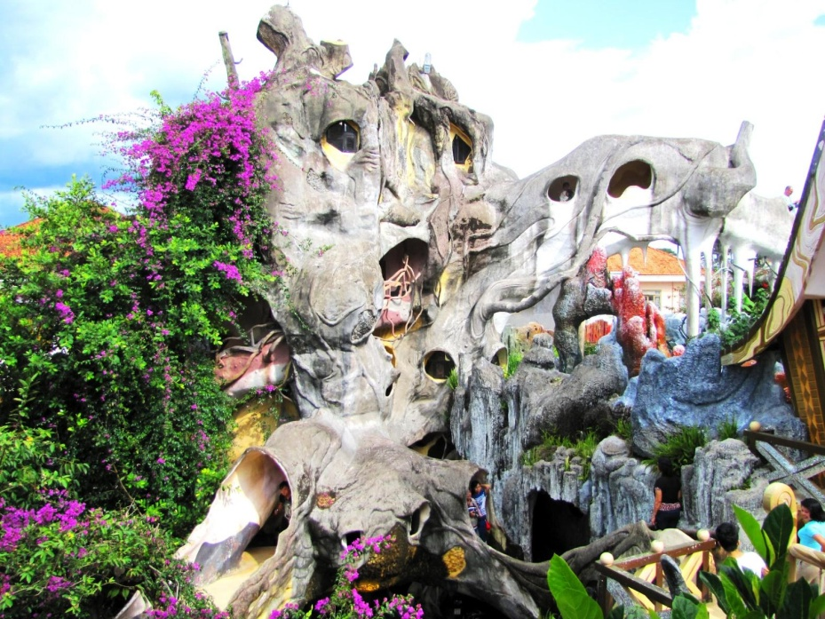
* VOCABULARY
*Vocabulary:
- crazy (adj):
kì dị, lạ thường
- shape (n):
hình dạng
- messy (adj):
lộn xộn,bừa bộn

Slide 16
* Checking words.
- crazy (adj):
kì dị, lạ thường
- shape (n):
hình dạng
- messy (adj):
lộn xộn,bừa bộn

Slide 17

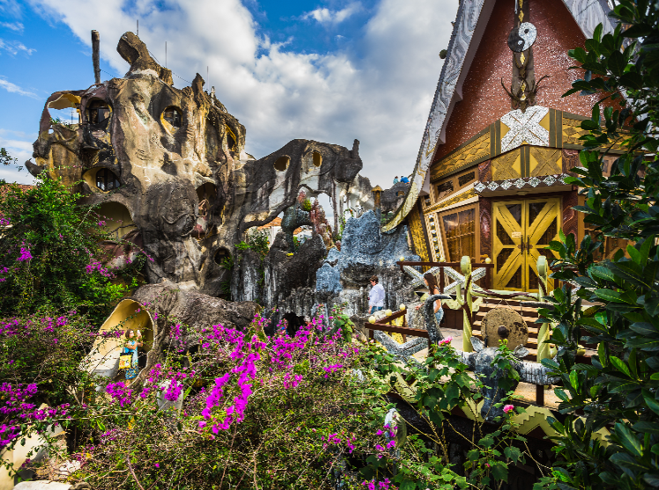
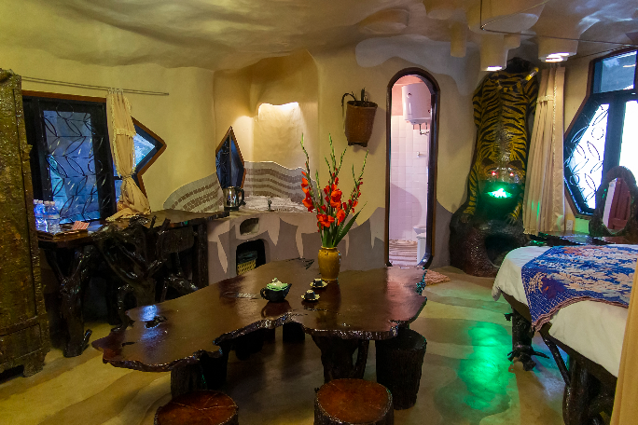

Look at the text. Answer the questions.
Reading skill: Predicting
Predicting makes reading easy.
Before reading, look at the pictures, design and title.
Decide what the text is about.
Think about what you know about the topic.

Slide 18


To: phong@webmail.com; mi@webmail.com
Subject: A room at the Crazy House Hotel
Hi Phong and Mi,
How are you? I’m in Da Lat with my parents. We’re staying at the Crazy House Hotel. Wow! It really is crazy. There are ten rooms in the hotel.
There’s a Kangaroo Room, an Eagle Room, and even an Ant Room. I’m staying in the Tiger Room. It’s called the Tiger Room because there’s a big tiger on the wall.
The tiger is between the bathroom door and the window. The bed is next to the window, but the window is a strange shape. I put my bag under the bed. There’s a lamp, a wardrobe and a desk.
You should stay here when you visit Da Lat. It’s great.
See you soon!
Nick
1. Is it an email or a letter?
It's an email.
2. What is the text about?
The text is about Nick's room at the Crazy House Hotel.

Slide 19

Read the text again and answer the questions.
1.
Who is Nick in Da Lat with?
2.
How many rooms are there in the hotel?
3.
Why is the room called the Tiger Room?
4.
Where is Nick’s bag?
Game: Lucky Numbers

Slide 20



Read the text again and answer the questions.
cats
dogs
Lucky Numbers
1
2
3
4
5
6

Slide 21
1. Who is Nick in Da Lat with?
→He's in Da Lat with his parents.

Slide 22
2. How many rooms are there in the hotel?
→There are ten rooms.

Slide 23
3. Why is the room called the Tiger Room?
→Because there's a big tiger on the wall.

Slide 24
4. Where is Nick’s bag?
→ It's under the bed.

Slide 25

LUCKY NUMBER!

Slide 26
LUCKY NUMBER!

Slide 27
Read the text again and answer the questions.
1.
Who is Nick in Da Lat with?
He's in Da Lat with his parents.
2.
How many rooms are there in the hotel?
There are ten rooms.
3.
Why is the room called the Tiger Room?
Because there's a big tiger on the wall.
4.
Where is Nick’s bag?
It's under the bed.

Slide 28

Circle the things in the Tiger Room.
a window
a wardrobe
a cooker
a cupboard
a shelf
a lamp
a desk
a tiger

Slide 29



II. Speaking
Create a new room for the hotel. Draw a plan for the room.
- Why is the room called the … room?
(Dog / Cat / Horse / Dolphin (cá heo)/ - Where is your bed?
(under the window / next to the door / in the corner / in the middle of the room / …)
- What are there in your room?
(a TV / a fridge / air-conditioner / a piano, …)
- How is your room?
(big / bright with a lot of windows / cool / clean / dirty / messy / tidy / nice / …

Slide 30

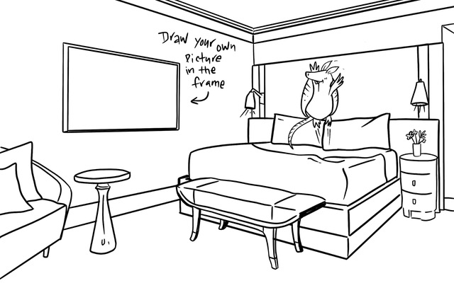

Show your plan to your partner and describe it.
Example:
This is the Dolphin Room. There’s a big Dolphin at the door. There’s a table and a sofa in the middle of the room ...

Slide 31


HOMEWORK
- Learn by heart new words.
- Describe your living-room
- Prepare: Unit 2 – Lesson 6: Skills 2

Slide 32

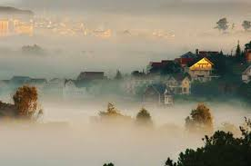

Goodbye!
See you again!

