Slide 1


Slide 2
THI SƠN SECONDARY SCHOOL
Welcome to our class
6A

Slide 3
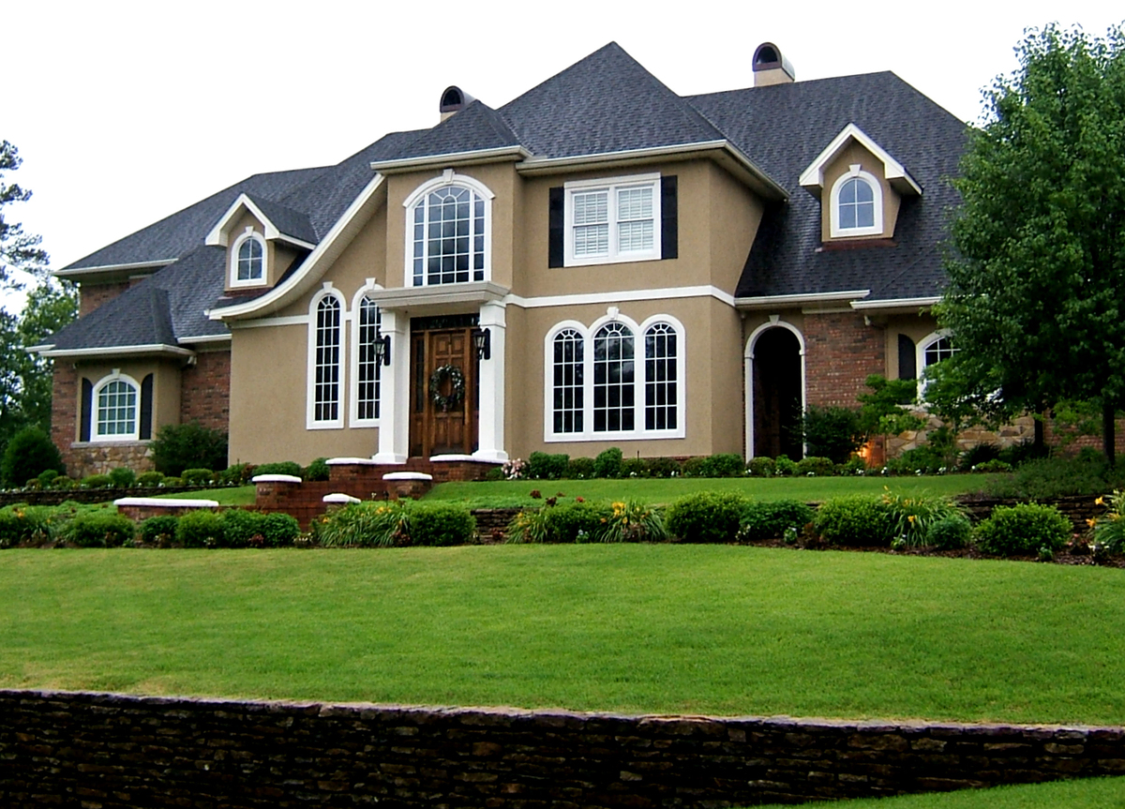
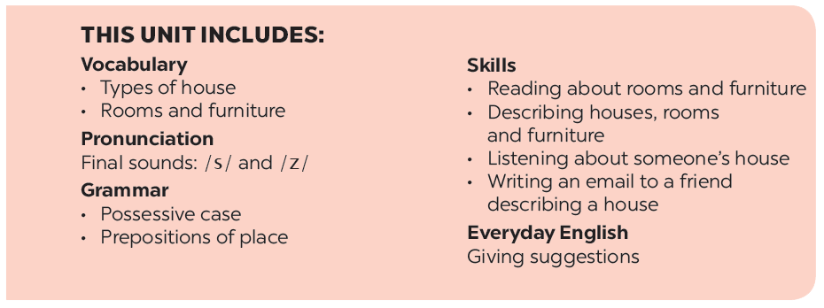
UNIT 2: MY HOUSE
LESSON 4

Slide 4
Check - up
How to use the Possessive case and give example.
Some prepositions of place and describe the position of some things in the classroom.

Slide 5


UNIT 2: MY HOUSE
LESSON 4
Everyday English
Giving suggestions

Slide 6


Elena and her mum are discussing how to decorate her bedroom. Listen and read the dialogue. Pay attention to the highlighted sentences.
…
Elena: My bedroom isn’t nice.
Mum: How about putting a picture on the wall?
Elena: Great idea, Mum.
Mum:Let’s go to the department store to buy one.
…
Notes:
Slide này không đúng.

Slide 7


* Structure: Giving suggestions
How about + V-ing? : Còn về ….thì sao? (mẫu câu này dùng để đưa ra gợi ý cùng làm công việc gì)
- Let’s +V …: Chúng ta hãy ( Mẫu câu này dùng để yêu cầu ai đó cùng làm gì với mình.)
Work in pairs. Make a similar dialogue. Remember to use the structures: How about + V-ing? ; Let’s +V.
A: My bedroom isn't nice
Mum: How about putting a picture on the wall?
A: Great idea. Mum.
Mum: Let’s go to the departrment store to buy one.
A: Dad, our living room doesn’t have enough chairs.
B: How about buying some new ones?
A: Great idea, Dad.
B: Let’s go to the shopping mall this afternoon.
Mum: The kitchen is dirty and messy.
Elena: How about cleaning it and rearranging things?
Mum: Great idea, Elena.
Elena: Let’s do it right now

Slide 8

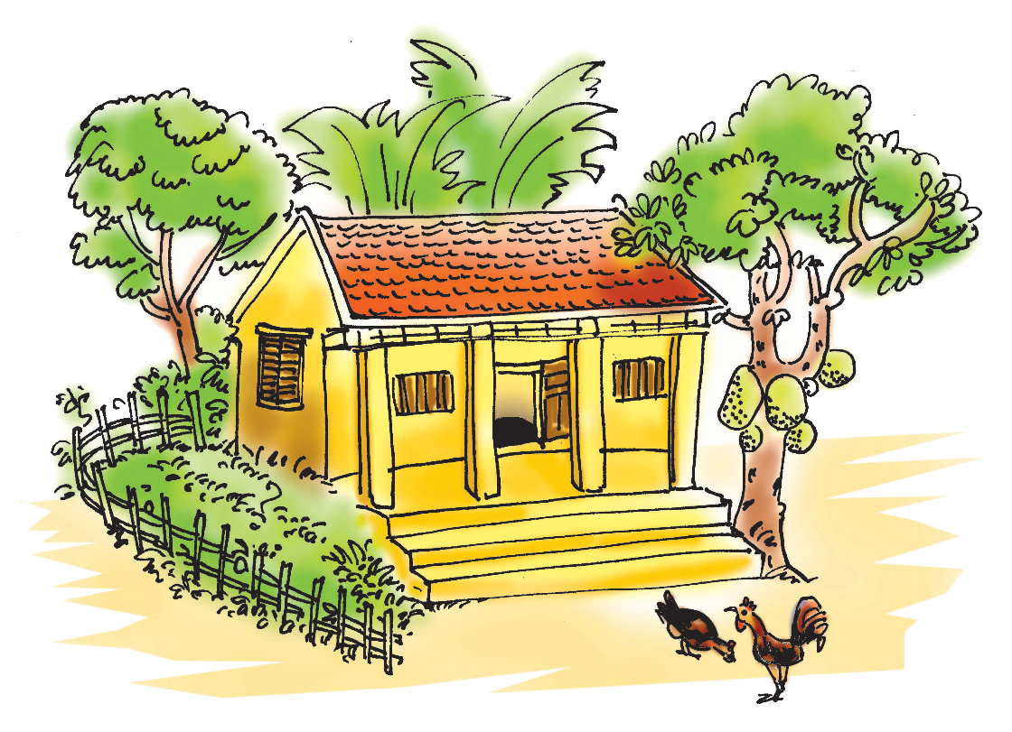
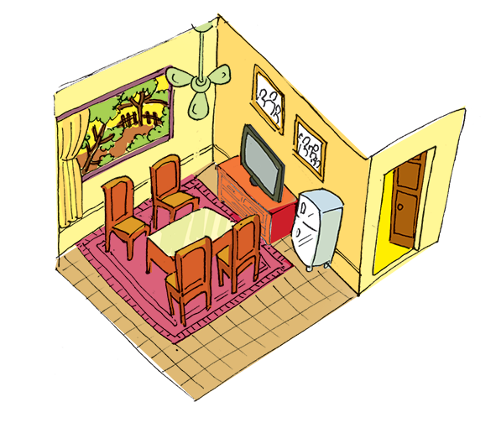
Living places
Mi tells Nick about her grandparents’ country house. Look at the pictures of her grandparents’ house and complete thesentences.
Notes:
City landmarks phải ở trên mục 3

Slide 9

country
1.
My grandparents live in a house in Nam Dinh.
There four rooms in the house and big garden.
2.
are
I like the living room. There a big window in this room.
3.
is
4.
There are four and a table in the middle of the room.
chairs
5.
There are two family photos the wall.
on

Slide 10

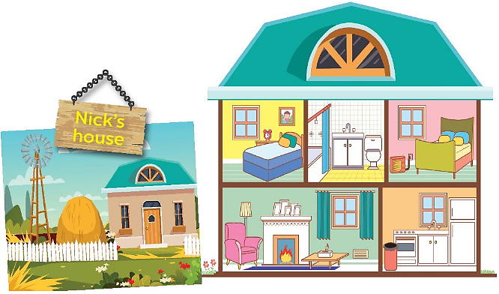
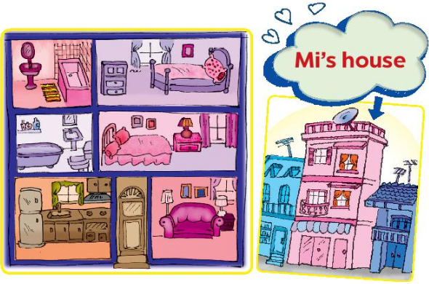
Student A looks at the pictures of Nick’s house on this page. Student B looks at the pictures of Mi’s house on page 25. Ask questions to find the differences between the two houses.

Slide 11
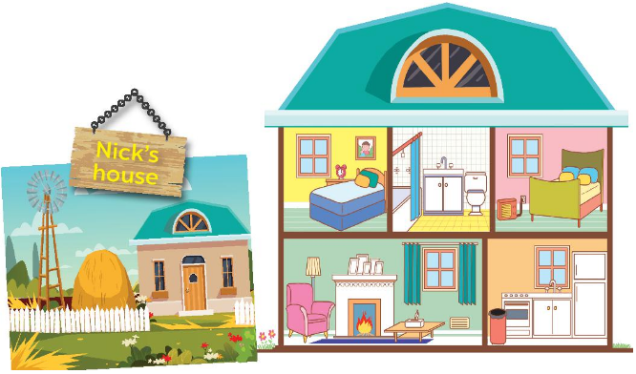
* Nick’s house
- country house
2 floors
5 rooms
small
…….
* Mi’s house
- City house
- 3 floors
- 7 rooms
- big
…….

Slide 12

* Work in pairs
Example 1:
A: Nick lives in a coutry house. Where does Mi live?
B: Mi lives in a town house.
Example 2:
A: Is Nick’s house small? What about Mi’s house?
B: Yes, it is. Mi’s house is big.

Slide 13





Draw a simple picture of your house.
Tell your partner about it.
MODEL WRITING
This is my house . It is a small house in the country. There are 5 rooms in my house such as living room, bathroom, dining room, my room and my parent’s room. There is a sofa, a coffee table and two stools in the living room. There are six chairs and a table, and a fridge in the dining room. The kitchen is big and fully equipped. There is a bed , a table, a chair and a bookshelf in the bedroom. There is a sink and a toilet in the bathroom….. I love my house..

Slide 14
homework
-Write a short paragraph your house
- prepare next lesson

Slide 15






Goodbye!
See you again!

