Slide 2
HELLO EVERYBODY

Slide 3
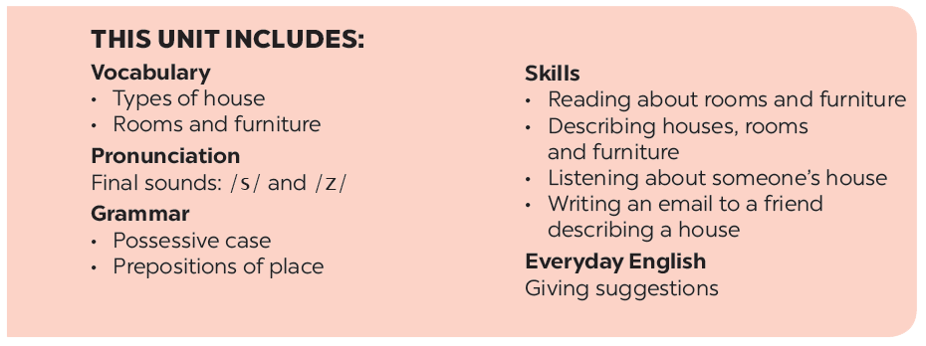
UNIT 2: MY HOUSE
LESSON 3

Slide 4
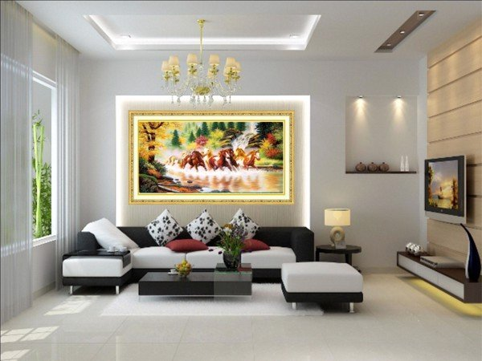
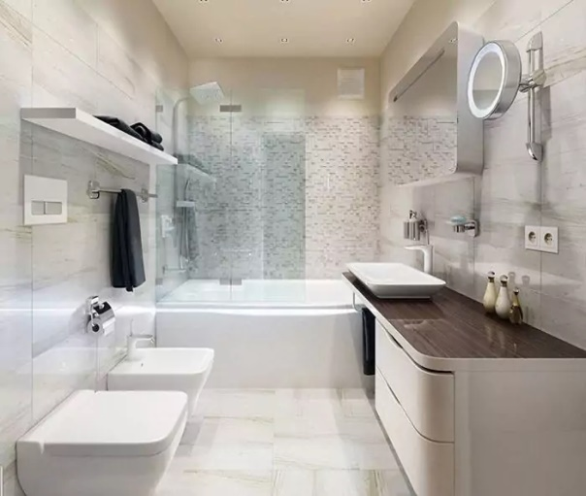
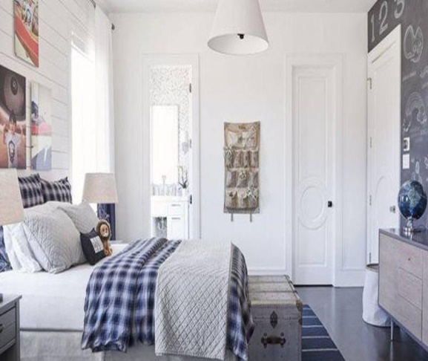
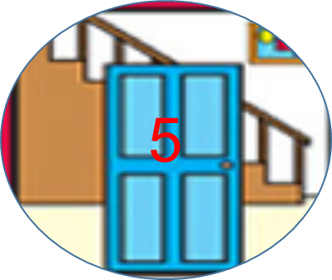
kitchen
Living room
MY HOUSE
bathroom
bedroom
hall

Slide 5
UNIT 2: MY HOUSE
LESSON 3

Slide 6
* Grammar
Possessive case : ( Sở hữu cách)
We use ’s after a proper name.
Example: This is Elena’s room.
We use ’s after a singular noun.
Example: This is my mum’s book.
- Chúng ta sử dụng 's sau một tên riêng.
EX: This is Nam’s pen.
Chúng ta sử dụng 's sau một danh từ số ít
EX : This is my teacher’s book.

Slide 7
Choose the correct answer.
1.
My (grandmothers / grandmother’s) house is in Ha Noi.
2.
This is my (sister’s / sister’) desk.
3.
My (cousin’s / cousin) dad is my uncle.
4.
(Nam’s / Nam’) house is small.
5.
There are two bedrooms in (Ans / An’s) flat.

Slide 8
Complete the sentences with the correct possessive forms.
Mi’s
1.
Thuc Anh is cousin. (Mi)
This is their chair. (teacher)
2.
teacher’s
3.
Where is computer? (Nick)
Nick’s
4.
My motorbike is in the garden. (father)
father’s
5.
My bedroom is next to the living room. (brother)
brother’s

Slide 9
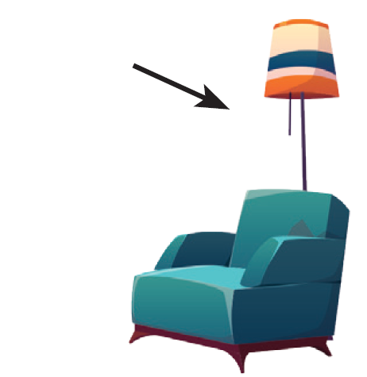
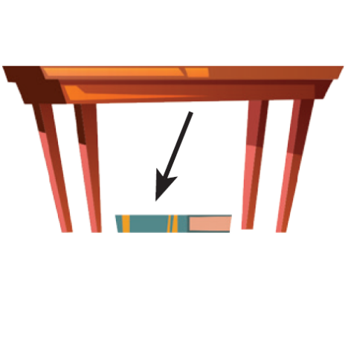
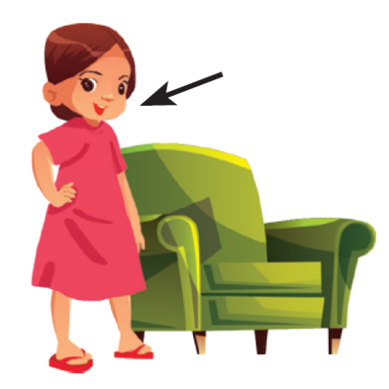
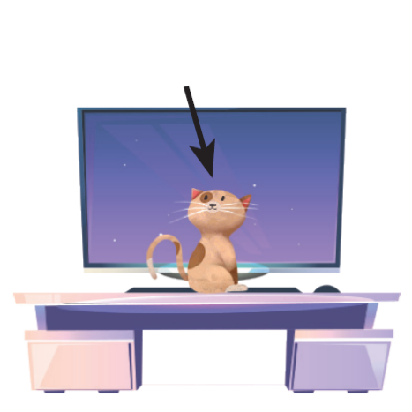
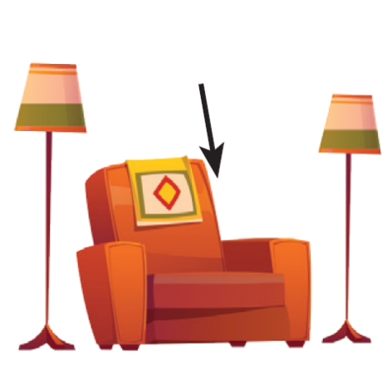
* Grammar
Prepositions of place : ( Giới từ chỉ nơi chốn)
Prepositions of place describe where people or things are. These are some prepositions of place. (Giới từ chỉ nơi chốn miêu tả nơi ở của người hoặc vật. Đây là một số giới từ chỉ nơi chốn.)
in
on
behind
under
next to
in front of
between

Slide 10
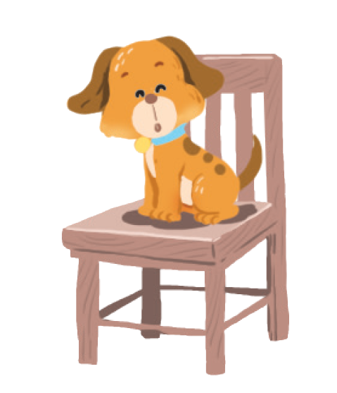
Write the correct preposition in the box under each picture. Say a sentence to describe the picture.
in
on
next to
behind
in front of
under
between
Example:
1.
on
The dog is on the chair.

Slide 11
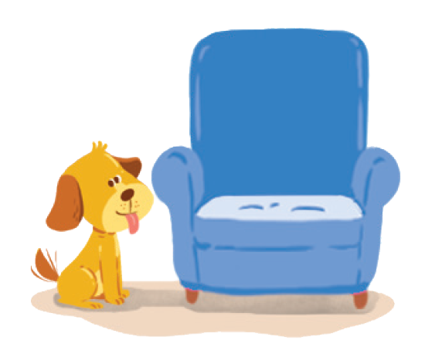
behind
on
next to
behind
in
next to
in front of
under
between
2.
next to
3.
behind

Slide 12
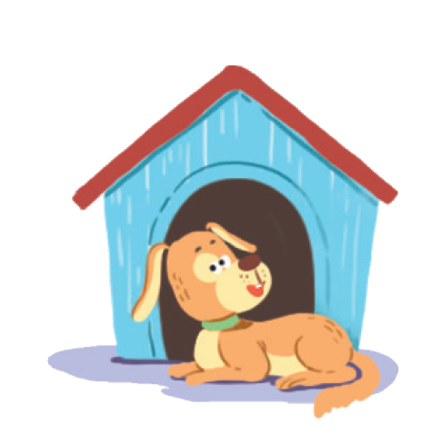
in
on
next to
behind
in
in front of
under
between
in front of
4.
in
5.
in front of

Slide 13
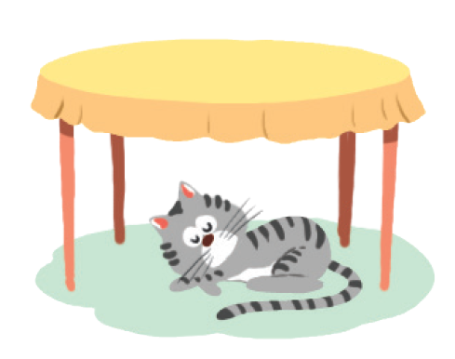
in
on
next to
behind
between
under
between
in front of
under
6.
between
7.
under

Slide 14
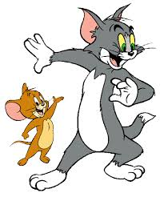
Game: Lucky numbers
1
2
3
4
5
6
7
8

Slide 15
2. The dog is next to the armchair.
next to

Slide 16
3. The cat is behind the TV.
behind

Slide 17
4. The cat is in the wardrobe.
in

Slide 18
5. The dog is in front of the doghouse.
in front of

Slide 19
6. The cat is between the lamp and the armchair.
between

Slide 20
7. The cat is under the table.
under

Slide 21
LUCKY NUMBER!

Slide 22
LUCKY NUMBER!

Slide 23
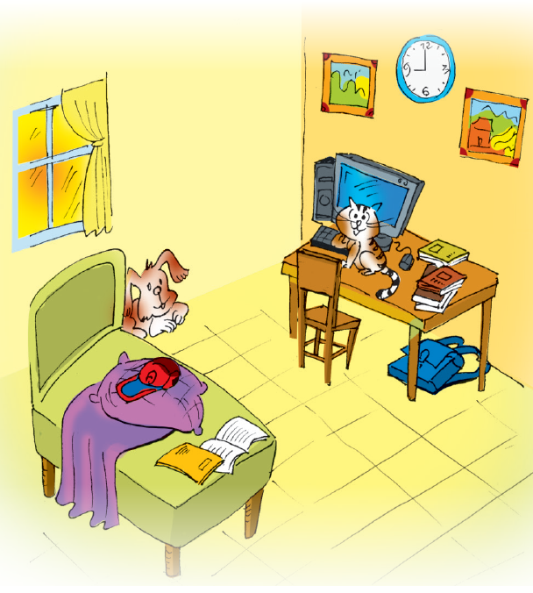
Look at the picture and write T (true) or F (False) for each sentence. Correct the false ones.
Example:
The books are under the table.
F
The books are on the table.

Slide 24
Look at the picture and write T (true) or F (False) for each sentence. Correct the false ones.
1.
The dog is behind the bed.
T
2.
The school bag is on the table.
F
The school bag is under the table.
3.
The picture is between the clocks.
F
The clock is between the two pictures.
4.
T
The cat is in front of the computer.
5.
The cap is under the pillow.
F
The cap is on the pillow.

Slide 25
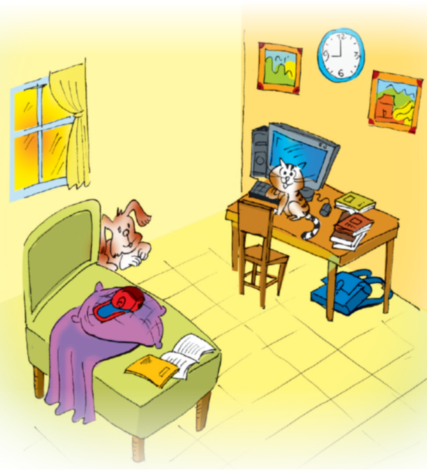
Memory challenge
Work in pairs. Look at the picture in 4 carefully, and then cover it. Ask and answer questions about the position of things in the picture.
Example:
A: Where are the books?
B: They’re on the table.
A: Where is the clock?
B: It’s between the pictures.
A: Where is the cat?
B: It’s in front of the computer.
A: Where are the pictures?
B: They’re on the wall.

Slide 26
Homework
Learn grammar ( possessive and prepositions of place.
- Do Ex4,5 /page 11 in workbook.
- Prepare “ Communication”

Slide 27
Thank you for your attention!

