Slide 1


Slide 2

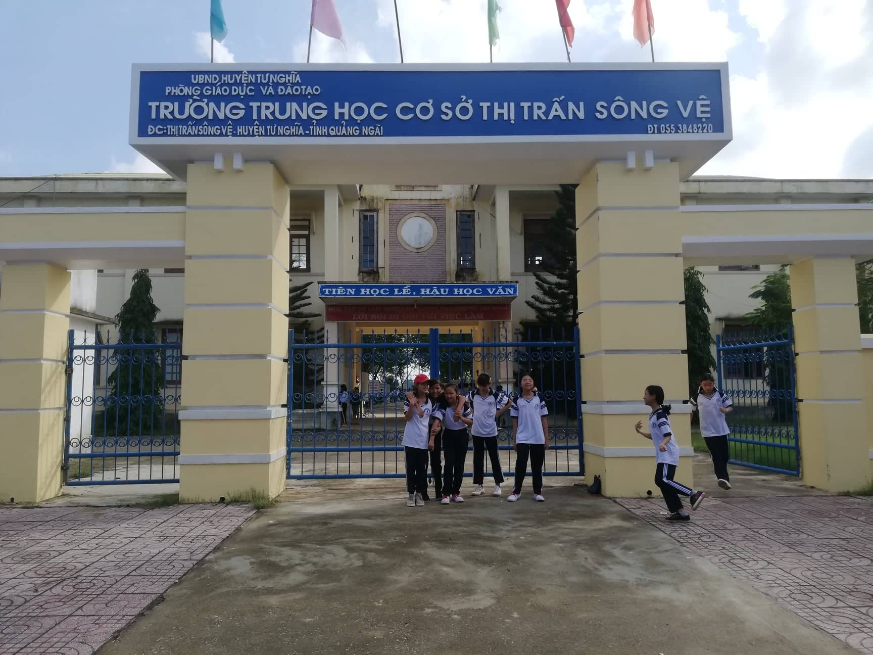
Thank you!

Slide 3
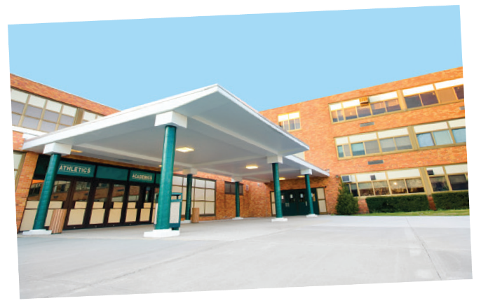
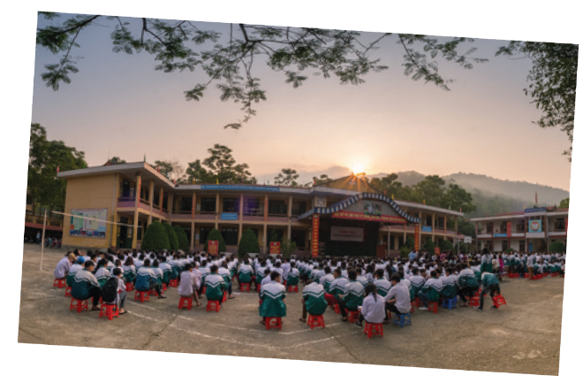

* Which school do you like best? Talk about it.
DREAM SCHOOL
AN SON SCHOOL
INTERNATIONAL SCHOOL

Slide 4


UNIT 1: MY NEW SCHOOL
LESSON 6
I. Listening
II . Writing

Slide 5
I. Listening
* Vocabulary.
- foreign language (n): ngôn ngữ nước ngoài
- helpful ( adj): hay giúp đỡ
- favourite (adj): yêu thích
- friendly (adj): thân thiện
- biology (n): sinh học

Slide 6
* Checking Vocabulary.
- foreign language (n):
ngôn ngữ nước ngoài
- helpful ( adj):
hay giúp đỡ
- favourite (adj):
yêu thích
- friendly (adj):
thân thiện
- biology (n):
sinh học
I. Listening

Slide 7



Janet, a student at Palmer School in America, is talking about her school. Guess the answers to these questions.
1.
Do you think the students there wear uniforms?
2.
Do they learn Vietnamese as a foreign language?
Listen to the talk and check your guesses.
T

Slide 8

Listen again and choose the correct answer A or B.
Guess
A | B
1.
Janet’s favourite teacher is her teacher.
A.
maths
B.
science
2.
Today Janet her uniform.
A.
is wearing
B.
isn’t wearing
3.
Janet studies for two hours a week.
A.
B.
Vietnamese
English
4.
Janet usually does her homework .
A.
B.
at home
in the library
5.
Her class is going to have a biology lesson .
A.
on a farm
B.
in the classroom

Slide 9
AUDIO SCRIPT
Hi. My name's Janet. I'm eleven years old. I'm now in year 6 at Palmer School. I like it here. My classmates are friendly. The teachers at my school are nice and very helpful, and my favourite teacher is Mrs. Smith. She teaches us maths. I have two hours to study Vietnamese every week. I usually do my homework in the library. We wear our uniforms every day, but today we aren't. We're going to have a biology lesson on a farm.

Slide 10
II. Writing

Slide 11

Write the answers to the following questions about your school.
1.
What is the name of your school?
It’s Nguyen Trai Secondary school.
2.
Where is your school?
It’s in Mo Duc District, Quang Ngai city
3.
How many classes does your school have?
It has 16 classes
4.
What do students do at your school?
They learn many subjects and play games at breaktime
5.
What do you like about your school?
The students are friendly , teachers are nice and helpful.

Slide 12


Use the answers in 3 to write a paragraph of 40-50 words about your school. You can refer to the reading passages to help you.
My school is

Slide 13
Write about your school
1. Name of the school: Nguyen Trai Secondary school
2. Location: Mo Duc distric ,Quang Ngai City
3. Number of students and teachers: 50 teachers / more than 500 students
4. Activities at school: study in the morning/ join outdoor activities/ read books in the library at break time.
5. Great things about school: big, playground…
6. Clothing: wear uniform every day
7. Subject you like: Math, Literature, English….
Because …important, funny, interesting.
8. Activities after school: play sports / go home

Slide 14
Model writing:
Hi. My name is ... . I am now a student at Song Ve secondary school. It is a small school in Quang Ngai City.
It has 12 classrooms and about 350 students. The school is clean and cool with many green trees. We study in both the morning and afternoon . The teachers at my school are nice and very helpful, students are friendly. We join many outdoor activities at breaktime. We wear our uniform every day. We study many subjects like maths, literature English, history……I love my school very much.

Slide 15

HOMEWORK
- Learn by heart all the new words.
- Rewrite the webpage for your school in the notebook
- Prepare:Looking back - Project

Slide 16

Goodbye!
See you again!

