Slide 1


Slide 2



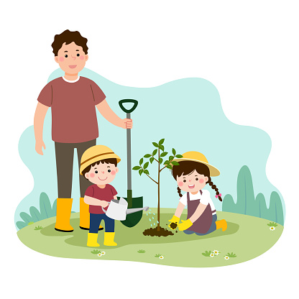
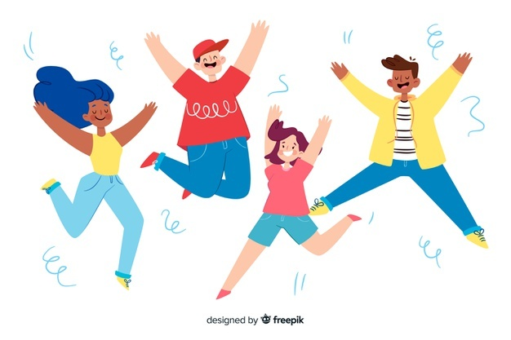
Unit
1
HOBBIES
LESSON 5: SKILLS 1
READING
SPEAKING
Unit
Gardening as a hobby
Benefits of hobbies

Slide 3

OBJECTIVES
By the end of the lesson, students will be able to:
develop reading skills for general and specific information about gardening
talk about benefits of hobbies

Slide 4
LESSON 5: SKILLS 1
WARM-UP
Brainstorming: Hobbies
Task 1: Work in pairs. Look at the picture and discuss the questions.
Task 2: Read the text about gardening. Match each word with its definition.
Task 3: Read the text again. Complete the sentences.
READING
Task 4: Work in pairs. Match each hobby with its benefit(s).
Task 5: Work in groups. Ask one another the following questions. Then present your partners’ answers to the class.
SPEAKING
POST-READING
& SPEAKING
Evaluation
CONSOLIDATION
Wrap-up
Homework

Slide 5


LESSON 5: SKILLS 1
WARM-UP
Brainstorming: Hobbies
Aims of the stage:
to introduce the topic of reading
to enhance students’ skills of cooperating with team mates

Slide 6

WARM-UP
List out as many hobbies that you know as possible in 1 minute.

Slide 7
LESSON 5: SKILLS 1
WARM-UP
Brainstorming: Hobbies
Task 1: Work in pairs. Look at the picture and discuss the questions.
Task 2: Read the text about gardening. Match each word with its definition.
Task 3: Read the text again. Complete the sentences.
READING

Slide 8
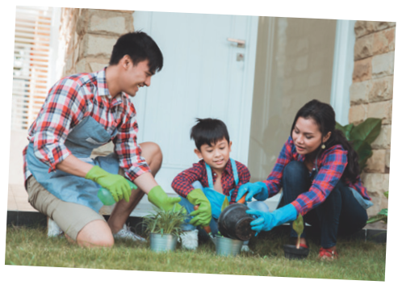
PRE-READING
1
Work in pairs. Look at the picture and discuss the questions below.
1. What can you see in the picture?
2. In your opinion, what is good about gardening?

Slide 9
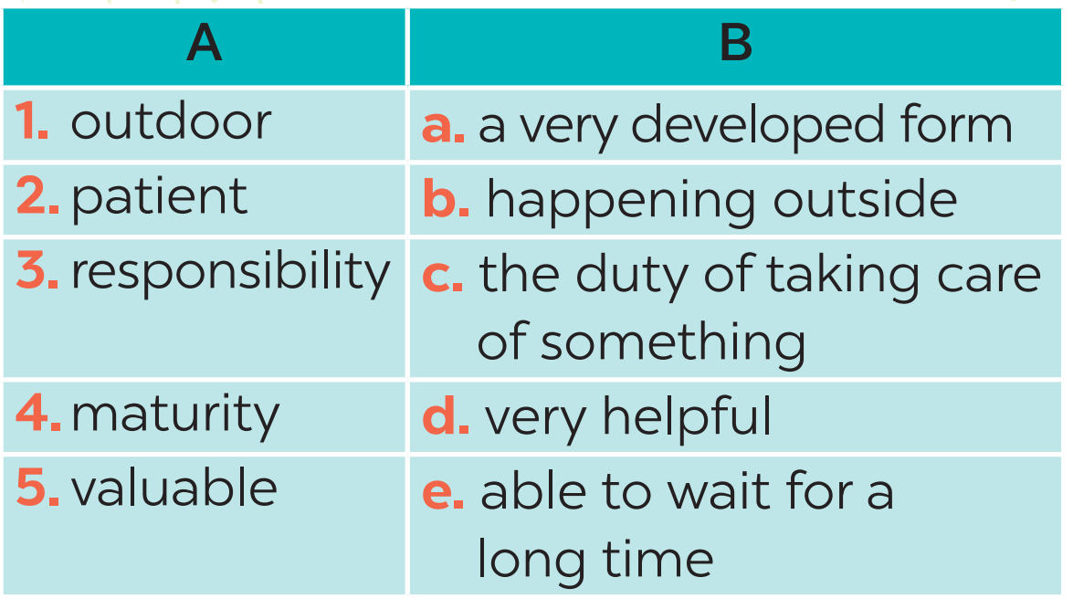
WHILE-READING
2
Read the text about gardening. Match each word in column A with its definition in column B.
1. b
2. e
3. c
4. a
5. d

Slide 10
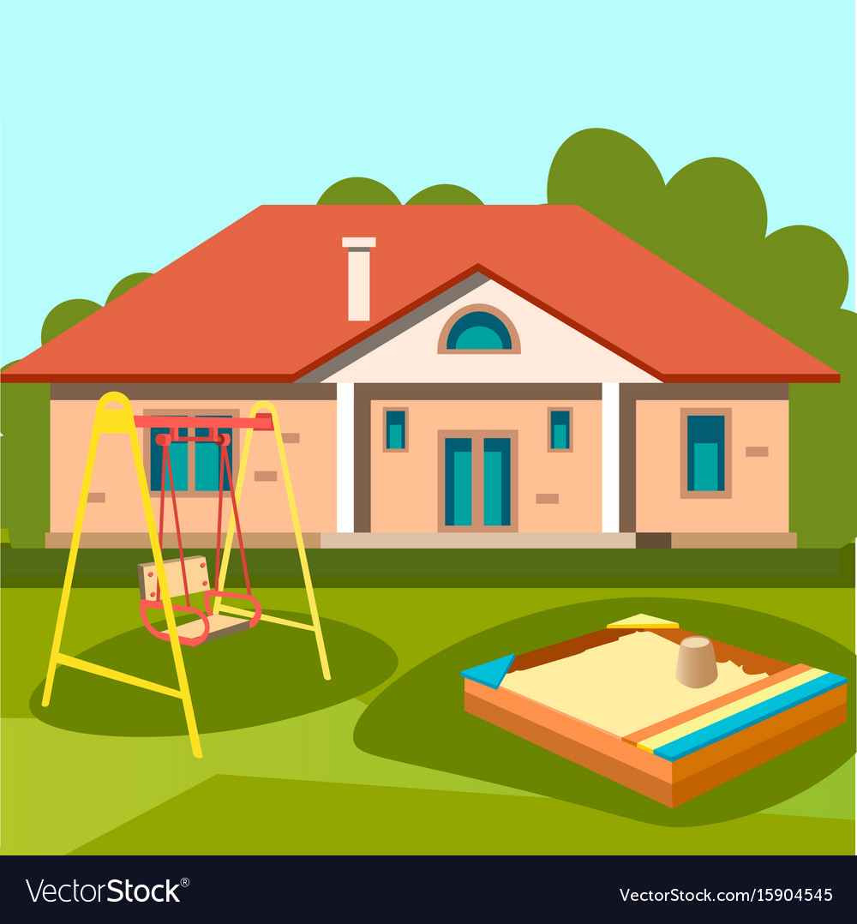

Vocabulary
outdoor (adj)
/ˈaʊtdɔː(r)/
ngoài trời

Slide 11
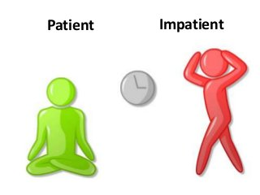
Vocabulary
patient (adj)
/ˈpeɪʃnt/
kiên nhẫn

Slide 12
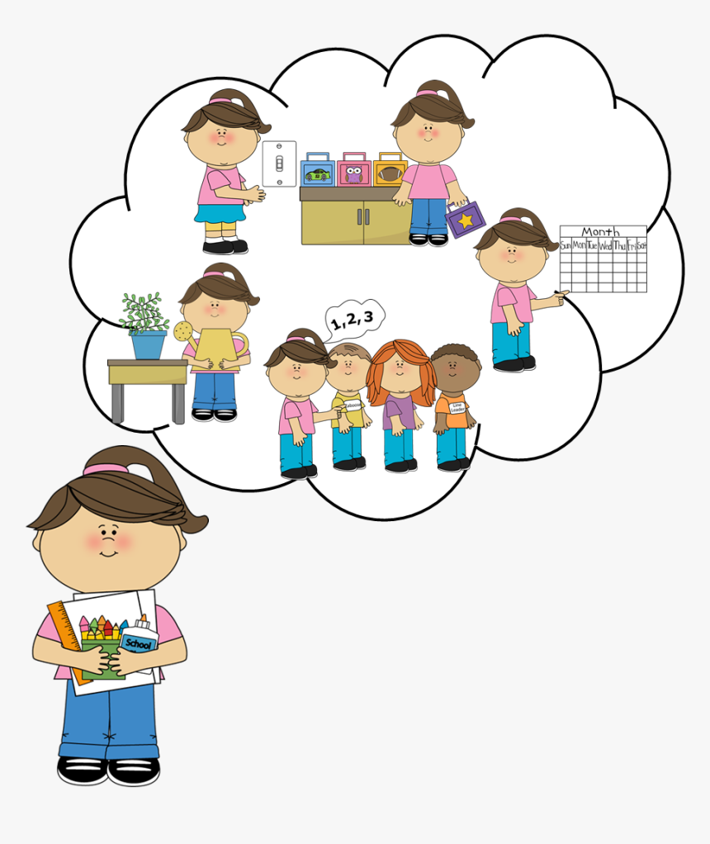
Vocabulary
responsibility (n)
/rɪˌspɒnsəˈbɪləti/
trách nhiệm

Slide 13
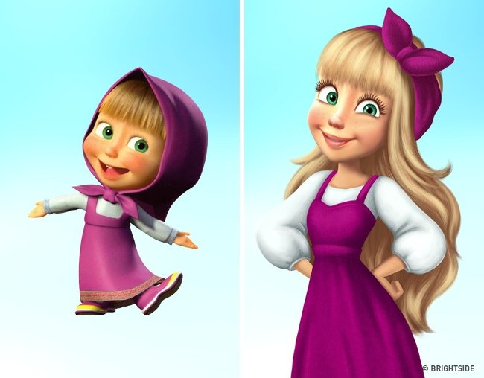
Vocabulary
maturity (n)
/məˈtjʊərəti/
sự trưởng thành

Slide 14

Vocabulary
valuable (adj)
/ˈvæljuəbl/
quý giá, quan trọng, hữu ích

Slide 15
Vocabulary
New words | Pronunciation | Meaning
1. outdoor (adj) | /ˈaʊtdɔː(r)/ | ngoài trời
2. patient (adj) | /ˈpeɪʃnt/ | kiên nhẫn
3. responsibility (n) | /rɪˌspɒnsəˈbɪləti/ | trách nhiệm
4. maturity (adj) | / məˈtjʊərəti/ | sự trưởng thành
5. valuable (adj) | /ˈvæljuəbl/ | quý giá, quan trọng, hữu ích

Slide 16
WHILE-READING
3
Read the text again. Complete each sentence with no more than THREE words.
1. Gardening belongs to the group of _______________.
2. Gardening teaches children about flowers, fruits, vegetables, _______________.
3. Gardening makes children become ______________ and responsible.
4. It is an activity that everyone in the family can ______________.
5. The author and her mother usually garden for ______________ a day.
doing things
insects and bugs
patient
join in
an hour

Slide 17
LESSON 5: SKILLS 1
WARM-UP
Brainstorming: Hobbies
Task 1: Work in pairs. Look at the picture and discuss the questions.
Task 2: Read the text about gardening. Match each word with its definition.
Task 3: Read the text again. Complete the sentences.
READING
Task 4: Work in pairs. Match each hobby with its benefit(s).
Task 5: Work in groups. Ask one another the following questions. Then present your partners’ answers to the class.
SPEAKING

Slide 18
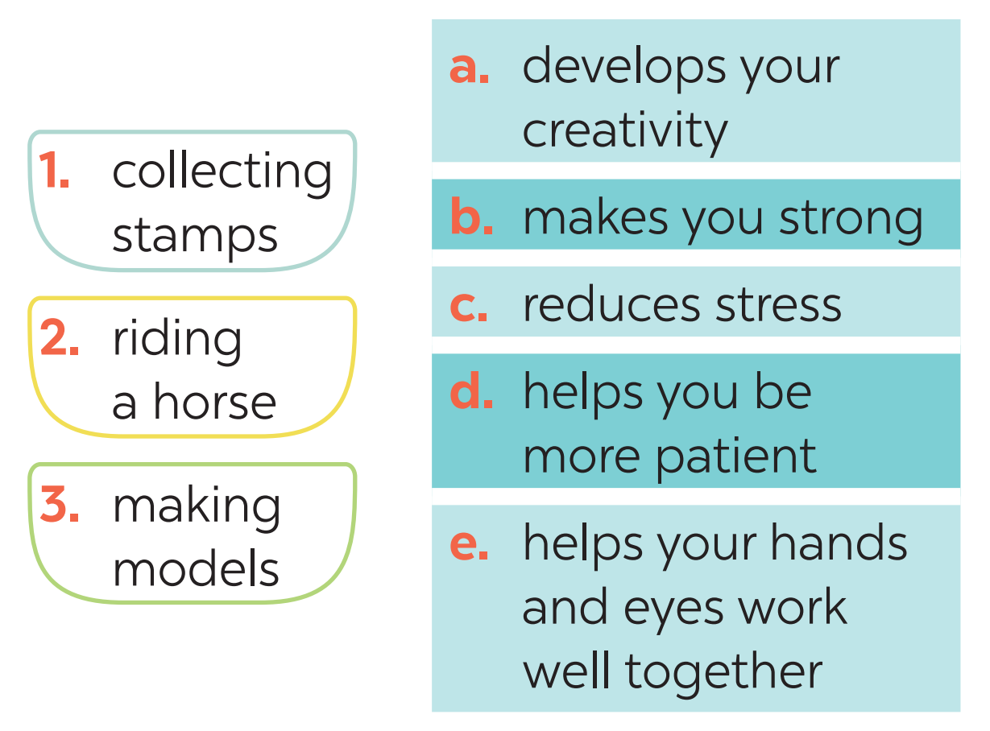
PRE-SPEAKING
4
Work in pairs. Match each hobby with its benefit(s). One hobby may have more than one benefit.
1. c, d
2. b, c
3. a, c, d, e

Slide 19
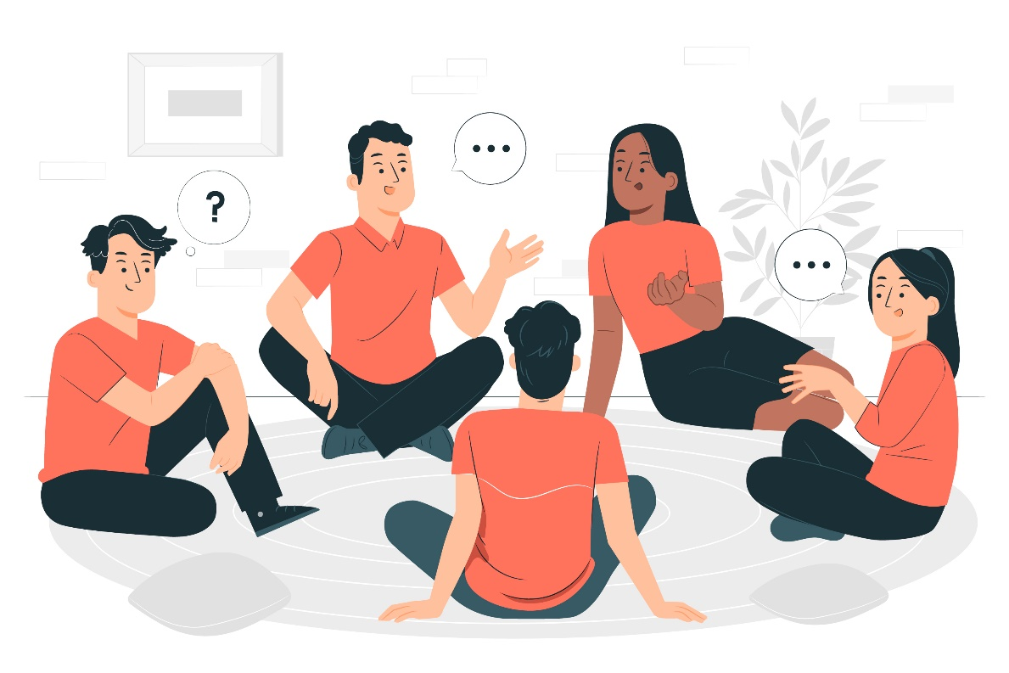
WHILE-SPEAKING
5
Work in groups. Ask one another the following questions. Then present your partners’ answers to the class.
What is your favourite hobby?
What are its benefits?
Example:
My friend Mi’s favourite hobby is
collecting stamps. It helps her be more patient.

Slide 20
LESSON 5: SKILLS 1
WARM-UP
Brainstorming: Hobbies
Task 1: Work in pairs. Look at the picture and discuss the questions.
Task 2: Read the text about gardening. Match each word with its definition.
Task 3: Read the text again. Complete the sentences.
READING
Task 4: Work in pairs. Match each hobby with its benefit(s).
Task 5: Work in groups. Ask one another the following questions. Then present your partners’ answers to the class.
SPEAKING
POST-READING
& SPEAKING
Evaluation

Slide 21
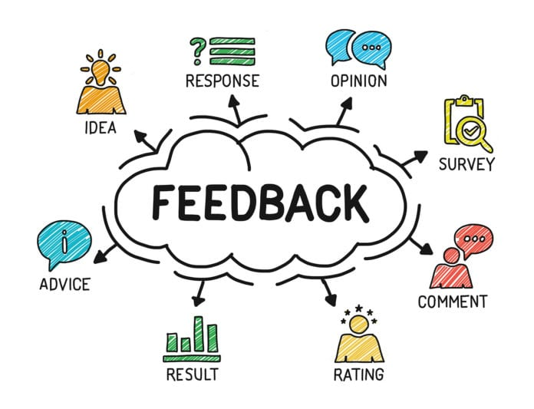
POST-READING & SPEAKING
Let’s give comments for your friends and vote for the most interesting and informative presentation.

Slide 22
LESSON 5: SKILLS 1
WARM-UP
Brainstorming: Hobbies
Task 1: Work in pairs. Look at the picture and discuss the questions.
Task 2: Read the text about gardening. Match each word with its definition.
Task 3: Read the text again. Complete the sentences.
READING
Task 4: Work in pairs. Match each hobby with its benefit(s).
Task 5: Work in groups. Ask one another the following questions. Then present your partners’ answers to the class.
SPEAKING
POST-READING
& SPEAKING
Evaluation
CONSOLIDATION
Wrap-up
Homework

Slide 23
CONSOLIDATION
1
WRAP-UP
READING
SPEAKING
Gardening as a hobby
Benefits of hobbies

Slide 24

CONSOLIDATION
2
HOMEWORK
Write down your opinions about carving eggshells.
Search for more information about this unique hobby.

Slide 25

Website: sachmem.vn
Fanpage: facebook.com/sachmem.vn/

