Slide 1


Slide 2



Unit
1
MY HOBBIES
LESSON 1: GETTING STARTED
My favourite hobby
Unit
HOBBIES

Slide 3

OBJECTIVES
By the end of the lesson, students will be able to gain:
an overview about the topic Hobbies
vocabulary to talk about hobbies

Slide 4
LESSON 1: GETTING STARTED
WARM-UP
Asking questions
PRESENTATION
Vocabulary
Task 1: Listen and read.
Task 2: Read the conversation again and write T (true) or F (False).
Task 3: Write the words and phrases from the box under the correct pictures. Then listen, check, and repeat.
Task 4: Work in pairs. Write the hobbies from Task 3 in the suitable columns.
PRACTICE
PRODUCTION
Task 5: Game: Find someone who …
CONSOLIDATION
Wrap-up
Homework

Slide 5

LESSON 1: GETTING STARTED
WARM-UP
Asking questions
Aims of the stage:
to introduce the topic
to lead in the lesson

Slide 6
WARM-UP
Answer the questions:
1. What do you like doing in your free time?
2. Do you like collecting dolls?
3. Do you like collecting glass bottles?
4. Do you enjoy mountain climbing?
HOBBY

Slide 7

LESSON 1: GETTING STARTED
WARM-UP
Asking questions
PRESENTATION
Vocabulary
Aims of the stage:
To provide students with vocabulary.
To help students well-prepared for the listening and reading tasks.

Slide 8
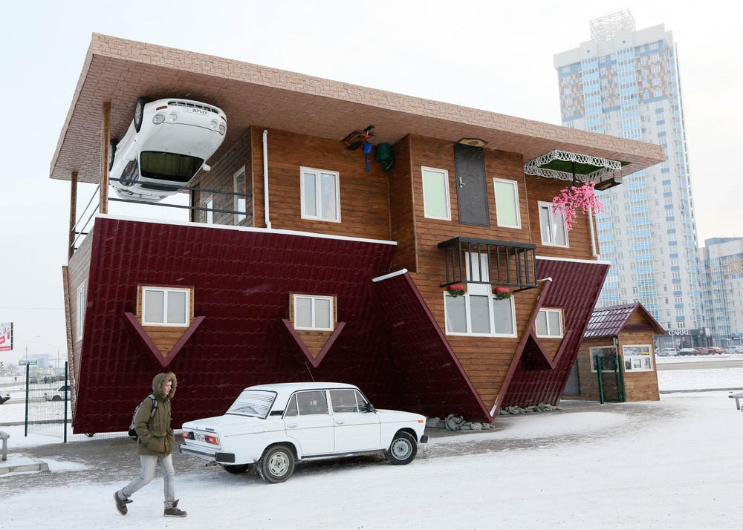

PRESENTATION
unusual (adj)
/ʌnˈjuːʒuəl/
khác thường

Slide 9

PRESENTATION
creativity (n)
/ˌkriːeɪˈtɪvəti/
sự sáng tạo

Slide 10
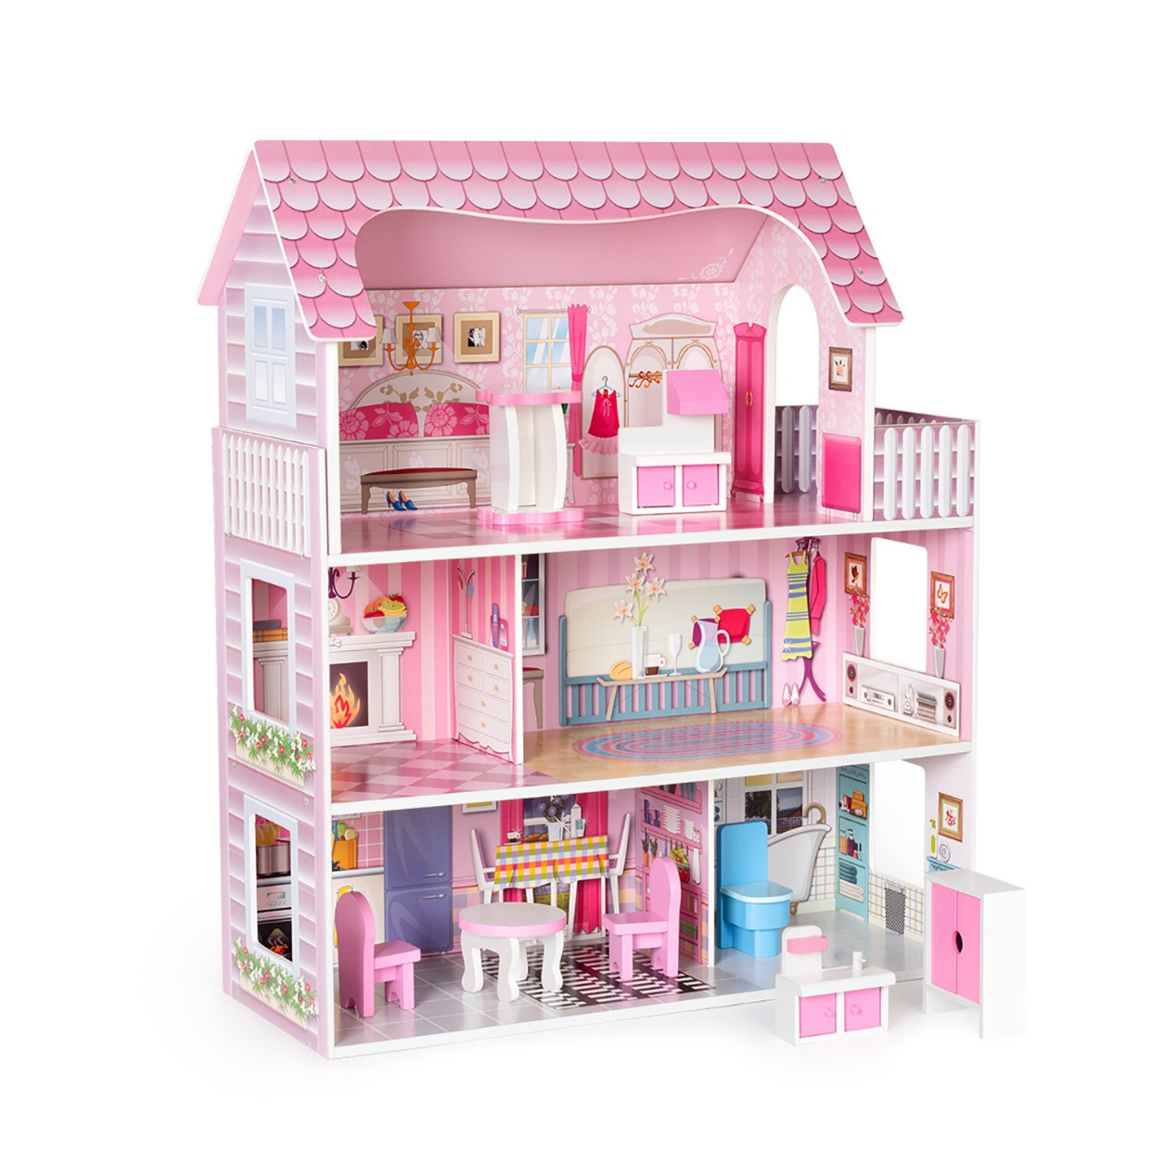
PRESENTATION
dollhouse (n)
/ ˈdɒlhaʊs/
nhà búp bê

Slide 11
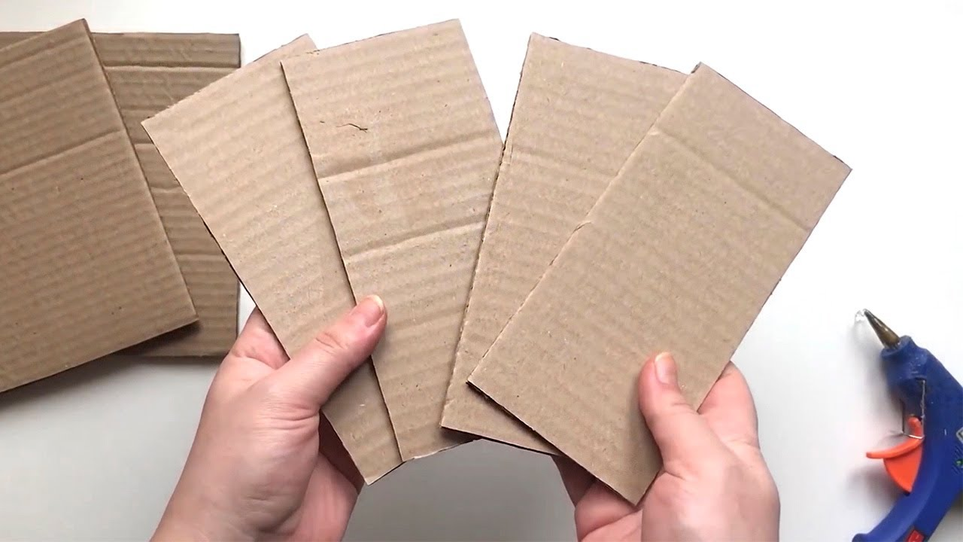
PRESENTATION
cardboard (n)
/ˈkɑːdbɔːd/
bìa các tông

Slide 12
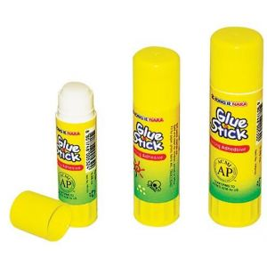
PRESENTATION
glue (n)
/ɡluː/
keo dán, hồ

Slide 13
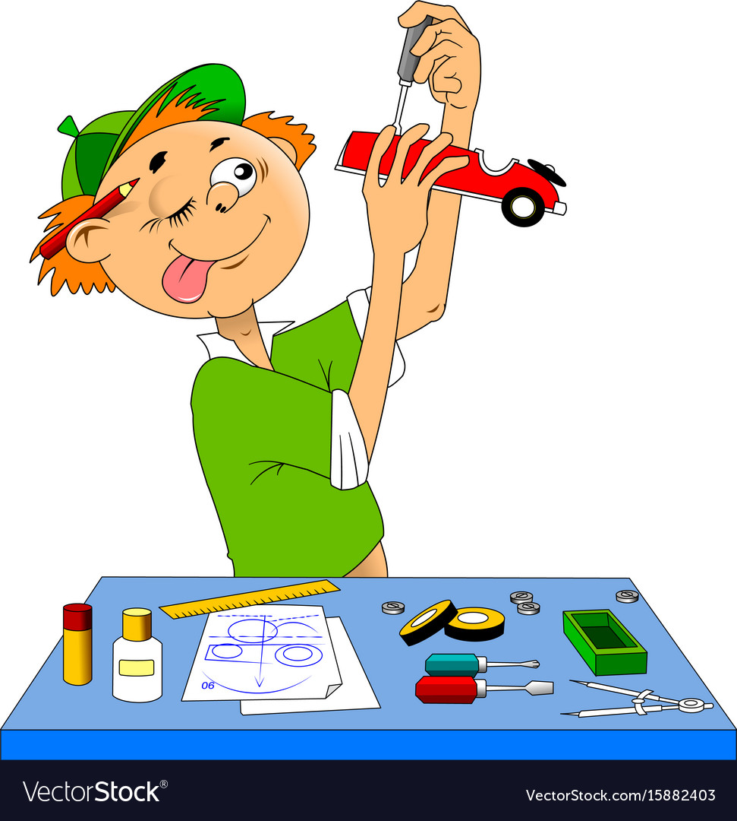
PRESENTATION
making models
/ˈmeɪkɪŋ ˈmɒdlz/
làm mô hình

Slide 14
PRESENTATION
New words | Pronunciation | Meaning
1. unusual (adj) | /ʌnˈjuːʒuəl/ | khác thường
2. creativity (n) | /ˌkriːeɪˈtɪvəti/ | sự sáng tạo
3. dollhouse (n) | /ˈdɒlhaʊs/ | nhà búp bê
4. cardboard (n) | /ˈkɑːdbɔːd/ | bìa các tông
5. glue (n) | /ɡluː/ | keo dán, hồ
6. making models | /ˈmeɪkɪŋ ˈmɒdlz/ | làm mô hình

Slide 15
LESSON 1: GETTING STARTED
WARM-UP
Asking questions
PRESENTATION
Vocabulary
Task 1: Listen and read.
Task 2: Read the conversation again and write T (true) or F (False).
Task 3: Write the words and phrases from the box under the correct pictures. Then listen, check, and repeat.
Task 4: Work in pairs. Write the hobbies from Task 3 in the suitable columns.
PRACTICE

Slide 16
PRACTICE
1
Listen and read.
Ann: Your house is very nice, Trang.
Trang: Thanks! let’s go upstairs. I’ll show you my room.
Ann: I love your dollhouse. It’s amazing. Did you make it yourself?
Trang: Yes. I like building dollhouses very much.
Ann: Really? Is it hard to build one?
Trang: not really. All you need is some cardboard and glue. Then just use a bit of creativity. What do you do in your free time?
Ann: I like horse riding.
Trang: That’s rather unusual. Not many people do that.
Ann: Actually, it’s more common than you think. There are some horse riding clubs in
Ha Noi now. I go to the Riders’ Club every Sunday.
Trang: I’d love to go to your club this Sunday. I want to learn how to ride.
Ann: Sure. My lesson starts at 8 a.m.

Slide 17
PRACTICE
2
Read the conversation again and write T (True) or F (False).
F
1. Trang needs help with building dollhouses. ______
2. Trang uses glue and cardboard to build her dollhouse. ______
3. To build a dollhouse, you need to use your creativity. ______
4. Ann goes to a horse riding club every Sunday. ______
5. Ann’s lesson starts at 8 p.m. ______
T
T
T
F

Slide 18
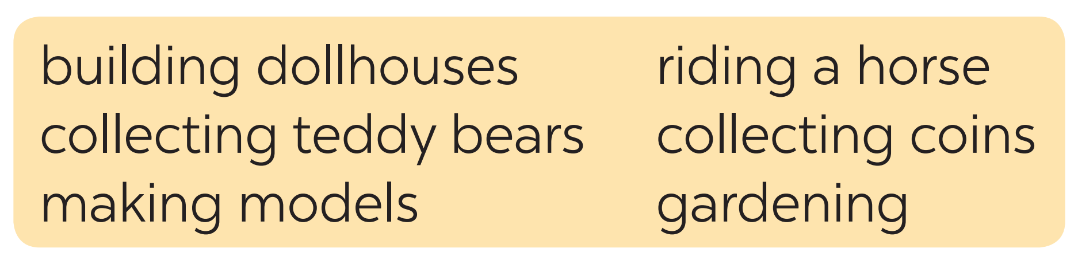
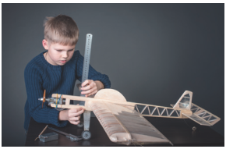
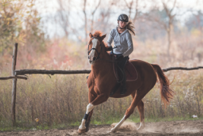
PRACTICE
3
Write the words and phrases from the box under the correct pictures. Then listen, check, and repeat.
making models
riding a horse

Slide 19
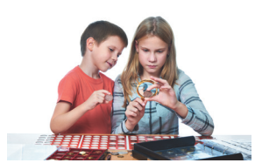
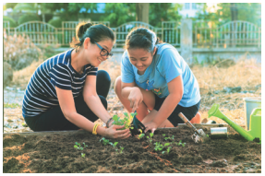
PRACTICE
3
Write the words and phrases from the box under the correct pictures. Then listen, check, and repeat.
collecting coins
gardening

Slide 20
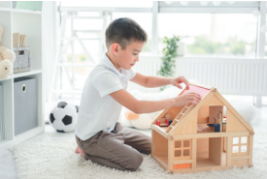
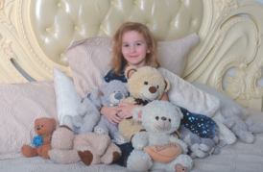
PRACTICE
3
Write the words and phrases from the box under the correct pictures. Then listen, check, and repeat.
building dollhouses
collecting teddy bears

Slide 21
PRACTICE
3
Write the words and phrases from the box under the correct pictures. Then listen, check, and repeat.
making models
riding a horse
collecting coins
gardening
building dollhouses
collecting teddy bears

Slide 22
PRACTICE
4
Work in pairs. Write the hobbies from Task 3 in the suitable columns.
doing things | making things | collecting things
riding a horse
making models
collecting coins
gardening
building dollhouses
collecting teddy bears
(others: travelling, skiing, doing yoga, etc.)
(others: painting, making pottery, etc.)
(others: collecting toys, collecting books, etc.)

Slide 23
LESSON 1: GETTING STARTED
WARM-UP
Asking questions
PRESENTATION
Vocabulary
Task 1: Listen and read.
Task 2: Read the conversation again and write T (true) or F (False).
Task 3: Write the words and phrases from the box under the correct pictures. Then listen, check, and repeat.
Task 4: Work in pairs. Write the hobbies from Task 3 in the suitable columns.
PRACTICE
PRODUCTION
Task 5: Game: Find someone who …

Slide 24
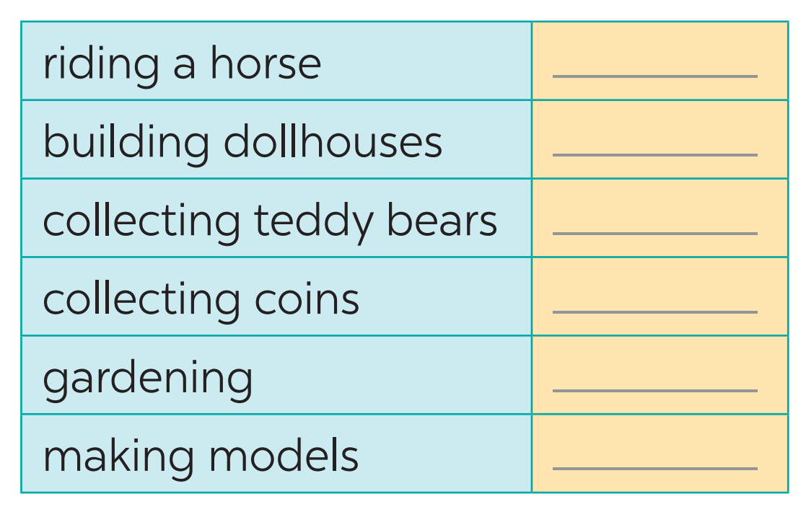

PRODUCTION
5
GAME: Find someone who likes…

Slide 25
LESSON 1: GETTING STARTED
WARM-UP
Asking questions
PRESENTATION
Vocabulary
Task 1: Listen and read.
Task 2: Read the conversation again and write T (true) or F (False).
Task 3: Write the words and phrases from the box under the correct pictures. Then listen, check, and repeat.
Task 4: Work in pairs. Write the hobbies from Task 3 in the suitable columns.
PRACTICE
PRODUCTION
Task 5: Game: Find someone who …
CONSOLIDATION
Wrap-up
Homework

Slide 26

CONSOLIDATION
1
WRAP-UP
What have we learnt in this lesson?
identify the topic of the unit
use lexical items related to hobbies
identify the language features that are covered in the unit

Slide 27

CONSOLIDATION
2
HOMEWORK
Name a list of cheap hobbies, expensive hobbies, easy and difficult hobbies.
Prepare for the project.

Slide 28

Website: sachmem.vn
Fanpage: facebook.com/sachmem.vn/

