Slide 1


Slide 2



Unit
2
HEALTHY LIVING
LESSON 5: SKILLS 1
READING
SPEAKING
Unit

Slide 3

OBJECTIVES
By the end of the lesson, students will be able to:
+ Reading:
- read for specific information about acne
+ Speaking:
- talk about how to deal with some health problems

Slide 4
LESSON 5: SKILLS 1
WARM-UP
Game: Hangman
* Vocabulary
* Discussion
* Practice
Task 1: Read the passage and match the beginnings in A with the endings in B.
Task 2: Read the passage again and choose the correct answer A, B, or C.
Task 3: Retelling
READING
Task 4: Read the passage again. Pick the tips which you can easily follow. Share your ideas with your partner.
Task 5: Read about the health problems below. Discuss and make notes of some tips you can give each person. Then share your ideas with the class.
SPEAKING
CONSOLIDATION
Wrap-up
Home work

Slide 5


LESSON 5: SKILLS 1
WARM-UP
Game: Hangman
Aims of the stage:
to introduce the topic of reading

Slide 6
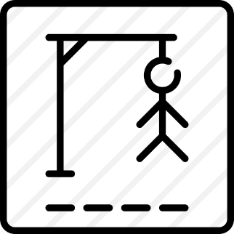
WARM-UP
S K I N C O N D I T I O N

Slide 7
LESSON 5: SKILLS 1
WARM-UP
Game: Hangman
* Vocabulary
* Discussion
* Practice
Task 1: Read the passage and match the beginnings in A with the endings in B.
Task 2: Read the passage again and choose the correct answer A, B, or C.
Task 3: Retelling
READING

Slide 8
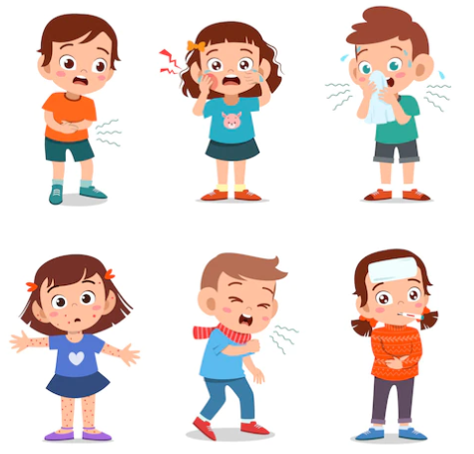
PRE-READING: VOCABULARY
disease (n)
/dɪˈziːz/
bệnh tật

Slide 9
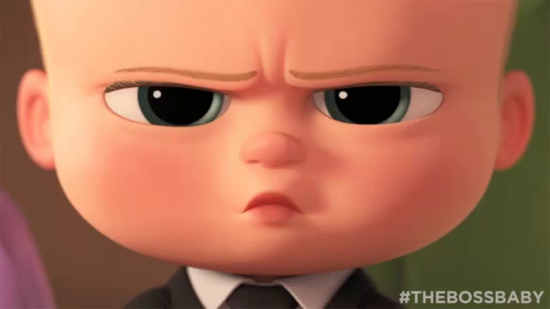
VOCABULARY
serious (adj)
/ˈsɪəriəs/
nghiêm trọng

Slide 10
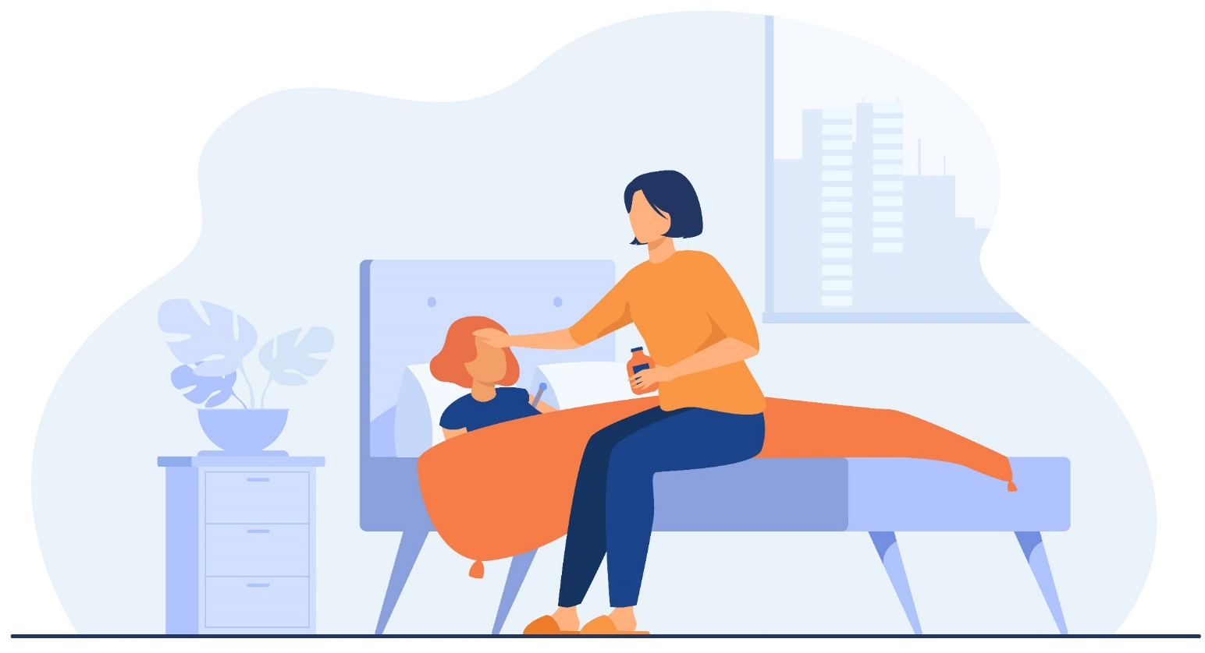
VOCABULARY
take care of (phr v)
/teɪk keər əv/
chăm sóc

Slide 11
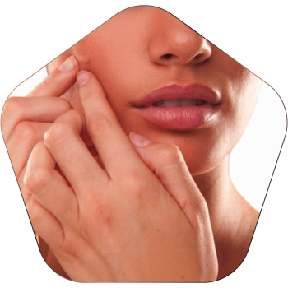
VOCABULARY
pop (v)
/pɒp/
nặn, bóp

Slide 12
VOCABULARY
New words | Pronunciation | Meaning
disease (n) | /dɪˈziːz/ | bệnh tật
serious (adj) | /ˈsɪəriəs/ | nghiêm trọng
take care of (phr v) | /teɪk keər əv/ | chăm sóc
pop (v) | /pɒp/ | nặn, bóp

Slide 13


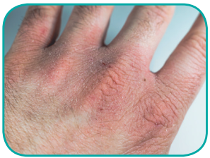
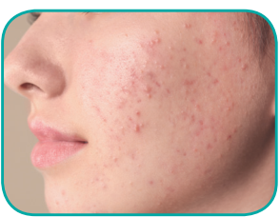
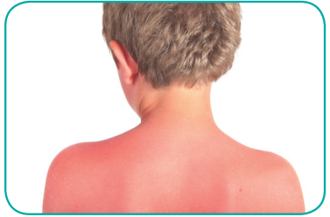
PRE-READING: DISCUSSION
Which skin condition is the most common among teenagers?
1.
chapped skin
2.
acne
3.
sunburn

Slide 14
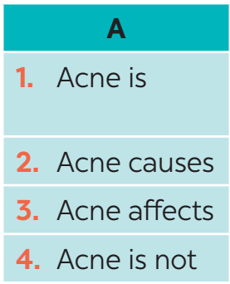
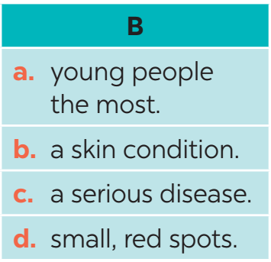
WHILE-READING
1
Read the passage and match the beginnings in A with the endings in B.

Slide 15
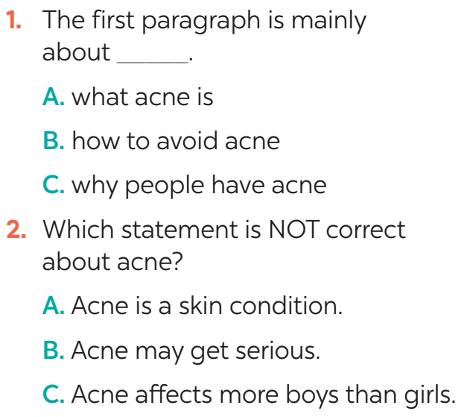
WHILE-READING
2
Read the passage again and choose the correct answer A, B, or C.
Evidence
Acne is a skin condition. It causes small, red spots on the face and the back. It affects 70 -80% of young people between 12 and 30. More girls have acne than boys.

Slide 16
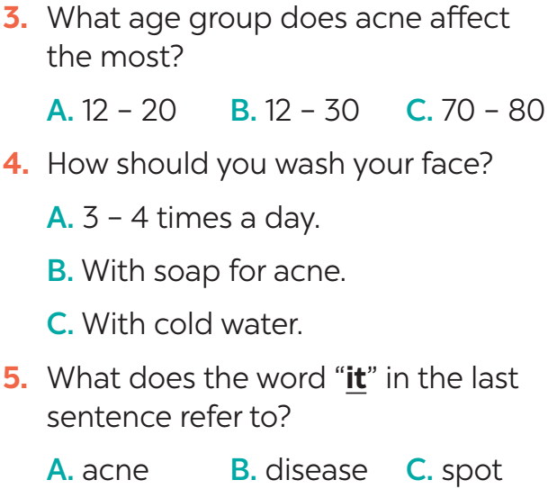
WHILE-READING
2
Read the passage again and choose the correct answer A, B, or C.
Evidence
It affects 70-80% of young people between 12 and 30.
Wash your face with special soap for acne, but no more than twice a day.
Here are some tips for taking care of skin with acne… If it gets serious, see a doctor.

Slide 17
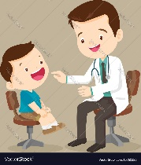
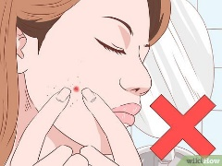
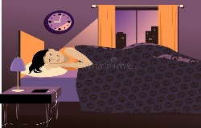
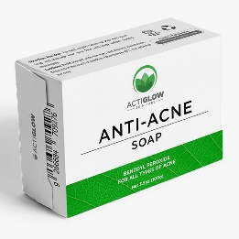

POST-READING
acne
a skin condition
causes small, red spots on the face and back
affects 70-80% of young people between 12 & 30
- more girls have acne than boys.
- not a serious disease
Tips
3
Retelling

Slide 18
LESSON 5: SKILLS 1
WARM-UP
Game: Hangman
* Vocabulary
* Discussion
* Practice
Task 1: Read the passage and match the beginnings in A with the endings in B.
Task 2: Read the passage again and choose the correct answer A, B, or C.
Task 3: Retelling
READING
Task 4: Read the passage again. Pick the tips which you can easily follow. Share your ideas with your partner.
Task 5: Read about the health problems below. Discuss and make notes of some tips you can give each person. Then share your ideas with the class.
SPEAKING

Slide 19
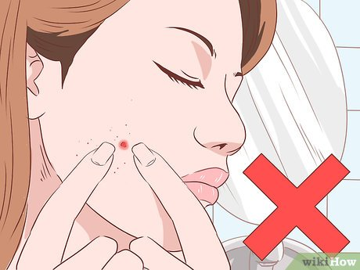
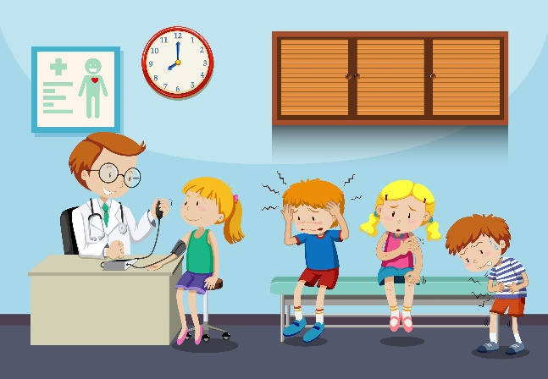



SPEAKING
4
Read the passage again. Pick the tips which you can easily follow. Share your ideas with your partner.

Slide 20
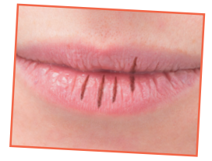
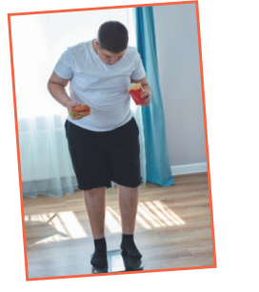
SPEAKING
5
Read about the health problems below. Discuss and make notes of some tips you can give each person. Then share your ideas with the class
1. I have chapped lips.
Use some lip balm.
Use coconut oil or body lotion.
2. I’m putting on weight.
Eat less fast food, meat, and ice cream.
Eat more fruit and vegetable.

Slide 21
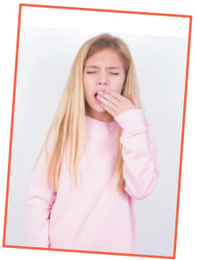
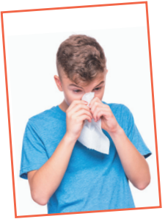
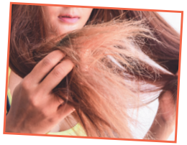
SPEAKING
5
Read about the health problems below. Discuss and make notes of some tips you can give each person. Then share your ideas with the class
3. I often feel sleepy during the day.
Get enough sleep, 7 - 8 hours a day.
Don't go to bed too late.
4. I have the flu.
Keep warm and stay in bed.
Drink plenty of water and eat light food.
5. My hair is dry.
Avoid washing your hair every day.
Take vitamins.

Slide 22
LESSON 5: SKILLS 1
WARM-UP
Game: Hangman
* Vocabulary
* Discussion
* Practice
Task 1: Read the passage and match the beginnings in A with the endings in B.
Task 2: Read the passage again and choose the correct answer A, B, or C.
Task 3: Retelling
READING
Task 4: Read the passage again. Pick the tips which you can easily follow. Share your ideas with your partner.
Task 5: Read about the health problems below. Discuss and make notes of some tips you can give each person. Then share your ideas with the class.
SPEAKING
CONSOLIDATION
Wrap-up
Home work

Slide 23
CONSOLIDATION
1
WRAP-UP
READING
SPEAKING

Slide 24
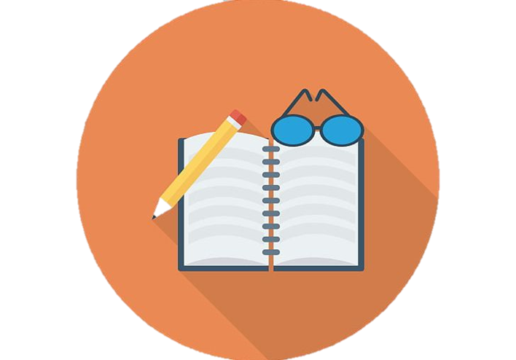
CONSOLIDATION
2
HOMEWORK
Prepare for the next lesson: Skills 2
Do exercises in the workbook.

Slide 25

Website: sachmem.vn
Fanpage: facebook.com/sachmem.vn/

