Slide 1




WELCOME TO OUR CLASS

Slide 2

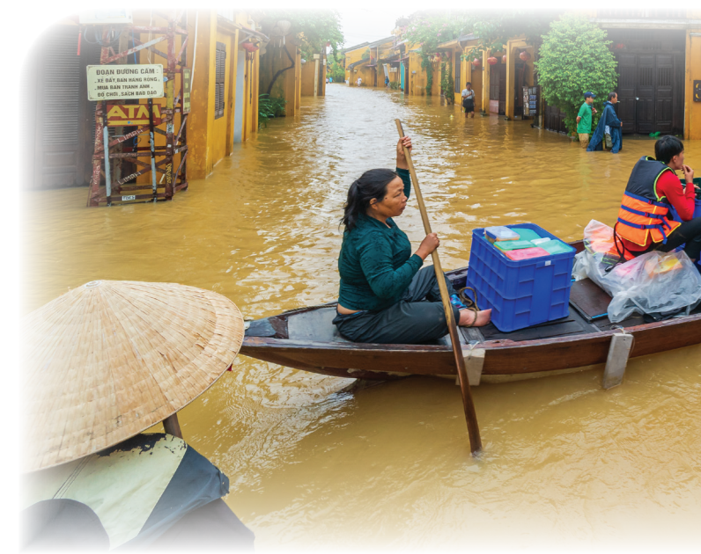
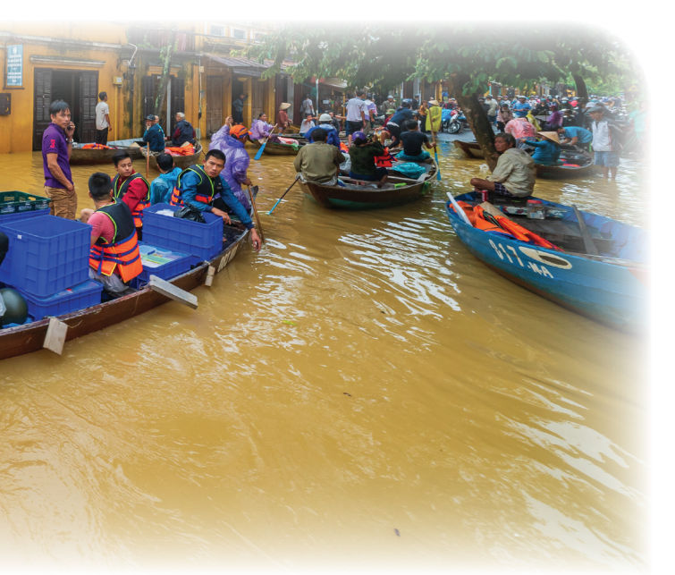
Unit
9
NATURAL DISASTERS
Unit
ETHNIC GROUPS OF VIET NAM
LESSON 1: GETTING STARTED
We are all safe!
Unit

Slide 3

* WARM-UP
Network
Earthquake
Natural disasters
NATURAL DISASTERS
- Earthquake - snow storm
- acid rain - typhoon
- tidal wave - flood,
- drought - …

Slide 4
* Answer the questions:
1. Can you name some natural disasters in Viet Nam?
2. Are there often natural disasters in Viet Nam?
3. How can you know when there is an
incoming natural disaster?
4. What would you do if you were notified of an incoming earthquake?
NATURAL DISASTERS

Slide 5
Unit
9
NATURAL DISASTERS
Unit
ETHNIC GROUPS OF VIET NAM
LESSON 1: GETTING STARTED
We are all safe!
Unit

Slide 6


* Vocabulary
damage (n,v):
thiệt hại, gây tổn hại
/ˈdæmɪdʒ/

Slide 7

* Vocabulary
- funnel (n):
cái phễu
/ˈfʌnl/

Slide 8
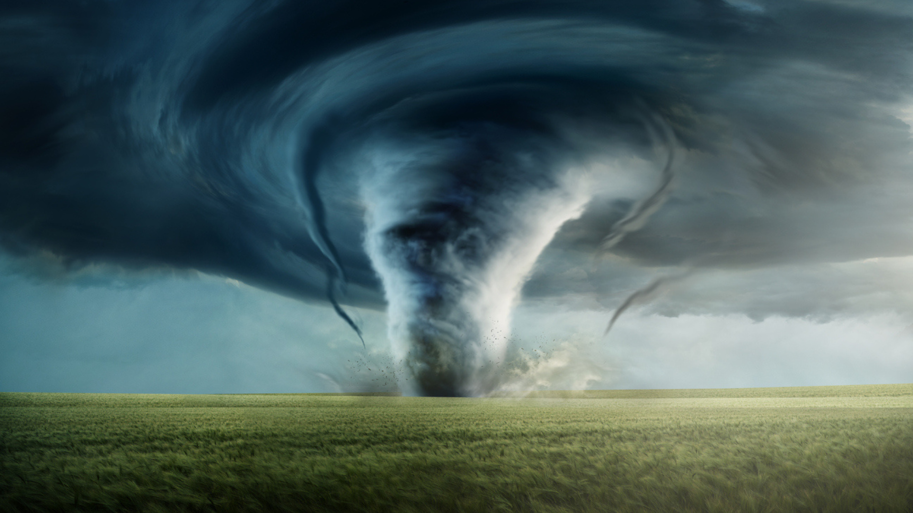
* Vocabulary
- tornado (n):
lốc xoáy
/tɔːˈneɪdəʊ/

Slide 9
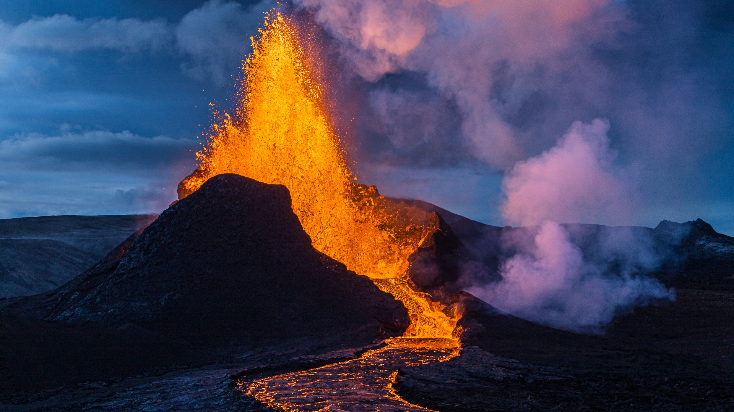
* Vocabulary
eruption (n):
sự phun trào
/ɪˈrʌpʃn/

Slide 10
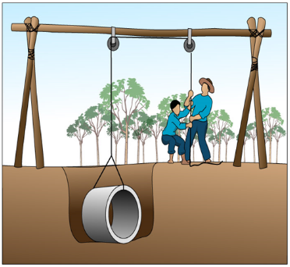
* Vocabulary
pull up:
kéo lên, nhổ lên, lôi lên
/pʊl ʌp/

Slide 11
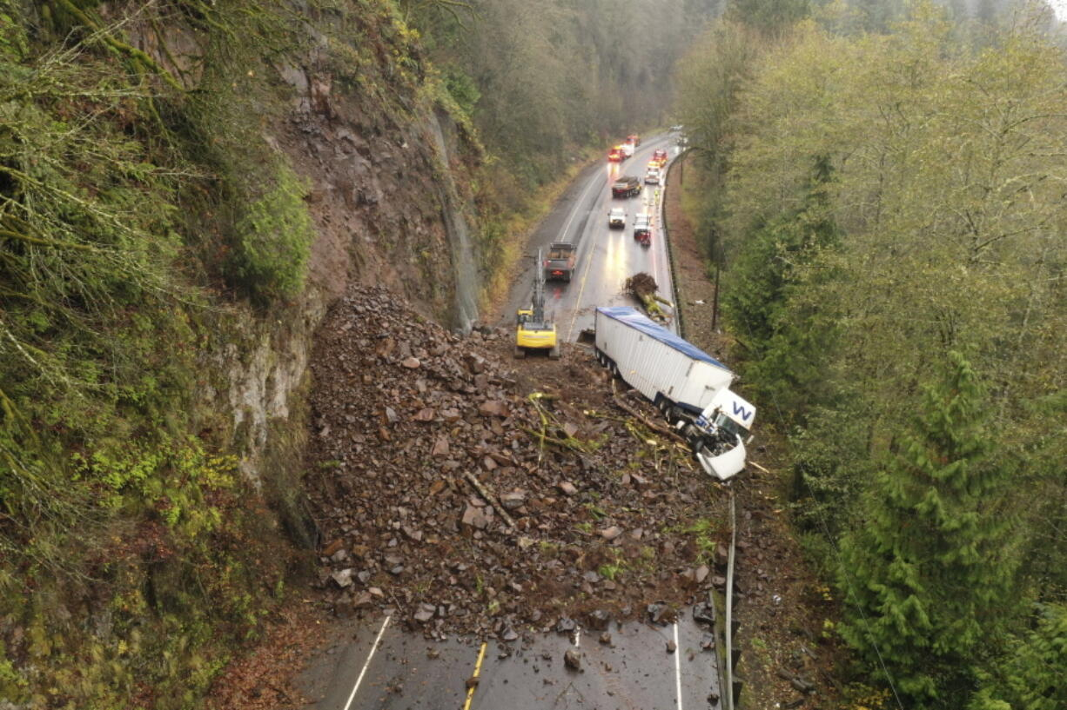
* Vocabulary
- landslide (n):
vụ sạt lở
/ˈlændslaɪd/

Slide 12
* Vocabulary
New words | Pronunciation | Meaning
1. damage (n,v) | /ˈdæmɪdʒ/ | thiệt hại, gây tổn hại
2. funnel (n) | /ˈfʌnl/ | cái phễu
3. tornado (n) | /tɔːˈneɪdəʊ/ | lốc xoáy
4. eruption (n) | /ɪˈrʌpʃn/ | sự phun trào
5. pull up | /pʊl ʌp/ | kéo lên, nhổ lên, lôi lên
6. landslide (n) | /ˈlændslaɪd/ | vụ sạt lở

Slide 13
* Checking vocabulary
Word | Vietnamese
1. | lốc xoáy
2. | sự phun trào
3. | thiệt hại, gây tổn hại
4. | cái phễu
5. | vụ sạt lở
6. | kéo lên, nhổ lên, lôi lên
damage (n,v)
funnel (n)
tornado (n)
eruption (n)
pull up
landslide (n)

Slide 14
1
Listen and read.
- What can you see in the picture?
- What natural disaster is it?

Slide 15
1
Listen and read.
Tom: You look pretty sad, Mi. What’s the matter?
Mi: My uncle called us this morning. Our home town has been affected by a flood. It’s the second time this year.
Tom: I’m sorry to hear that. How are things there now?
Mi: My uncle, his wife, and his children are all safe. They moved everything to the second floor of their house last night. Are there natural disasters in your home town in the US?
Tom: Yes, we sometimes have tornadoes.
Mi: Tornadoes? Sounds strange. What’s a tornado?
Tom: It’s a violent storm that moves in a circle with very strong winds. I still remember the tornado we had last year.
Mi: What happened?
Tom: One evening my parents and I were having dinner. Suddenly we heard a very loud noise. When we looked out of the window, we saw a big funnel of wind moving towards us.
Mi: Did it cause any damage?
Tom: Yes, a lot. It damaged the roof of our house and pulled up some trees in our yard. Fortunately, no one was hurt.

Slide 16
2
Read the conversation again. Complete each sentence with no more than TWO words from it.
1. There is a _____ in Mi’s home town.
2. Her uncle’s family had to move everything to the ___________ last night.
3. A tornado is an example of a _______________.
4. Tom’s family ___________ dinner when the tornado came.
5. The tornado damaged their roof and _______ up some trees in their yard.
Game

Slide 17




Who chooses the number first?
Conrgatulation
You are the first
Oh, no
You are the second
1
2
Notes:
17

Slide 18
LUCKY NUMBERS
Team A
1
2
3
4
Team A
2
4
6
8
10
2
4
6
8
10
6
7
8
9

Slide 19
2
Read the conversation again. Complete each sentence with no more than TWO words from it.
flood
1. There is a _____ in Mi’s home town.

Slide 20
2
Read the conversation again. Complete each sentence with no more than TWO words from it.
2. Her uncle’s family had to move everything to the ___________ last night.
second floor

Slide 21
2
Read the conversation again. Complete each sentence with no more than TWO words from it.
3. A tornado is an example of a _______________.
natural disaster

Slide 22
2
Read the conversation again. Complete each sentence with no more than TWO words from it.
4. Tom’s family ___________ dinner when the tornado came.
was having

Slide 23
2
Read the conversation again. Complete each sentence with no more than TWO words from it.
5. The tornado damaged their roof and _______ up some trees in their yard.
pulled

Slide 24

UNLUCKY NUMBER

Slide 25



Slide 27
2
Read the conversation again. Complete each sentence with no more than TWO words from it.
1. There is a _____ in Mi’s home town.
2. Her uncle’s family had to move everything to the ___________ last night.
3. A tornado is an example of a _______________.
4. Tom’s family ___________ dinner when the tornado came.
5. The tornado damaged their roof and _______ up some trees in their yard.
flood
second floor
natural disaster
was having
pulled

Slide 28
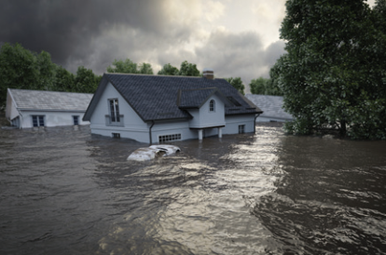
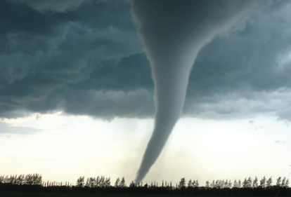
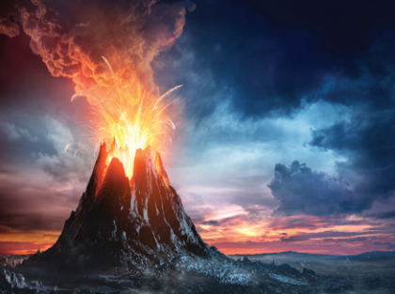
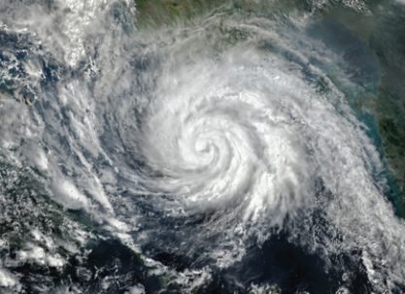
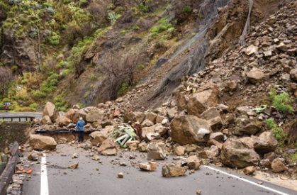
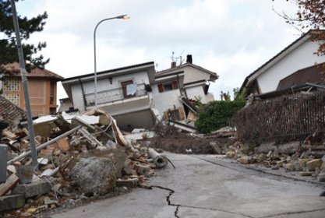
3
Write the natural disasters from the box under the pictures. Then listen, check, and repeat.
volcanic eruption
earthquake
landslide
storm
tornado
flood
1. ………………………....
2. ………………………....
3. ………………………....
4. ………………………....
5. ………………………....
6. …………………………..

Slide 29
4
Choose the correct answer to complete each sentence.
1. When there is a(n) earthquake / volcanic eruption, hot gases and liquid rock pour out from a mountain.
2. Oh, the house is shaking! I think we’re having a(n) earthquake / flood.
3. We wanted to travel to Ha Giang, but there was a tornado / landslide. Some big rocks and mud came down the mountains.
4. Every year more than ten floods / storms with strong winds and rain cause damage in our country.
5. A tornado / storm looks like a huge funnel and causes a lot of damage. Its strong winds can reach 480 km per hour.

Slide 30
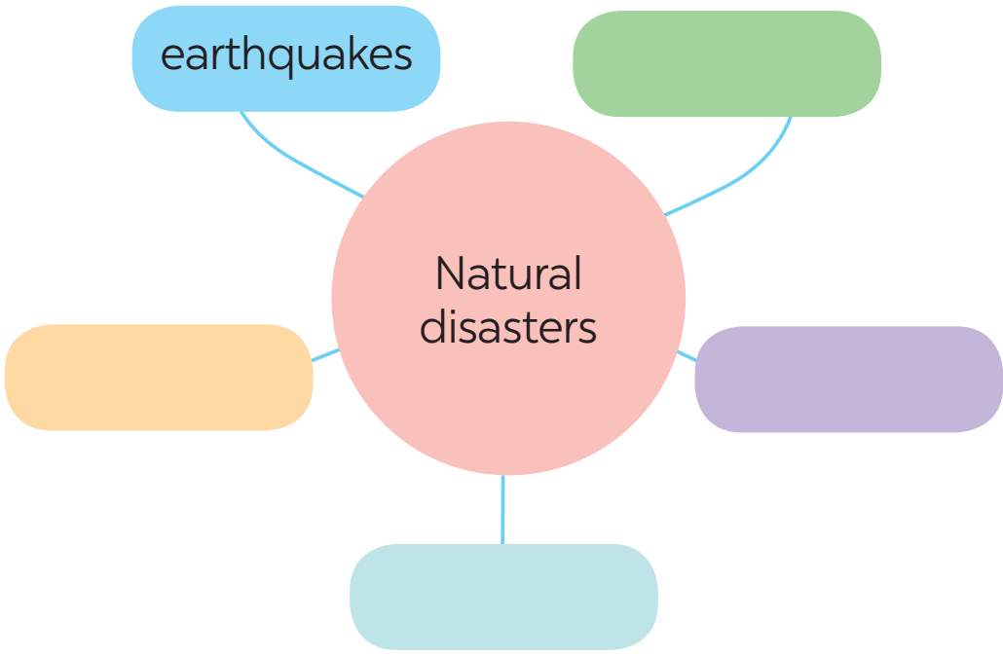
* PRODUCTION
5
Work in groups. Complete the web with all of the words and phrases related to natural disasters you know.

Slide 31
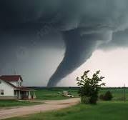
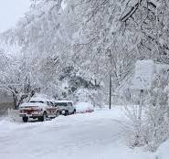
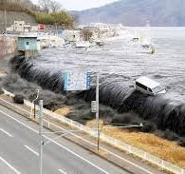
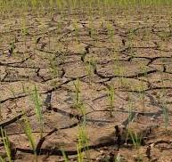
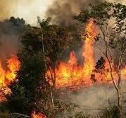
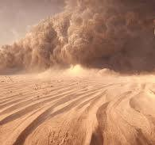
* PRODUCTION
5
Work in groups. Complete the web with all of the words and phrases related to natural disasters you know.
tsunami
snowstorm
tornado
drought
wildfire
dust storm

Slide 32
* CONSOLIDATION
About natural disasters
Vocabulary
Topic of the unit
NATURAL DISASTERS

Slide 33

* Homework
Learn the new words by heart.
Do exercises in the workbook.
Start preparing for the Project of the unit.

Slide 34


Thank you!
Goodbye!

