Slide 1



Slide 2

WARM-UP
OPTION 1
Brainstorm

Slide 3
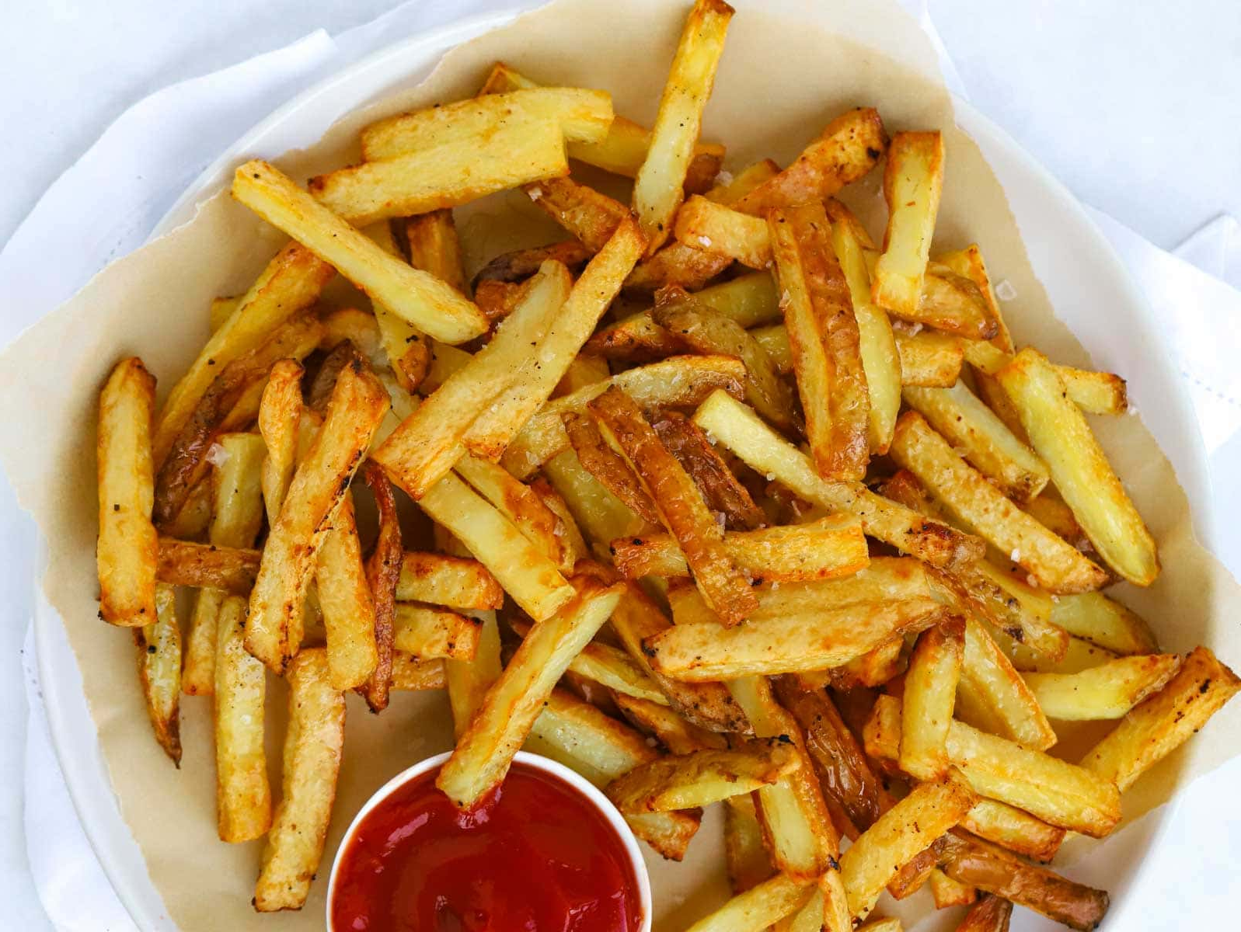
WARM-UP
OPTION 1
- There are some pictures
- You need to say the words in British English and American English.

Slide 4

UK: chips US: French Fries

Slide 5
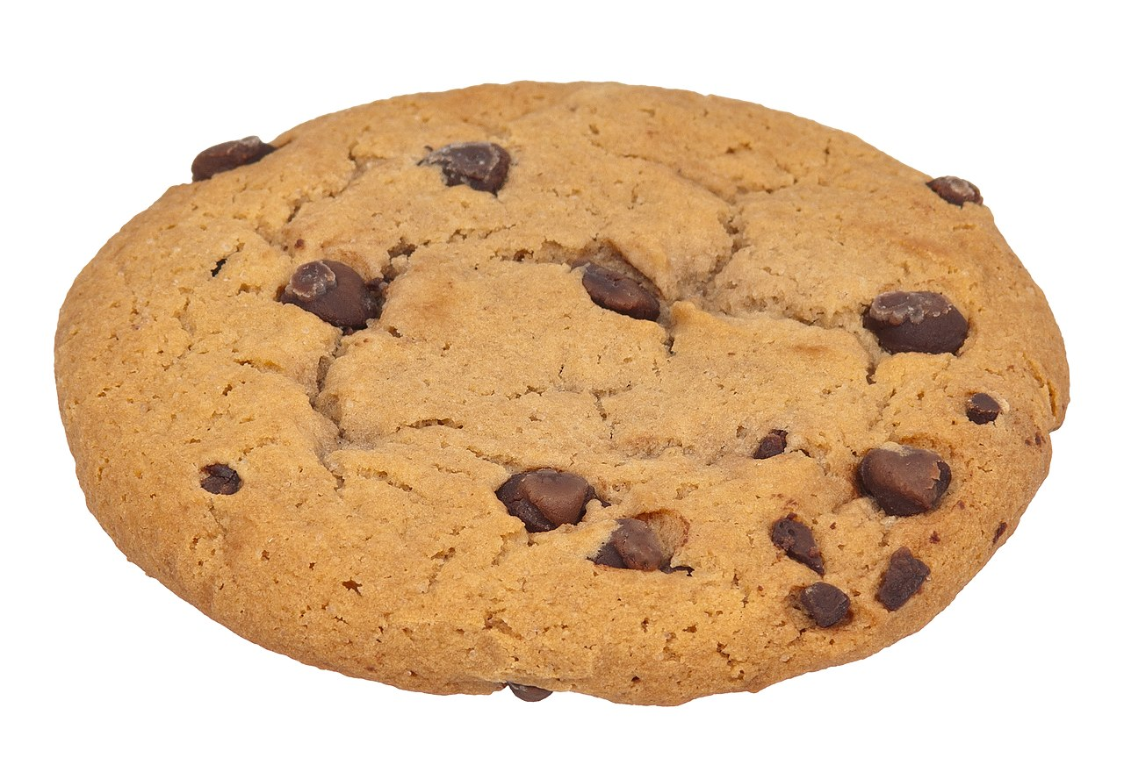
UK: flat US: apartment

Slide 6

UK: biscuit US: cookie

Slide 7
UK: dustbin
US: garbage can

Slide 8
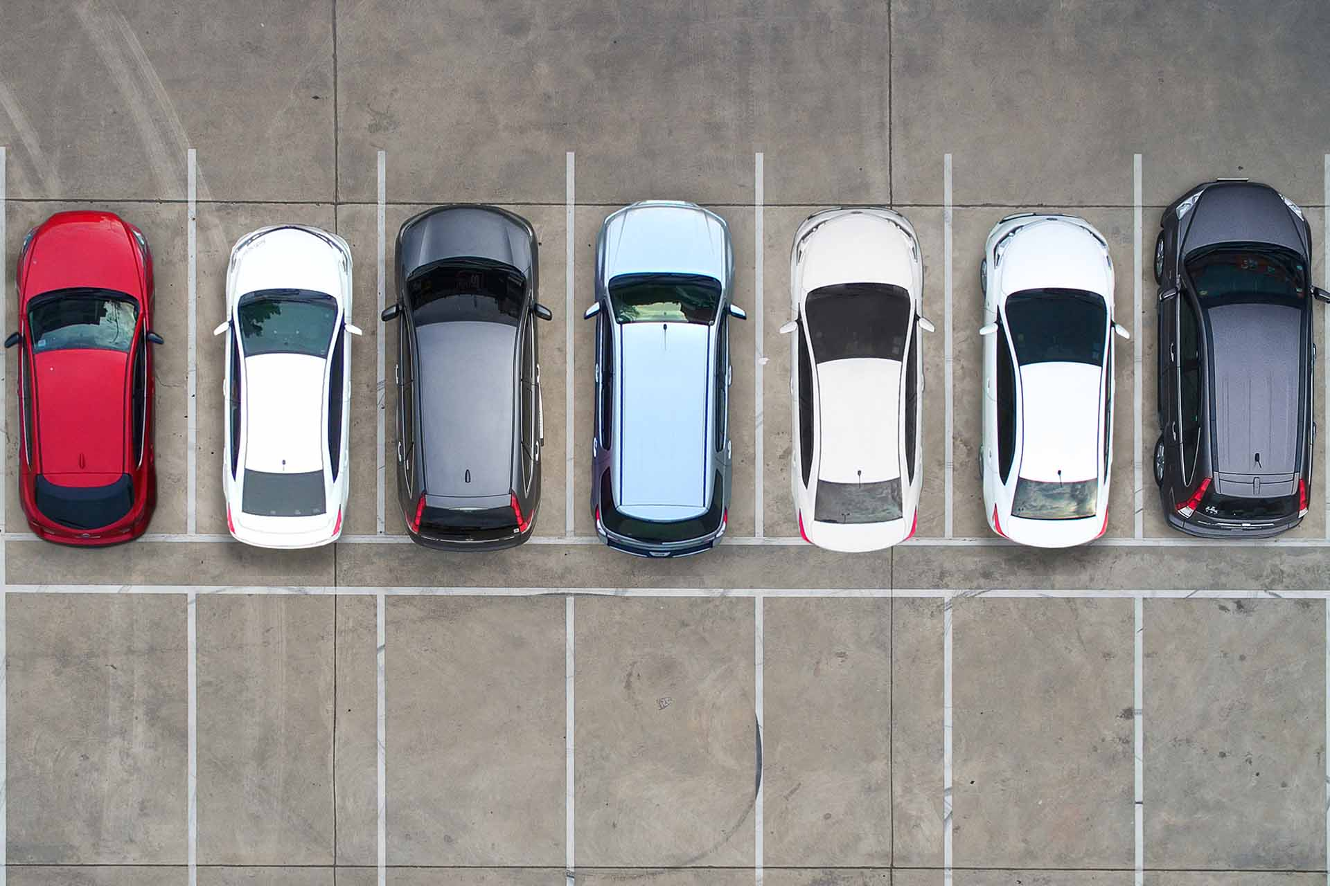
UK: car park US: parking lot

Slide 9



Unit
9
WORLD ENGLISHES
LESSON 2: A CLOSER LOOK 1

Slide 10


VOCABULARY
able to use two languages equally well
- bilingual (adj)
/baɪˈlɪŋɡwəl/
sử dụng được 2 ngôn ngữ

Slide 11

VOCABULARY

Slide 12

VOCABULARY
- variety (n)
a different type of something
/vəˈraɪəti/
biến thể/ đa dạng

Slide 13
VOCABULARY
- fluent (adj)
able to speak a language easily and well
/ˈfluːənt/
trôi chảy, thành thạo
Ex: He's a fluent English speaker.

Slide 14

VOCABULARY
(of circles and rings) being one inside another and having the same center
- concentric (adj)
/kənˈsentrɪk/
đồng tâm

Slide 15
VOCABULARY
- go over
- to study something again
Ex: I always go over my notes just before I go into an exam.
/ɡəʊ ˈəʊvə/
ôn tập lại

Slide 16
VOCABULARY
- pick up
to learn a new skill or language by practising it rather than being taught it
/pɪk ʌp/
học (ngôn ngữ tự nhiên)
Ex: When you live in a country you soon pick up the language.
A | B
1. variety | a. a language which has legal status in a country. | 1.
2. bilingual | b. a different type of something | 2.
3. fluent | c. (of circles) having the same centre | 3.
4. concentric | d. able to speak two languages equally well | 4.
5. official language | e. able to speak, read, or write a language, especially a foreign language, easily and well | 5.

Slide 17
VOCABULARY
Form | Pronunciation | Vietnamese equivalent
1. bilingual (adj) | /baɪˈlɪŋɡwəl/ | sử dụng được 2 ngôn ngữ
2. variety (n) | /vəˈraɪəti/ | biến thể
3. fluent (adj) | /ˈfluːənt/ | trôi chảy, thành thạo
4. concentric (adj) | /kənˈsentrɪk/ | đồng tâm
5. go over | /ɡəʊ ˈəʊvə/ | ôn tập lại
pick up | /pɪk ʌp/ | học (ngôn ngữ tự nhiên)

Slide 18
Checking vocab
Form | Vietnamese equivalent
 | sử dụng được 2 ngôn ngữ
 | biến thể
 | trôi chảy, thành thạo
 | đồng tâm
 | ôn tập lại
 | học (ngôn ngữ tự nhiên)
1. bilingual (adj)
2. variety (n)
3. fluent (adj)
4. concentric (adj)
5. go over
pick up

Slide 19
1
Match a word or phrase in A with its meaning in B.
A | B
1. variety | a. a language which has legal status in a country. | 1.
2. bilingual | b. a different type of something | 2.
3. fluent | c. (of circles) having the same centre | 3.
4. concentric | d. able to speak two languages equally well | 4.
5. official language | e. able to speak, read, or write a language, especially a foreign language, easily and well | 5.
b
d
e
c
a

Slide 20
2
Match a verb in A with a phrase in B to make a meaningful expression.
A | B
1. translate | a. over the grammatical points | 1.
2. copy | b. up a new language | 2.
3. pick | c. up new words in an English-English dictionary | 3.
4. look | d. from Vietnamese into English | 4.
5. go | e. words into a notebook | 5.
d
e
b
c
a

Slide 21
3
Choose the correct word to complete each sentence.
1. English is a(n) official / first language in Singapore besides Malay, Mandarin, and Tamil.
2. Although he was born in Britain, he is fluent / bilingual in Vietnamese
3.After you pick / look up a word in the dictionary, remember to make an example with it
4. How many books have you picked /translated from English into Vietnamese?
5. Remember to go / copy over the words you have learnt in class

Slide 22

PRONUNCIATION
Pronounce the words ending in –ion and –ity with correct stress.

Slide 23


Slide 24

PRONUNCIATION
4
Listen and repeat the words. Pay attention to the word stress
-ion | -ity
relation | charity
decision | quality
position | clarity
education | ability
operation | obesity
Words ending in -ion and -ity have stress on the syllable immediately before them.

Slide 25
5
Listen and repeat the sentences. Mark the stress in the underlined words.
1. They had a discussion about the quality of the courses at their language centre.
2. Pay attention to her ability to express herself in English.
3. I have an intention of organising an English class for the community.
4. Let’s do a revision activity before the exam.
5. What is the function of the word ‘identity’ in this sentence?

Slide 26

CONSOLIDATION
What have we learnt in this lesson?
Some other learned words / phrases related to world Englishes
Pronounce correctly words ending -ion and -ity .

Slide 27

HOMEWORK
Do exercises in the workbook.
write as many words ending in –ion and –ity and
stress on the correct syllable in each word written
Prepair lesson 3 - A closer look 2

Slide 28

Thank you!
Have a nice day!

Slide 29
EXTRA ACTITIVTY
- Work in groups. Ask groups to write as many words ending in –ion and –ity as possible in ............... minutes.
- The group with the most words to the words on the board.
- Other students from other groups go to the board and put stress on the correct syllable in each word written.
Notes:
wish → wish
know → knowledge
decide → decision
damage → damage

Slide 30
LESSON 2: A CLOSER LOOK 1
LESSON 2: A CLOSER LOOK 1
WARM-UP
Option 1: Brainstorm
Option 2: Bin it or Keep it quiz
Vocabulary
Task 1: Match a word or phrase in A with its meaning in B.
Task 2: Match a verb in A with a phrase in B to make a meaningful expression.
Task 3: Choose the correct word to complete each sentence.
VOCABULARY
Task 4: Listen and repeat the words. Pay attention to the word stress.
Task 5: Listen and repeat the sentences. Mark the stress in the underlined words
PRONUNCIATION
CONSOLIDATION
Wrap-up
Homework

Slide 31
CONSOLIDATION
1
Wrap-up
What have we learnt in this lesson?
Use the lexical items related to the topic WORLD ENGLISHES
Pronounce the words ending in –ion and –ity with correct stress.

Slide 32
CONSOLIDATION
2
Homework
- Do exercises in the workbook.
- Find 3 more words that ending with the sounds –ion and –ity and put the stress to the appropriate syllable in each of them.

Slide 33
Website: hoclieu.vn
Fanpage: facebook.com/www.tienganhglobalsuccess.vn/

Slide 34

WARM-UP
OPTION 2
Bin it or Keep it

Slide 35
WARM-UP
OPTION 2
- Work in teams
- There are signs or flashcards labeled "Bin it" and "Keep it."
- There is some sentences.
- You hold up the sign corresponding to your answer: "Bin it" if the sentence is not American English, "Keep it" if it is..

Slide 36
WARM-UP
OPTION 2
The sidewalk is cracked.
Keep

Slide 37
WARM-UP
OPTION 2
Please turn off the tap when you're finished.
Bin
Tap (UK) Faucet (US)

Slide 38
WARM-UP
OPTION 2
Can you pass me the rubber?
Bin
rubber (UK) eraser (US)

Slide 39
WARM-UP
OPTION 2
Let's grab some chips after school.
Keep

Slide 40

OBJECTIVES
By the end of the lesson, students will be able to:
Use the lexical items related to the topic WORLD ENGLISHES
Pronounce the swords ending in –ion and –ity with correct stress

Slide 41
LESSON 2: A CLOSER LOOK 1
LESSON 2: A CLOSER LOOK 1
WARM-UP
Option 1: Brainstorm
Option 2: Bin it or Keep it quiz
Vocabulary
Task 1: Match a word or phrase in A with its meaning in B.
Task 2: Match a verb in A with a phrase in B to make a meaningful expression.
Task 3: Choose the correct word to complete each sentence.
VOCABULARY
Task 4: Listen and repeat the words. Pay attention to the word stress.
Task 5: Listen and repeat the sentences. Mark the stress in the underlined words
PRONUNCIATION
CONSOLIDATION
Wrap-up
Homework

Slide 43
LESSON 2: A CLOSER LOOK 1
LESSON 2: A CLOSER LOOK 1
WARM-UP
Option 1: Brainstorm
Option 2: Bin it or Keep it quiz
Vocabulary
Task 1: Match a word or phrase in A with its meaning in B.
Task 2: Match a verb in A with a phrase in B to make a meaningful expression.
Task 3: Choose the correct word to complete each sentence.
VOCABULARY
Task 4: Listen and repeat the words. Pay attention to the word stress.
Task 5: Listen and repeat the sentences. Mark the stress in the underlined words
PRONUNCIATION

