Slide 1

GOOD MORNING
EVERYONE !!!

Slide 2
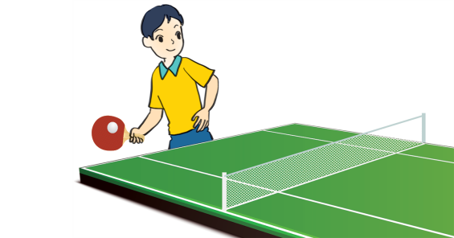
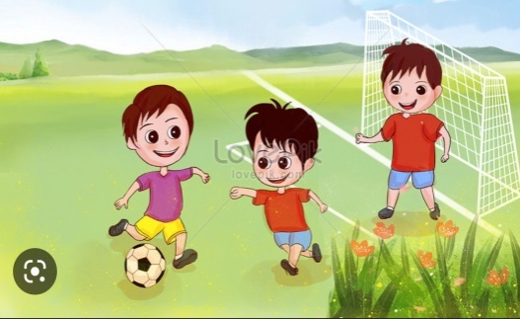
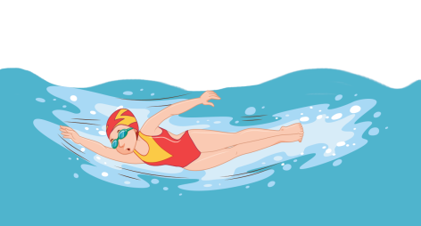
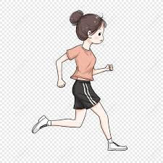
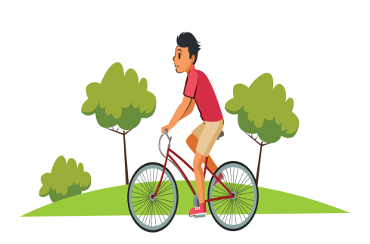
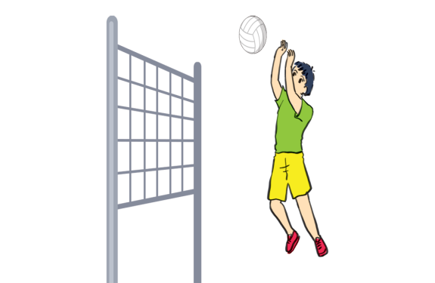
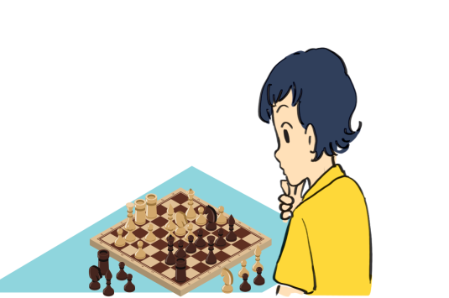
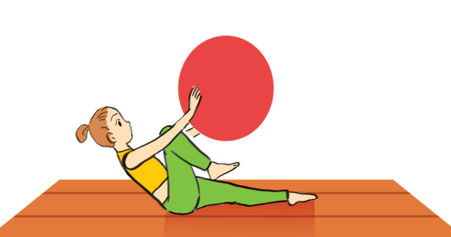
Game
Sports & Games

Slide 3
Answer key
table tennis
football
swimming
Sports & Games
running
cycling
volleyball
chess
aerobics

Slide 4
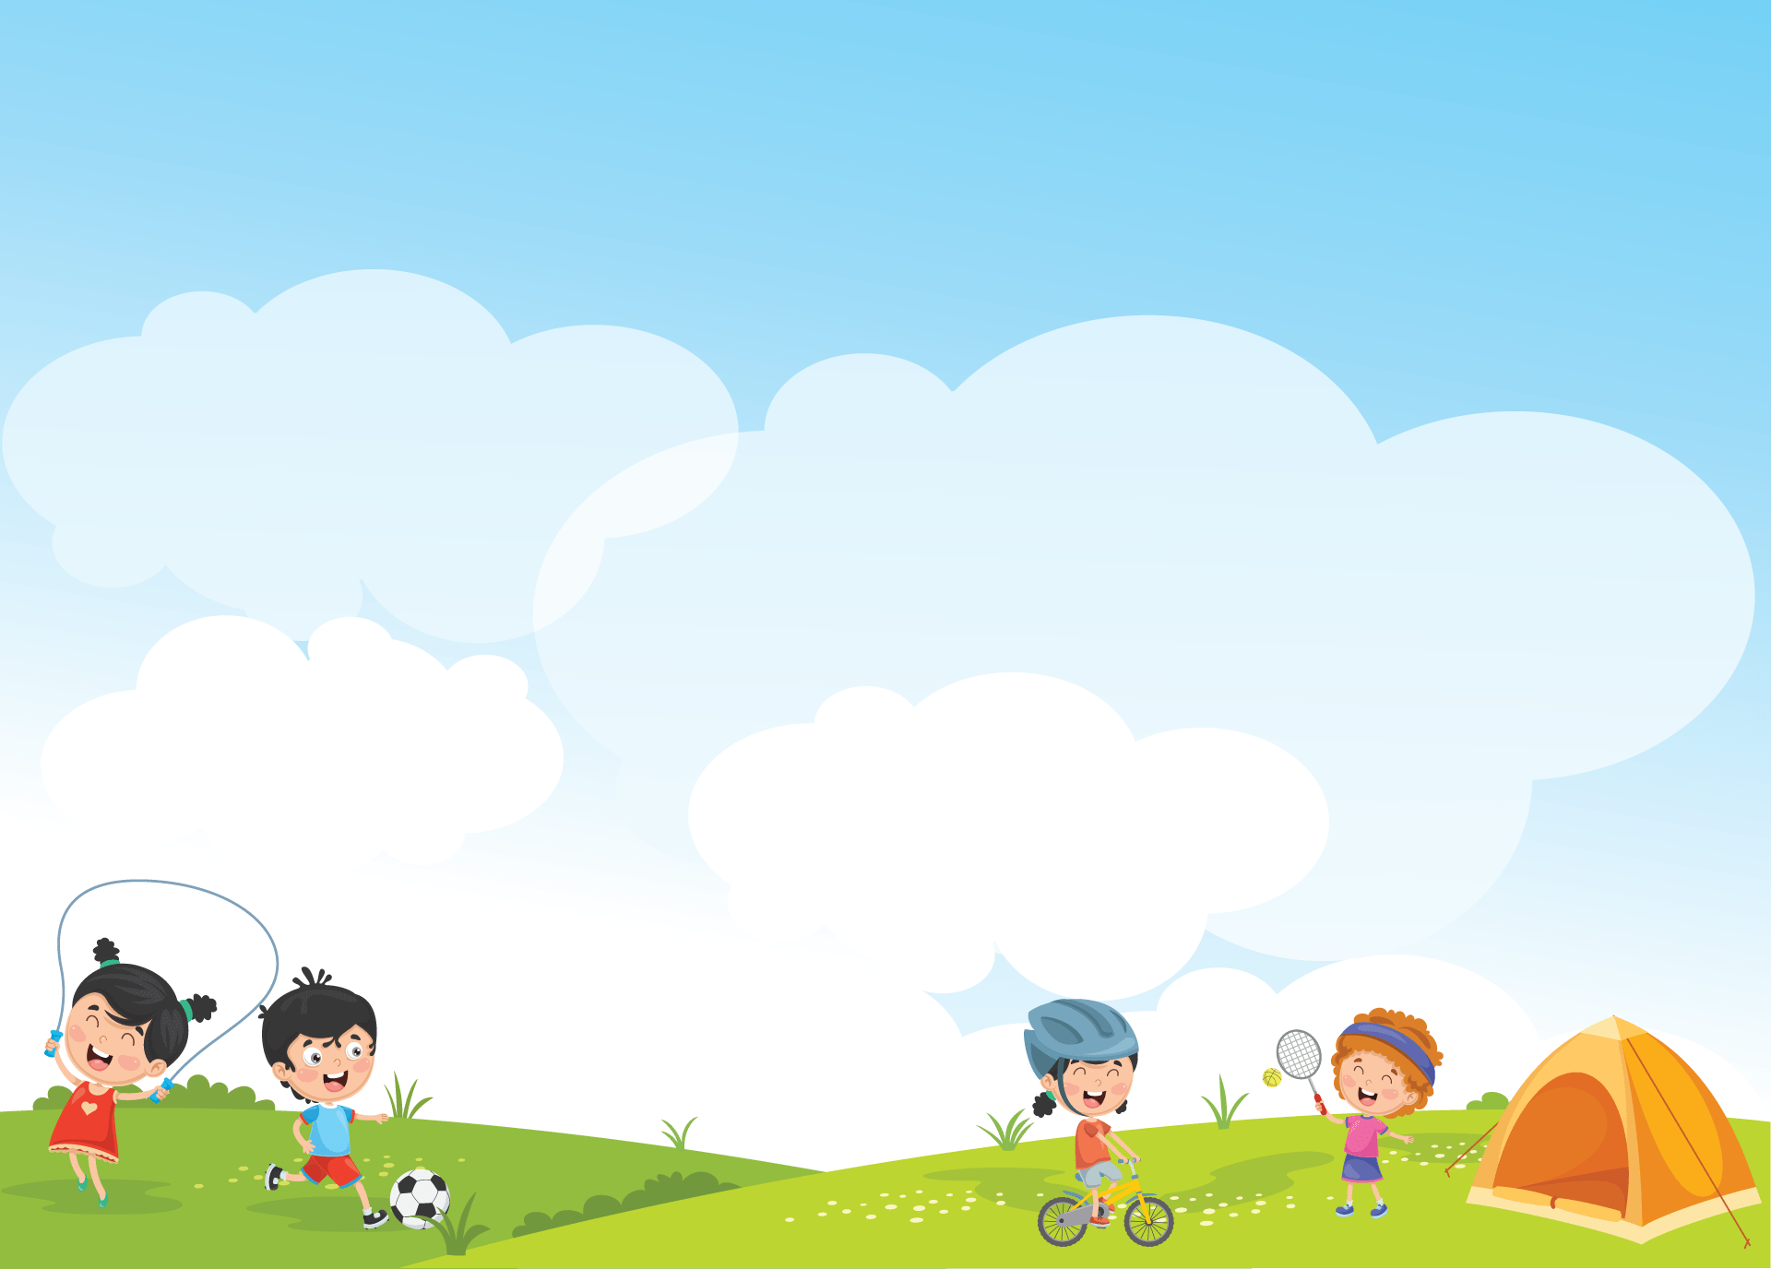

UNIT 8: SPORTS AND GAMES
PERIOD 63: LESSON 2:

Slide 5


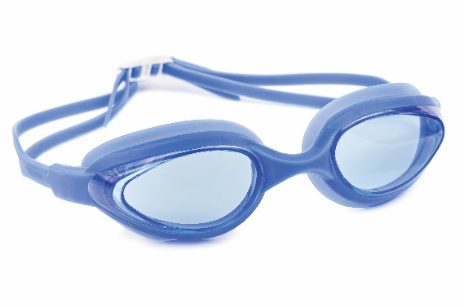
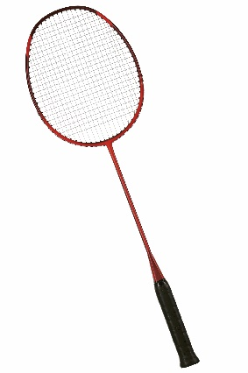
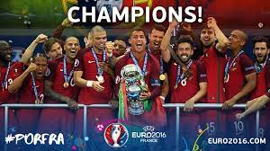
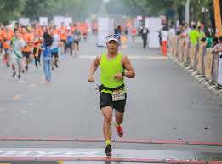
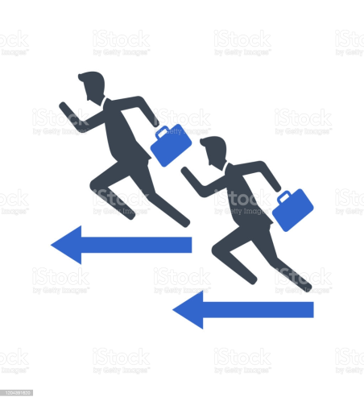
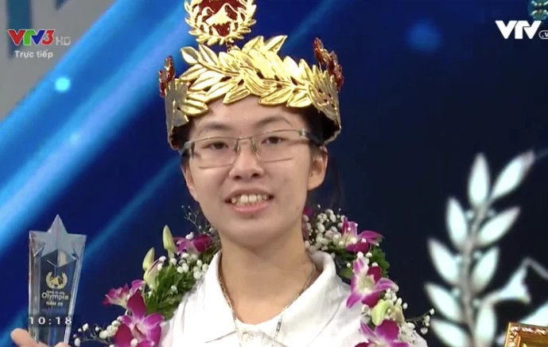
UNIT 8: SPORTS AND GAMES
LESSON 2: A CLOSER LOOK 1
* Vocabulary
- racket (n) /'rækit/:
- goggles (n) /'gɒglz/:
- competition (n) /kɒmpə'ti∫n/:
- champion (n) /'t∫æmpiən/:
- marathon (n) /'mærəθən/:
- congratulations (n) /kəngrætʃə'lei∫n/:

Slide 6


UNIT 8: SPORTS AND GAMES
LESSON 2: A CLOSER LOOK 1
* Vocabulary
1 | - racket (n) /'rækit/:
2 | - goggles (n) /'gɒglz/:
3 | - competition (n) /kɒmpə'ti∫n/:
4 | - champion (n) /'t∫æmpiən/:
5 | - marathon (n) /'mærəθən/:
6 | - congratulations (n) /kəngrætʃə'lei∫n/:

Slide 7

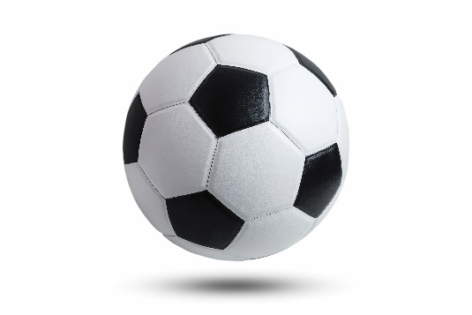
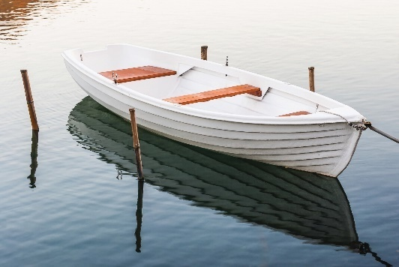
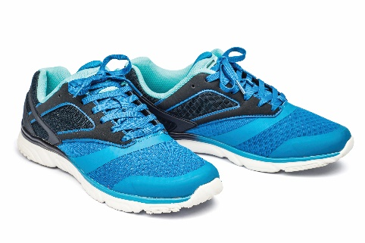
Write the right words under the pictures.
ball
racket
sports shoes
boat
goggles
1. ball
2. sports shoes
3.
1.
2.
3. boat
4. racket
5. goggles
4.
5.

Slide 8

What sports are these things for? Match each thing in column A with a sport in column B.
A
B
1.
bicycle
a.
boating
2.
ball
b.
swimming
3.
boat
c.
cycling
4.
goggles
d.
ball games
5.
racket
e.
badminton

Slide 9

Fill each blank with one of the words from the box.
champion
competition
sporty
marathon
congratulations
practice
1. She won an international sports __________.
2. He became the world tennis _________when he was very young.
3. "Can you send my __________ to the winner of the contest?“
4. My friend David is very ___________ . He does exercise every day.
5. The first __________ took place in 1896.
6. He want to be a footballer, so he __________ playing football every day.

Slide 10
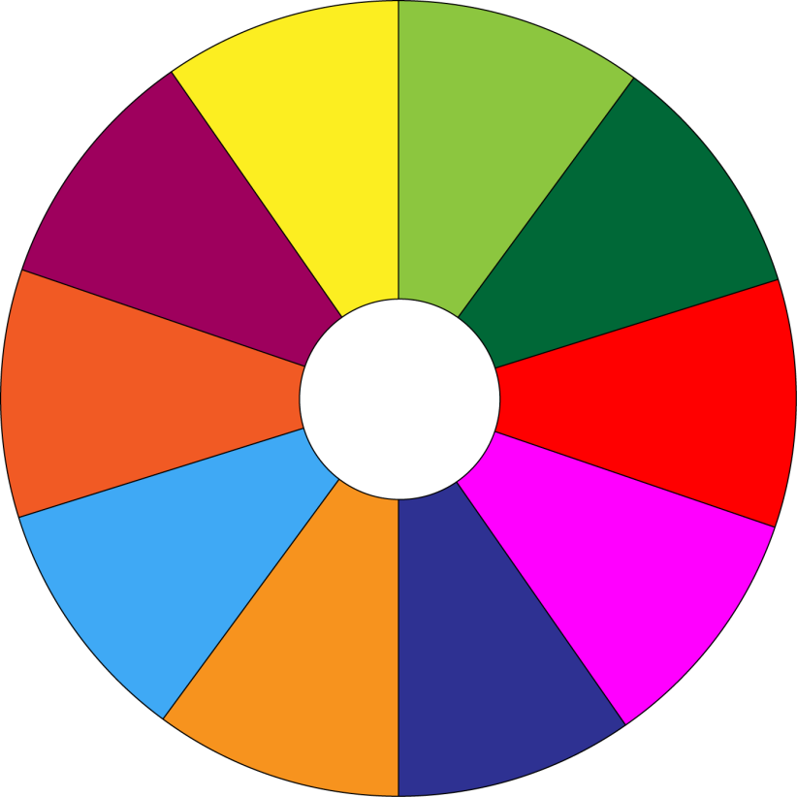
THE BIG WHEEL GAME
QUESTIONS
10
40
1
4
30
50
SPIN
2
5
20
10
-15
-20
3
6
05
60

Slide 11
Fill each blank with one of the words from the box.
champion
competition
sporty
marathon
congratulations
practice
1. She won an international sports __________.
competition.

Slide 12
Fill each blank with one of the words from the box.
champion
competition
sporty
marathon
congratulations
practice
2. He became the world tennis _________when he was very young.
champion

Slide 13
Fill each blank with one of the words from the box.
champion
competition
sporty
marathon
congratulations
practice
3. "Can you send my __________ to the winner of the contest?“
congratulations

Slide 14
Fill each blank with one of the words from the box.
champion
competition
sporty
marathon
congratulations
practice
4. My friend David is very __________. He does exercise every day.
sporty.

Slide 15
Fill each blank with one of the words from the box.
champion
competition
sporty
marathon
congratulations
practice
5. The first __________ took place in 1896.
marathon

Slide 16
Fill each blank with one of the words from the box.
champion
competition
sporty
marathon
congratulations
practice
6. He want to be a footballer, so he __________playing football every day.
practices

Slide 17
Fill each blank with one of the words from the box.
champion
competition
sporty
marathon
congratulations
practice
1. She won an international sports __________.
2. He became the world tennis _________when he was very young.
3. “Can you send my __________ to the winner of the contest?”
4. My friend David is very ___________ . He does exercise every day.
5. The first __________ took place in 1896.
6. He want to be a footballer, so he __________ playing football every day.
competition
champion
congratulations
sporty
marathon
practices

Slide 18
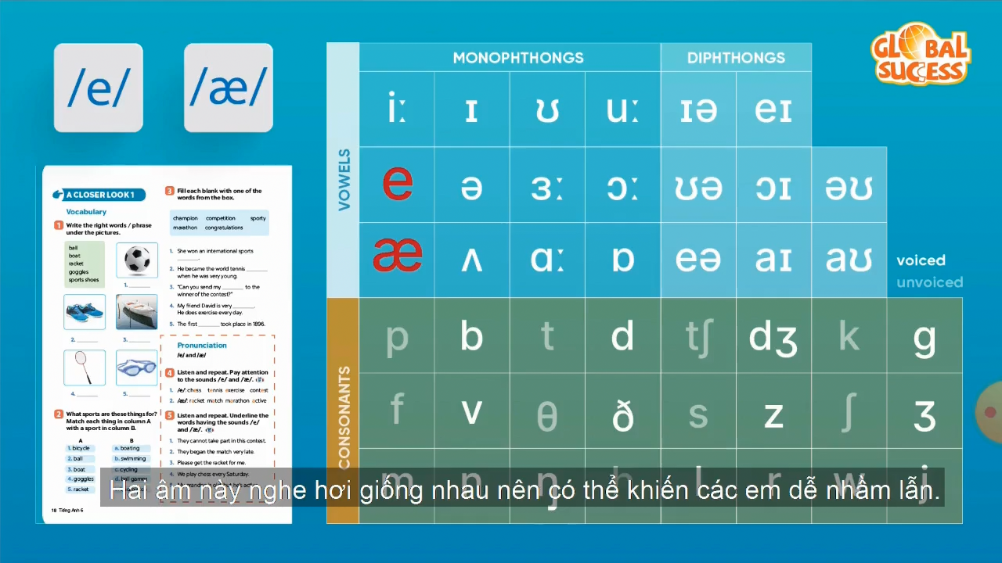
* Pronunciation
/e/ and /æ/

Slide 19

Listen and repeat the words. Pay attention to the sounds /e/ and /æ/.
/e/ | /æ/
chess tennis exerise contest | racket match marathon active

Slide 20

Listen and repeat. Underline the words having the sounds /e/ and /æ/.
1.
They cannot take part in this contest.
2.
They began the match very late.
3.
Please get the racket for me.
4.
We play chess every Saturday.
5.
My grandpa is old, but he’s active.

Slide 21
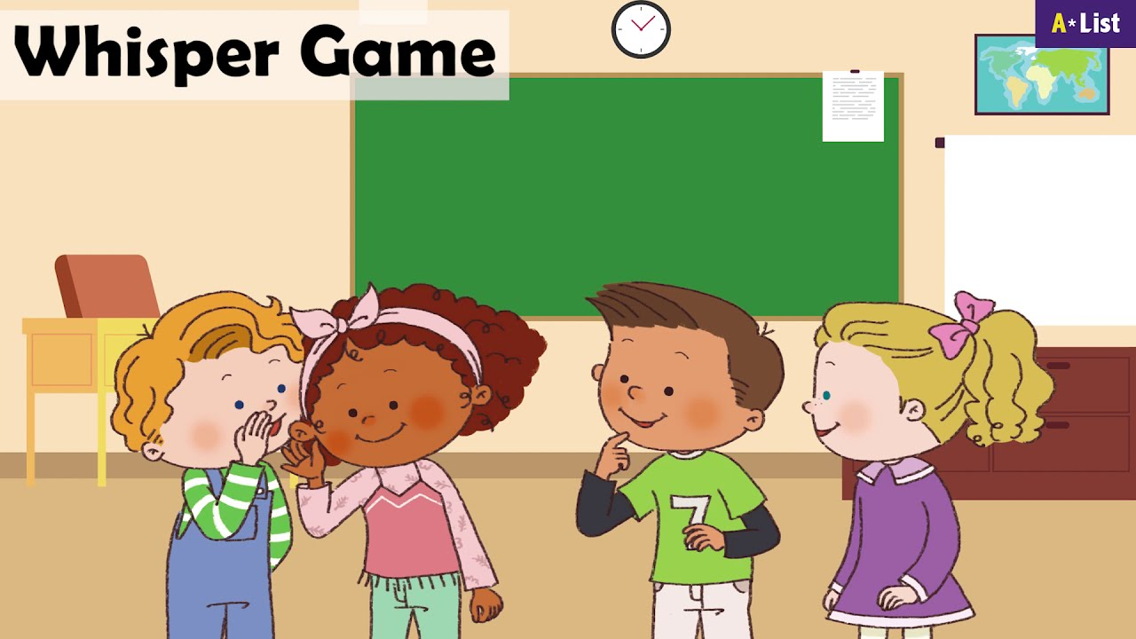

Slide 22

4. homework
Learn new words by heart.
Redo all the exercises.
Prepare A CLOSER LOOK 2.

Slide 23

Thank you!
Goodbye!

