Slide 1
SONG VE SECONDARY SCHOOL
Hello every one !!!

Slide 2
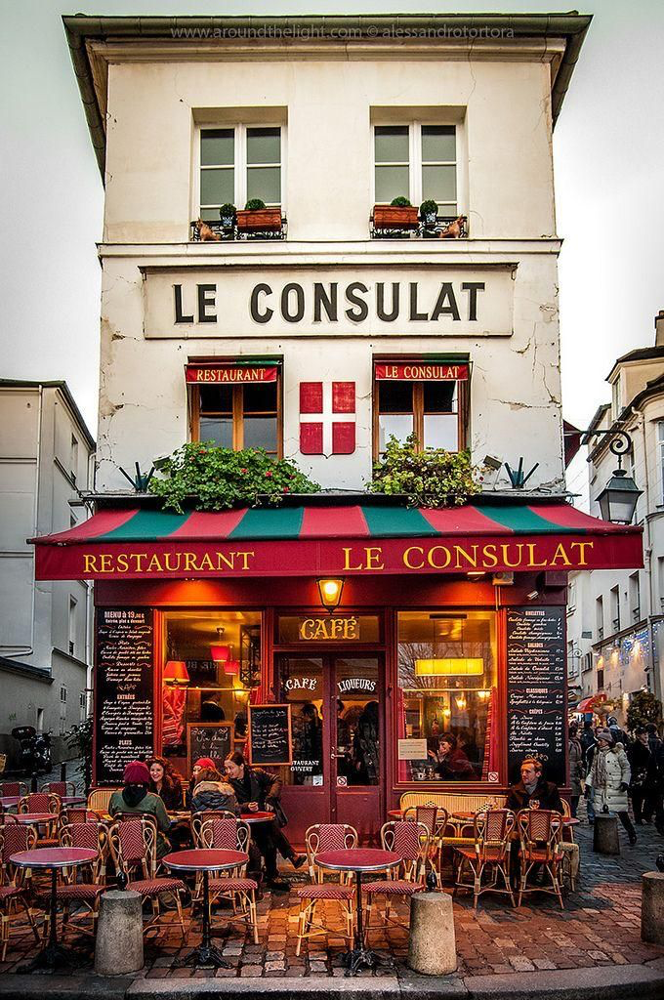
WARM-UP
Chatting
- Have you been to the restaurant?
- Who did you go with?
- What is your favorite food?
- Do you think the dishes and drinks at the restaurant are cheap or expensive?

Slide 3
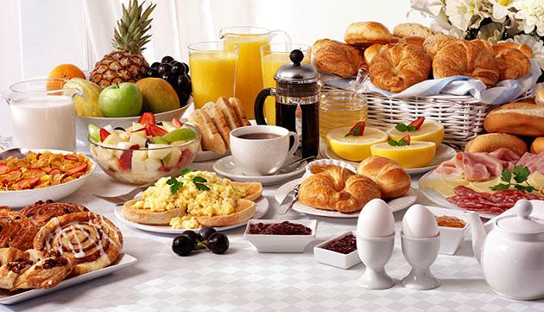
Unit
5
FOOD AND DRINK
LESSON 4: COMMUNICATION

Slide 4
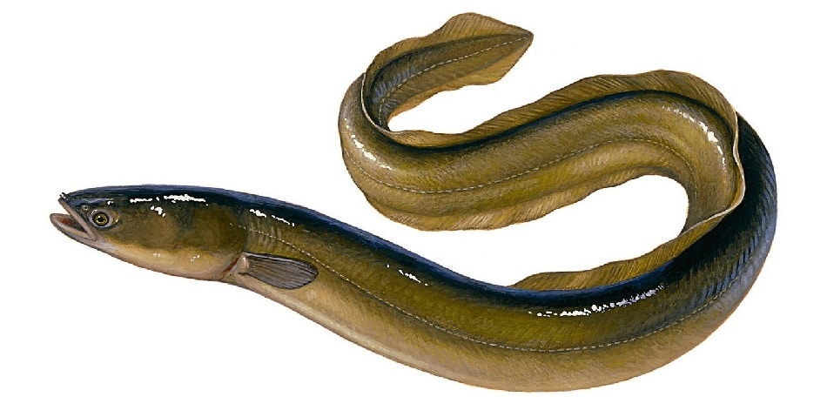
* VOCABULARY
- Eel (n):
/iːl/
con lươn

Slide 5
- Foreign (n):
/ˈfɒr.ən/
ngoại quốc

Slide 6
- interview (v):
/ˈɪn.tə.vjuː/
cuộc phỏng vấn

Slide 7
* VOCABULARY
New words | Pronunciation | Meaning
1. eel (n) | /iːl/ | con lươn
2. foreign (adj) | /ˈfɒr.ən/ | ngoại quốc
3. favourite (adj) | /ˈfeɪ.vər.ɪt/ | ưa thích
4. interview (n) | /ˈɪn.tə.vjuː/ | cuộc phỏng vấn
5. try (v) | /traɪ/ | thử làm

Slide 8
* Checking vocabulary.
What and Where
foreign
eel
try
interview
favourite

Slide 9
EVERYDAY ENGLISH
1
Listen and repeat the conversation. Pay attention to the questions and answers.
Mark: How much is a bottle of mineral water?
Mi: It's 5,000 dong.
Mark: And how much are two kilos of apples?
Mi: They're 50,000 dong.

Slide 10
1
Work in pairs. Take turns to ask and answer about the prices of the food and drink on the menu.
2
LY'S RESTAURANT Breakfast Menu
Food
bowl of beef noodle soup | 30,000 dong
bowl of eel soup | 35,000 dong
toast | 20,000 dong
Drink
glass of milk | 9,000 dong
bottle of mineral water | 8,000 dong
cup of green tea | 5,000 dong
Sample:
A: How much is a bowl of beef noodle soup?
B: It’s 30,000 dong.

Slide 11
1
Work in pairs. Take turns to ask and answer about the prices of the food and drink on the menu.
2
LY'S RESTAURANT Breakfast Menu
Food
bowl of beef noodle soup | 30,000 dong
bowl of eel soup | 35,000 dong
toast | 20,000 dong
Drink
glass of milk | 9,000 dong
bottle of mineral water | 8,000 dong
cup of green tea | 5,000 dong
A: How much is a toast?
B: It's 20,000 dong.
A: How much is a bottle of mineral water?
B: It's 5,000 dong.

Slide 12
YOUR FAVOURITE FOOD AND DRINK
3
Listen to the conversation and answer the following questions.
2
1. What's Nam's favourite food?
2. What's his favourite drink?
3. What foreign food does he like?
4. What food does he want to try?
5. What food can he cook?
Spring rolls.
Lemonade.
Apple pie and pancakes.
Hu tieu (in Ho Chi Minh City).
Omelettes, rice, and spring rolls.

Slide 13
* Audio script
Peter: Nam, can you help me with my school project? I need to interview some people about what they like to eat and drink.
Nam: Sure. What questions do you have?
Peter: What’s your favourite food, Nam?
Nam: It’s spring rolls.
Peter: What’s your favourite drink?
Nam: I like lemonade.
Peter: Interesting. What foreign food do you like?
Nam: Mmm, I like apple pie and pancakes.
Peter: How about new food? Is there anything that you’ve never had, but would like to try?
Nam: Certainly. I’d love to try hu tieu in Ho Chi Minh City.
Peter: I’d like to give it a try too. What can you cook?
Nam: Let me think... I cook omelettes, rice, and spring rolls.

Slide 14
2
Work in groups. Interview two of you friends about their favourite food and drink. Write their answers in the table below.
4
2
Work in groups. Interview two of you friends about their favourite food and drink. Write their answers in the table below.
4
Questions | Student 1 | Student 2
1. What's your favourite food?
2. What's your favourite drink?
3. What food or drink do you want to try?
4. What foreign food or drink do you like?
5. What can you cook?
Questions | Student 1 | Student 2
1. What's your favourite food?
2. What's your favourite drink?
3. What food or drink do you want to try?
4. What foreign food or drink do you like?
5. What can you cook?

Slide 15
2
Work in groups. Interview two of you friends about their favourite food and drink. Write their answers in the table below.
4
2
Work in groups. Interview two of you friends about their favourite food and drink. Write their answers in the table below.
4
Questions | Student 1 | Student 2
1. What's your favourite food?
2. What's your favourite drink?
3. What food or drink do you want to try?
4. What foreign food or drink do you like?
5. What can you cook?
Questions | Huy | Huong
1. What's your favourite food? | beef noodles soup | roasted chicken
2. What's your favourite drink? | fruit juice | Milk -tea
3. What food or drink do you want to try? | spaghetti | beefsteak
4. What foreign food or drink do you like? | Korea Kimbap | Dumpling
5. What can you cook? | Egg fried rice omelette | Seaweed rice rolls:

Slide 16
* Now report your results to the class.
I interviewed Huy and Huong about their favourite food and drink.
Huy's favourite food is beef noodles soup. His favourite drink is fruit juice. He wants to try spaghetti. His favourite foreign food is Korea Kimbap. He can cook omelette and egg fried rice.
Huong’s favourite food is………….

Slide 17
* CONSOLIDATION
1
WRAP-UP
In this lesson, we have learn to:
Use lexical items related to the favourite food and drink in everyday life
Understand and use ways to ask and answer about prices in English

Slide 18
2
HOMEWORK
- Create a menu and include starters, main courses, side dishes, desserts and drinks. Don't forget the prices.
- To prepare for the next lesson: Unit 5( Skills 1)

