Slide 1

UNIT 1 : LEISURE TIME
LESSON 1 : GETTING STARTED

Slide 2


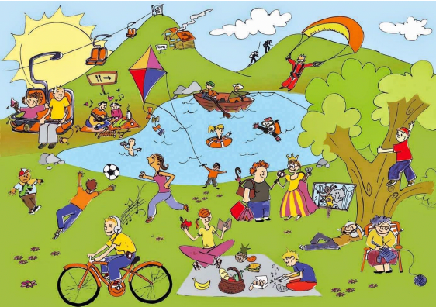

LEISURE ACTIVITIES
Names the activities in the picture
WARM UP:
WHO KNOWS MORE

Slide 3


NEW WORDS

Slide 4

NEW WORDS

Slide 5
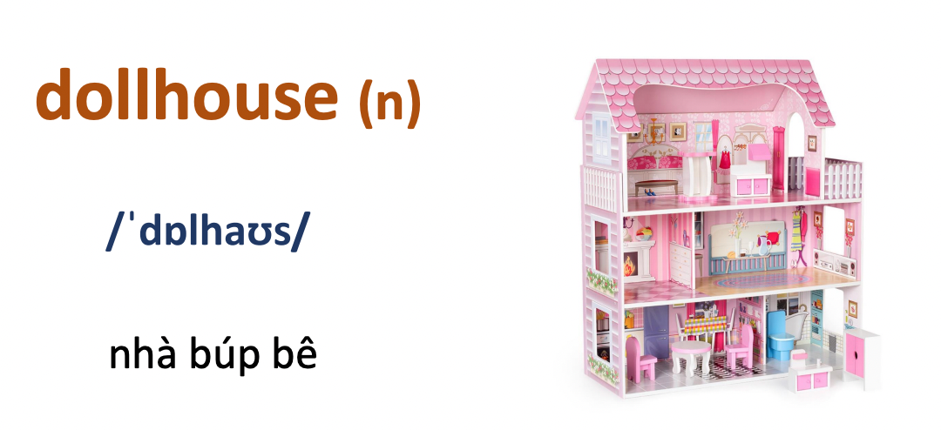
NEW WORDS

Slide 6
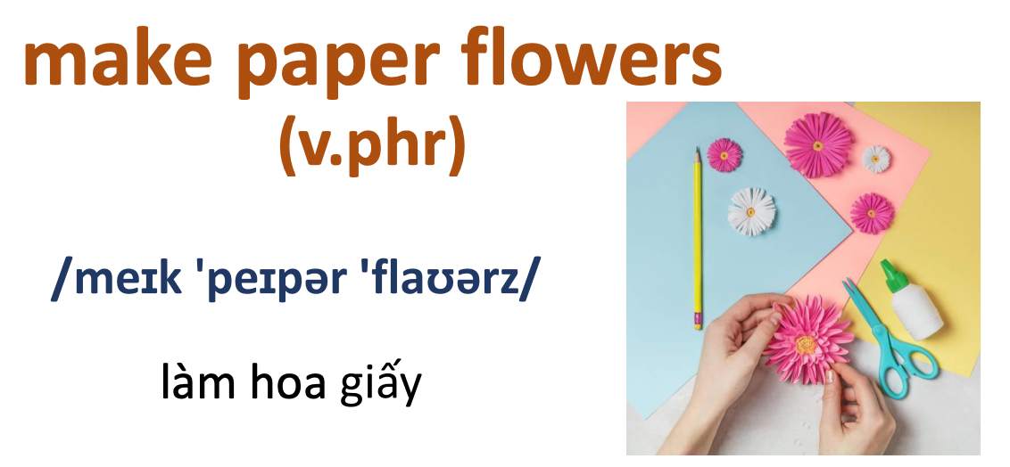
NEW WORDS

Slide 7
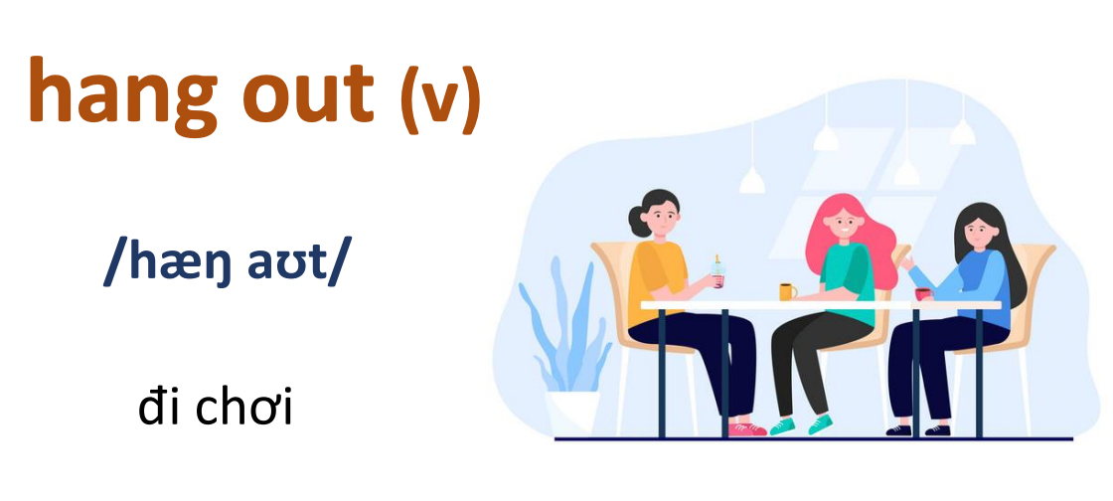
NEW WORDS

Slide 8
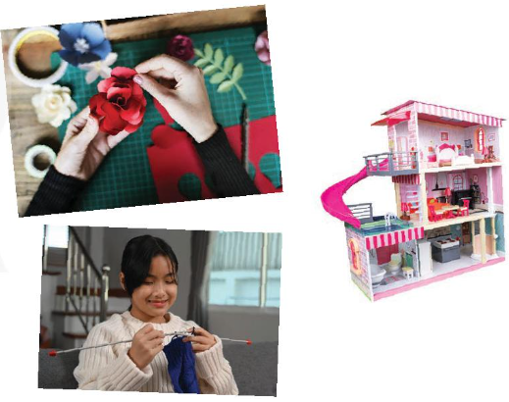


practice
Listen and read
Tom: Hi, Trang. Surprised to see you. What brings you here?
Trang: Oh, hello Tom. I'm looking for a knitting kit.
Tom: A knitting kit? I didn't know you like knitting.
Trang: Actually, I'm keen on many DIY activities. In my leisure time, I love knitting, building dollhouses, and making paper flowers.
Tom: I see. So, you like spending time on your own.
Trang: Yeah. What do you do in your free time?
Tom: I'm a bit different. I usually hang out with my friends. We go to the cinema, go cycling, or play sport in the park.
Trang: You love spending free time with other people, don't you?
Tom: That's right. By the way, would you like to go to the cinema with me and Mark this Sunday? There's a new comedy at New World Cinema.
Trang: Yes, I'd love to. Can I ask Mai to join us?
Tom: Sure. Let's meet outside the cinema at 9 a.m.

Slide 9



practice
2 Read the conversation again and complete the sentences.
1. Trang is looking for a _____________
2. She likes doing DIY in her ______________
3. Tom loves spending his free time with _______________
4. Tom and his friends usually ____________ together.
5. Tom, Mark, Trang, and Mai are going to see a comedy this _________
knitting kit
leisure time
other people
hang out
Sunday

Slide 10
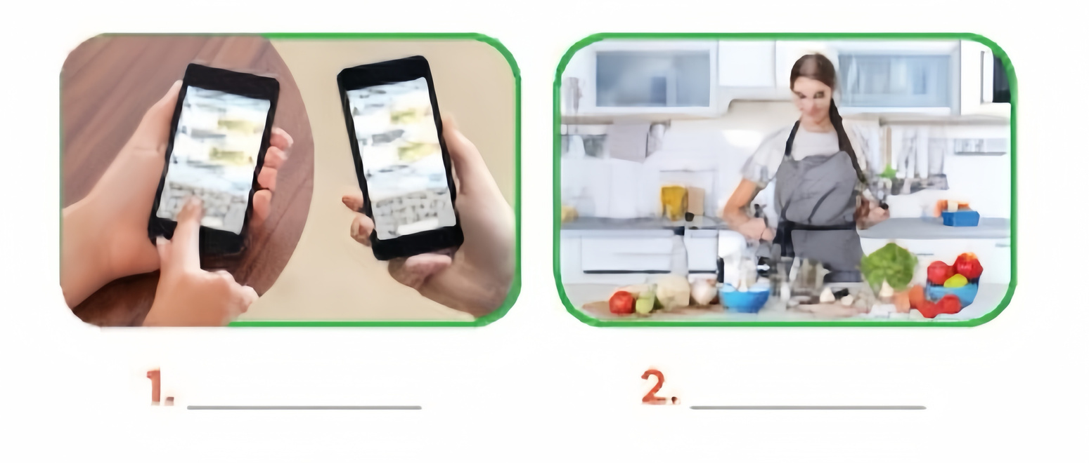
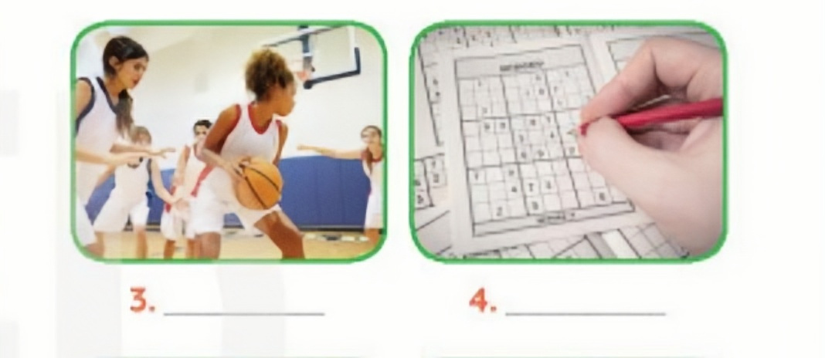

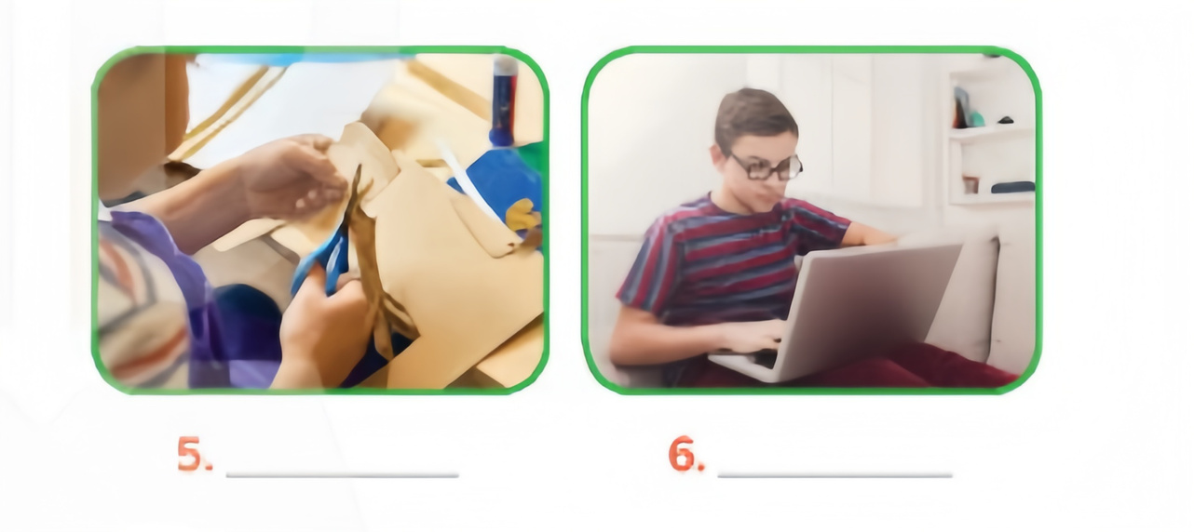
3 Work in pairs. Write the activities from the box under the correct pictures.
doing DIY cooking doing puzzle playing sport surfing the net messaging friends
playing sport
doing puzzles
messaging friends
cooking
doing DIY
surfing the net

Slide 11


PRACTICE
4. Work in pairs. Read the word and phrases, and guess which activities in 3 are described.
1. improve memory, a mental exercise
2. Save money, increase creativity
3. Improve physical health, make friends
4. Keep in touch, be relaxed
5. Learn something about IT, computer skills
doing puzzles
doing DIY
playing sport
messaging friends
surfing the net

Slide 12
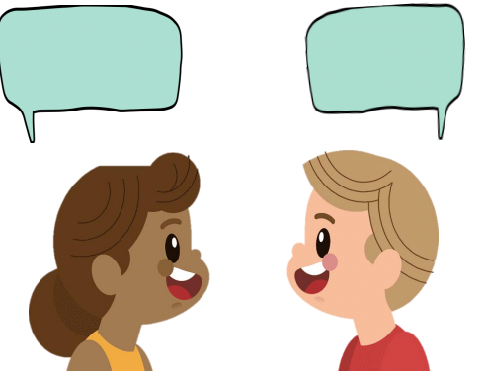
production
5. Work in groups. Ask one another the question below. Then report your friends’ answers to the class
If you have some free time this weekend, what will you do?

Slide 13


Consolidation
1 : What have we learnt in this lesson?
identify the topic of the unit
use lexical items related to leisure activities
2 : Homework
Learn by heart all the words that students have just learnt.
Do exercises in the workbook.
Project preparation lesson 2

Slide 14



THANK YOU !

