Slide 1
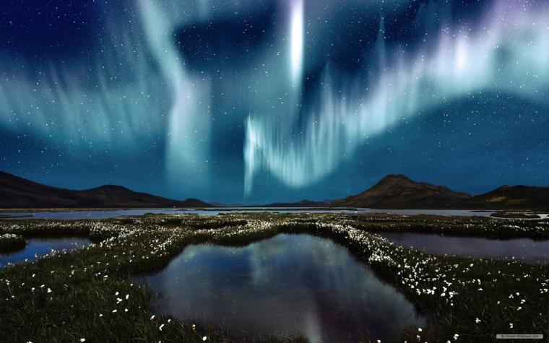

Slide 2

WARM-UP
OPTION 1
Brainstorming

Slide 3
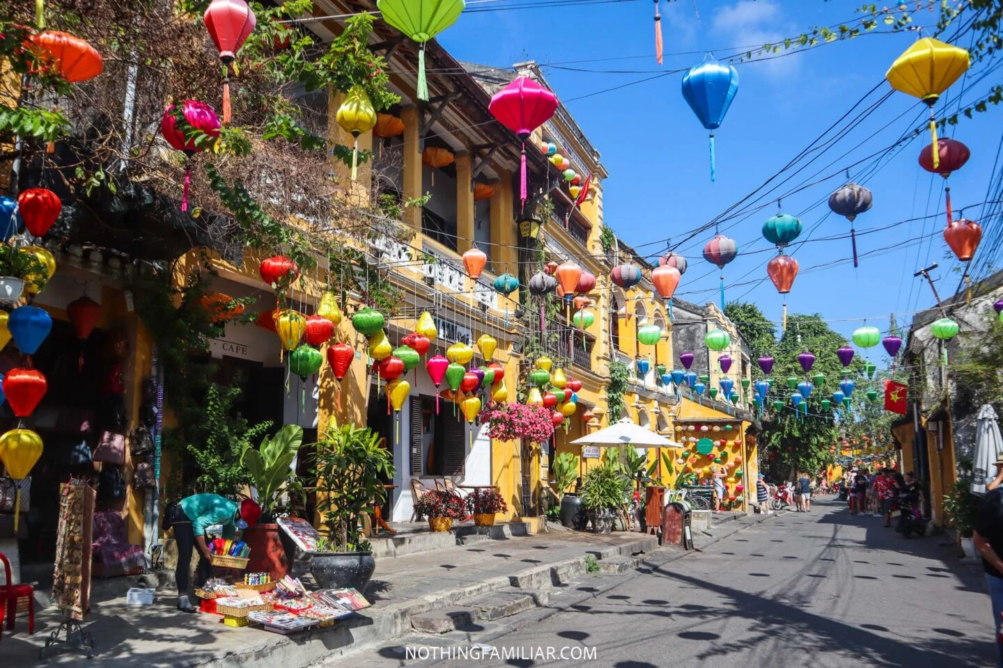
WARM-UP
OPTION 1
HOI AN

Slide 4
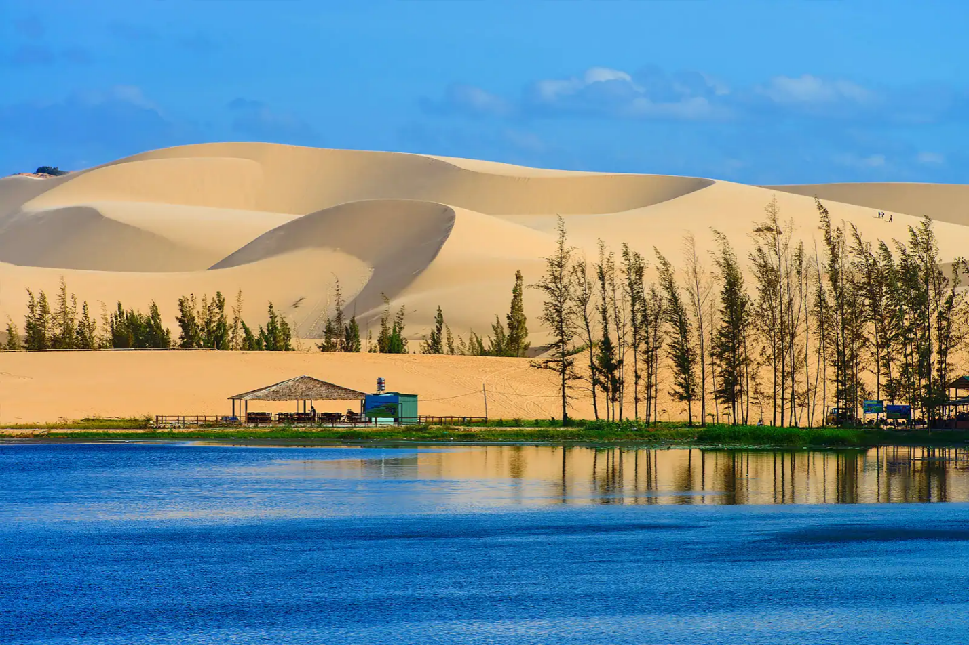
WARM-UP
OPTION 1
BAU TRANG, MUI NE

Slide 5
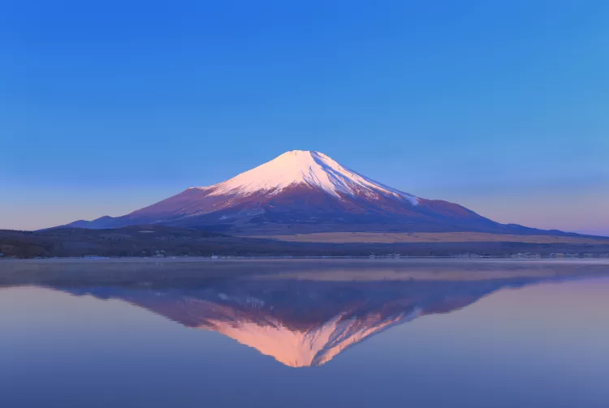
WARM-UP
OPTION 1
FUJI, JAPAN

Slide 6
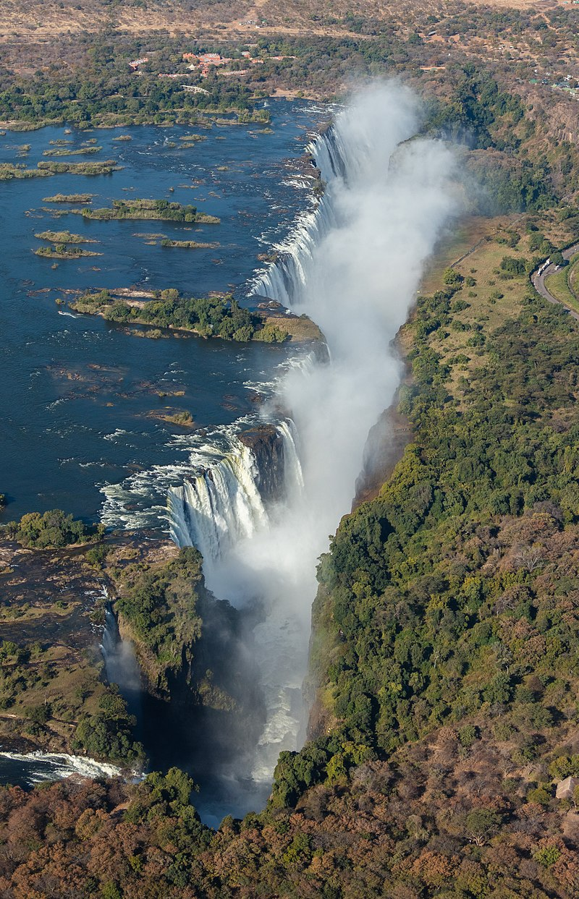
WARM-UP
OPTION 1
VICTORIA FALLS, BETWEEN ZAMBIA AND ZIMBABWE

Slide 7


PERIOD 56
Unit
7
NATURAL WONDERS OF THE WORLD
LESSON 2: A CLOSER LOOK 1

Slide 8

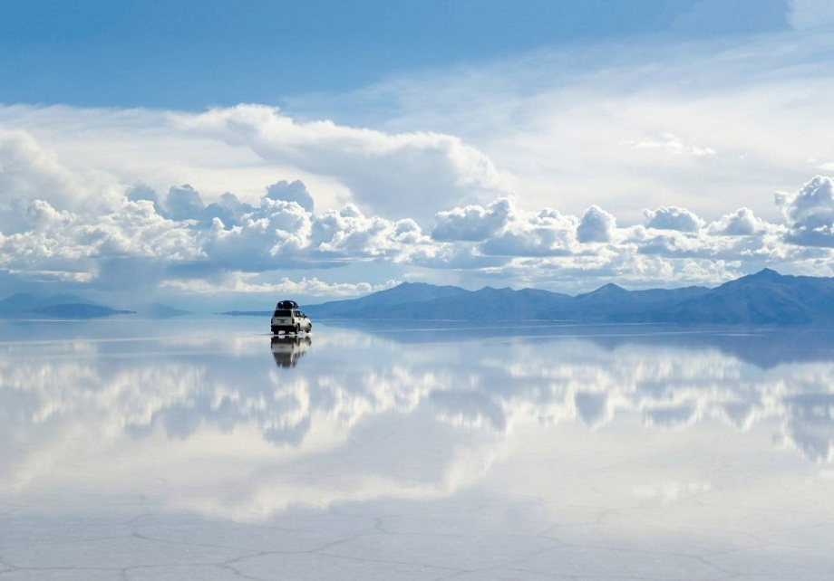
VOCABULARY
permit (v)
to allow something
/pəˈmɪt/
E.g. The security system will not permit you to enter without the correct password.
cho phép

Slide 9
VOCABULARY
paradise (n)
an amazing place that seems perfect
/ˈpærədaɪs/
thiên đường,
nơi đẹp tuyệt trần

Slide 10
VOCABULARY
annual (adj)
happening once every year
/ˈænjuəl/
E.g. an annual event/ visit/ holiday
(xảy ra) hằng năm

Slide 11

VOCABULARY
access (n)
the method or possibility of getting near to a place or person
/ˈækses/
E.g. The only access to the village is by boat.
tiếp cận, đến được

Slide 12
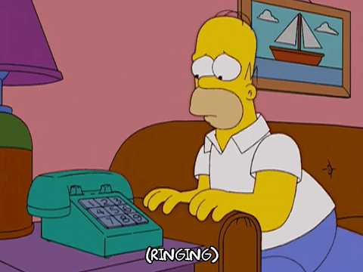
VOCABULARY
very important and needing attention immediately
urgent (adj)
/ˈɜːdʒənt/
gấp, cấp bách

Slide 13
VOCABULARY
to pause before you do or say something, often because you are uncertain or nervous about it
hesitate (v)
/ˈhezɪteɪt/
lưỡng lự

Slide 14
VOCABULARY
New words | Pronunciation | Meaning
1. permit (v) | /pəˈmɪt/ | cho phép
2. paradise (n) | /ˈpærədaɪs/ | thiên đường, nơi đẹp tuyệt trần
3. annual (adj) | /ˈænjuəl/ | (xảy ra) hàng năm
4. access (n) | /ˈækses/ | tiếp cận, đến được
5. urgent (adj) | /ˈɜːdʒənt/ | gấp, cấp bách
6. hesitate (v) | /ˈhezɪteɪt/ | lưỡng lự

Slide 15
VOCABULARY
1
Match the words in A with their definitions/explanations in B.
A | B
1. permit | a. happening once every year | 1.
2. paradise | b. a way of entering or reaching a place | 2.
3. annual | c. a range of many things that are very different from each other | 3.
4. diversity | d. that needs to be done or happen immediately | 4.
5. access | e. to allow or make something possible | 5.
6. urgent | f. a place that is extremely beautiful and that seems perfect | 6.
e
f
a
c
b
d

Slide 16
VOCABULARY
2
Complete the following table. There is one example.
Verb | Noun
discover | discovery
1. locate
2. hesitate
3. Explore
4. possess
5. admire
location
hesitation
exploration
possession
admiration

Slide 17
VOCABULARY
3
Complete the following sentences with the words from the box.
located
hesitation
permit
urgent
diversity
1. The government encourages people to protect the ________________ of their communities.
diversity
urgent
2. There is a(n) _____________ need to preserve biological diversity of our national parks.
Located
3.________________ between Israel and Jordan, the Dead Sea is the lowest place on Earth.
4. When I asked her to go to Lan Ha Bay with me, she agreed without ____________________.
5.They do not ________________ visitors to take photographs of the palace.

Slide 18
1. The government encourages people to protect the ________________ of their communities.
2. There is a(n) _____________ need to preserve biological diversity of our national parks.
3.________________ between Israel and Jordan, the Dead Sea is the lowest place on Earth.
VOCABULARY
3
Complete the following sentences with the words from the box.
located
hesitation
permit
urgent
diversity
4. When I asked her to go to Lan Ha Bay with me, she agreed without ____________________.
hesitation
permit
5.They do not ________________ visitors to take photographs of the palace.

Slide 19
EXTRA ACTITIVTY
- Close your books.
- Try to recall at least a word they have learnt in this unit.
- Then make up a sentence with it.
Notes:
wish → wish
know → knowledge
decide → decision
damage → damage

Slide 20

PRONUNCIATION
/sl/ | /sn/
sleepy slice slippery slogan slope | snack snowy sneeze sneaker snake
Notes:
Video link: https://www.youtube.com/watch?v=ypwZkRXCvmU&list=PL8_ETpRL2xNa7hp3KtZP2F3VZpMbUUlXp&index=7

Slide 21

PRONUNCIATION
4
Listen and repeat the words. Pay attention to the sounds /sl/ and /sn/.
/sl/ | /sn/
sleepy slice slippery slogan slope | snack snowy sneeze sneaker snake

Slide 22
PRONUNCIATION
5
Listen and repeat the sentences. Pay attention the underlined words.
1. There are many snowstorms on Mount Everest.
2. He went down the slope, wearing a pair of sneakers.
3. She sneezed when I gave her a slice of pizza.
4. The way down the hill was slippery as it was covered in snow.
5. After eating a snack, she felt very sleepy.

Slide 23
EXTRA ACTITIVTY
- Give at least one word having the sound /sl/ and one word having the sound /sn/.
Suggested answers:
(slide, slip, slow, sleeve, dogsled, mudslide, snake, snail, snorkel, snowball, …)
Notes:
wish → wish
know → knowledge
decide → decision
damage → damage

Slide 24

CONSOLIDATION
1
Wrap-up
What have we learnt in this lesson?
Use the lexical items related to the topic Natural wonders of the world.
Pronounce the sounds /sl/ and /sn/ in words and sentences correctly.

Slide 25

CONSOLIDATION
2
Homework
- Do exercises in the workbook.
- Find 3 more words that have the sounds /sl/ and /sn/.

Slide 26
Website: hoclieu.vn
Fanpage: facebook.com/tienganhglobalsuccess.vn/

