Slide 1
Unit 6
Our school
facilities
Lesson 1 – Period 2
MsPham
0936082789

Slide 2
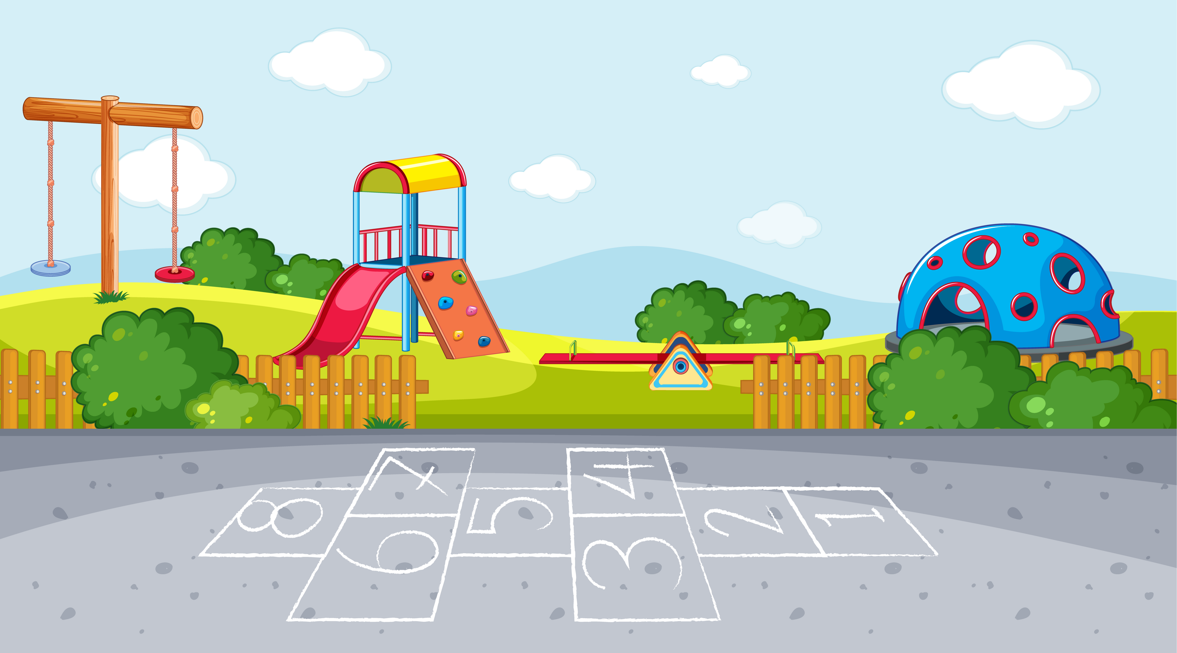
Warm-up

Slide 3
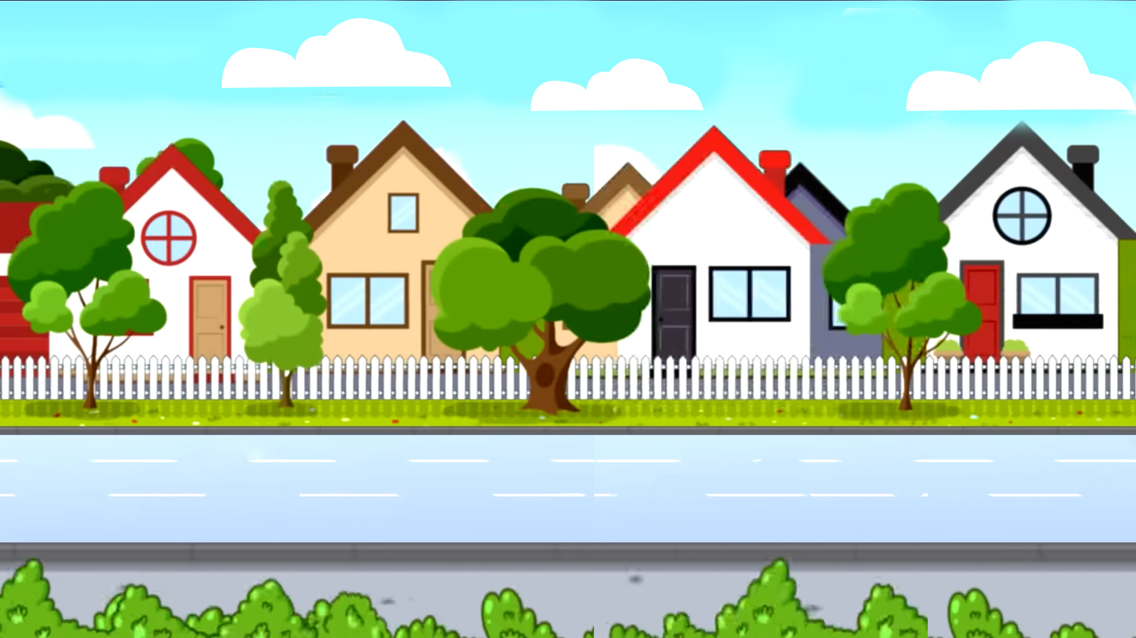
School bus
Play

Slide 4
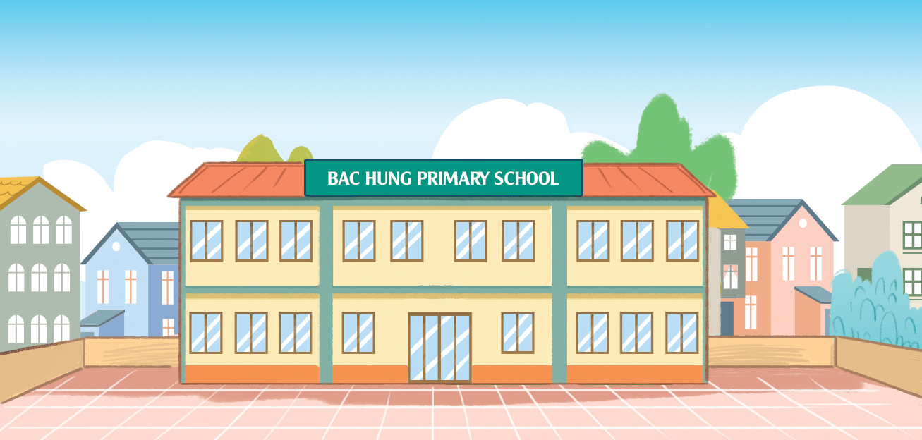
Where ___ your school?
is
Check
Next

Slide 5
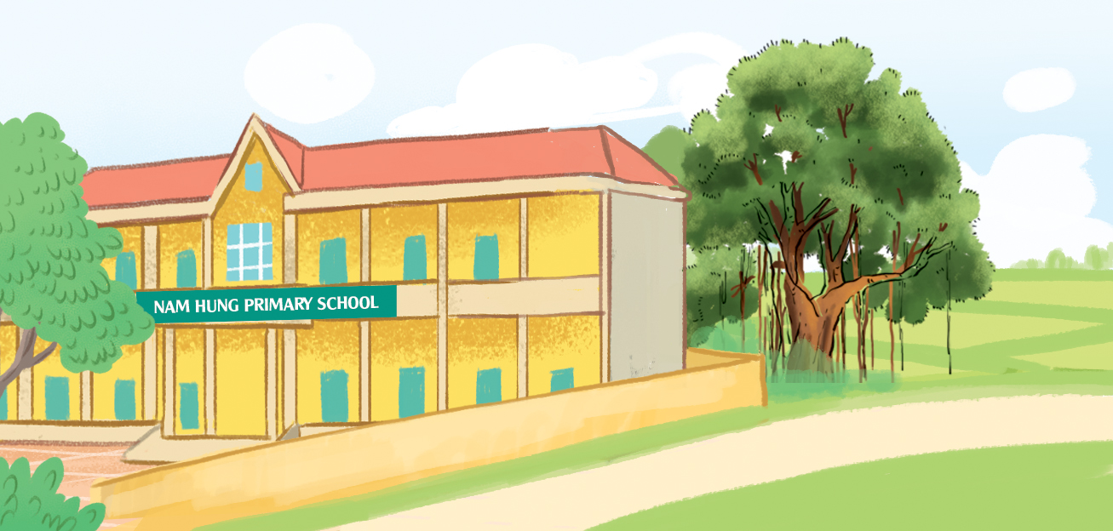
_____ your school?
Where’s.
Check
Next

Slide 6
It’s ___ the city.
in
Check
Next

Slide 7
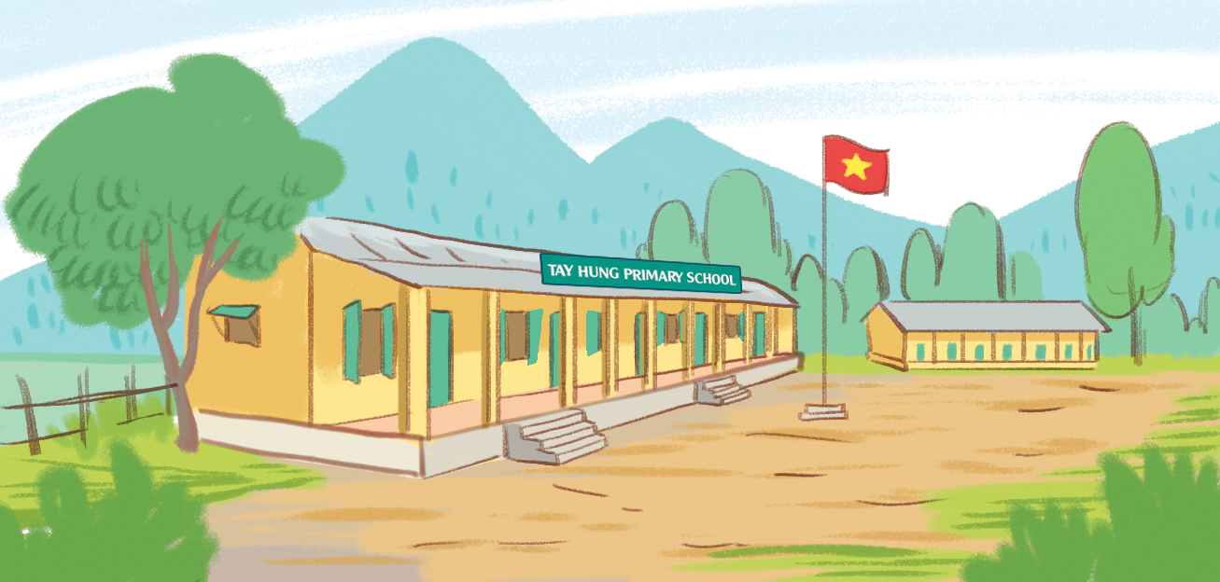
It’s in ___ mountains.
the
Check
Next

Slide 8
Where’s your school?
It’s in the village.
Check
Next

Slide 9
Where’s your school?
It’s in the town.
Check
Next

Slide 10
Where’s your school?
It’s in the mountains.
Check
Next

Slide 11
Where’s your school?
It’s in the city.
Check
Next

Slide 12
End

Slide 13
MsPham
0936082789
Review

Slide 14
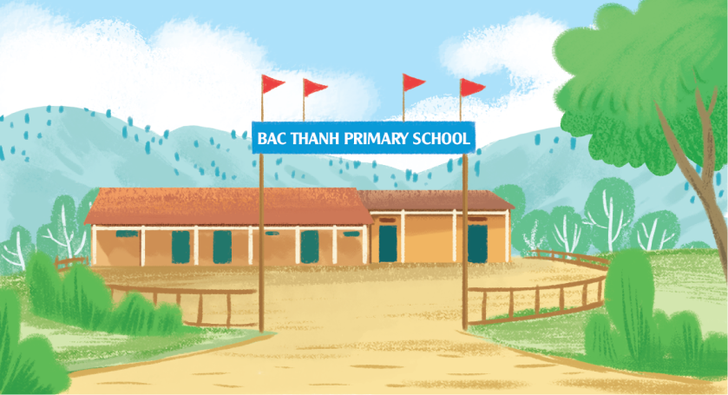
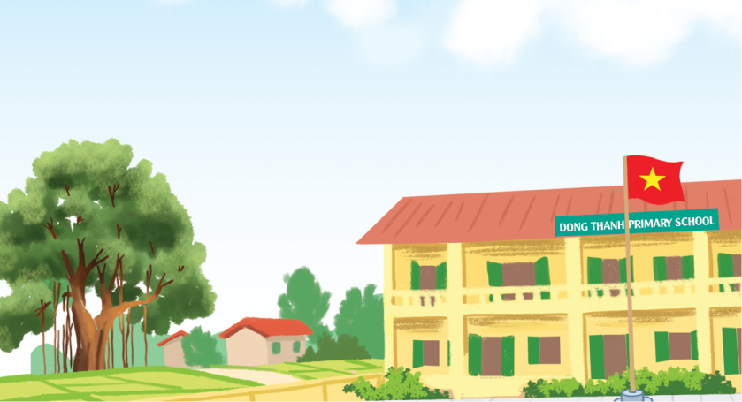
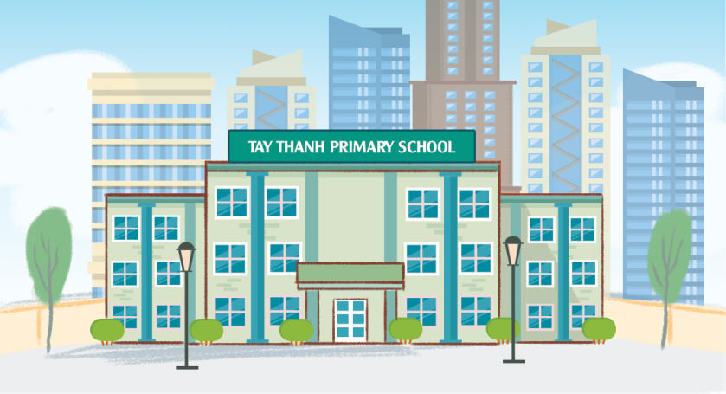
Where’s your school?
MsPham
0936082789
It’s in the ________.
MsPham
0936082789
mountains
village
city
town

Slide 15
MsPham
0936082789
Practice

Slide 16
MsPham
0936082789
4
Listen and number.
MsPham
0936082789
3
4
1
2
1
2
3
4

Slide 17
MsPham
0936082789
5
Look, complete and read.
1
2
MsPham
0936082789
A: Where's your school?
B: It's in the __________.
A: Where's your school?
B: It’s ________________.
village
in the town
3
4
school
Where's
A: Where's your _________?
B: It’s in _____________.
A: ___________ your school?
B: It’s ___________________.
the city
in the mountains

Slide 18
MsPham
0936082789
6
Let’s play.

Slide 19
Thank you!
MsPham
0936082789

