Slide 2
Warm-up
Let's dance.

Slide 3
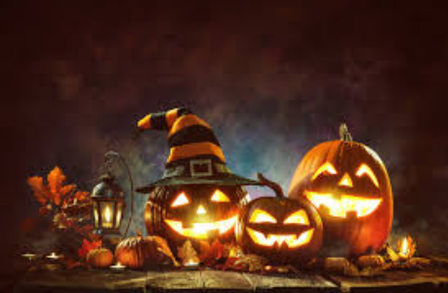
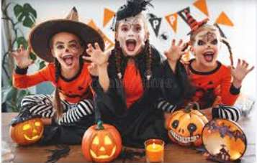
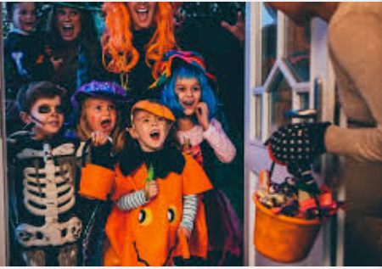
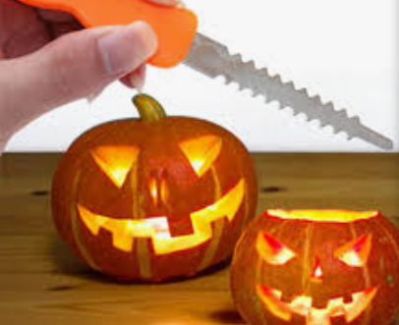

Slide 4
OUR SPECIAL DAYS Lesson 1 - Period 1

Slide 5
01
Activity 1
Look, listen and repeat.

Slide 6
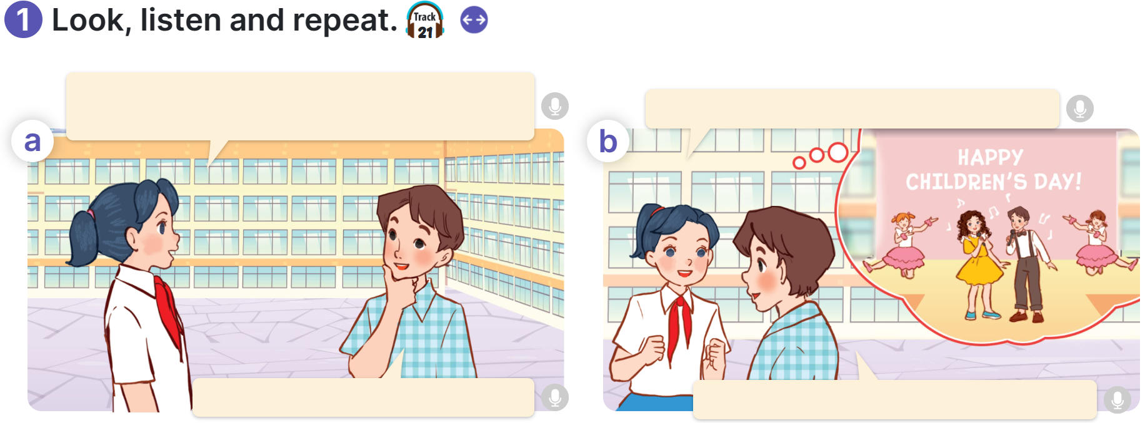

Slide 7
1. Look, listen, and repeat.

Slide 8
02
Activity 2
Listen, point and say.

Slide 9
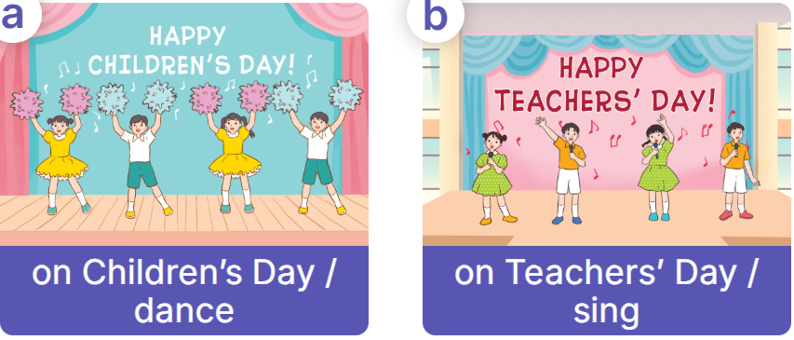

Slide 10
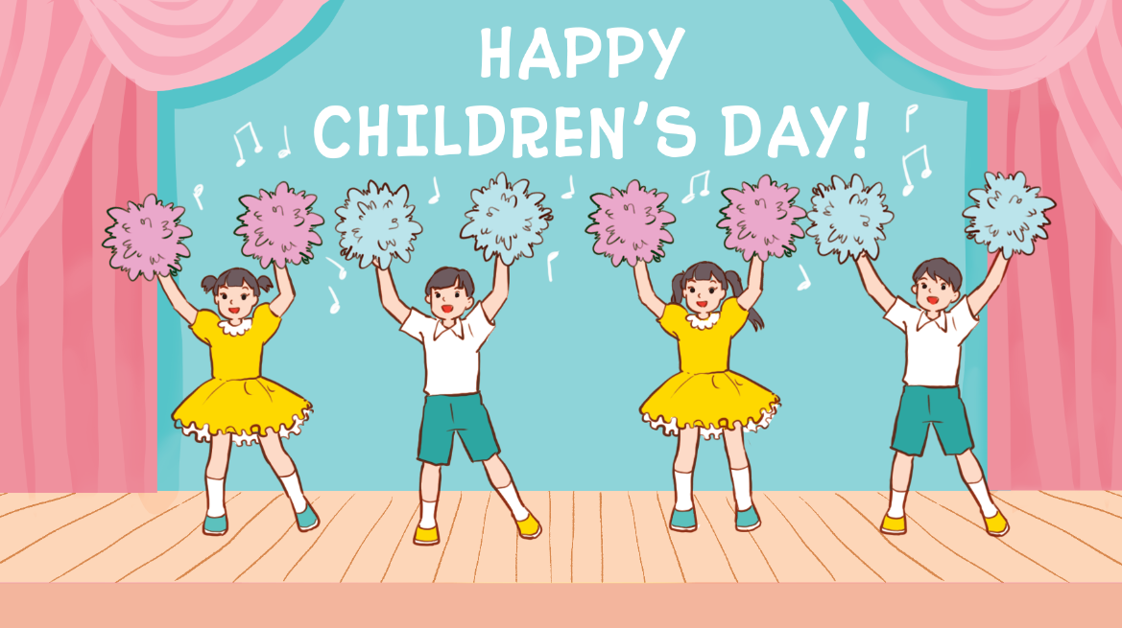
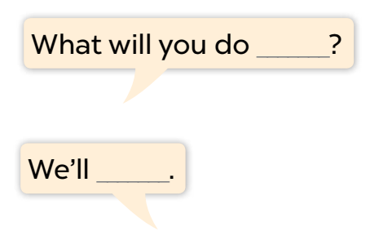
Listen, point and say.
a. On Children’s Day / dance

Slide 11
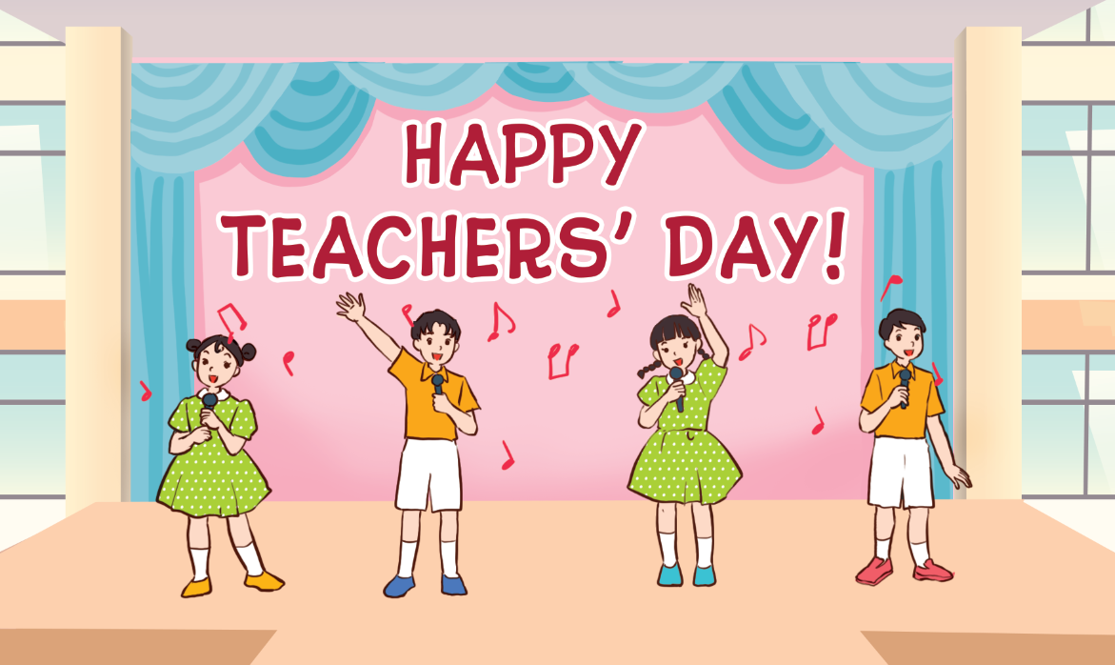
Listen, point and say.
b. on Teacher’s Day / sing

Slide 12
Listen, point and say.
c. on Sports Day / play badminton

Slide 13
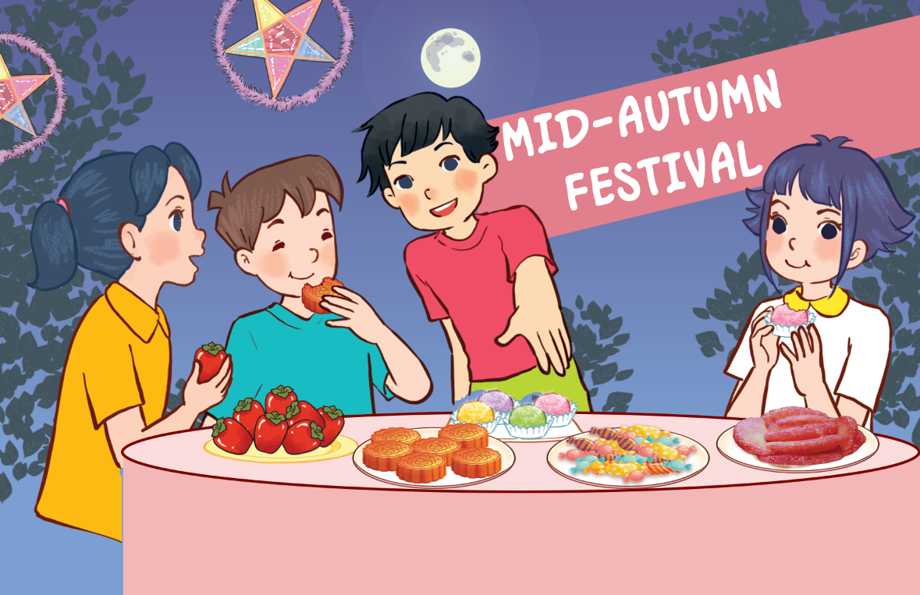
Listen, point and say.
d. at Mid-Autumn Festival / have a party

Slide 14
Game:
SPIN THE WHEEL

Slide 15
Spin the wheel
1 STAR
4 STARS
5 STARS
3 STARS
-3 STARS
- 2 STARS
Click here to spin
NO STAR
7 STARS
-2 STARS
-5 STARS
6 STARS
2 STARS

Slide 16
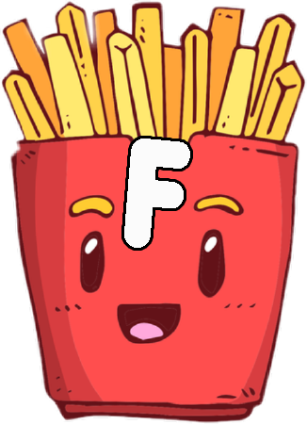

Slide 17
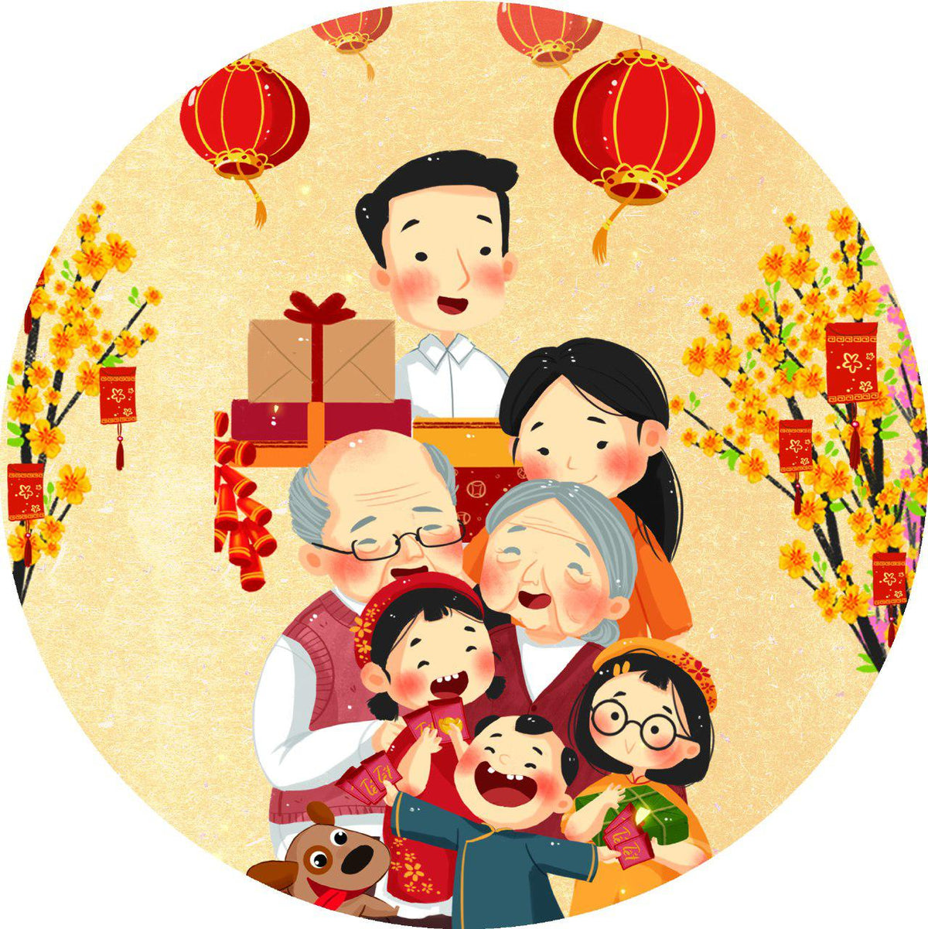
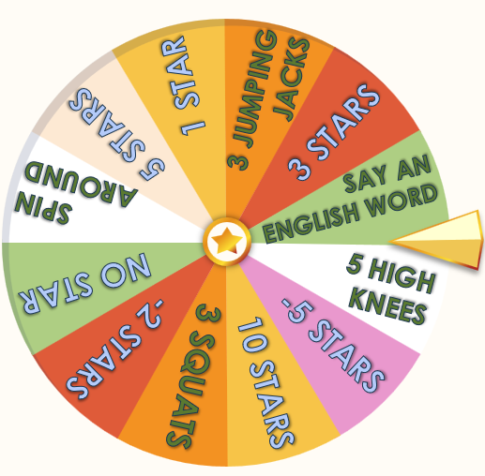
What festival is it?
Answer the question
It’s Tet.
(Lunar New Year)

Slide 18
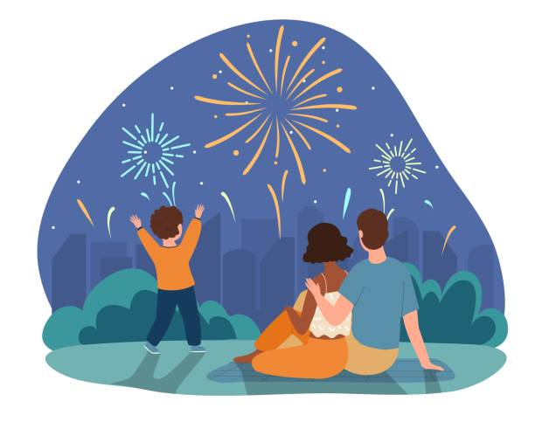
Ask and answer
What will you do at Tet?
We’ll watch fireworks.

Slide 19
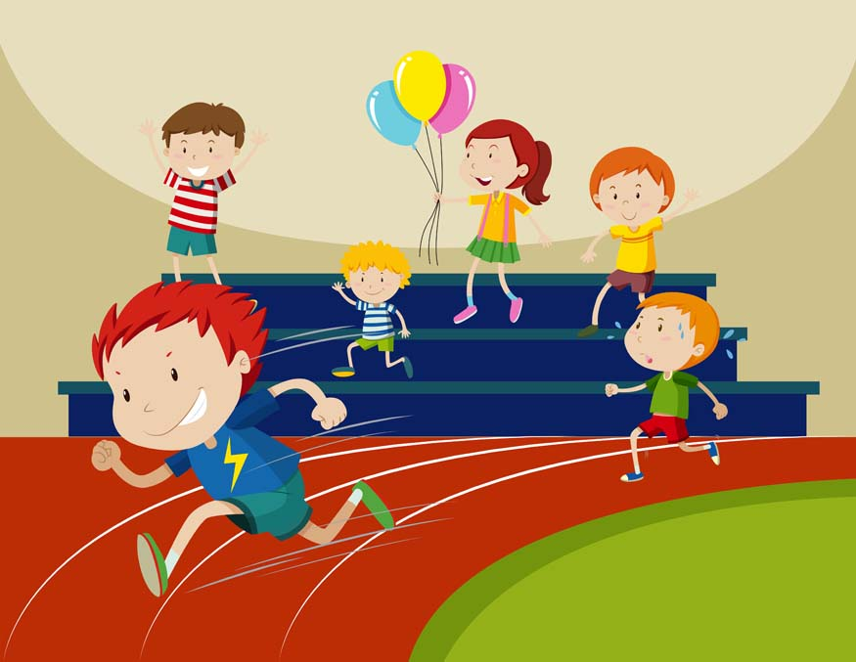
Ask and answer
What will you do on Sports Day?
We'll run.

Slide 20
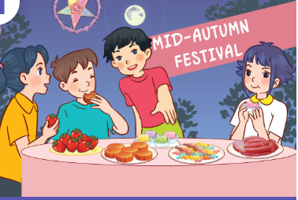
Ask and answer
What will you do on Children’s Day?
We’ll have a party.

Slide 21
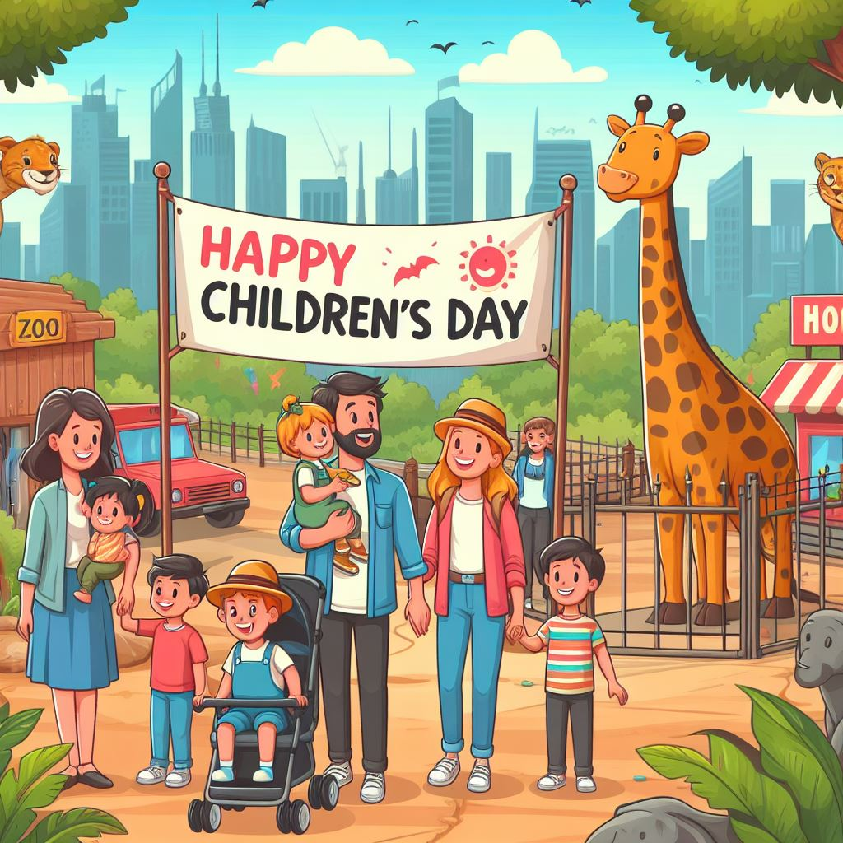
Ask and answer.
What will you do on Children’s Day?
We’ll go to the zoo.

Slide 22
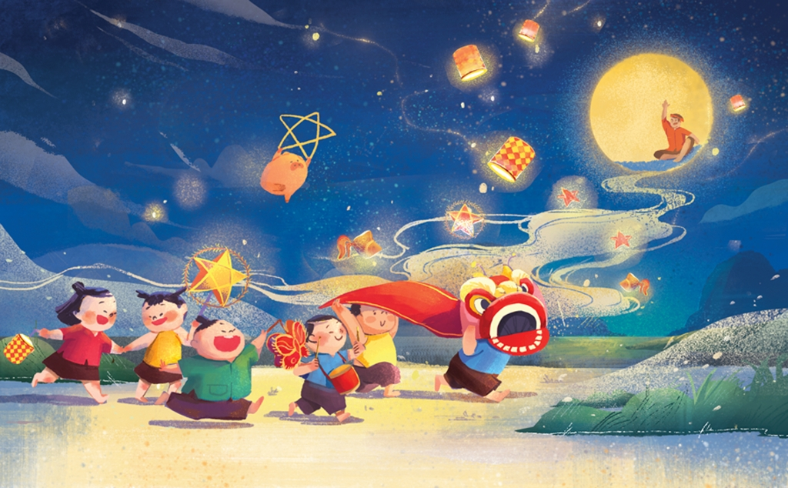
What festival is it?
Answer the question
It's Mid-Autumn Festival.

Slide 23
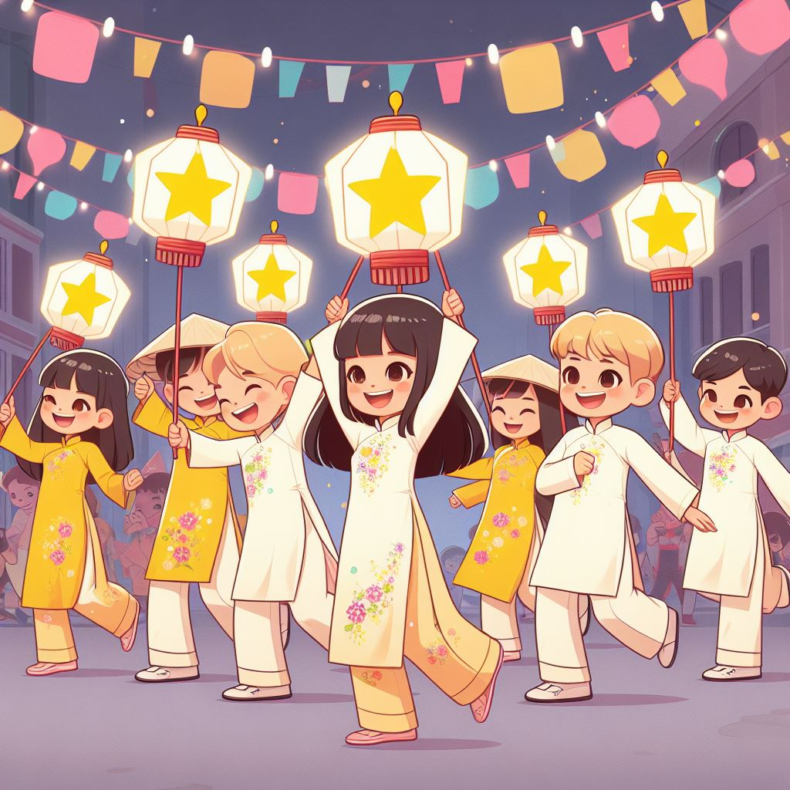
Ask and answer
What will you do at Mid-Autumn Festival?
We’ll dance.

Slide 24
Ask and answer
What will you do on Teachers’ Day?
'
We'll sing.

Slide 25
Activity 3
03
Let's talk.

Slide 26
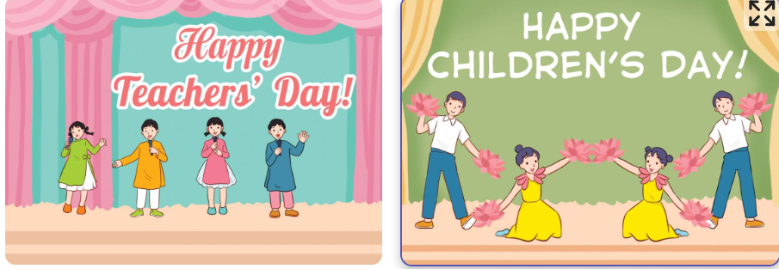

Slide 27
Website: hoclieu.vn
Fanpage: https://www.facebook.com/tienganhglobalsuccess.vn/

