Slide 1




NAM HA PRIMARY SCHOOL
WELCOME TO OUR CLASS 2A5
Teacher: TRAN THI MO
Notes:
1

Slide 2


Unit 6: On the farm
Lesson 1

Slide 3


Play a game
Surfing letters

Slide 4

A
C
X
D
B

Slide 5
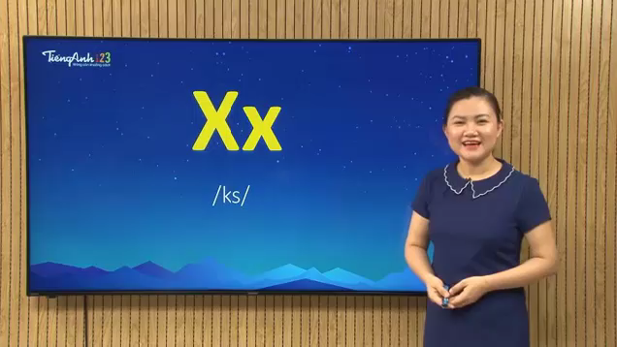

Slide 6
Play a game
Rub out and Remember

Slide 7
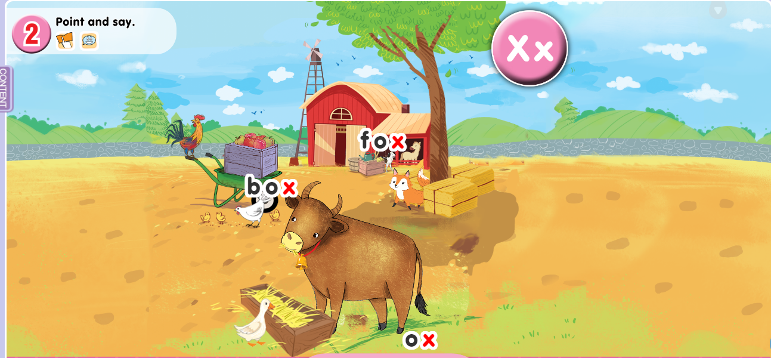

Slide 8

Let's play a game !
SURF THE ANIMALS

Slide 9
