Slide 1




NAM HA PRIMARY SCHOOL
WELCOME TO OUR CLASS 1A5
Teacher: TRAN THI MO
Notes:
1

Slide 2
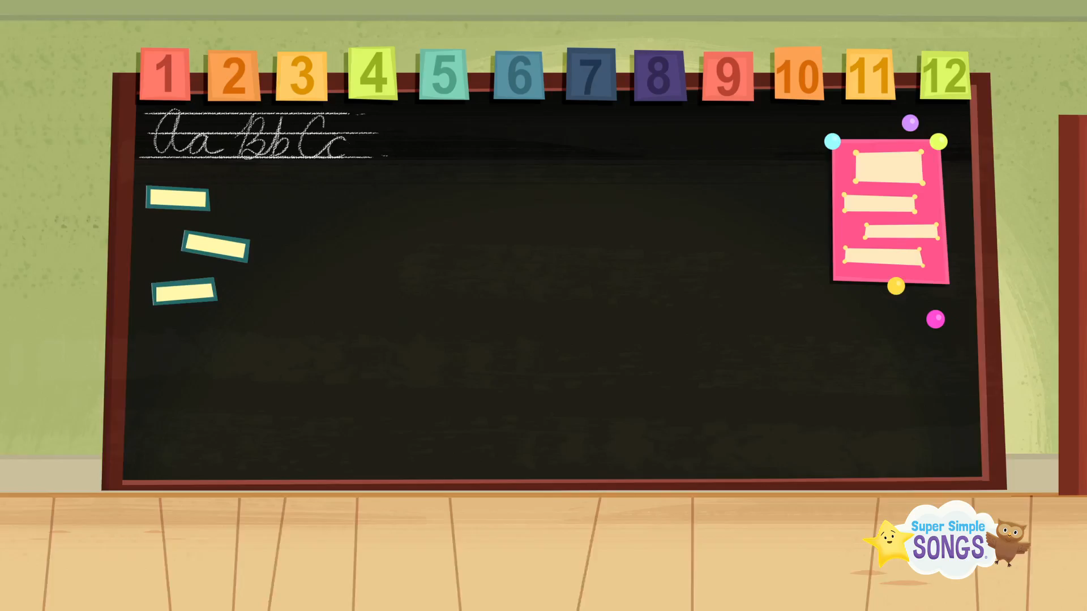

Slide 3


Unit 4: In the bed room Lesson 2

Slide 4


Play a game
Slap the board

Slide 5
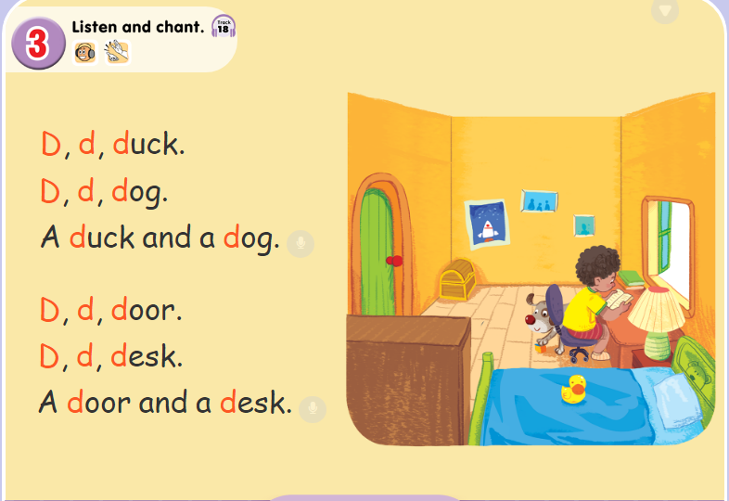

Slide 6
Play a game

Slide 7
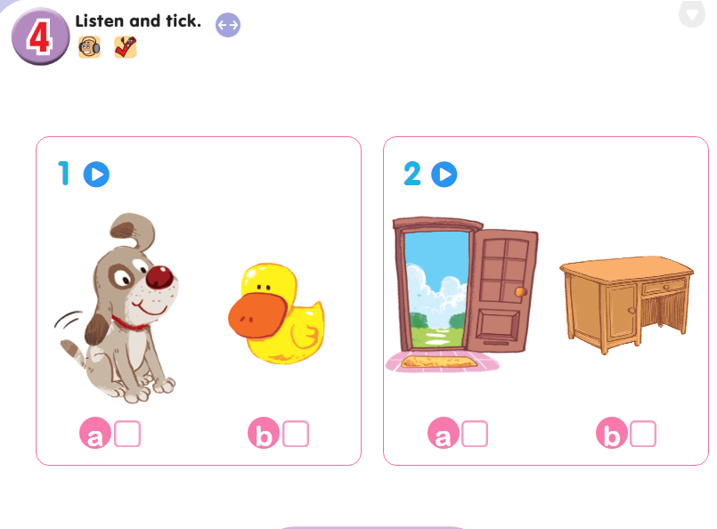

Slide 8
Play a game

Slide 9

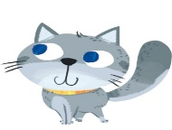

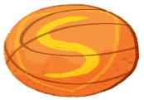
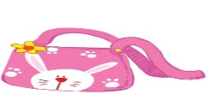


Lucky
things
CAT
DOG

Slide 10
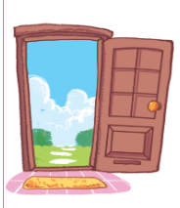

door

Slide 11
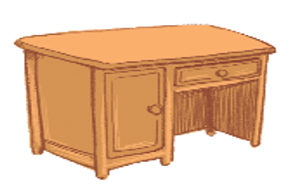
desk

Slide 12
duck

Slide 13

dog

Slide 14



You are lucky

Slide 15
You are lucky

Slide 16















