Slide 2


















5
My future job
Lesson 1(1,2,3)

Slide 3




Quiz game

Slide 4






He cooks food in the restaurant. Who is he?
He’s a cook.

Slide 5
She works at school. She teaches pupils. Who is she?
She’s a teacher.

Slide 6

He works in a police station. Who is he?
He’s a policeman.

Slide 7

She takes care of sick people.
Who is she?
She’s a doctor.

Slide 8

She’s young, she studies at school. Who is she?
She’s a pupil.

Slide 9
She works on a farm. Who is she?
She’s a farmer.

Slide 10

He can sing very well. Who is he?
He’s a singer.

Slide 11
New words
Look, listen and repeat.

Slide 12






firefighter

Slide 13

reporter

Slide 14

gardener

Slide 15

writer

Slide 16
Let’s guess!

Slide 17
a firefighter

Slide 18
a writer

Slide 19
a gardener

Slide 20
a reporter

Slide 21
Look, listen and repeat.

Slide 22
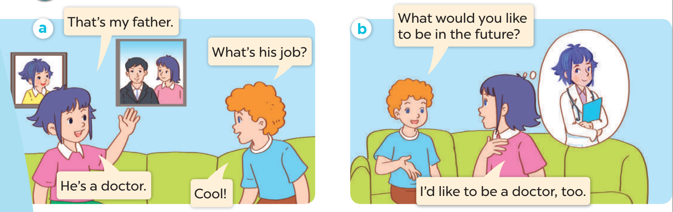

Look, listen and repeat.

Slide 23
Listen, point and say.

Slide 24
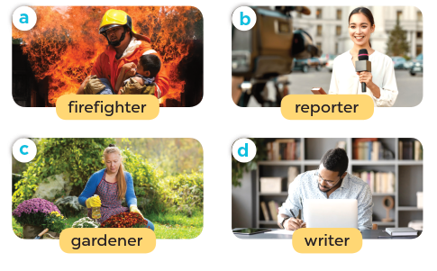
Listen, point and say.

Slide 25
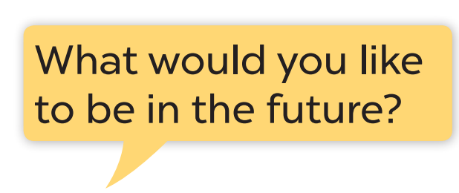




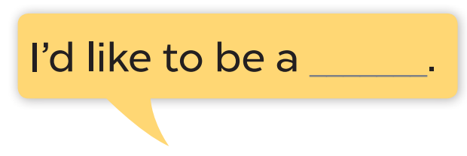

Slide 26
Model sentence:

Slide 27
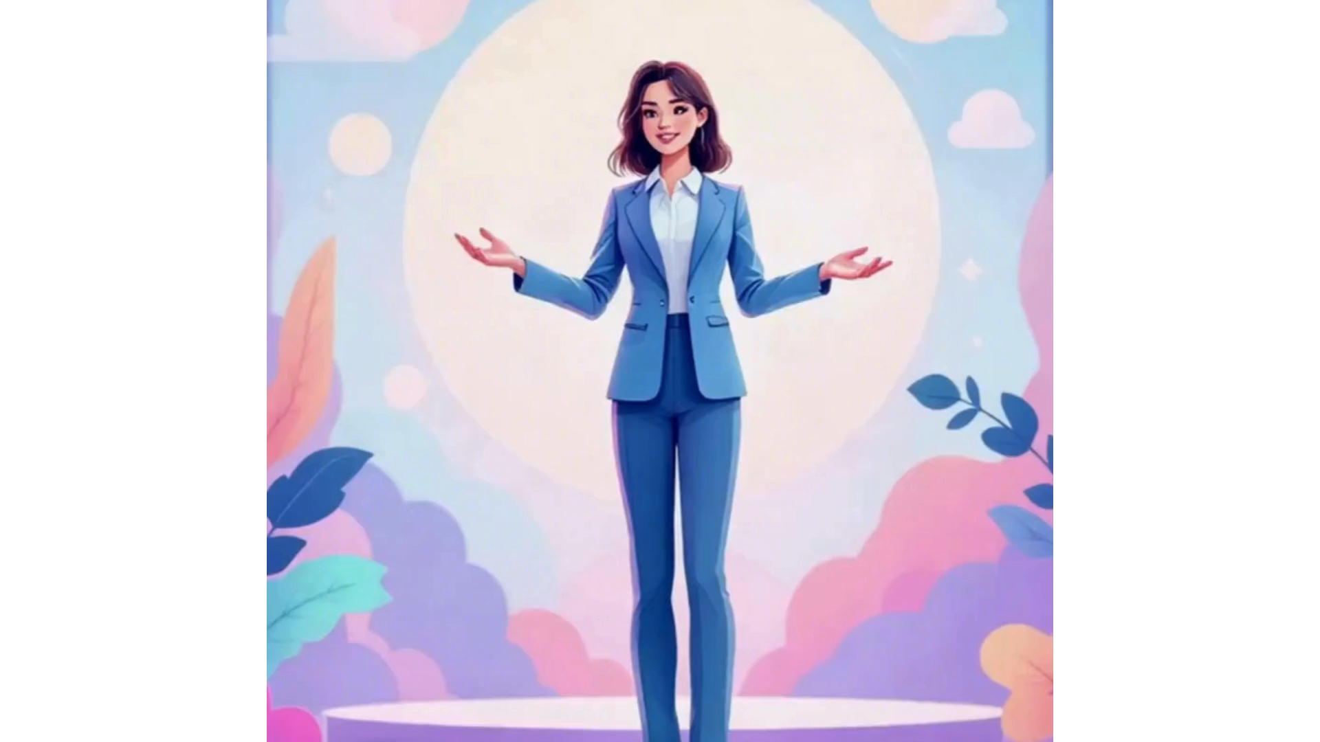

Slide 28
Let’s talk.

Slide 29
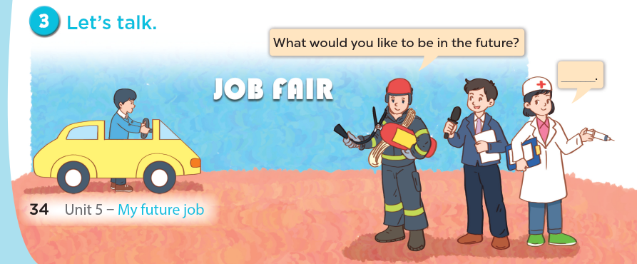

Slide 30
Fun corner and Wrap-up

Slide 31
Let’s play a game!

Slide 32
PASS THE BALL!

Slide 33
HOW TO PLAY
Pass the balls: When the music stops, whoever has a ball must stand up and either ask or answer the question on the screen.
Notes:
GV có thể thay tranh khác hoặc bỏ tranh để hs nói về mình.

Slide 34
PASS THE BALL!
STOP!

Slide 35
PASS THE BALL!
STOP!

Slide 36
PASS THE BALL!
STOP!

Slide 37
PASS THE BALL!
STOP!

Slide 38
PASS THE BALL!
STOP!

Slide 39
PASS THE BALL!
STOP!

Slide 40
PASS THE BALL!
STOP!

Slide 41
PASS THE BALL!
STOP!

Slide 42
PASS THE BALL!
STOP!

Slide 43
WELL DONE!

Slide 44
Website: hoclieu.vn
Fanpage: https://www.facebook.com/tienganhglobalsuccess.vn/

