Slide 1
Unit 6: My Hobby
Lesson 3: Task 7, 8, 9/P86

Slide 2

Game
CANDY CATCH
Notes:
HOẠT ĐỘNG TƯƠNG TÁC
- Divide class into 4 groups
- Ask students to choose the missing letters.
- Do as a model

Slide 3



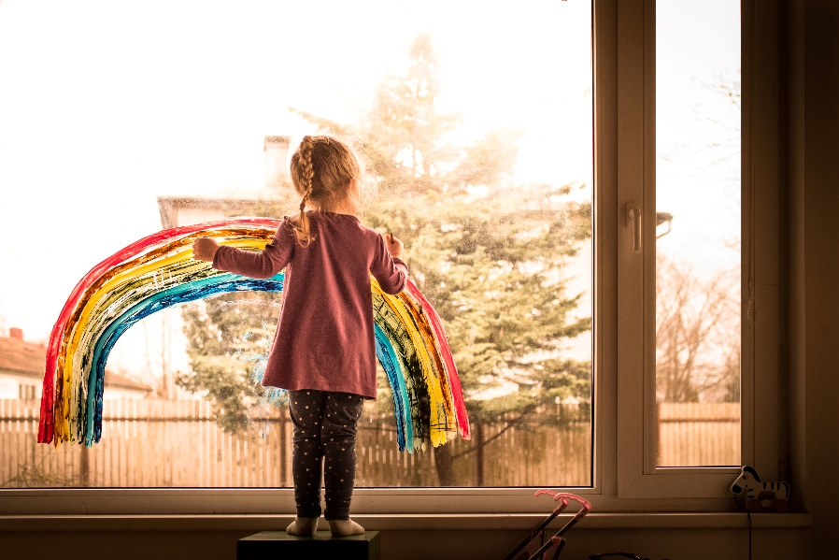



t
o
k
pain_
t
Notes:
-Ask students to choose the missing letters.
Bấm vào cái kẹo để chọn đáp án. Click màn hình để sang câu tiếp theo.

Slide 4


n
d
t
coa_
t
Notes:
-Ask students to choose the missing letters.
Bấm vào cái kẹo để chọn đáp án

Slide 5

ee
oy
ou
b_ _
o y
Notes:
-Ask students to choose the missing letters.
Bấm vào cái kẹo để chọn đáp án

Slide 6

b
t
d
ha_
t
Notes:
-Ask students to choose the missing letters.
Bấm vào cái kẹo để chọn đáp án

Slide 7


Task 7 Listen and repeat.
Notes:
- Play the recording and tell students how to pronounce the sound /t/, / ɔɪ /, pronounce the sound /t/ in the word write, / ɔɪ / in the word toy and in the sentence I can write with my pen. I can buy a toy
- Play the recording again. Tell students to follow to the words and sounds that they hear with their fingers and repeat. (whole class, in groups and individually)
- Ask some volunteers to perform in front of the whole class.

Slide 8

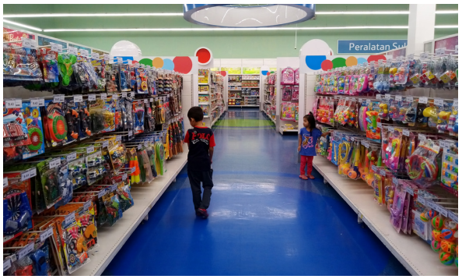
Listen and repeat.
t
wri e
t
oy
I can write with my pen.
I can buy a toy.
Notes:
Bấm vào loa để nghe cả bài
Bấm vào chữ t, oy màu đỏ để nghe âm
Bấm vào chữ w, t màu đen để nghe từ
Bấm vào câu để nghe từng câu
- Play the recording and tell students how to pronounce the sound /t/, / ɔɪ /, pronounce the sound /t/ in the word write, / ɔɪ / in the word toy and in the sentence I can write with my pen. I can buy a toy
- Play the recording again. Tell students to follow to the words and sounds that they hear with their fingers and repeat. (whole class, in groups and individually)
- Ask some volunteers to perform in front of the whole class.

Slide 9
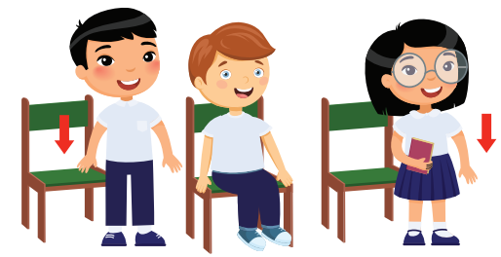
SIT AND STAND GAME
Notes:
- Checking: Sit and stand game
+ Teacher say /t/, write and students must to repeat and stand up
+ Teacher say /ɔɪ/, toy and students must to repeat and sit down
+ If students do the wrong action, they will be out of the game
-Play some rounds (increase the speed to make the game more interesting.)

Slide 10
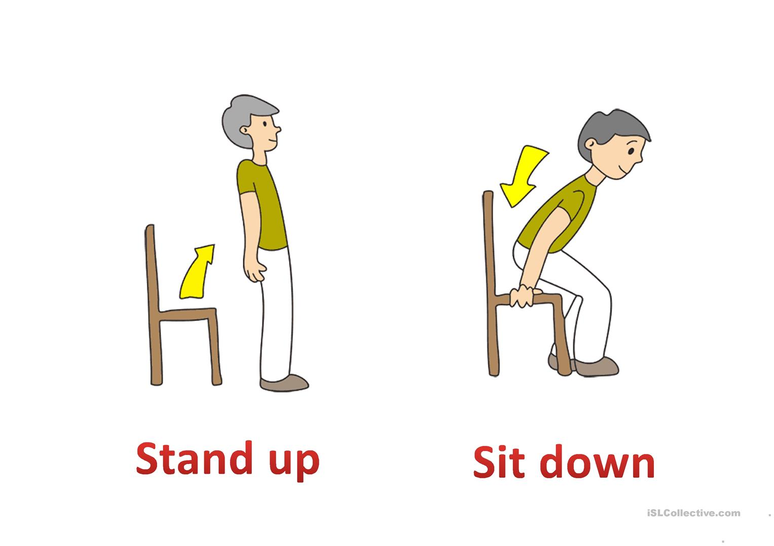

Notes:
Teacher say or play the audio /t/, write and students must to repeat and stand up

Slide 11
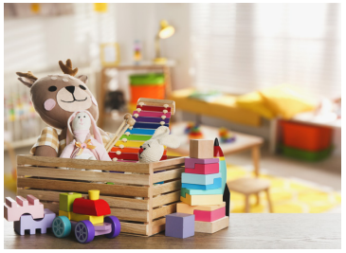
Notes:
Teacher say or play the audio /ɔɪ/, toy and students must to repeat and sit down

Slide 12
?
Next
Notes:
-Play some rounds (increase the speed to make the game more interesting.)
If students do the wrong action, they will be out of the game
Có 60 lượt âm thanh, nếu không chơi hết 60 lượt gv bấm vào next để chuyển tiếp
Bấm chuột nhanh để tang tốc độ đọc

Slide 13
Task 8 Listen and chant.
Notes:
- Play the recording and tell students to listen and follow the words with their fingers.
- Read out the chant one line at a time and ask students to repeat after teacher.
- Play the recording again. Encourage students to chant along. Practice several times until students are familiar with the words and sounds.
- Ask one team to makes the beat by clap hands – another team have to follow the beat to chant with matching.
- Ask some volunteers to chant in front of class.

Slide 14
Listen and chant.
Write and paint!
I can write.
I can paint.
Toy, toy, toy!
I can paint
my new toys.
Notes:
- Play the recording and tell students to listen and follow the words with their fingers.
- Read out the chant one line at a time and ask students to repeat after teacher.
- Play the recording again. Encourage students to chant along. Practice several times until students are familiar with the words and sounds.
- Ask one team to makes the beat by clap hands – another team have to follow the beat to chant with matching.
- Ask some volunteers to chant in front of class.

Slide 15
Task 9 Say it!

Slide 16

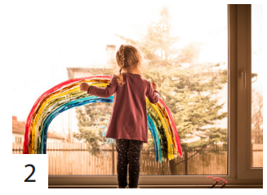

Say it!
1 I can write and paint.
2 My sister can’t write, but she can paint.
3 The boys can play with their toys.
Notes:
- Show three pictures and ask some questions:
1 What can you do?
2 What can she do?
3 What can they do?
- Ask students to look at the sentences. Tell them to pay attention to the sounds /t/ and /ɔɪ/ in each word.
- Read out the words with /t/ and /ɔɪ/ and ask students to repeat.
- Ask students to work in pairs and say the sentences, paying attention to the correct pronunciation of /t/ and /ɔɪ/
- Ask volunteers to say the sentences in front of the class.

Slide 17



Hoa
Minh
…
Can you write?
✗
✓
write
Yes, I can.
No, I can’t.
paint
play
…
Notes:
Chỉnh font chữ
- Divide class into 8 groups
- Ask students to make a survey with their friends in group.
- Ask students to show their survey and perform in front of class, using can/ can’t

Slide 18
Hoa
Minh
…
I can write and paint.
Hoa can’t write but she can paint.
✗
✓
write
✓
✗
paint
✗
play
✓
…
Notes:
- Divide class into 8 groups
- Ask students to make a survey with their friends in group.
- Ask students to show their survey and perform in front of class, using can/ can’t

Slide 19
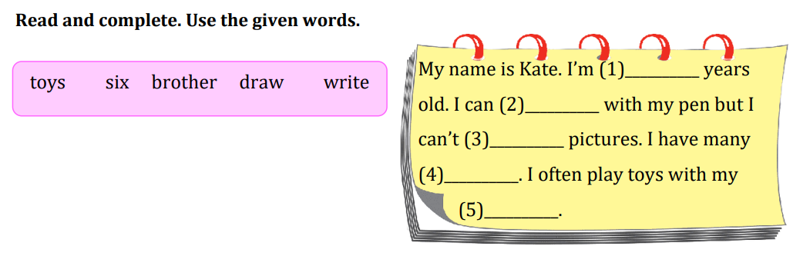
six
write
draw
toys
brother
Notes:
HOẠT ĐỘNG TƯƠNG TÁC

Slide 20




Thank you & goodbye!

