Slide 1
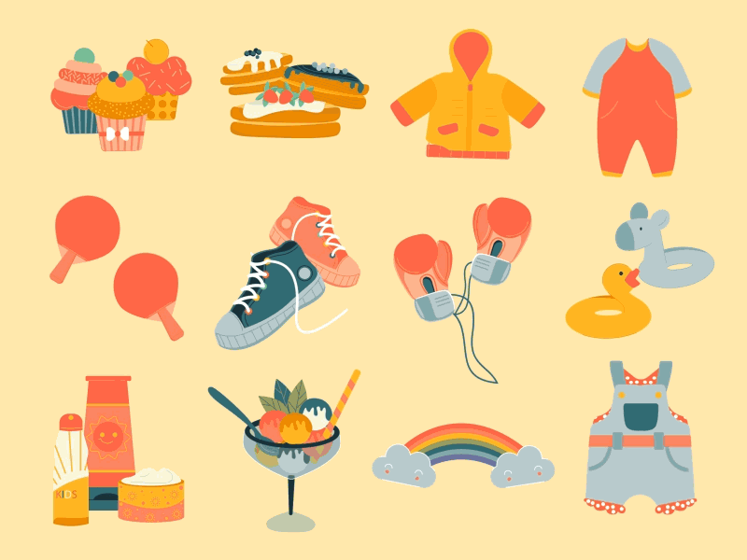


Unit 5: My clothes
Lesson 2 – Task 7,8,9/P69

Slide 2




Song: Hello song

Slide 3
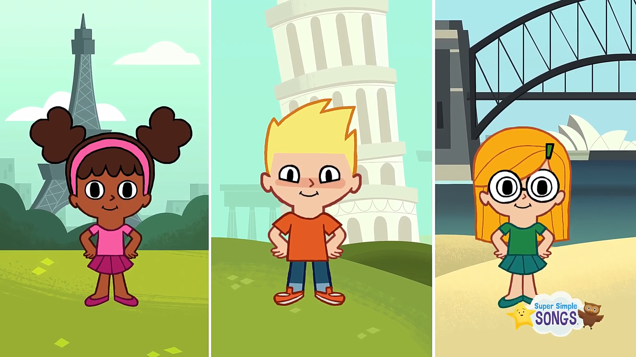

Slide 4
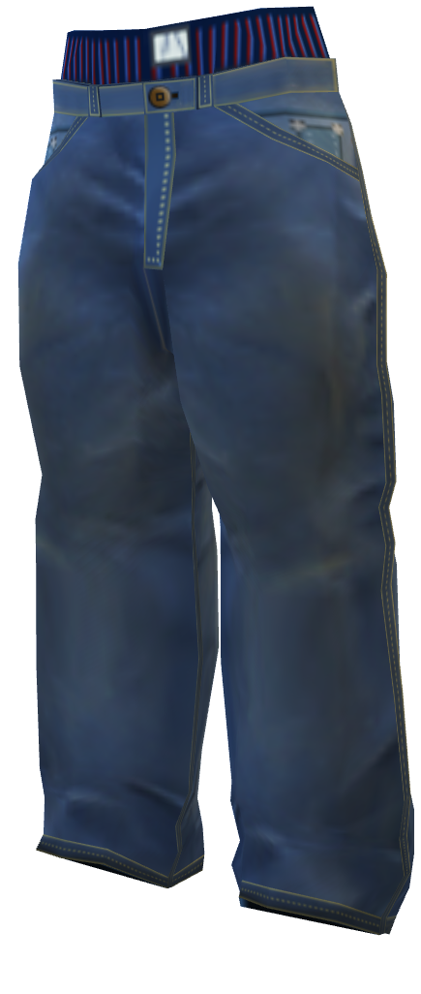
trousers

Slide 5
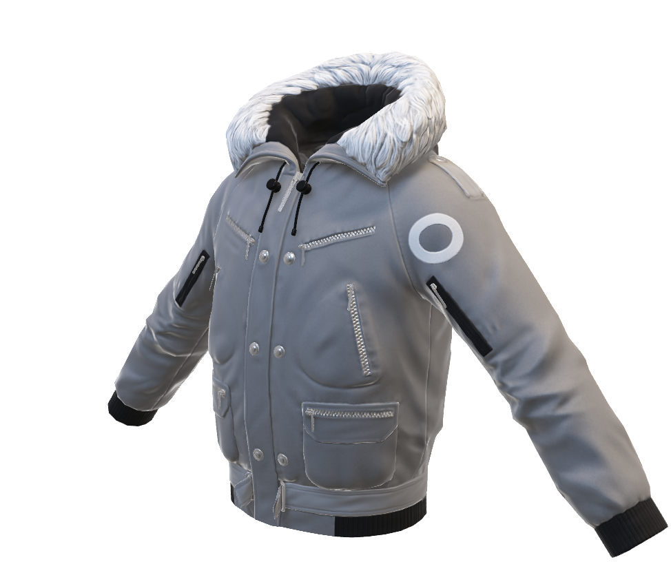
coat
Notes:
GV bấm vào mở từng ô vuông.
Coat

Slide 6
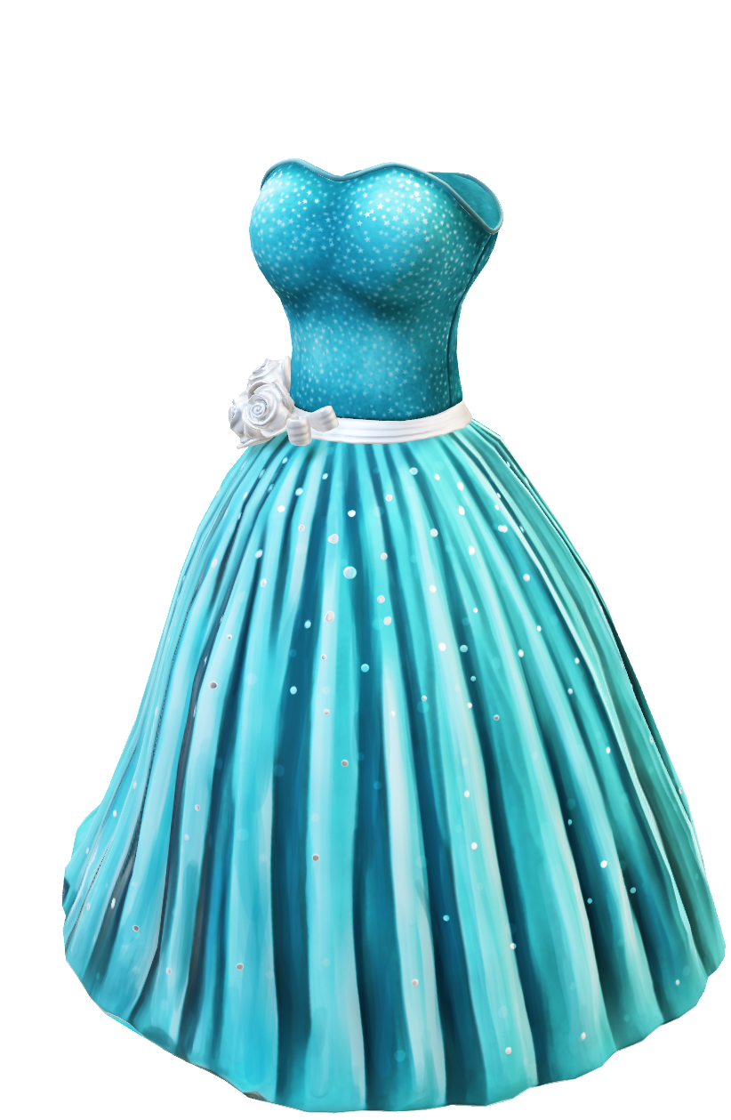
dress
Notes:
GV bấm vào mở từng ô vuông.
Dress

Slide 7
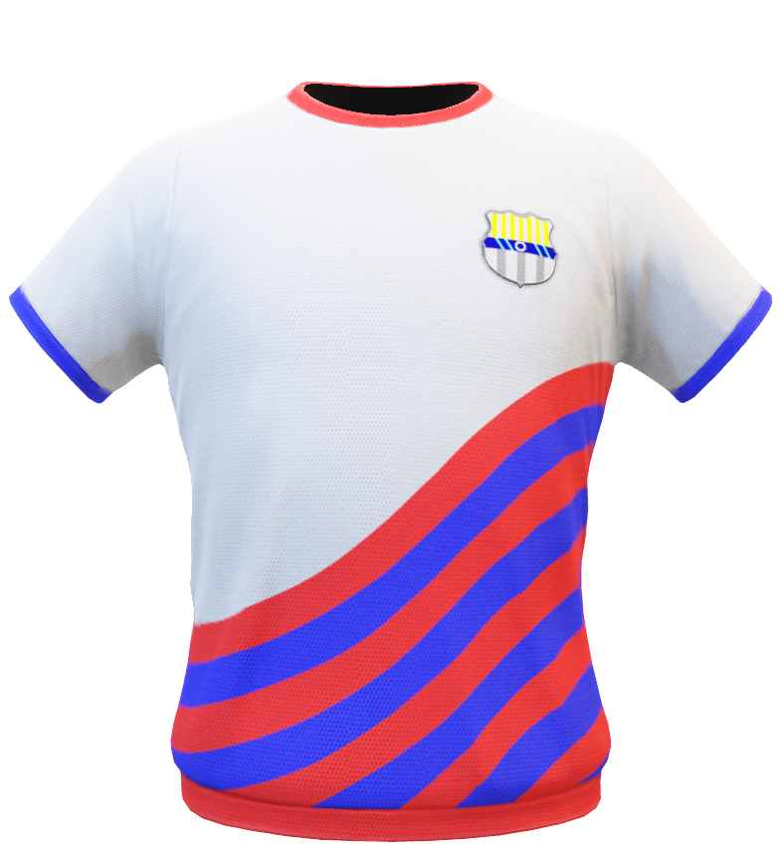
T-shirt
Notes:
GV bấm vào mở từng ô vuông.
T-shirt

Slide 8
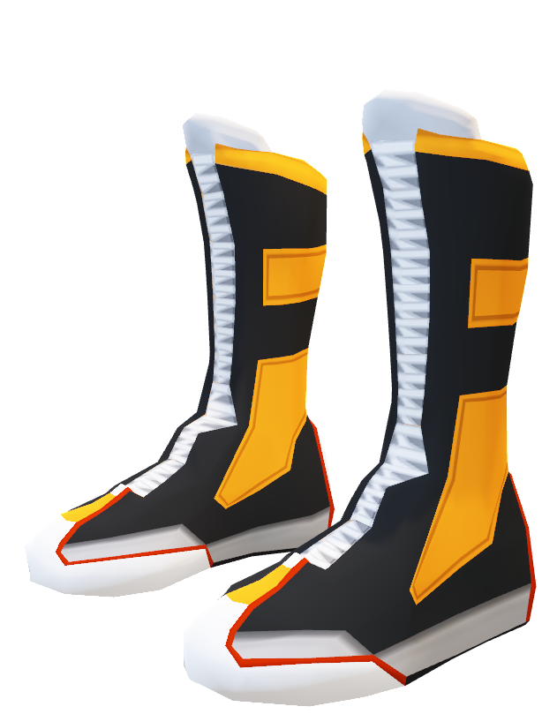
boots
Notes:
GV bấm vào mở từng ô vuông.
Boots

Slide 9
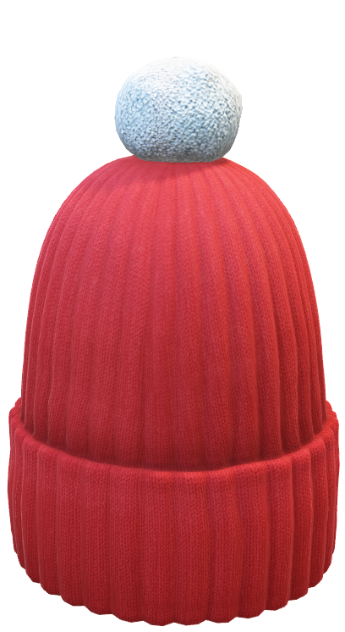
hat
Notes:
GV bấm vào mở từng ô vuông.
Hat

Slide 10
Task 7: Listen and complete

Slide 11
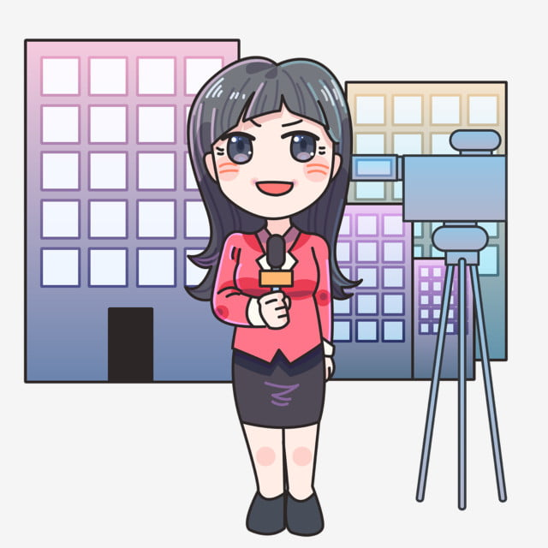
VTV reporter

Slide 12


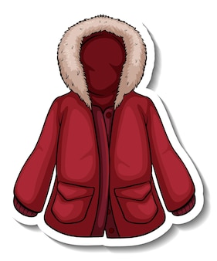
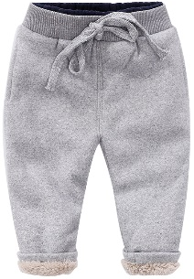

7.Listen and complete.
That is my (1) sister. She’s got an orange
and red (2) _______.
She’s got a green T-shirt and warm (3)
________. She’s got a blue hat
and black (4) ________, too.

Slide 13
7.Listen and complete.
That is my (1) sister. She’s got an orange
and red (2) _______.
She’s got a green T-shirt and warm (3)
________. She’s got a blue hat
and black (4) ________, too.
coat
trousers
boots

Slide 14
Task 8: Look and say

Slide 15
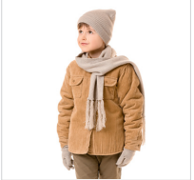
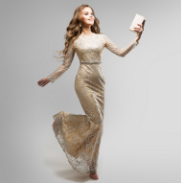
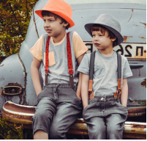
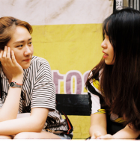
He’s got a coat.
They’ve got trousers.
Their trousers are black.
His coat is warm.
1.
2
3
4
She’s got a dress.
Her dress is nice.
They’ve got T-shirts.
Their T-shirts are nice.

Slide 16


Free talk

Slide 17
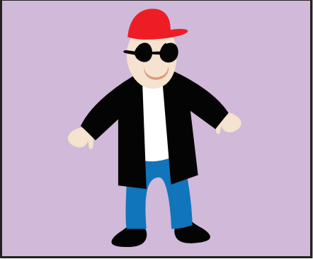
Draw. Write and say.
This is my brother, Liam.
He’s cool.
He’s got a black coat.

Slide 18


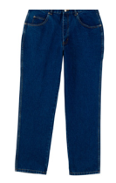
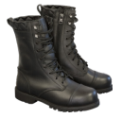






Listen and complete.
Ex: I have got a blue dress.
1. Peter has got ______.
2. Lily has got _________.
3. We have got ______________.
4. My dad has got __________.
5. Her brother has got __________.
a hat
black shoes
red skirts
a coat
a green T-shirt
Notes:
HOẠT ĐÔNG TƯƠNG TÁC

Slide 19




Good bye.
See you again!

