Slide 1


Unit 5: Animals
Lesson 1.1
Page 32

Slide 2
Lesson Outline
Warm-up
Vocabulary
Structure
Consolidation
Wrap-up

Slide 3

WARM-UP

Slide 4
Let’s play!
Simon says Game

Slide 5

It’s time to learn …

Slide 6

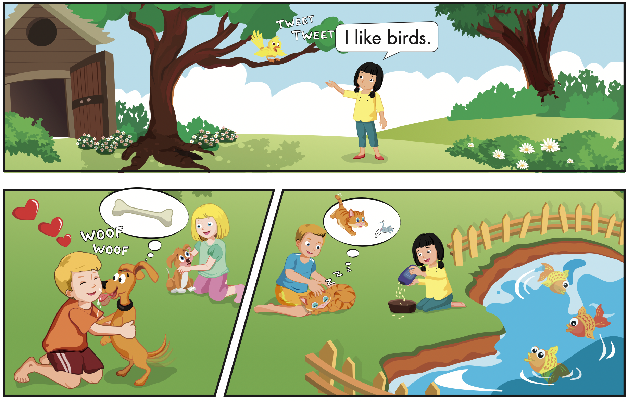
Click B to hear the sound

Slide 7

Speaking

Slide 8
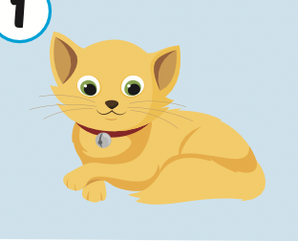
Let’s say!
It’s a cat.
I like cats.

Slide 9
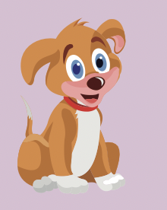
Let’s say!
It’s a dog.
I like dogs.

Slide 10
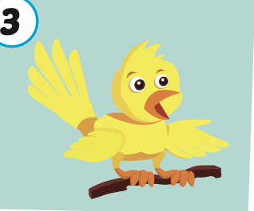
Let’s say!
It’s a bird.
I like birds.

Slide 11



Slide 13

Production

Slide 14
Let’s play!
Listen, look and say
I like……..

Slide 15




I like dogs.

Slide 16


I like birds.

Slide 17

I like cats.

Slide 18


Slide 19

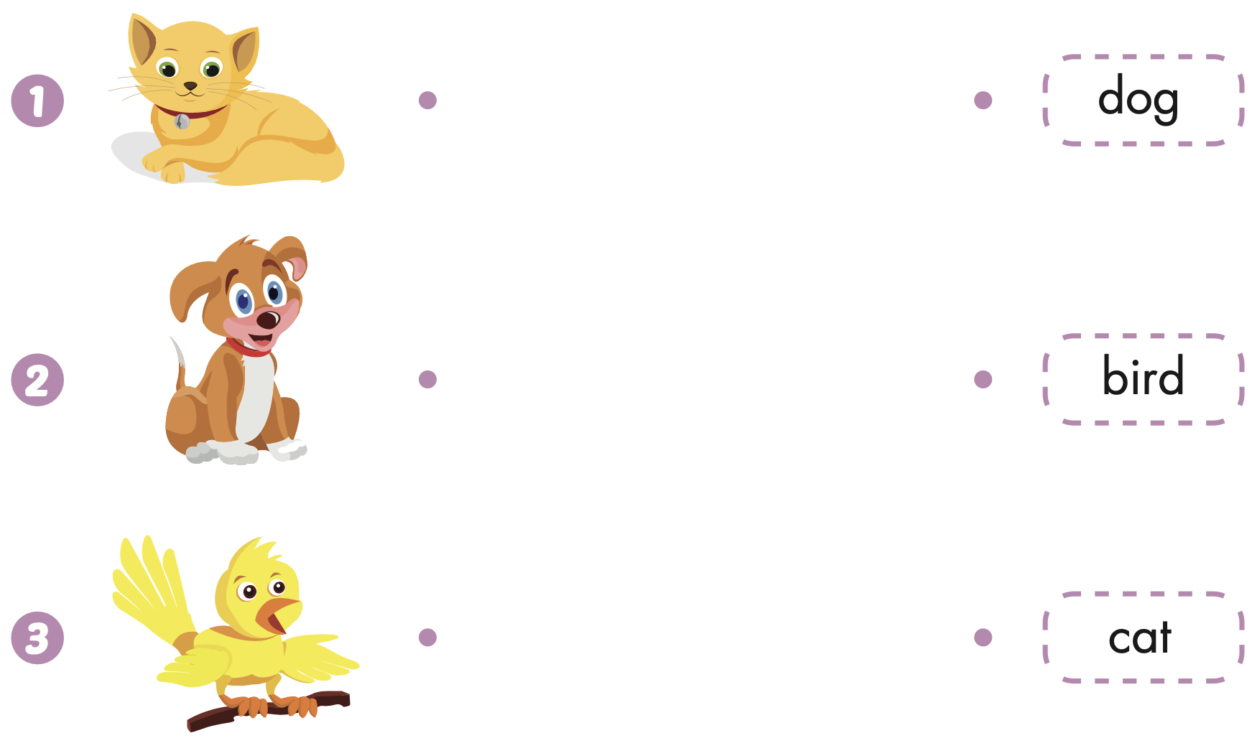
Extra Practice
WB, page 30

Slide 20
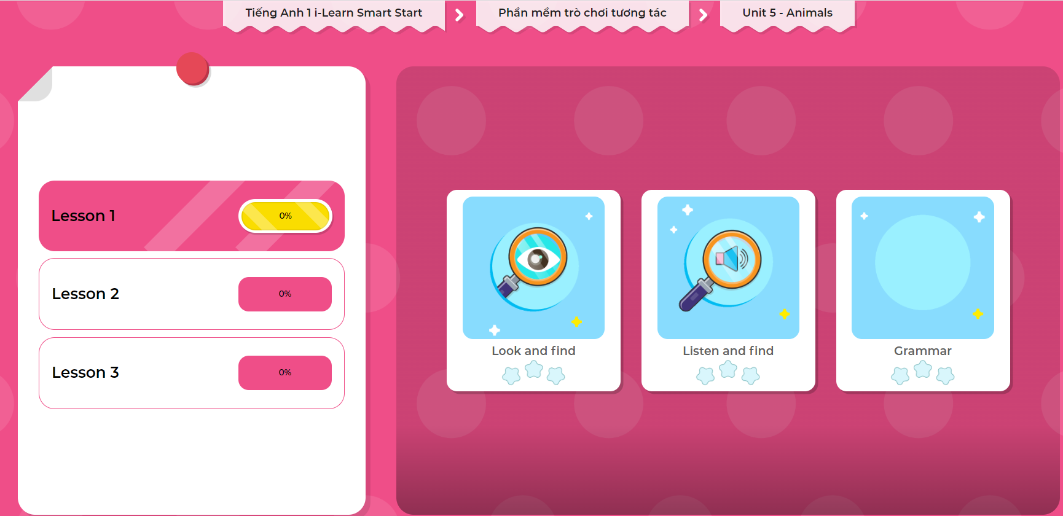
Extra Practice
DHA on Eduhome
LET’S PLAY!
Click on the picture below to play the games.

Slide 21

WRAP-UP

Slide 22
Today’s lesson
Vocabularies
Dog,
Cat,
Bird.
Structures/ Sentence patterns
I like(cats).

Slide 23
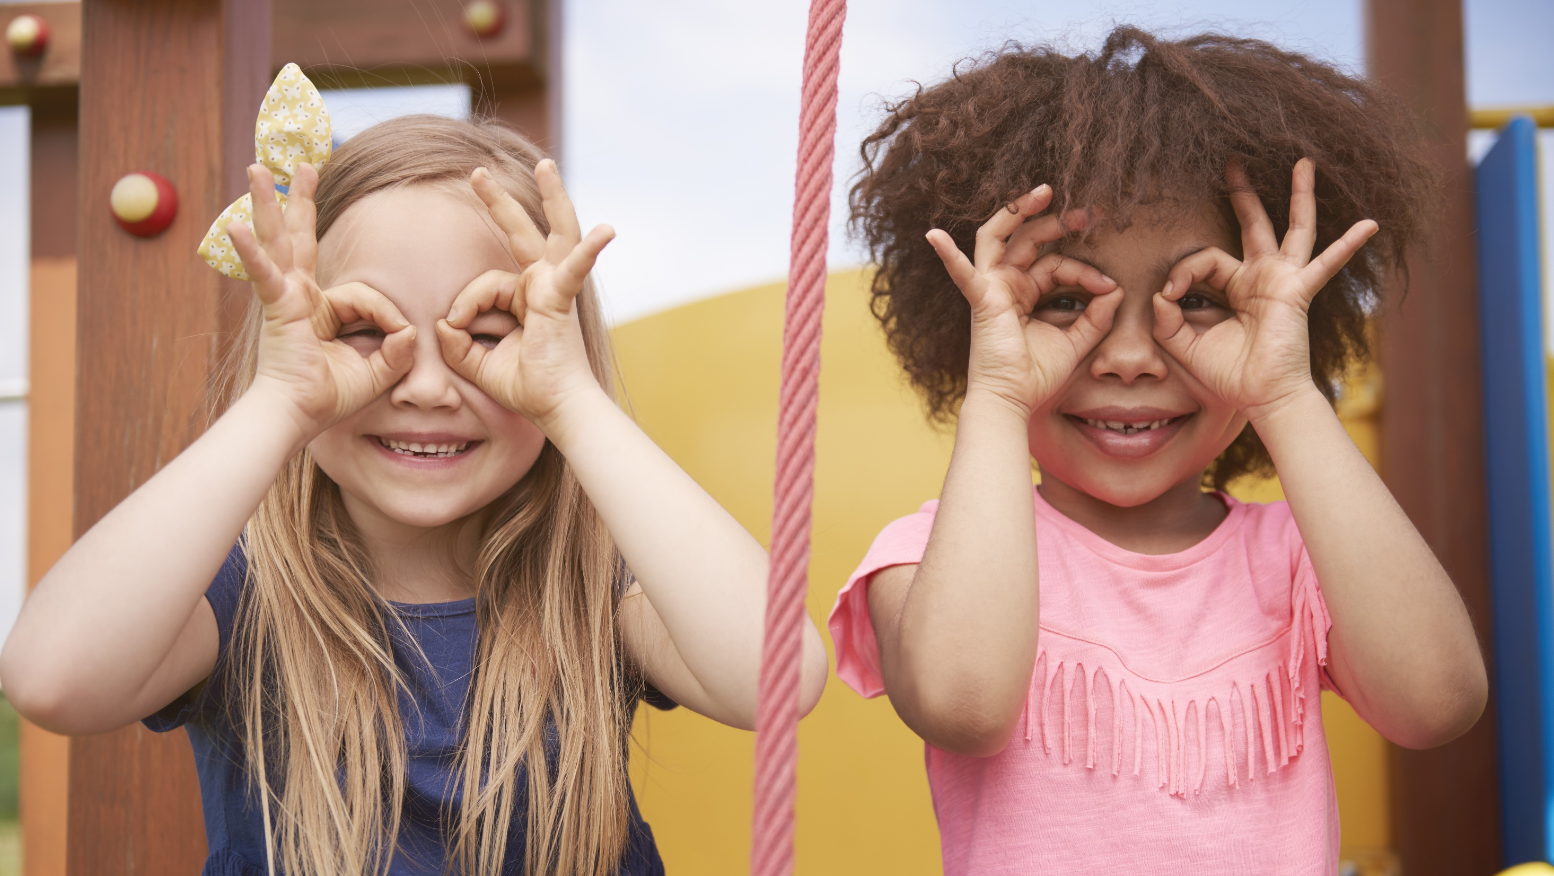
Enjoy your day!

