Slide 1


WELCOME ALL THE TEACHERS TO THE CLASS
ENGLISH 3
Teacher: Bui Bien Phong
School: Đai Ban I primary school

Slide 2








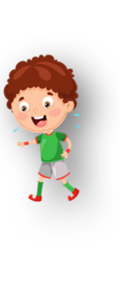











Unit 1
My family
Lesson 1 – Task 1,2,3

Slide 3






Finger family song.

Slide 4

Finger family song

Slide 5

Unit Opener
1. Is it a Chinese or Vietnamese family?
2. How many people are there in this photo?
3. What are they doing?

Slide 6




Slide 7
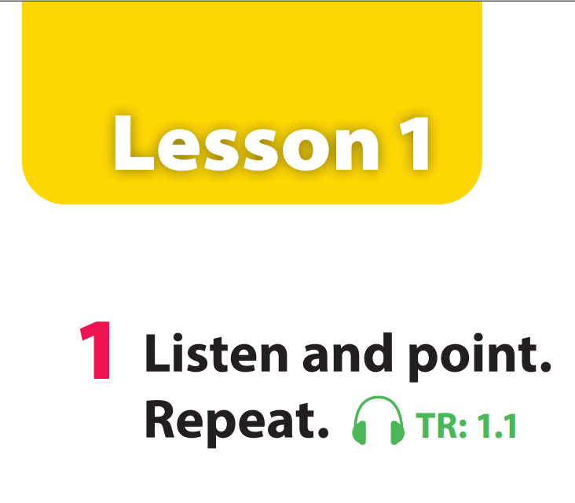

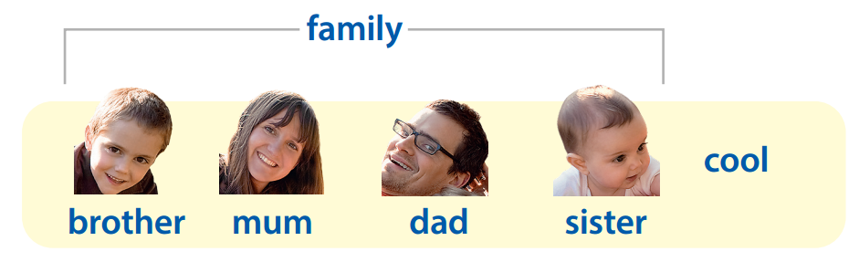


Slide 8


Who’s missing?

Slide 9


Slide 12
Notes:
Dad

Slide 15

Task 2: Listen and write

Slide 16

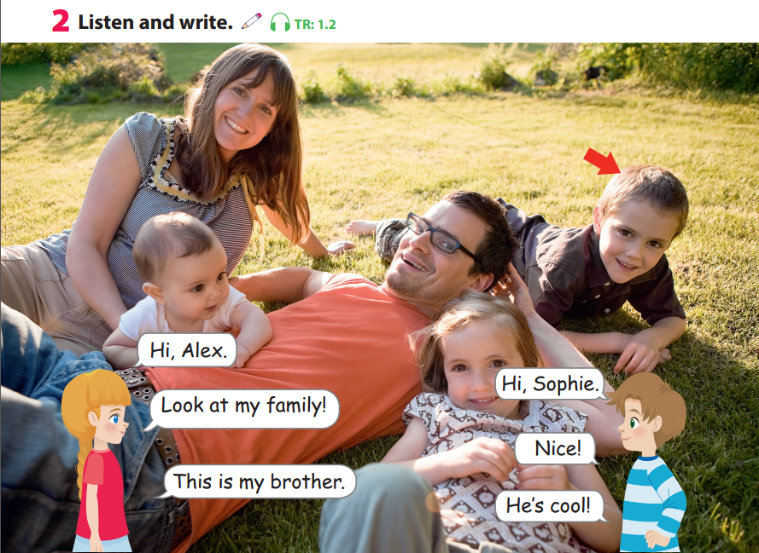


Slide 17
%
%
%
%
%

Slide 18

family
Let’s write!

Slide 19
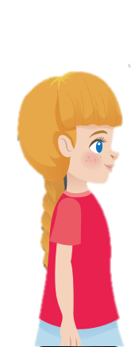
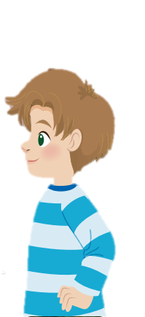
Role play!
Hi, Alex.
Hi, Sophie.
Look at my family!
Nice!

Slide 20
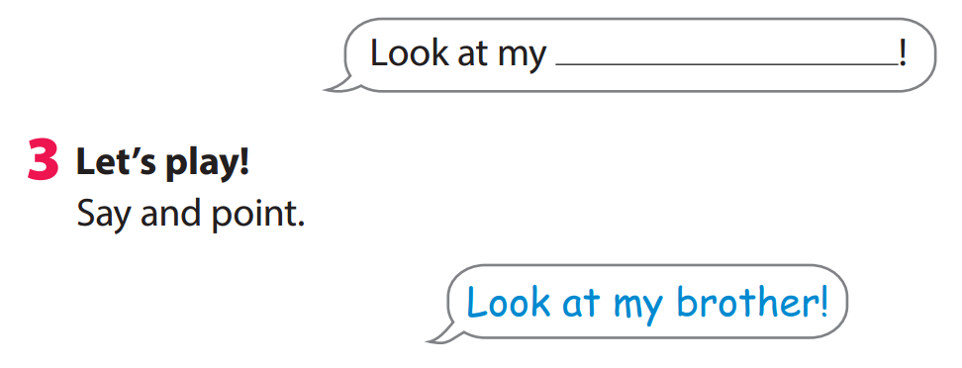


START

Slide 21


Let’s make and play
with finger puppet

Slide 22

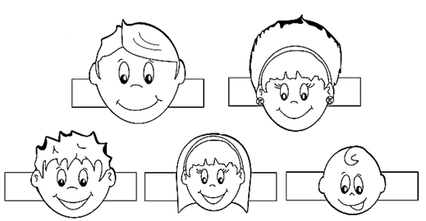


1
2
color
Make family
puppet

Slide 23

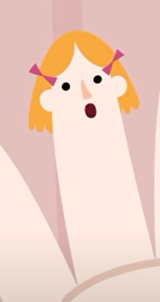
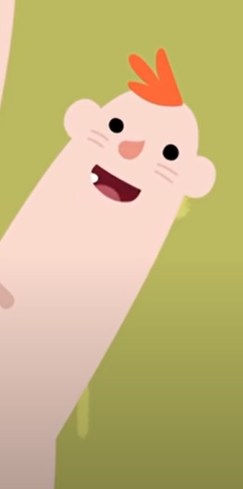
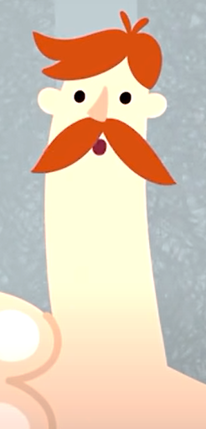

Let’s sing and play

Slide 24




A. mum
B. dad
C. cool
D. sister

Slide 25

A. sister
B. brother
C. dad
D. family
Notes:
Key: C

Slide 26
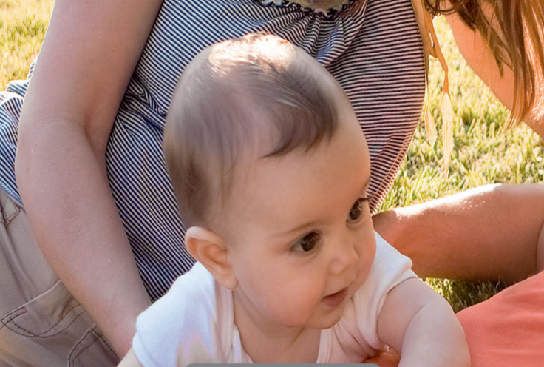
A. sister
B. brother
C. dad
D. family
Notes:
Key: A

Slide 27
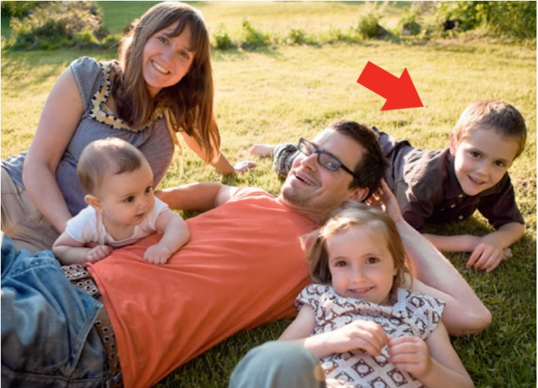
A. cool
B. family
C. mum
D. brother
Notes:
Key: B

Slide 28
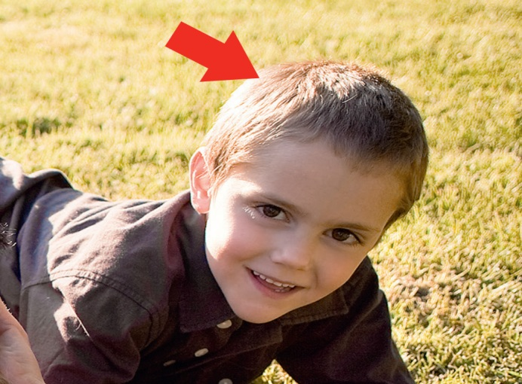
A. mum
B. sister
C. dad
D. brother
Notes:
Key: D

Slide 29



Good bye.
See you again!

