Slide 1


WELCOME ALL THE TEACHERS TO THE CLASS
ENGLISH 3
Teacher: Bui Bien Phong
School: Đai Ban I primary school

Slide 2





Task 7: Listen and tick

Slide 3

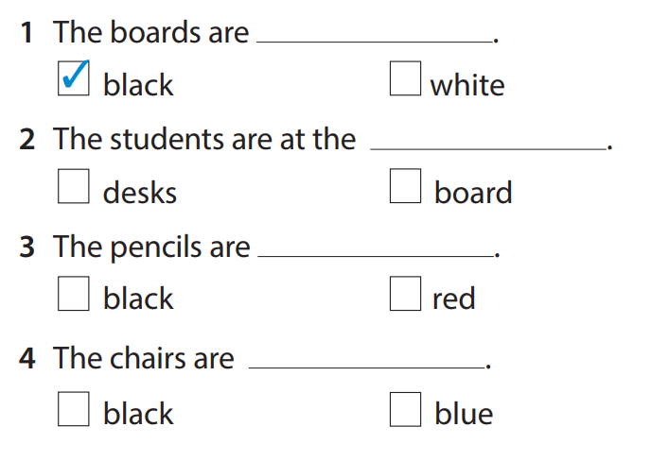
Listen and tick
✓
✓
✓

Slide 4

Task 8: Look and say

Slide 5










Slide 6


12
1
2
11
10
3
4
9
5
8
7
6

Slide 7
chairs/ white
They’re chairs.
They’re white.
WHEEL
CHECK

Slide 8
12
1
2
11
10
3
4
9
5
8
7
6

Slide 9
students/ cool
We’re students.
We’re cool
WHEEL
CHECK

Slide 10
12
1
2
11
10
3
4
9
5
8
7
6

Slide 11
teacher/ great
He’s/ She’s a teacher.
He’s/ She’s great.
WHEEL
CHECK

Slide 12
12
1
2
11
10
3
4
9
5
8
7
6

Slide 13
classroom/ nice
It’s a classroom.
It’s nice.
WHEEL
CHECK

Slide 14
12
1
2
11
10
3
4
9
5
8
7
6

Slide 15
desks/ green
They’re desks.
They’re green.
WHEEL
CHECK

Slide 16
8 READ AND SAY
1. They’re chairs. They’re white.
2. They’re students. They’re cool.
We’re students. We’re cool.
3. He’s a teacher. He’s great.
She’s a teacher. She’s great.
4. It’s a classroom. It’s nice.
5. They’re desks. They’re green.

Slide 17

Draw, write and say

Slide 18
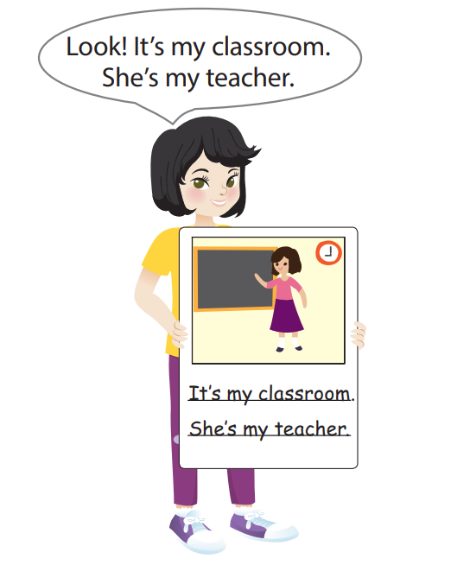
9 Draw, write and say
Look! It’s my classroom.
She’s my teacher.
It’s my classroom.
She’s my teacher.

Slide 19
Reorder the words
1.They/ chairs./ are ……………………….………………..
2. It/ a/ is/ clock. ……………………………………………..
3. He/ teacher/ is/ a ……………………………………………..
4. We’re/ nice. students./ are/ We
………………………………………………………….………..
They are chairs.
It is a clock.
He is a teacher.
We are students. We’re nice.

Slide 20



Good bye.
See you again!

