Slide 1
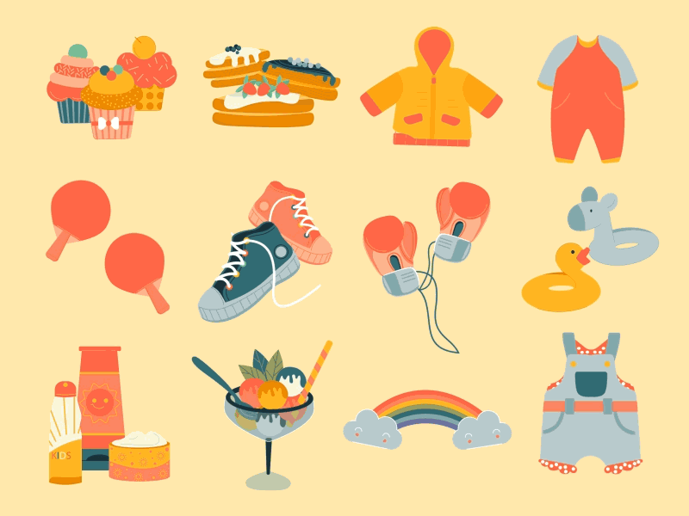


Review 3
Part 3 – Video

Slide 2
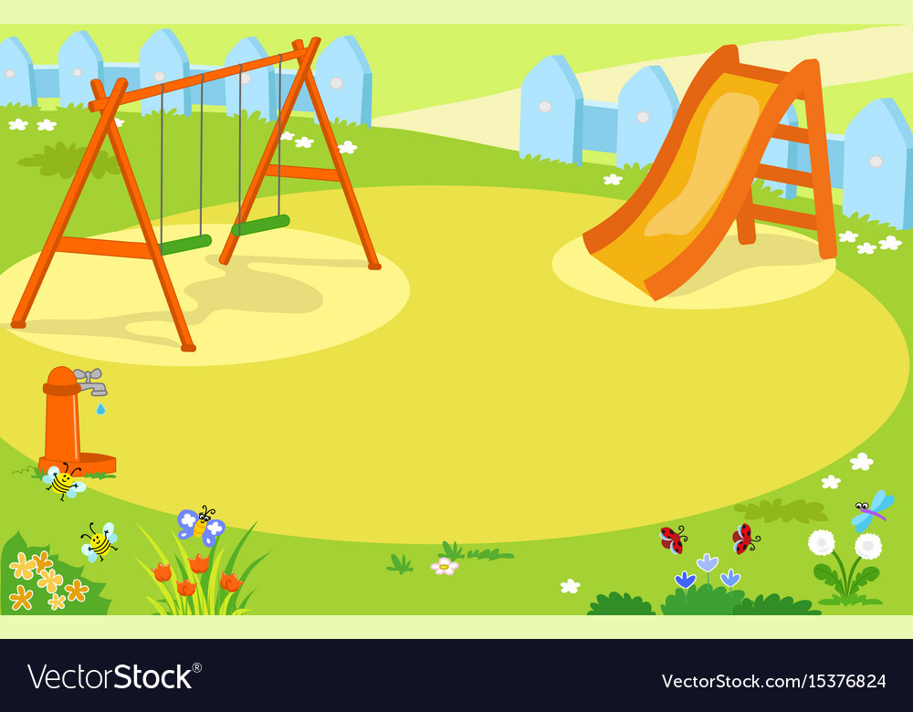



1
1
ant
2
mouse
3
elephant
4
dog
5
fish
6
iguana
7
hen
8
pet
9
Notes:
- Play “ Tick-Tac-toe” game
+ T calls two Ss of two teams go to the board to take turns marking the spaces in a three-by-three grid with X or O. Each square contains a question and Ss will mark X or O if he/she answers question correctly .The player who succeeds in placing three of their marks in a horizontal, vertical, or diagonal row is the winner.
+ GV gọi 2 HS của 2 đội lên bảng lần lượt đánh dấu X hoặc O vào các ô trong lưới 3x3. Mỗi ô vuông có 1 câu hỏi và HS sẽ đánh dấu X hoặc O nếu trả lời đúng câu hỏi. Người chơi nào đánh dấu thành công 3 ô theo hàng ngang, hàng dọc hoặc hàng chéo sẽ là người chiến thắng.

Slide 3


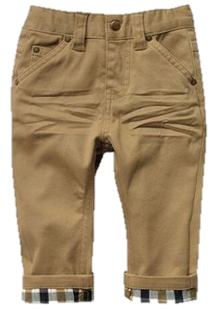
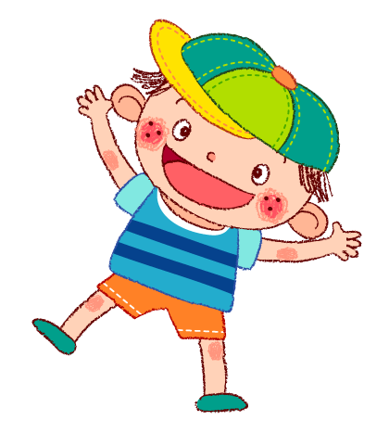
Question 1
Reorder the letters to make the correct word.
TROUSERS
TRSEROUS
Answer
Back

Slide 4
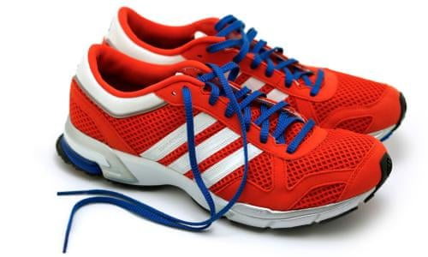
Question 2
Reorder the letters to make the correct word.
TROUSERS
TRSEROUS
Answer
Back

Slide 5
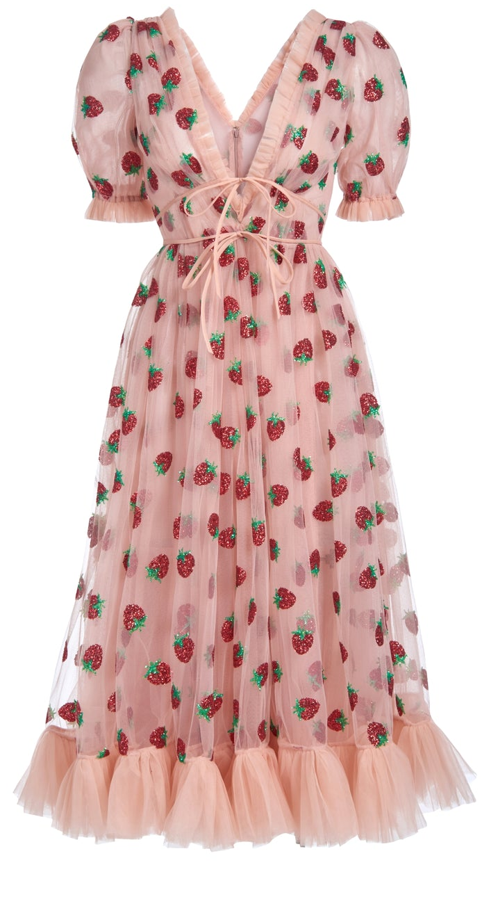
Question 3
Reorder the letters to make the correct word.
DRESS
SSDRE
Answer
Back

Slide 6
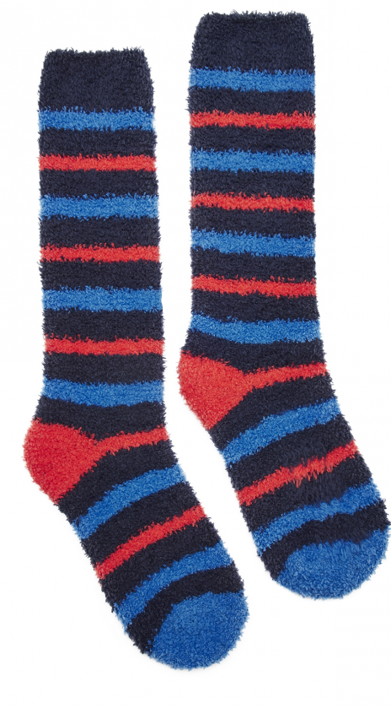
Question 4
Reorder the letters to make the correct word.
SOCKS
SKOCS
Answer
Back

Slide 7
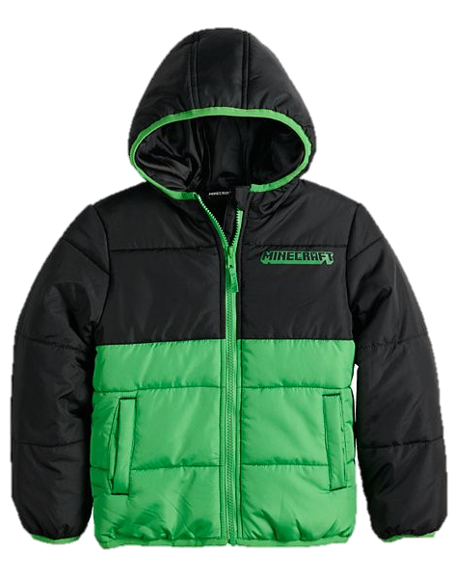
Question 5
Fill the missing letters
in the blank.
C _ A _
o
t
Answer
Back

Slide 8
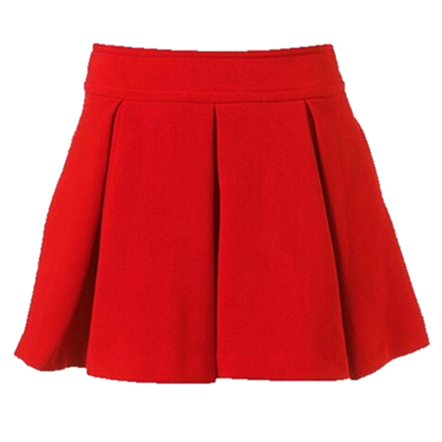
Question 6
Fill the missing letters
in the blank.
S _ i _ t
k
r
Answer
Back

Slide 9
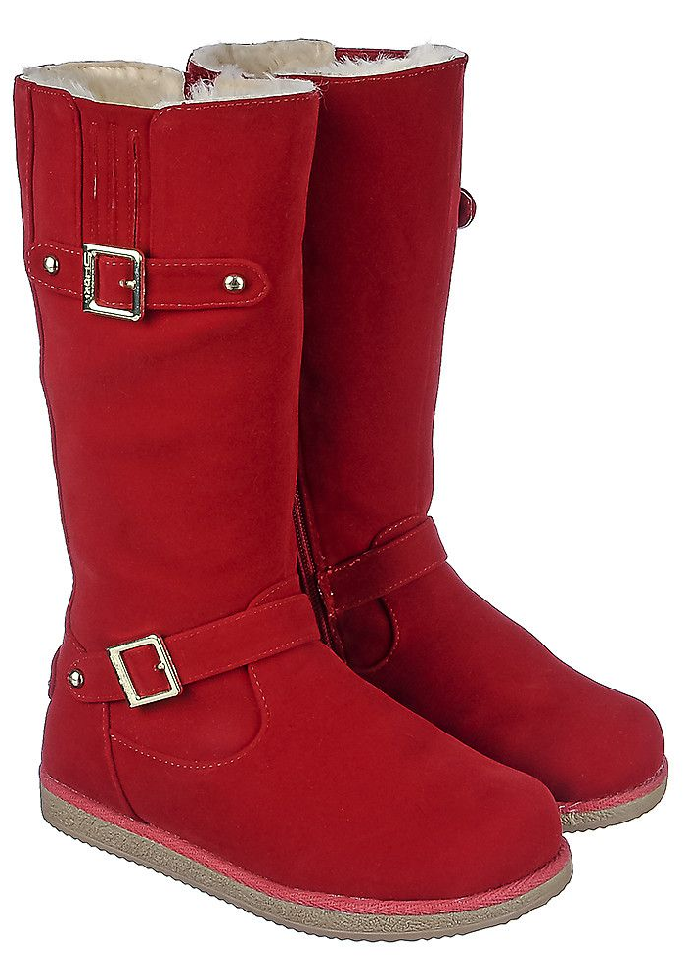
Question 7
Fill the missing letters
in the blank.
b_ _ t_
o
o
s
Answer
Back

Slide 10
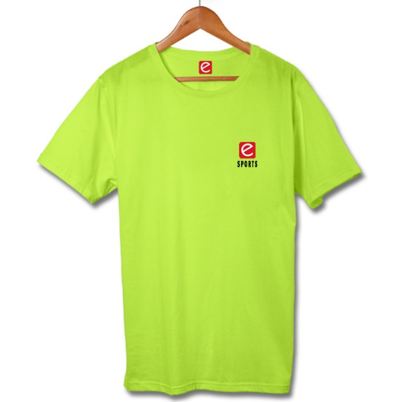

Question 8: look and fill in the blank.
t-shirt
My…………………is green.
Answer
Back

Slide 11
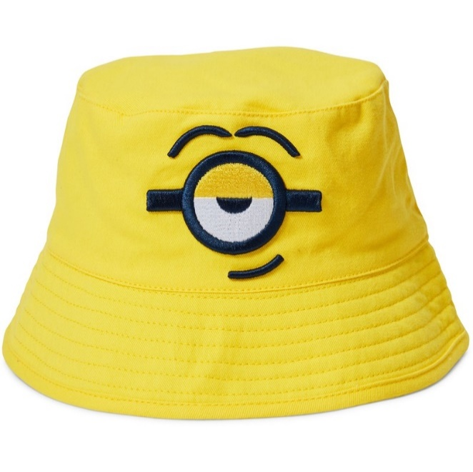
Question 9: look and fill in the blank.
hat
He’s got a yellow……….
Answer
Back

Slide 12







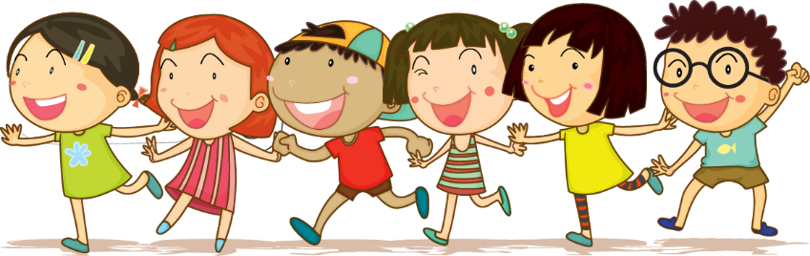



Review

Slide 13




1.Tick.What do you wear to school.
hat
skirt
t-shirt
socks
boot
shoes
coat
trouser

Slide 14
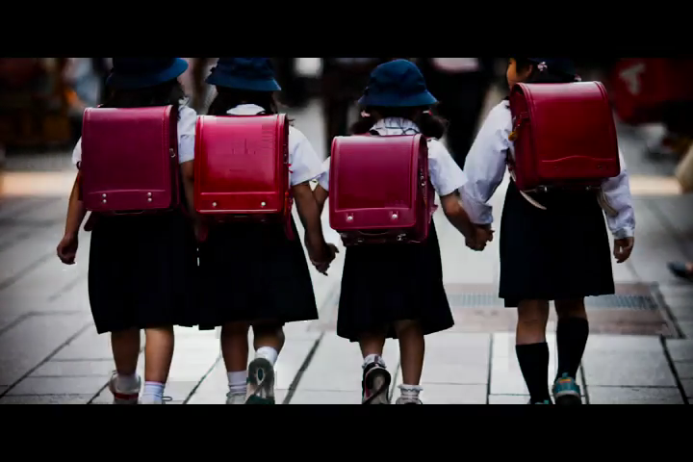

Slide 15

2 Look at the hats in the video.
What colours can you see? Tick.

Slide 17
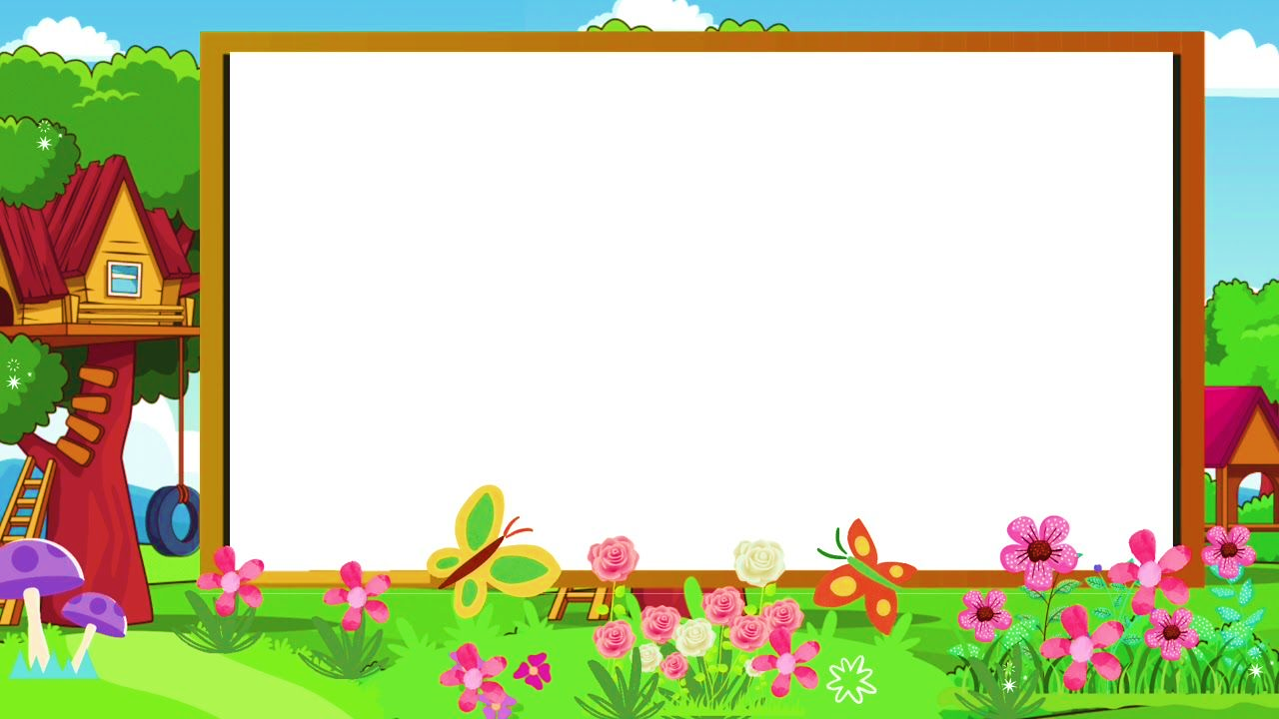
3. Tick T for True or F for False.
1, Some girls have got blue hats.
2, Some boys have got white and blue socks.
3, Some boys have got red hats and
orange T-shirts.
4, A girl has got a funny hat.
T
F
T
F
T
F
T
F

Slide 18
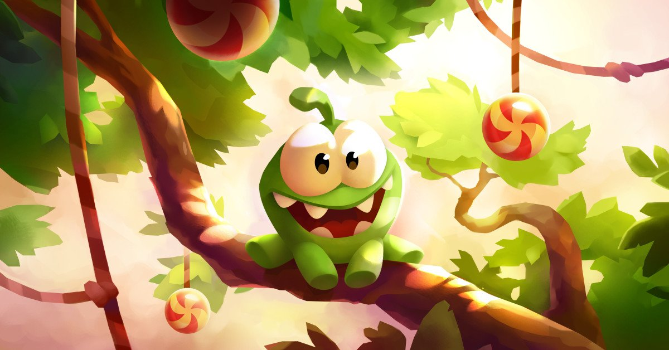
CANDY CATCHER
Notes:
Play game: “Candy catcher”
- T shows many questions and has many options and the task of student will have to choose the correct answer to get stars for each question.
- GV đưa ra nhiều câu hỏi và có nhiều lựa chọn, nhiệm vụ của học sinh là phải chọn câu trả lời đúng để nhận được sao cho mỗi câu hỏi.

Slide 19

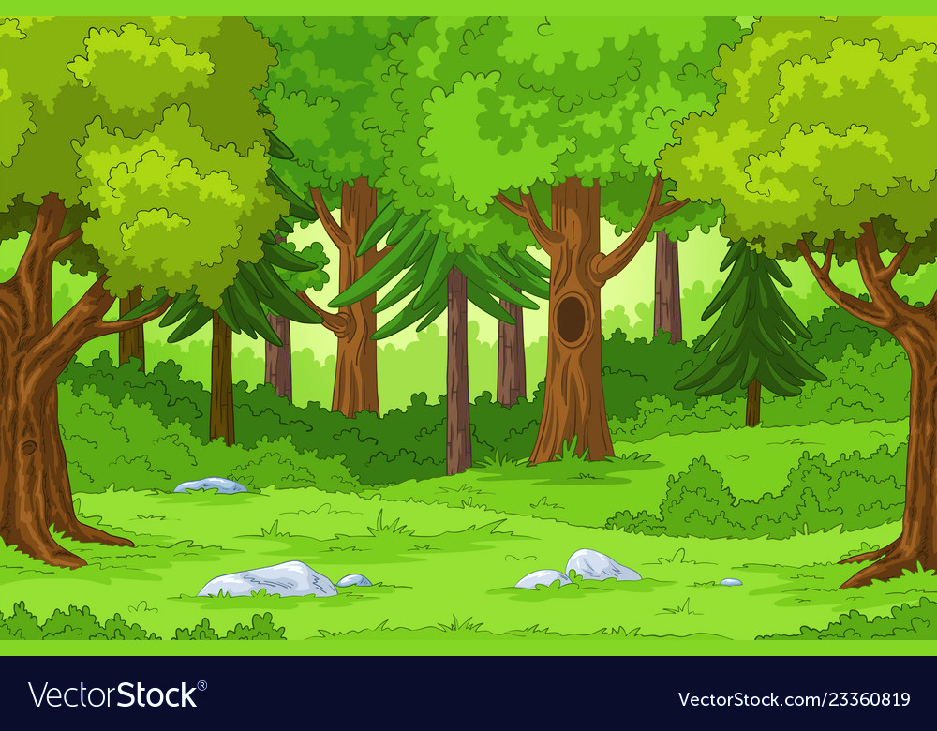





Find the opposite word.
His coat is not ugly. It’s …….
A. nice
B. short
01
C. long

Slide 20
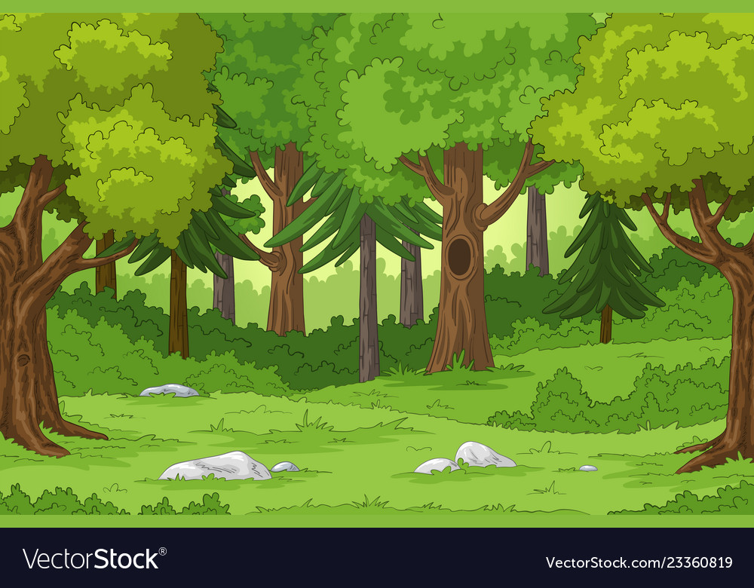
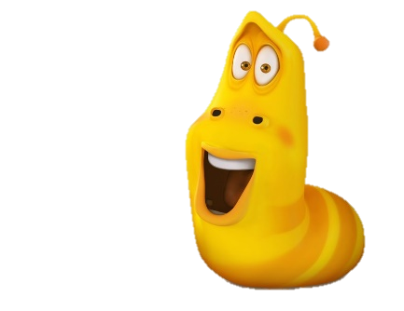

Listen and choose.
A. Her t-shirt is yellow.
B. Her skirt is yellow.
02
C. Her t-shirt is red.

Slide 21
Choose the correct answer.
A. They’ve got green boots.
B. They’re got boots green.
03
C. They’ve got a green boots.

Slide 22
Fill in the blank.
She…………green socks.
A. is got
B. ‘ve got
04
C. ’s got

Slide 23
Arrange to make a sentence.
‘ve got/ black and warm/trousers/ I.
A.Trousers’ve got black and warm I.
B.I’ve got black and warm trousers.
05
C. I’ve got trousers black and warm.

Slide 24
Extra activity

Slide 25


Task 1: Draw picture.
*Draw a photo of cloth.
*Write and tell your class about it.
I’ve got a skirt.
My skirt is red.

Slide 26

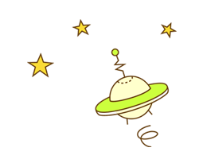
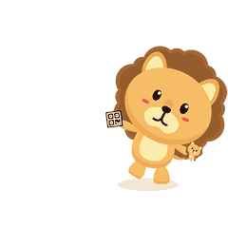
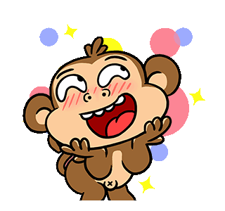
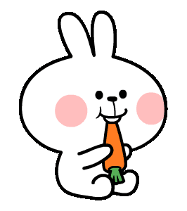
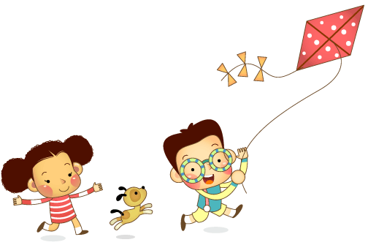
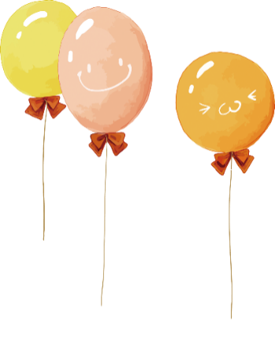

team lion | team rabbit | team monkey | team bee
draw
shoes
draw
socks
draw
hat
draw
t-shirt

Slide 27

Task 2 : Arrange the word in the bracket.
new
hat
1 My ___ ___ is green. (hat, new)
2 I’ve got ____ _____. (warm, boots)
3 Mum’s got ____ ____ . (skirt, white)
4 She’s got a______ ______ in her bαg. (dress, pretty)
warm
boots
white
skirt
pretty
dress

Slide 28




Good bye.
See you again!

