Slide 1





















Unit 4: My house Lesson 1:Task 4,5,6/P56

Slide 2
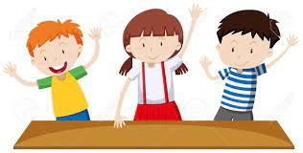


Movement Game: Hip hip hooray
Hands up!
Hands down!
Hip hip hooray
Go to Wonderful World!

Slide 3


Slide 4
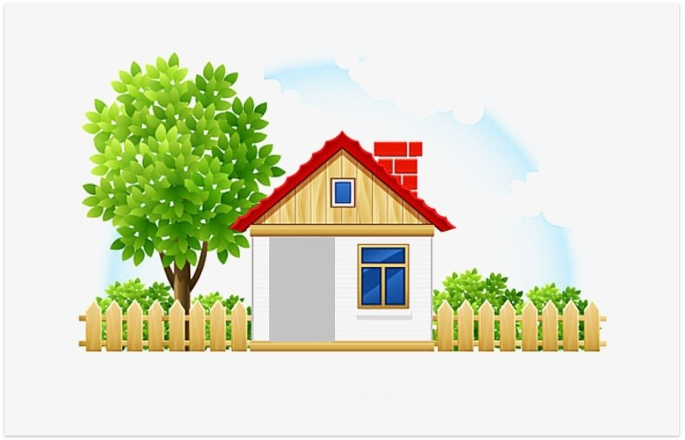



Slide 5
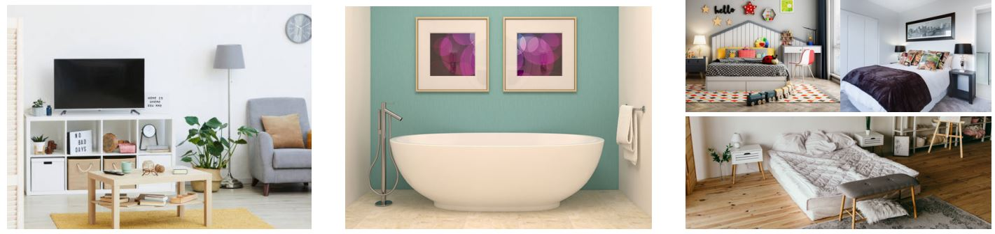

4 Listen and repeat
1
2
3
There are three bedrooms.
There’s a living room.
There’s a bathroom.

Slide 6
Listen and number
3
2
1

Slide 7
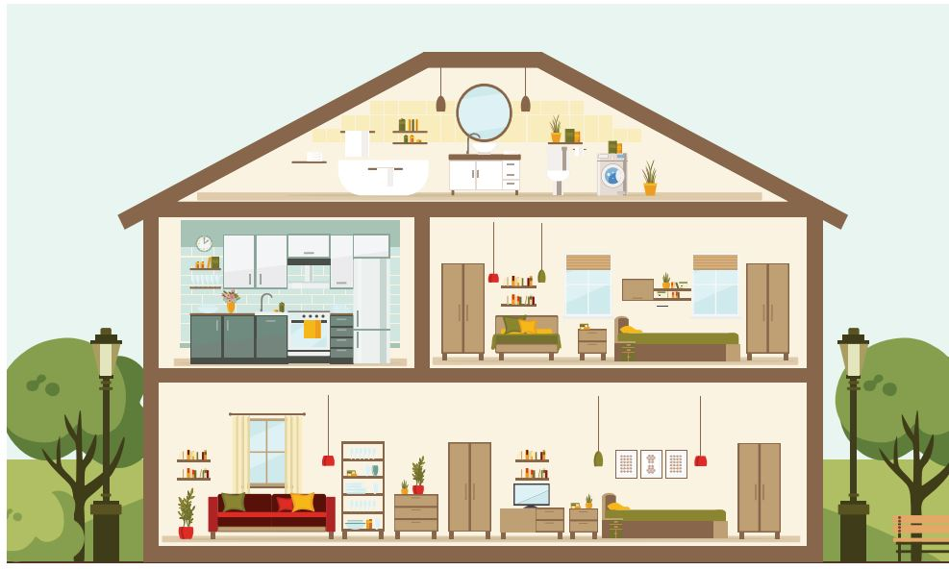
5
Say.
There is a …
There are …..s

Slide 8


a house
There’s a house.

Slide 9
two bedrooms
There are two bedrooms.

Slide 10
a bathroom
There’s a bathroom.

Slide 11
a kitchen
There’s a kitchen.

Slide 12
There is / There are…….
1.………
house
2.………
bedrooms
3.………
bathroom
4.………
kitchen

Slide 13


Let’s talk

Slide 14
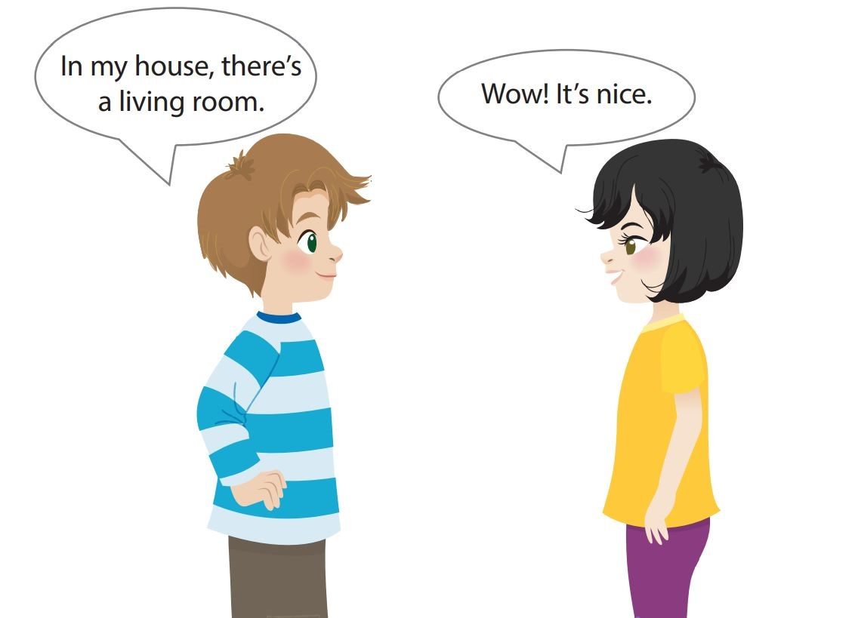
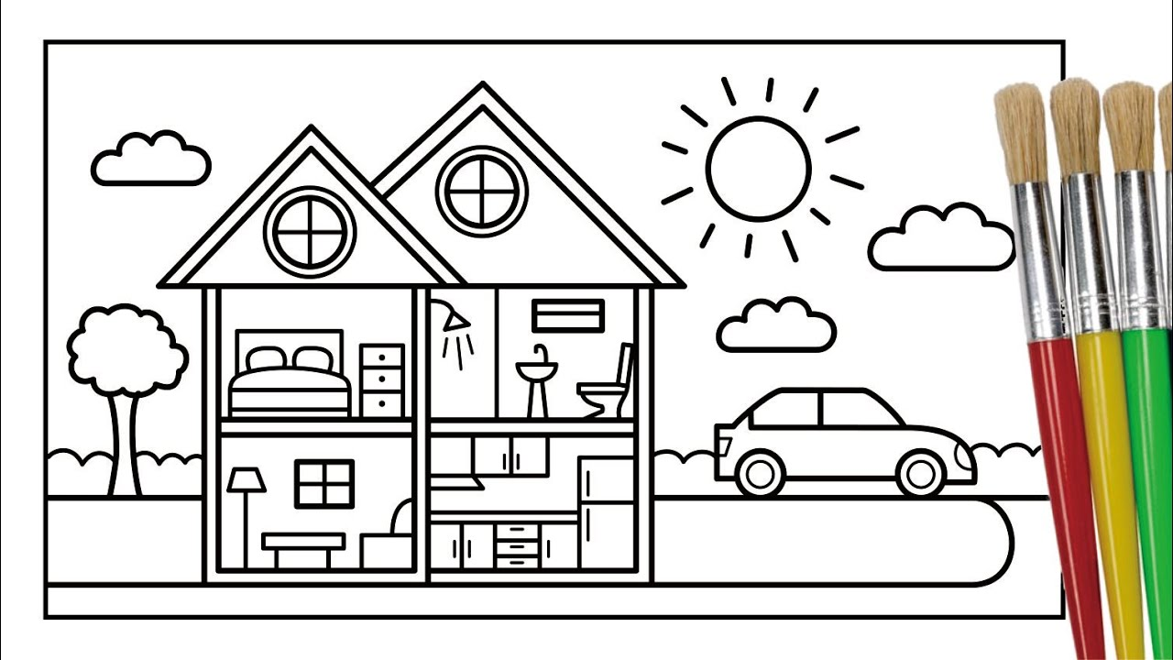
Let’s talk
bedroom
bathroom
living room
kitchen

Slide 15
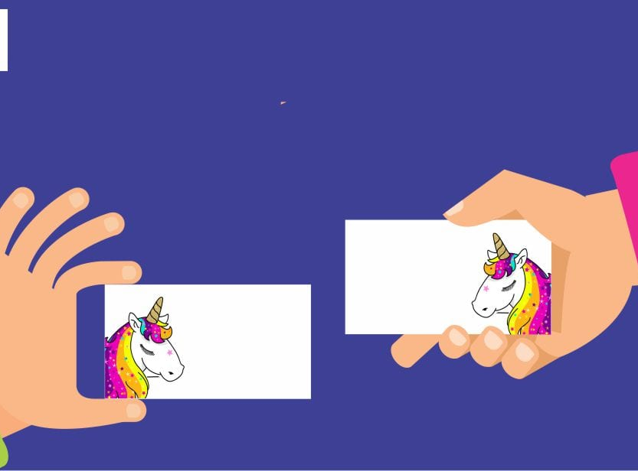
Pass the card Game

Slide 16
Color and say
bedroom
bathroom
living room
kitchen

Slide 17
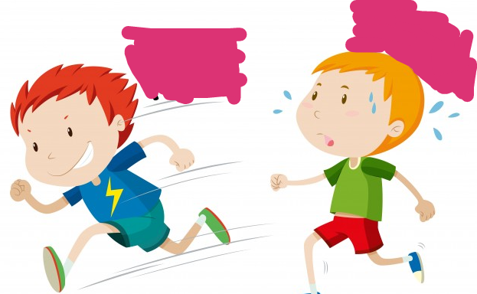
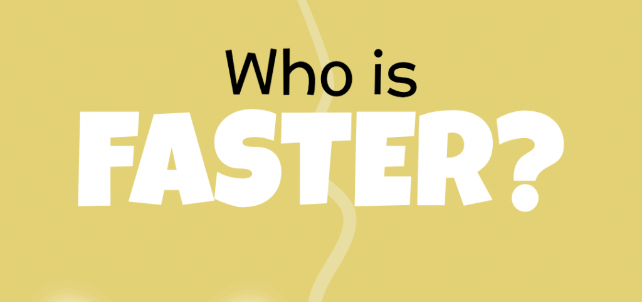

Slide 18

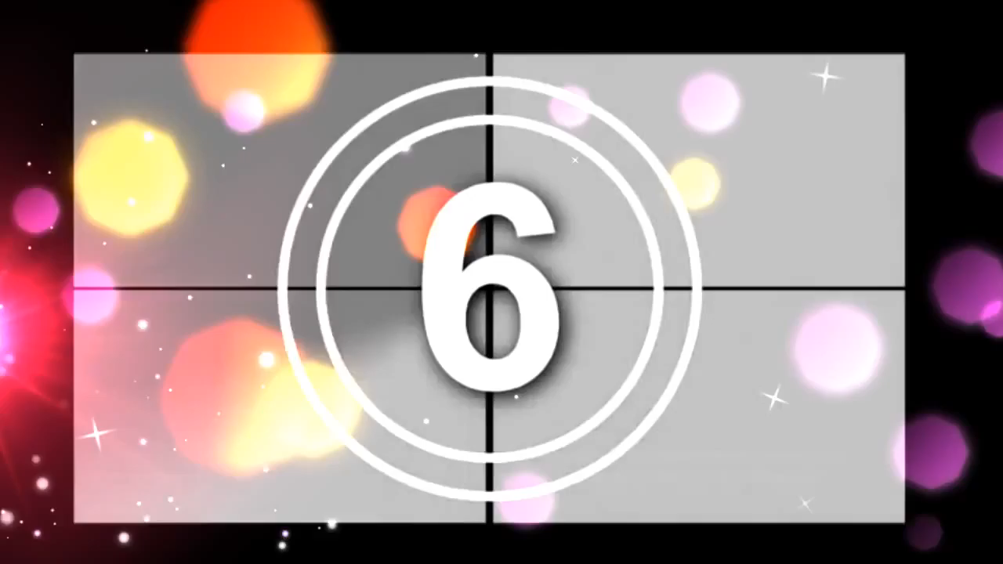
Choose the correct answer.
1. There’s ………………..
a
a living room
b
two bedrooms

Slide 19
Choose the correct answer.
2. In my house, there is a garden.
Wow, …………… nice
a
They’re
b
It’s

Slide 20



Slide 21



Good bye.
See you again!

