Slide 1
Unit 7: Numbers
Lesson 1.
Page: 44, 45

Slide 2
Objectives
By the end of this lesson, students will be able to gain the following:
Vocabulary:
one, two, three
Sentence pattern:
Skills:
Identify and use vocabulary about numbers.

Slide 3
WARM UP

Slide 4
one
two
four
five
next

Slide 5
twelve
three
two
eight
next

Slide 6
two
one
four
three
next

Slide 7
It’s time to learn …

Slide 8
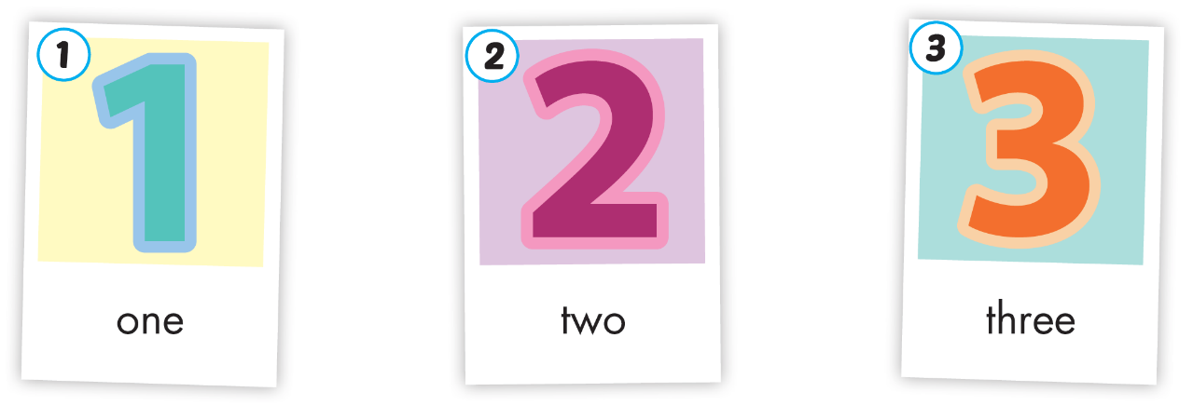
Click A to hear the sound
Notes:
Click vào hình A. 1. Listen and point. Repeat để cho cả audio full chạy

Slide 9
Click A to hear the sound
/wʌn/
số một
/tuː/
số hai
/θriː/
số ba
Notes:
Click vào hình A. 1. Listen and point. Repeat để cho cả audio full chạy

Slide 10
/wʌn/
số một
Notes:
Click vào hình A. 1. Listen and point. Repeat để cho cả audio full chạy

Slide 11
/tuː/
số hai

Slide 12
/θriː/
số ba

Slide 13
Who are they?
Notes:
B. Listen and point. Repeat. Role-play. (CD1 Track 03)
Have students call out the things they can see in each picture.
Play the audio and have them point to the characters.
Play the audio again and have them repeat the new words.
Divide the class into pairs to role-play the dialogue.
Swap roles and repeat.
Invite some pairs to demonstrate the activity in front of the whole class.
Go around the class and support them if necessary.

Slide 14
What are they doing?
Notes:
B. Listen and point. Repeat. Role-play. (CD1 Track 03)
Have students call out the things they can see in each picture.
Play the audio and have them point to the characters.
Play the audio again and have them repeat the new words.
Divide the class into pairs to role-play the dialogue.
Swap roles and repeat.
Invite some pairs to demonstrate the activity in front of the whole class.
Go around the class and support them if necessary.

Slide 15
Notes:
B. Listen and point. Repeat. Role-play. (CD1 Track 03)
Have students call out the things they can see in each picture.
Play the audio and have them point to the characters.
Play the audio again and have them repeat the new words.
Divide the class into pairs to role-play the dialogue.
Swap roles and repeat.
Invite some pairs to demonstrate the activity in front of the whole class.
Go around the class and support them if necessary.

Slide 16
One.
One.
One.
One.
One, two.
One, two.
One, two.
One, two.
One, two, three.
One, two, three.
One, two, three.
One, two, three.
Notes:
B. Listen and point. Repeat. Role-play. (CD1 Track 03)
Have students call out the things they can see in each picture.
Play the audio and have them point to the characters.
Play the audio again and have them repeat the new words.
Divide the class into pairs to role-play the dialogue.
Swap roles and repeat.
Invite some pairs to demonstrate the activity in front of the whole class.
Go around the class and support them if necessary.

Slide 17
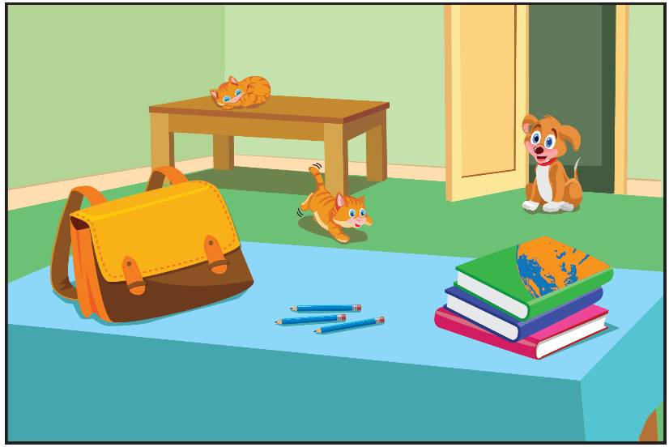
Notes:
Click vào hình A. 1. Listen and point. Repeat để cho cả audio full chạy

Slide 18
How many cats?
A. one
B. two
C. three

Slide 19
How many books?
A. one
C. two
B. three

Slide 20
How many bags?
B. one
A. two
C. three

Slide 21
How many dogs?
B. one
A. two
C. three

Slide 22
How many pencils?
A. one
C. two
B. three

Slide 23
Notes:
B. Listen and point. Repeat. Role-play. (CD1 Track 03)
Have students call out the things they can see in each picture.
Play the audio and have them point to the characters.
Play the audio again and have them repeat the new words.
Divide the class into pairs to role-play the dialogue.
Swap roles and repeat.
Invite some pairs to demonstrate the activity in front of the whole class.
Go around the class and support them if necessary.

Slide 24
Notes:
Thanh Yến Trần 0967 255 149 ZALO/ FB https://www.facebook.com/thanhyentrananhngutaymy/

Slide 25
two
three
one
Notes:
Thanh Yến Trần 0967 255 149 ZALO/ FB https://www.facebook.com/thanhyentrananhngutaymy/

Slide 26
two
one
three

Slide 27
three
two
one

Slide 28
two
three
one

Slide 29
two
three
one

Slide 30
one
two
three

Slide 31
three

Slide 32
one

Slide 33
two

Slide 34
Enjoy your day!

