Slide 2
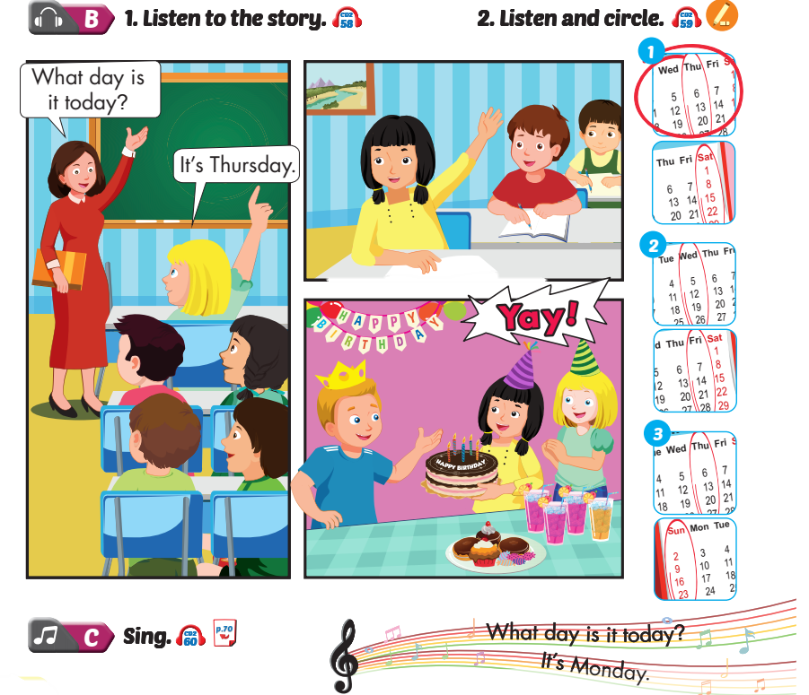
Lesson 1

Slide 3
Lesson 1

Slide 4
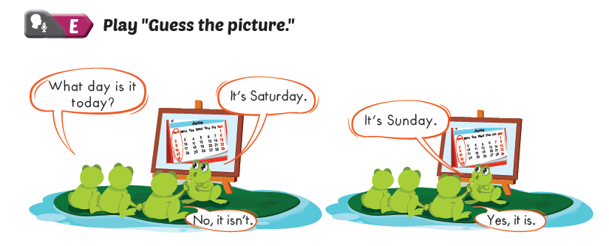
Lesson 1

Slide 6
Lesson 2

Slide 7
Lesson 2

Slide 8
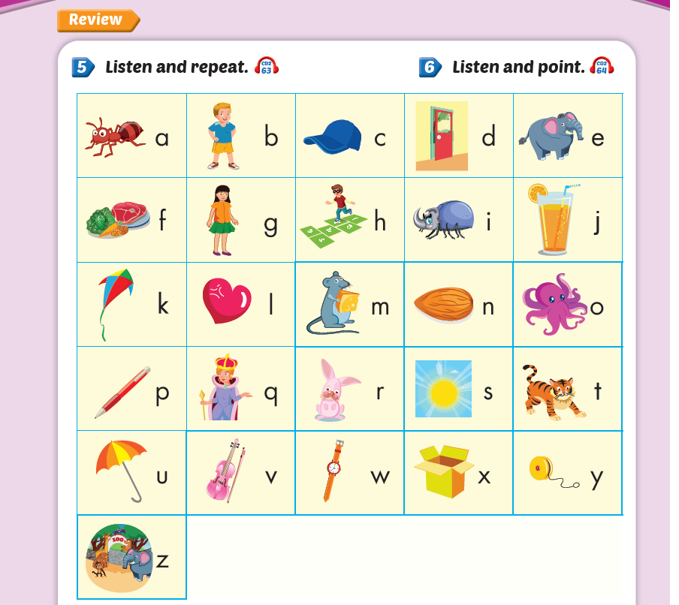
Lesson 2

Slide 9
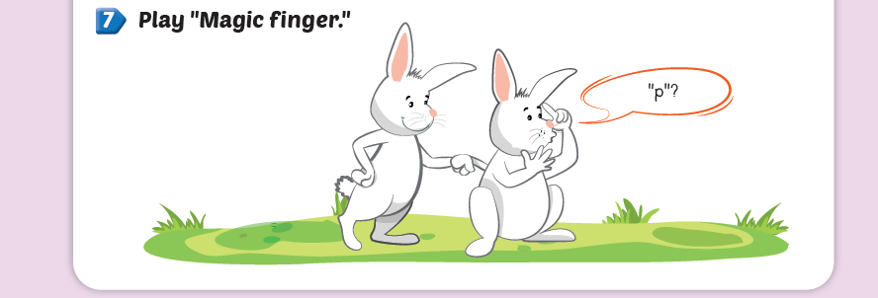

Slide 10
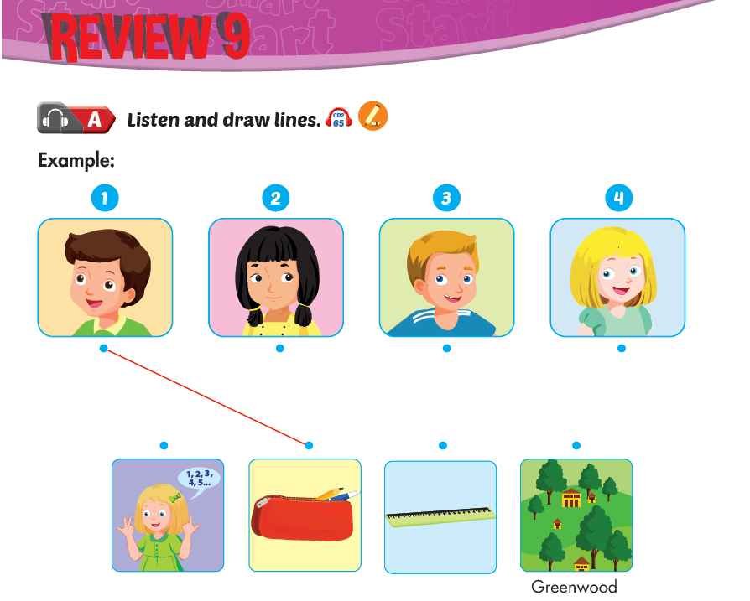

Slide 11
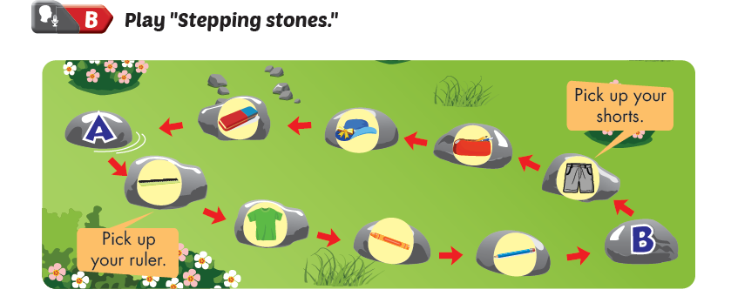

Slide 12
