Slide 1
WELCOME ALL THE TEACHERS TO THE CLASS
ENGLISH 4
Teacher: Bui Bien Phong
School: Đai Ban I primary school

Slide 2
WELCOME ALL THE TEACHERS TO THE CLASS
ENGLISH 4
Teacher: Bui Bien Phong
School: Đai Ban I primary school

Slide 4
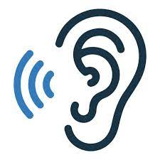
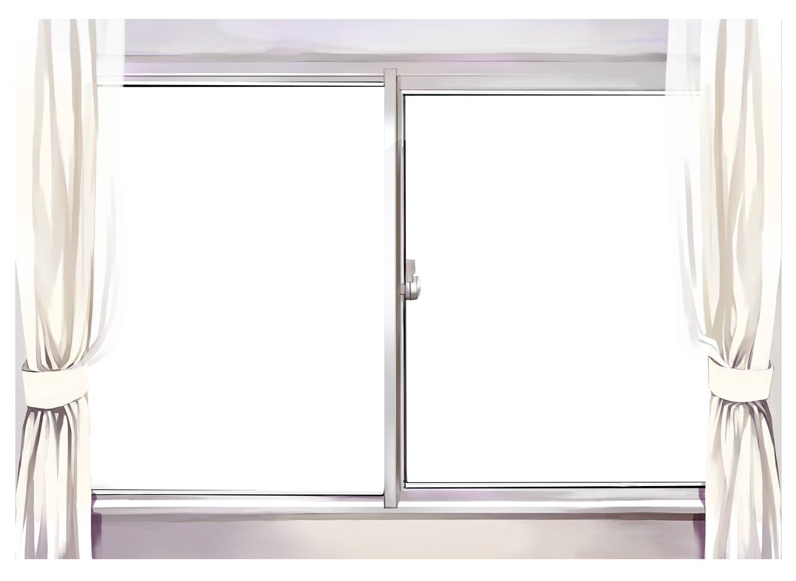
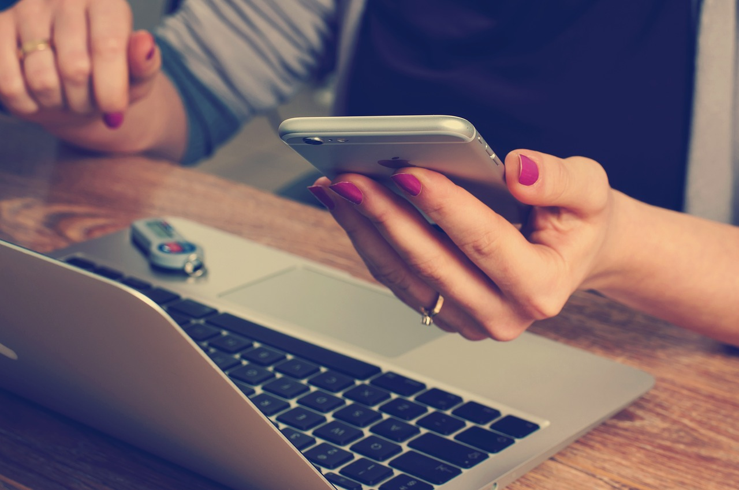
7. Listen and repeat.
s
/z/
Use
Use

Slide 5
7. Listen and repeat.
m
/m/
Make
Make

Slide 6
7. Listen and repeat.
use
I can use my phone at home.
2. make
I can make videos on my phone.

Slide 7
8. Listen and chant

Slide 8
! Game time !
Choose correct answer
Notes:
Sts choose the correct answer

Slide 9
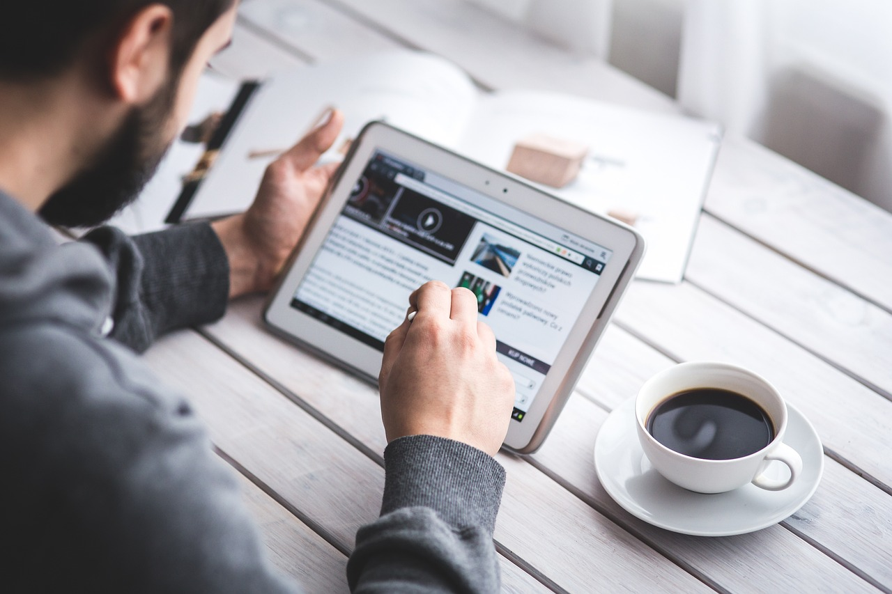
I sometimes ____ the tablet.
a. uses
b. use
b

Slide 10
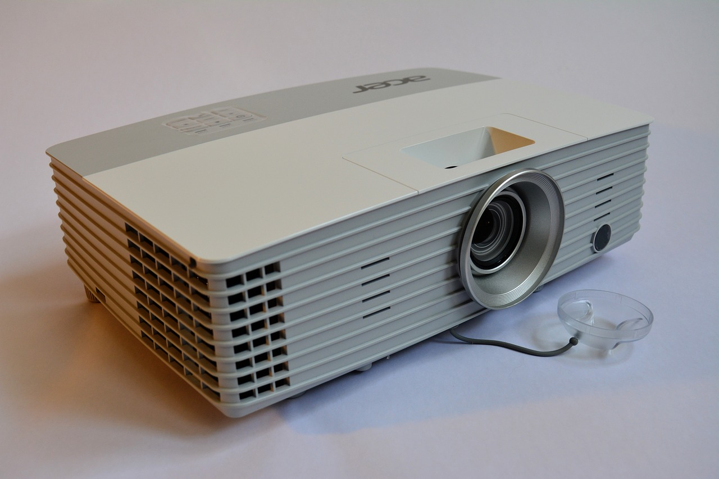
Teacher can use the ______.
a. projector
b. speaker
a

Slide 11
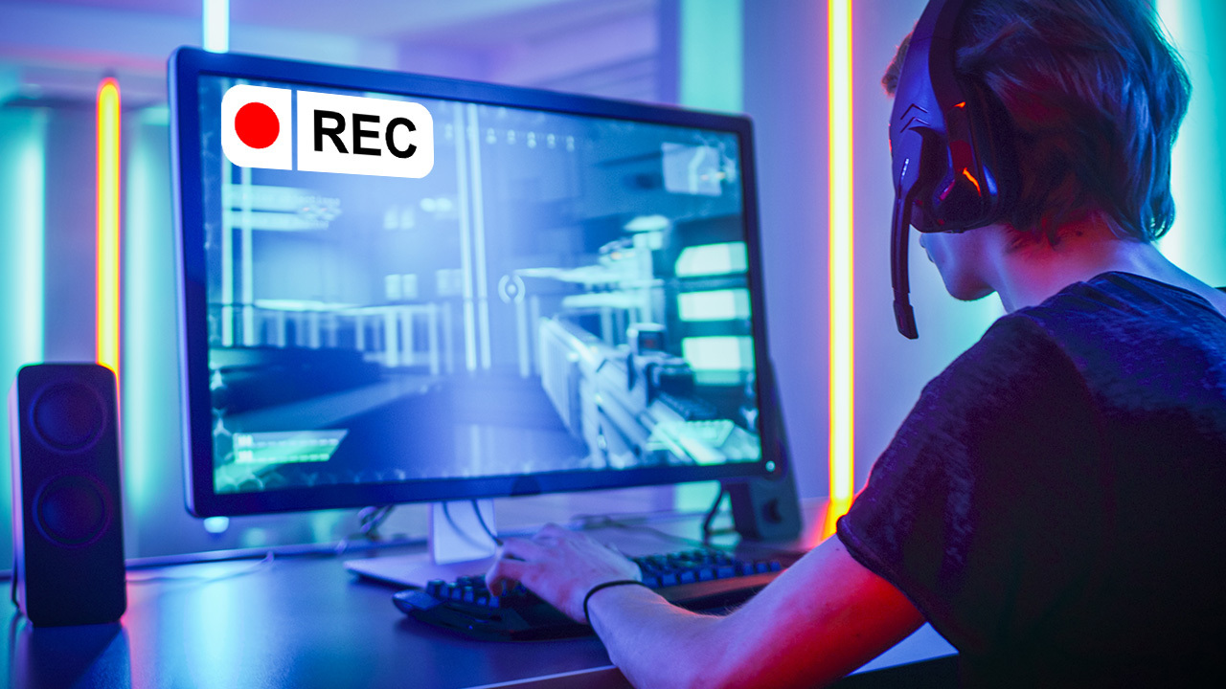
He can _____ videos on his computer.
a. take
b. make
b

Slide 12
Anna always makes _____ calls.
a
a. phone
b. computer

Slide 13
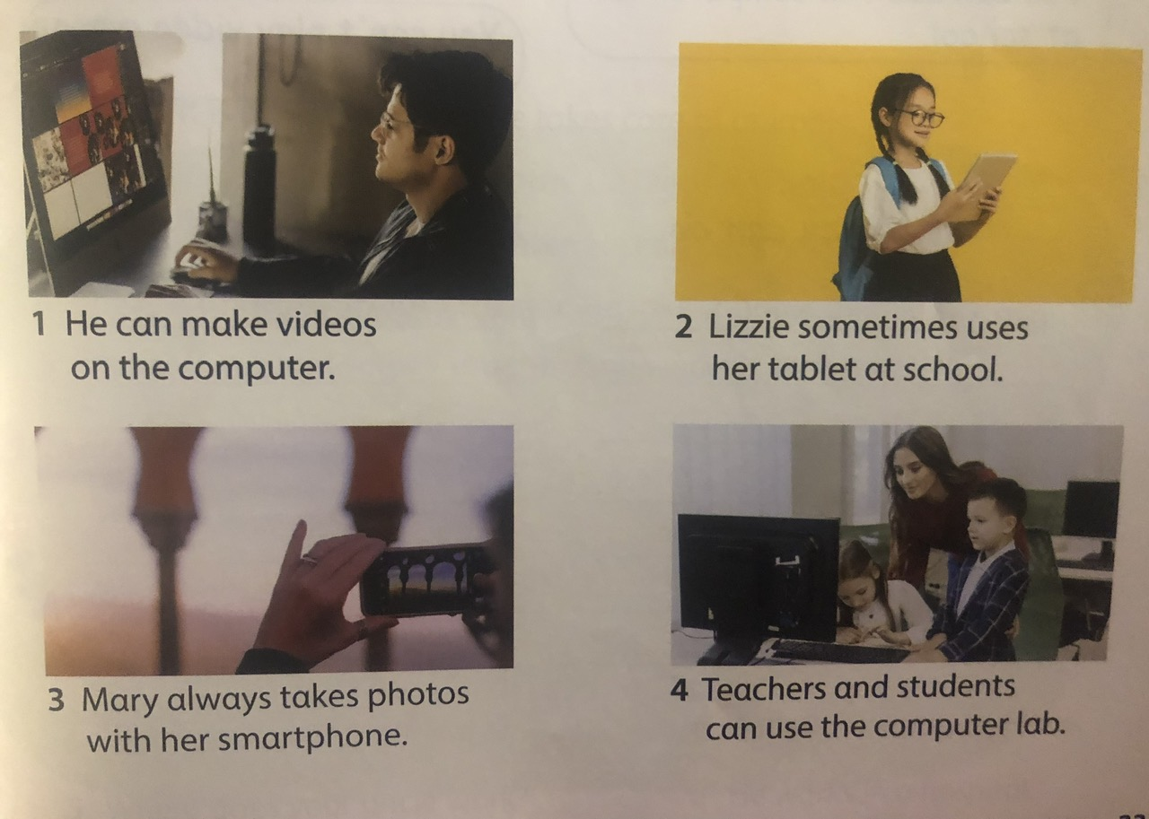
9. Say it

Slide 14
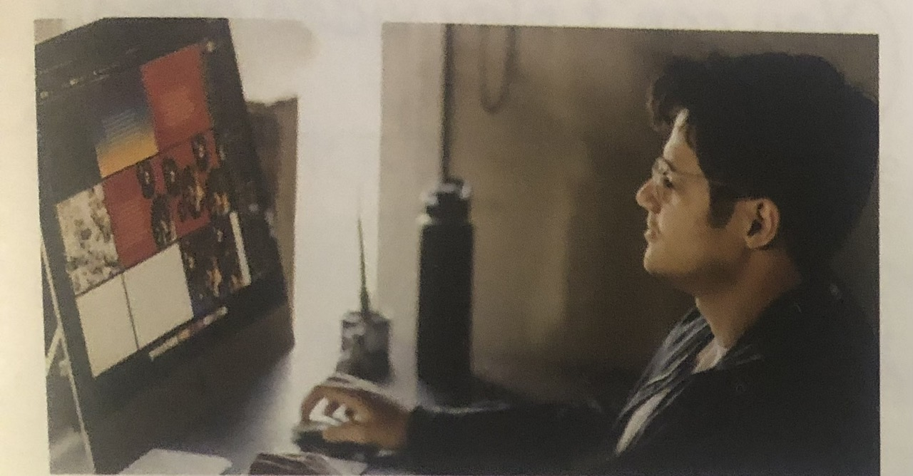
1. He can make videos on the computer.

Slide 15
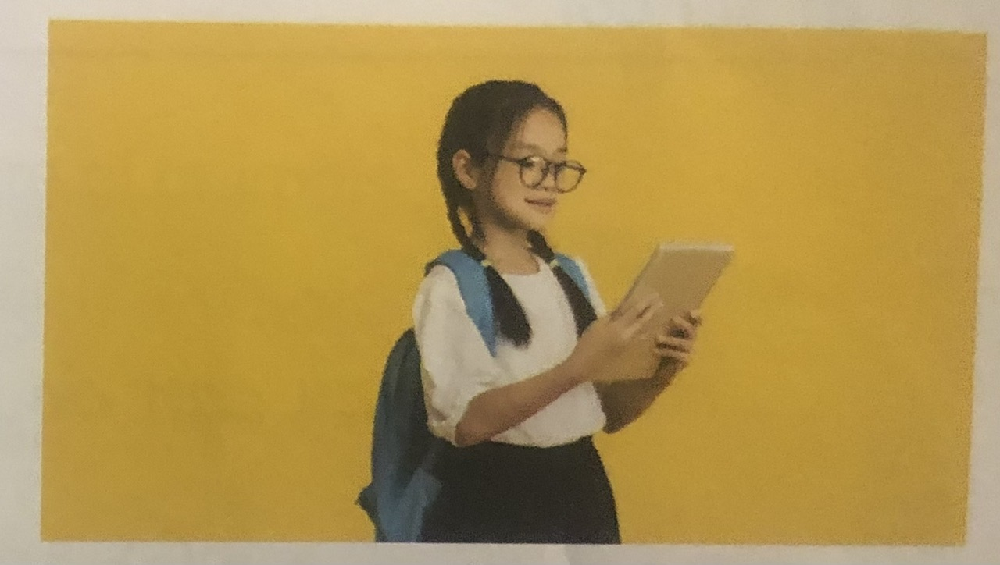
2. Lizzie sometimes uses her tablet at school.

Slide 16
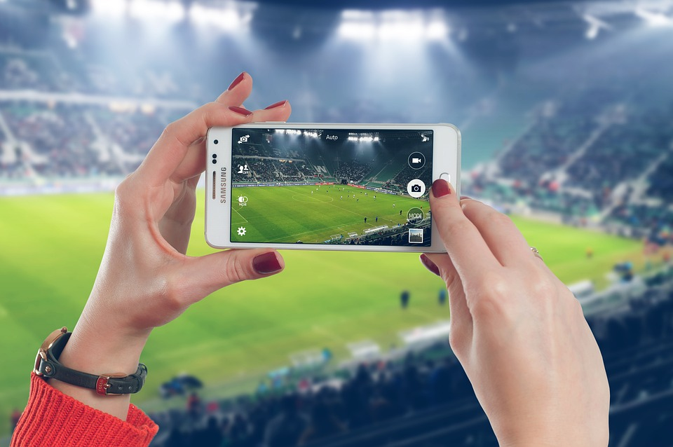
3. Mary always takes photos with her smartphone.

Slide 17
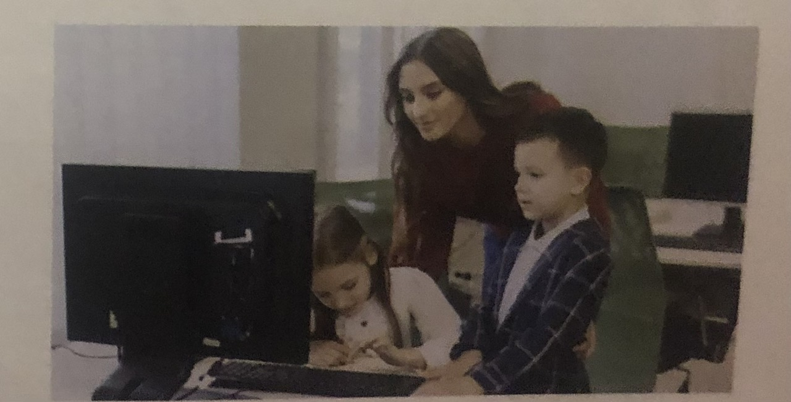
4. Teachers and students can use the computer lab.

Slide 18
Game: Take it and say
Notes:
Đây k phải là extra, đây là hđ 3 của bài

Slide 19
Wrap up
Notes:
Đây k phải là extra, đây là hđ 3 của bài

Slide 20
Pronunciation
use : /z/
make: /m/
STRUCTURE
I can use my phone.
I can make videos.

Slide 22
Thank you & goodbye!

