Slide 1
WELCOME ALL THE TEACHERS TO THE CLASS
ENGLISH 4
Teacher: Bui Bien Phong
School: Đai Ban I primary school

Slide 4
farm animals

Slide 5
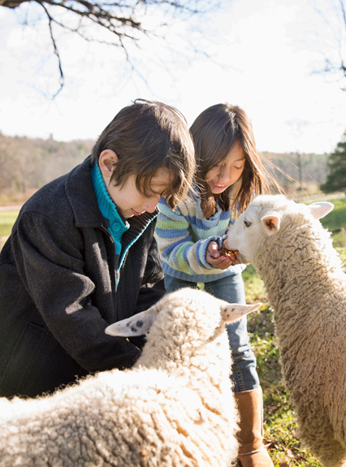
Children feeding αlpαcαs in α field
Look. Tick what you see.
boy giraffe
girl elephant
✓
✓

Slide 6
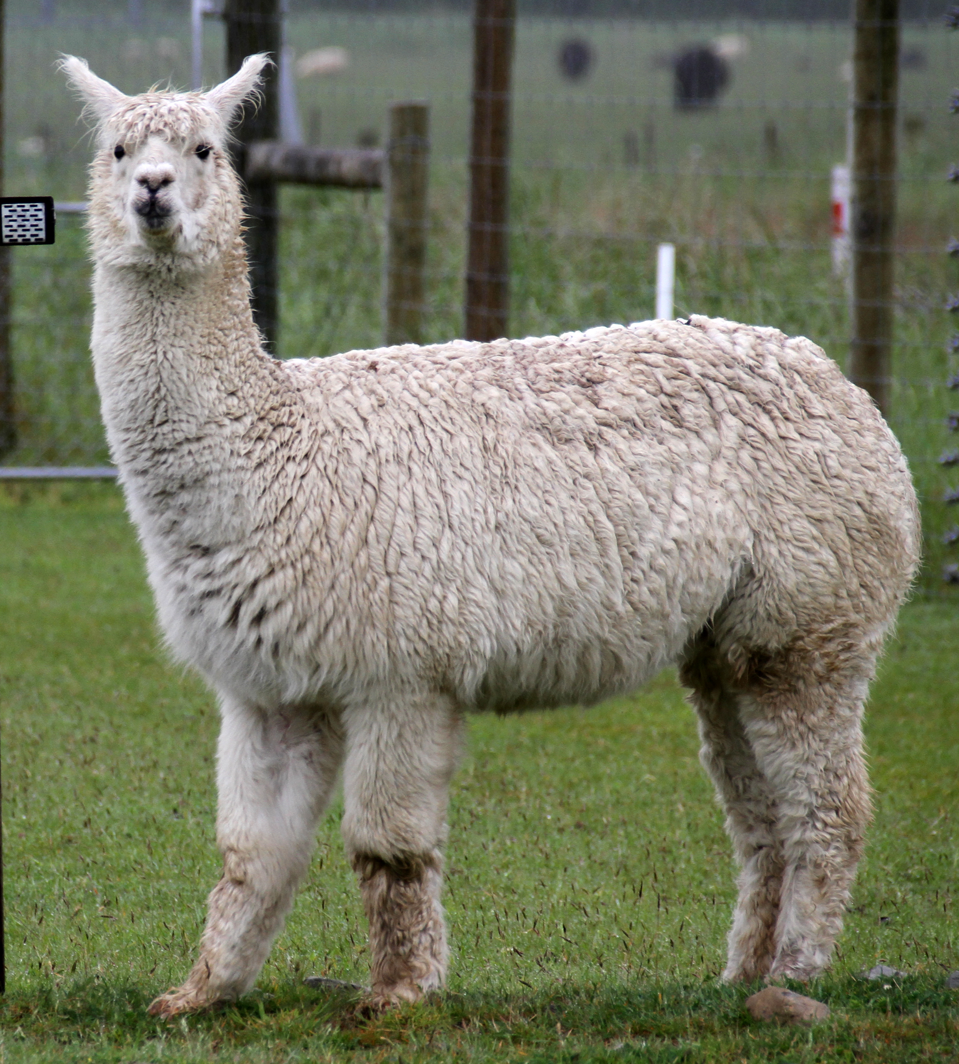
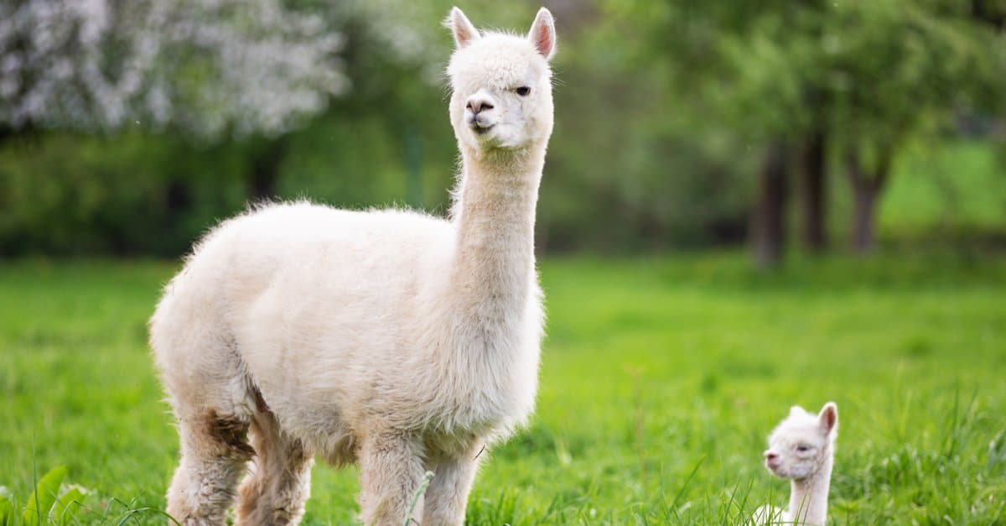
Alpaca

Slide 8
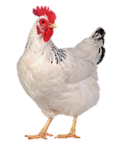
1 Listen and point. Repeat
chicken

Slide 9
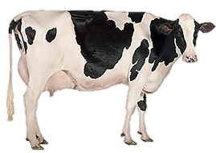
1 Listen and point. Repeat
cow

Slide 10
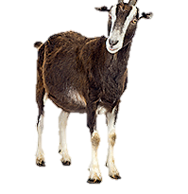
1 Listen and point. Repeat
goat

Slide 11
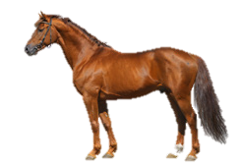
1 Listen and point. Repeat
horse

Slide 12
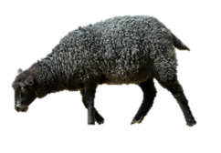
1 Listen and point. Repeat
sheep

Slide 13
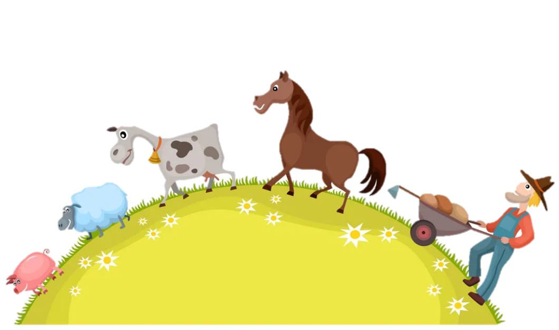
Guessing game

Slide 14
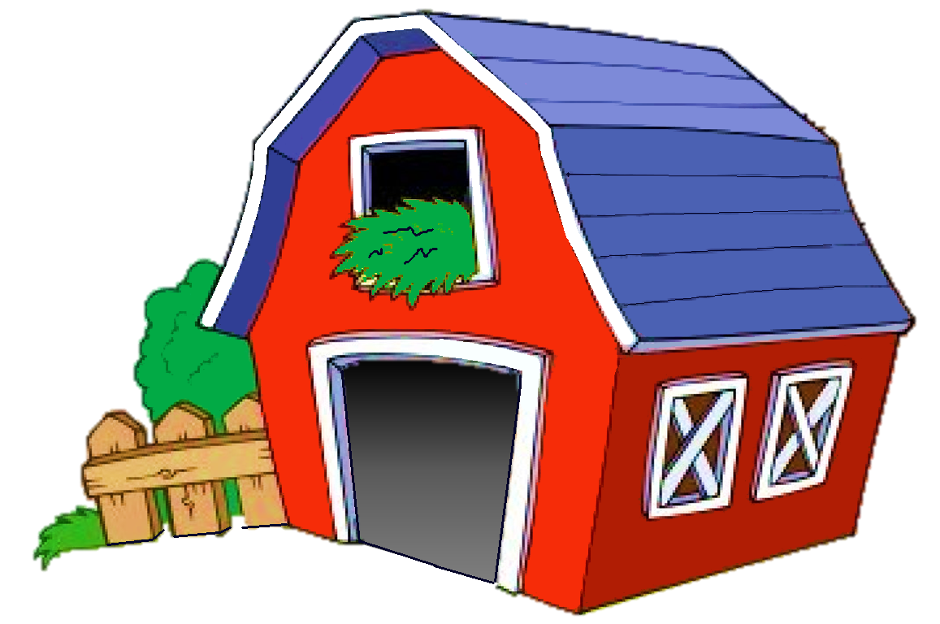
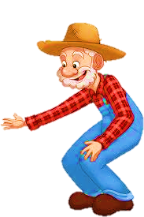
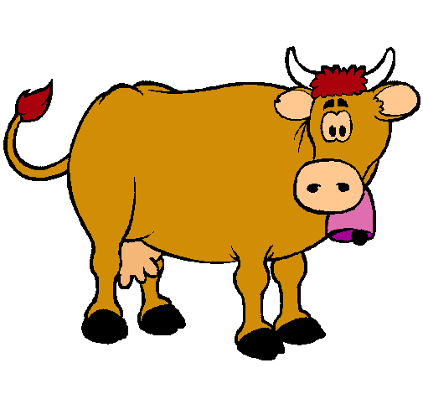
Click on the speaker and guess
NEXT
a goat
a cow
a duck

Slide 15
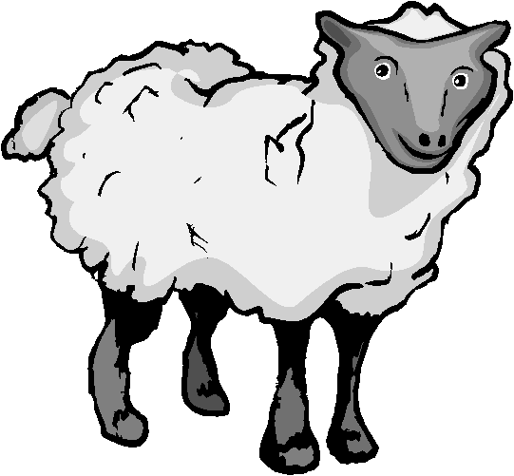
Click on the speaker and guess
NEXT
a sheep
a goat
a duck

Slide 16
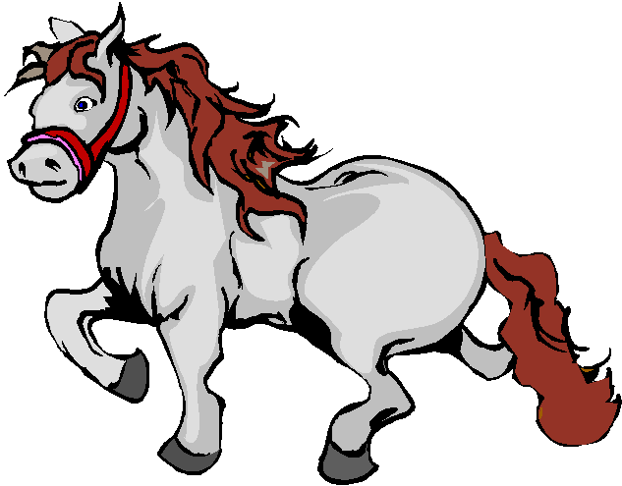
NEXT
a goat
a horse
a donkey

Slide 17
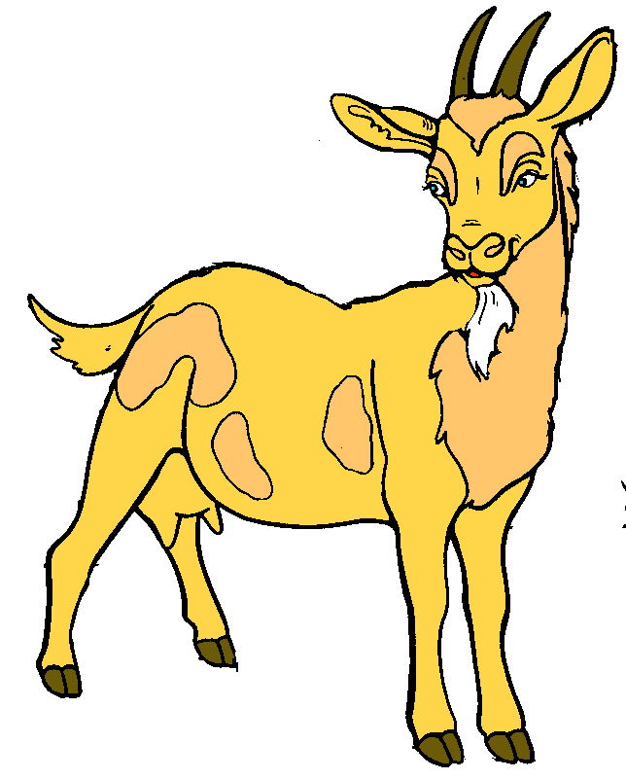
Click on the speaker and guess
NEXT
a hen
a goat
a rabbit

Slide 18
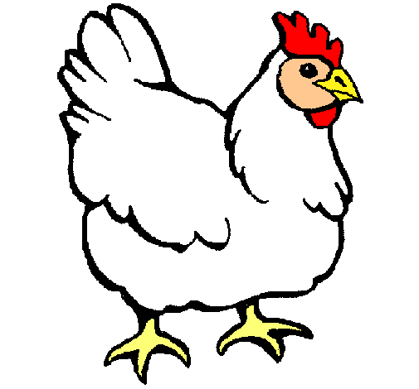
Click on the speaker and guess
a chicken
a goat
a pig

Slide 20
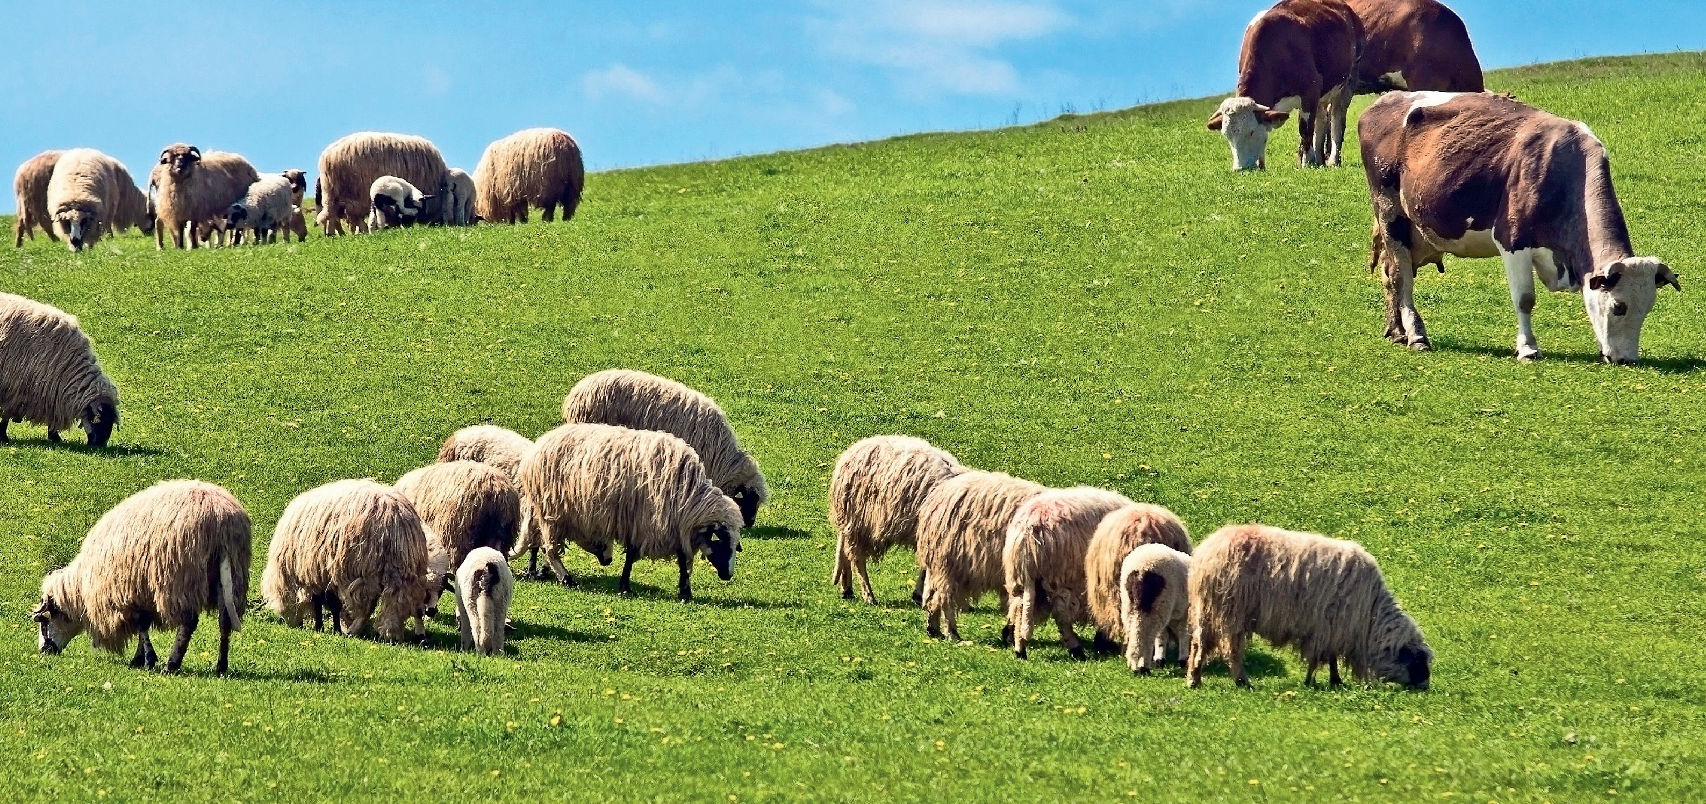
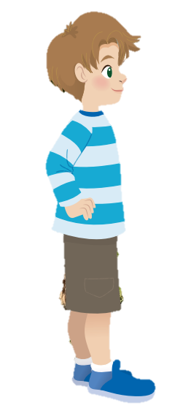
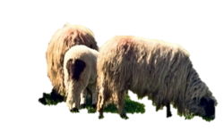
2 Listen and read. Match.
Sophie
Alex

Slide 23
2 Listen and read. Match.
1. sheep
a. tall
b. short
c. big
2. cows
d. small

Slide 25
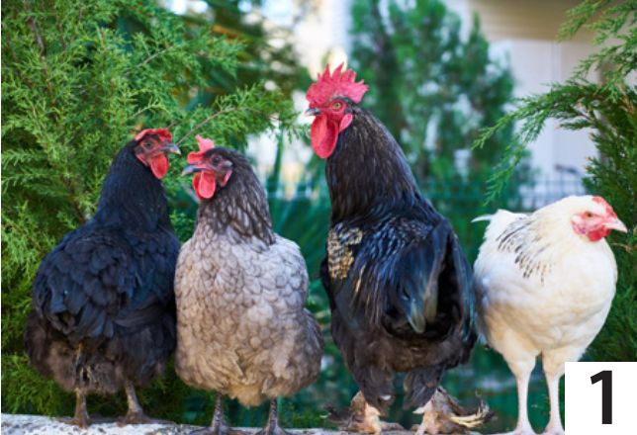
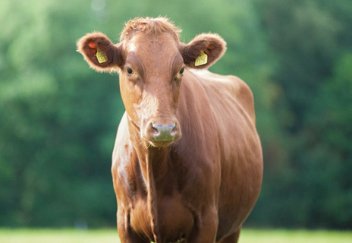
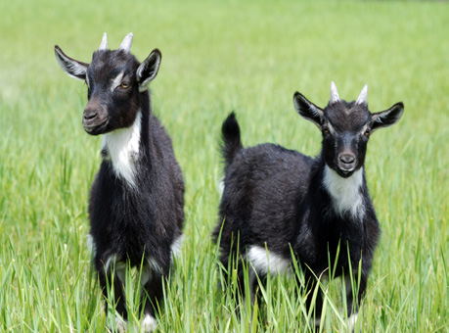
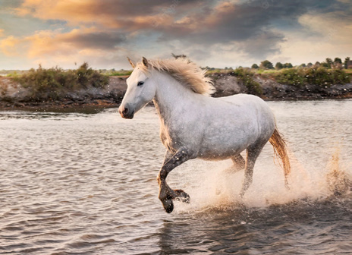
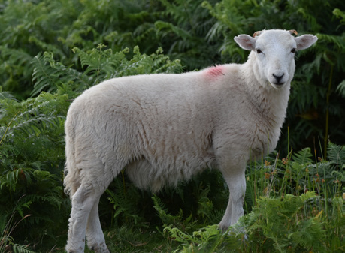
3 Look and say
1. I’ve got........................….
some chickens
2
3
4
5

Slide 26
3 Look and say
1. I’ve got........................….
some chickens.

Slide 27
3 Look and say
2. I’ve got........................….
a cow

Slide 28
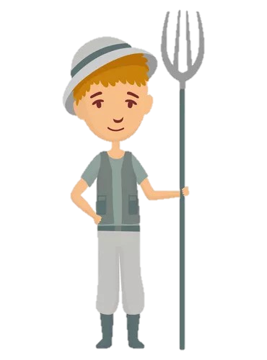
3 Look and say
3. I’ve got........................….
some goats.
BACK

Slide 29
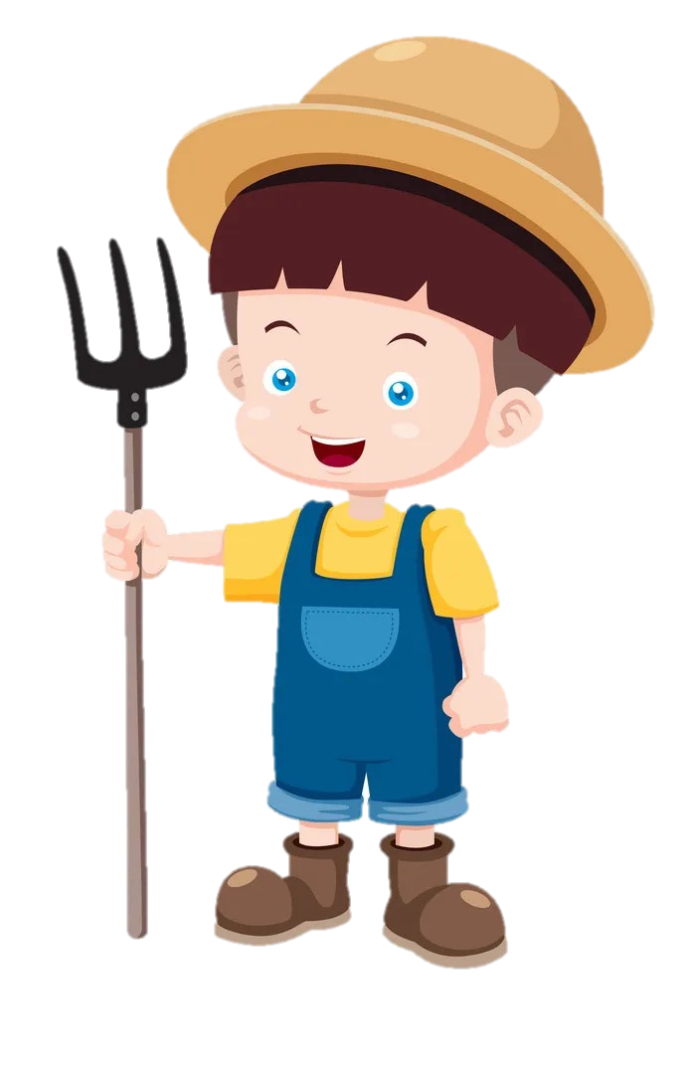
3 Look and say
4. I’ve got.....................
a horse.

Slide 30
3 Look and say
5. I’ve got........................….
a sheep.

Slide 31
Game: Pass the ball

Slide 32
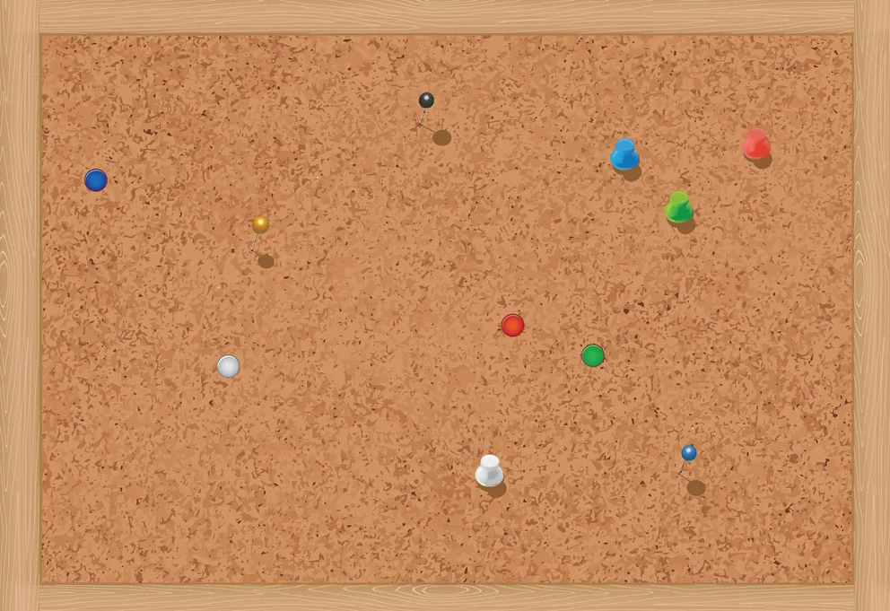
REMEMBER
Vocabulary
chicken
cow
goat
horse
sheep
Structure
I’ve got ……….

Slide 34
Thank you
& goodbye!

