Slide 1
Tiếng Anh 1 - MacMillan Next Move
Unit 1- Lesson 8: CRAFT TIME
Class objectives: Number cards 1-10, PowerPoint, review grammar and vocabulary form Unit 1,
Class duration: 40 minutes
Vocabulary review: hello, goodbye, numbers one to ten
Grammar review: How old are you? - I’m.......(six)
Resources: Student Book P10, Number cards 1-10, PowerPoint
Materials: PowerPoint, Song, Flashcards, Student Book, Workbook, Scissors, Crayons, Glue or tape,
Songs: how old are you song, number song

Slide 2
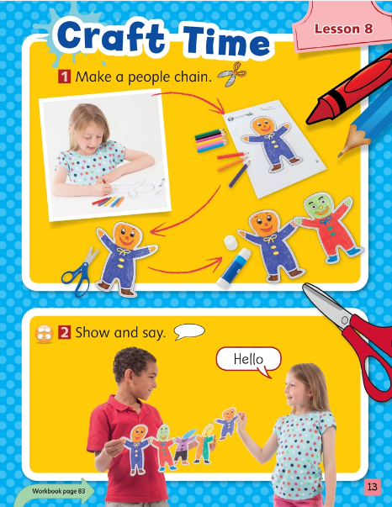
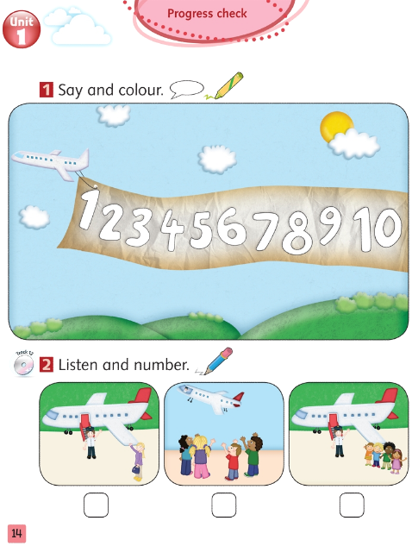

Slide 4
GRAMMAR

Slide 5
1
2
3
4
5
one
two
three
four
five
6
7
8
9
10
six
seven
eight
nine
ten

Slide 7
Flappy Bird game
Divide class into 2 teams
Choose a number
If the answer is correct, click
Click on or to move, then click
If not, click to back to questions
Which team reaching the finish line first will be the winner

Slide 8
NEXT

Slide 9
Click to Make Yellow Bird Move
Click to Make Pink Bird move

Slide 10
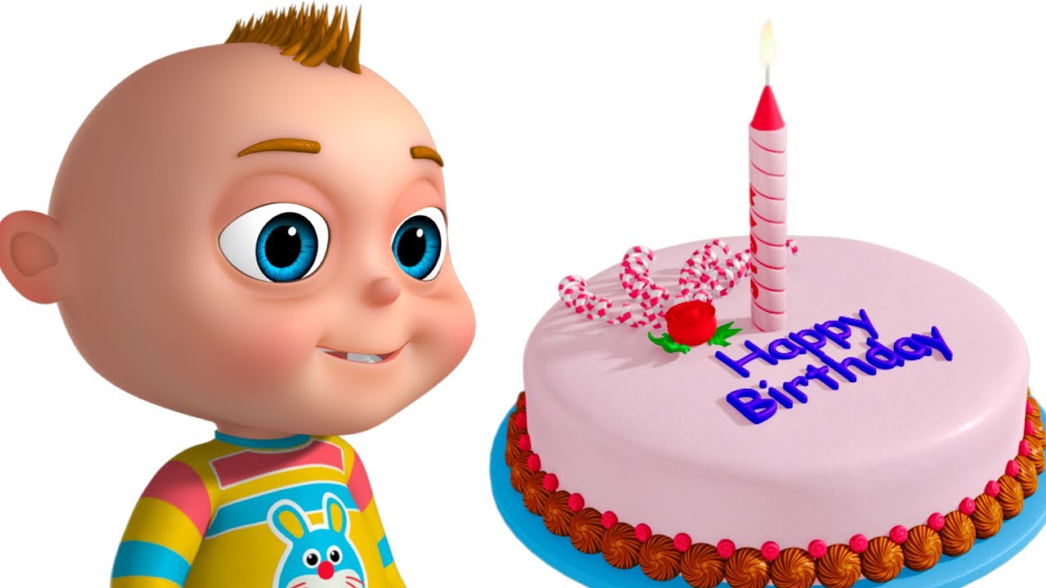
I'm _______.
one

Slide 11
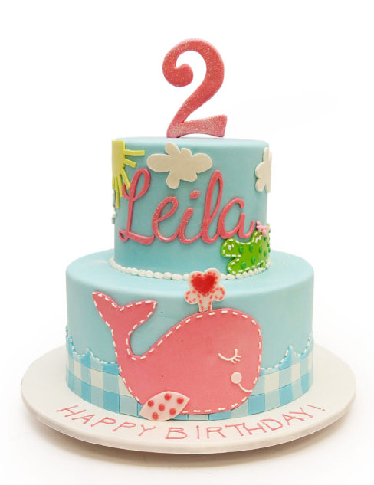
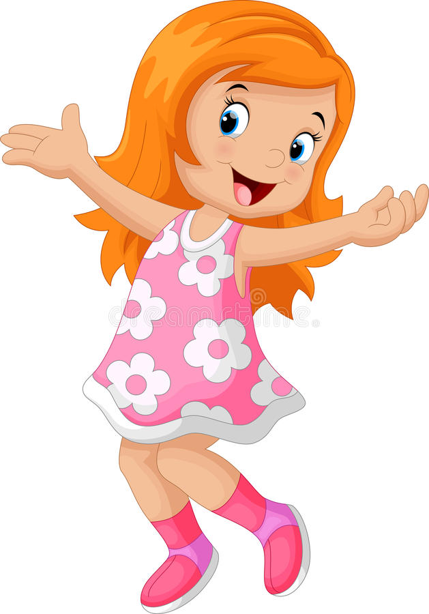
I'm _______.
two

Slide 12
I'm _______.
three

Slide 13
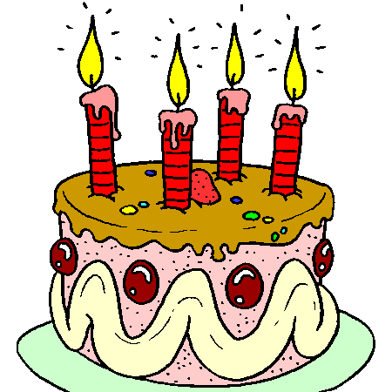
I'm ________.
four

Slide 14
I'm ________.
five

Slide 15
I'm __________.
six

Slide 16
I'm _______.
seven

Slide 17
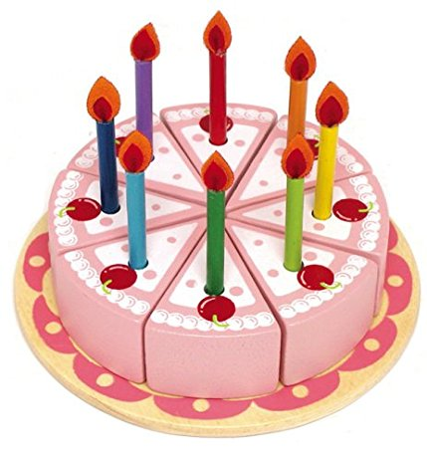
I'm ___________.
eight

Slide 18
I'm ________.
nine

Slide 19
I'm ___________.
ten

Slide 20
Topic
Make a people chain

Slide 21
Make a people chain
- Divide the class into groups of 4 or 5
- Each group colours 4 or 5 printed paper people.
Then use the glue to stick them together to make a people chain.
Then each group takes turn to present.
Student 1: Hello. I'm Hoa. I'm five.
Student 2: My name's Lan. I'm six.

Slide 22
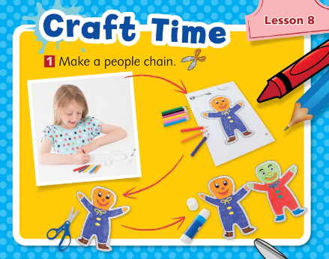

Slide 23
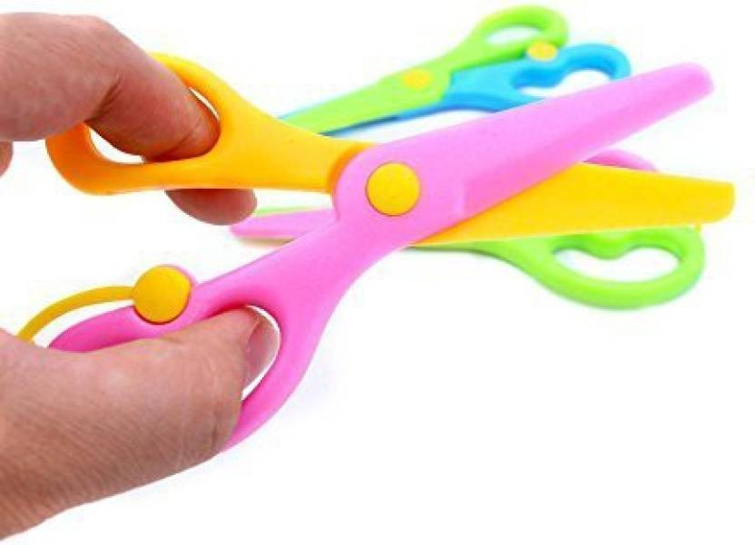

Slide 24
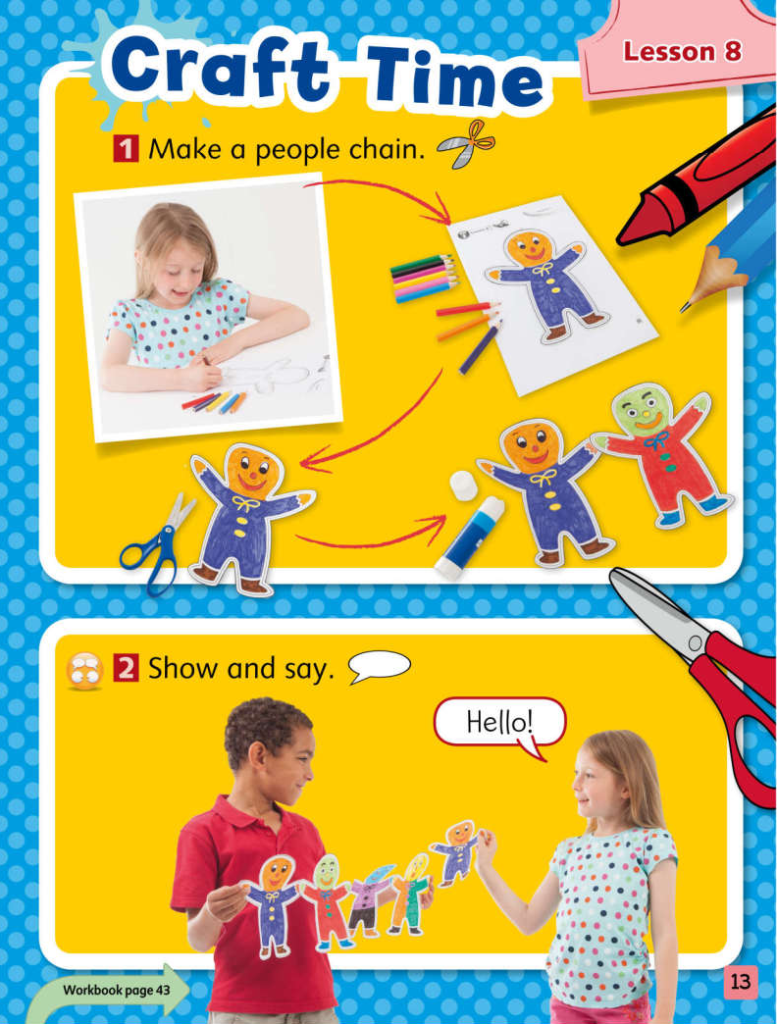
Student Book P13
BEFORE CRAFT
T goes over safety of using scissors (see following slides)
Go over directions and walk around to assist Ss
1-colour
2-cut
3-glue or tape
Notes:
GO OVER SCISSORS SAFETY FIRST

Slide 25
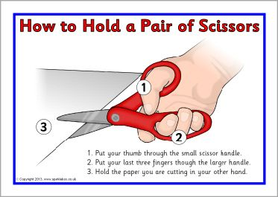
Scissors Safety!

Slide 26
Scissors Safety

Slide 27
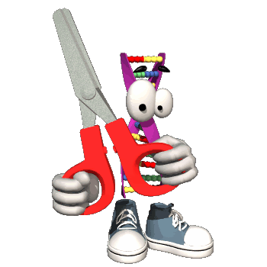
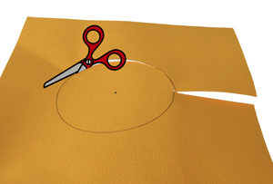
How To Cut!

Slide 28
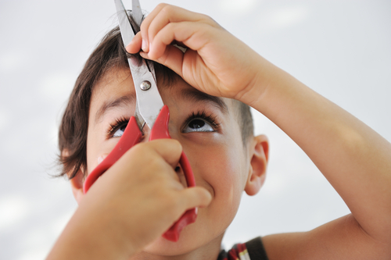
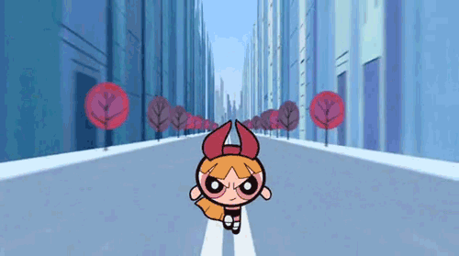
Scissors Safety

Slide 29
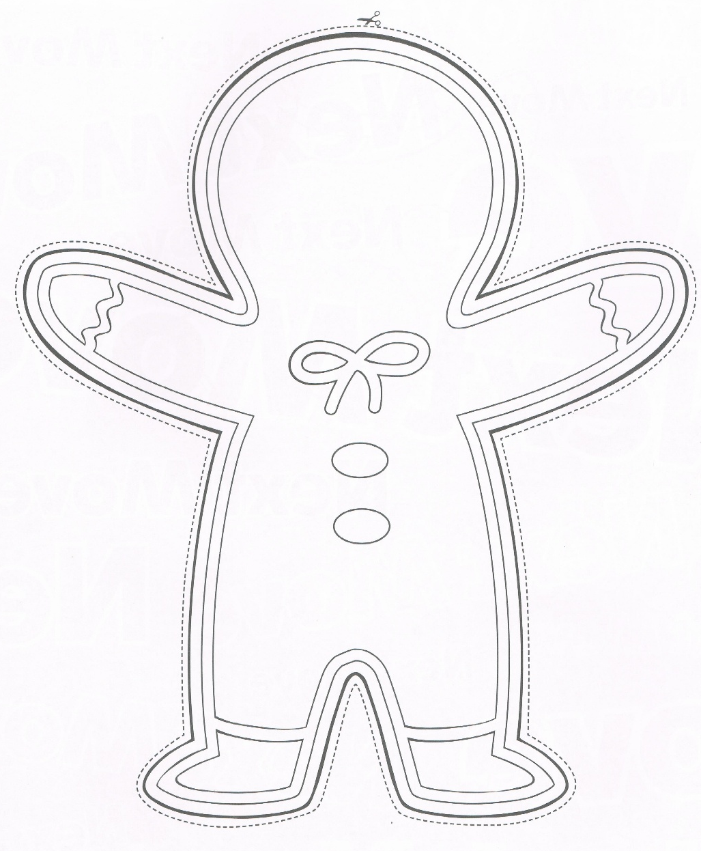
Colour the printed person and draw eyes, nose and mouth.

Slide 30
Note for Teachers
Make sure every child has the craft template for this lesson from their Workbook. Demonstrate cutting out the shape. Say the word Cut as you do so (note that for younger children you may wish to prepare for this activity by cutting out their templates in advance).
Demonstrate drawing the eyes, mouth and nose. Say the word Draw as you do so.
Encourage the children to add their own details to the figures. Say Hello to different children. Have them hold up their figure and reply Hello.
Encourage the children to make their figures say Hello to each other.

Slide 31
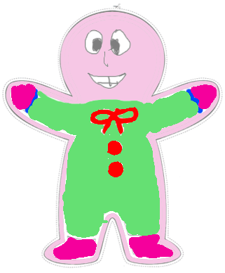

Slide 32
Say a number between one and ten. In small groups, the children collect the same number of figures and place them together where everyone can see them. Ask a child to put the correct number card next to the group of figures.

Slide 33
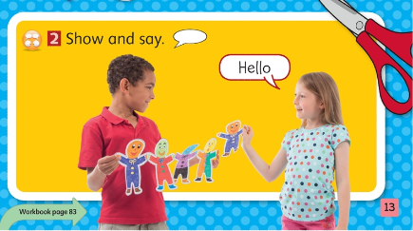

Slide 34
Show the class how to paste one figure to another, with the hands and feet touching. Pretend the figures are saying Hello to each other. Have each child attach their figure to the existing ones. As they attach it, have them make their figure say Hello to the others.
Start a new chain once ten figures have been joined. Ask the children to count the figures in each chain. Paste the chains to the backing sheets to make a display.

Slide 35
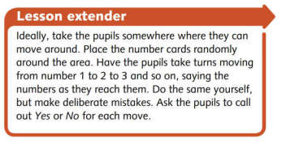
Ideally, take the children somewhere where they can move around. Place the number cards randomly around the area. Have the children take turns moving from number 1 to 2 to 3 and so on, saying the numbers as they reach them.
Do the same yourself, but make deliberate mistakes.
Ask the children to call out Yes or No for each move.

Slide 36
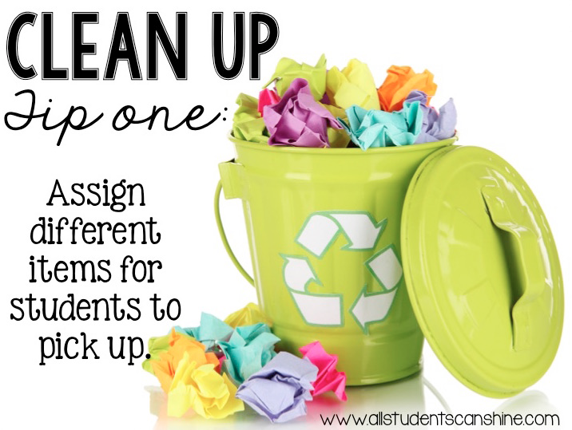

Slide 37
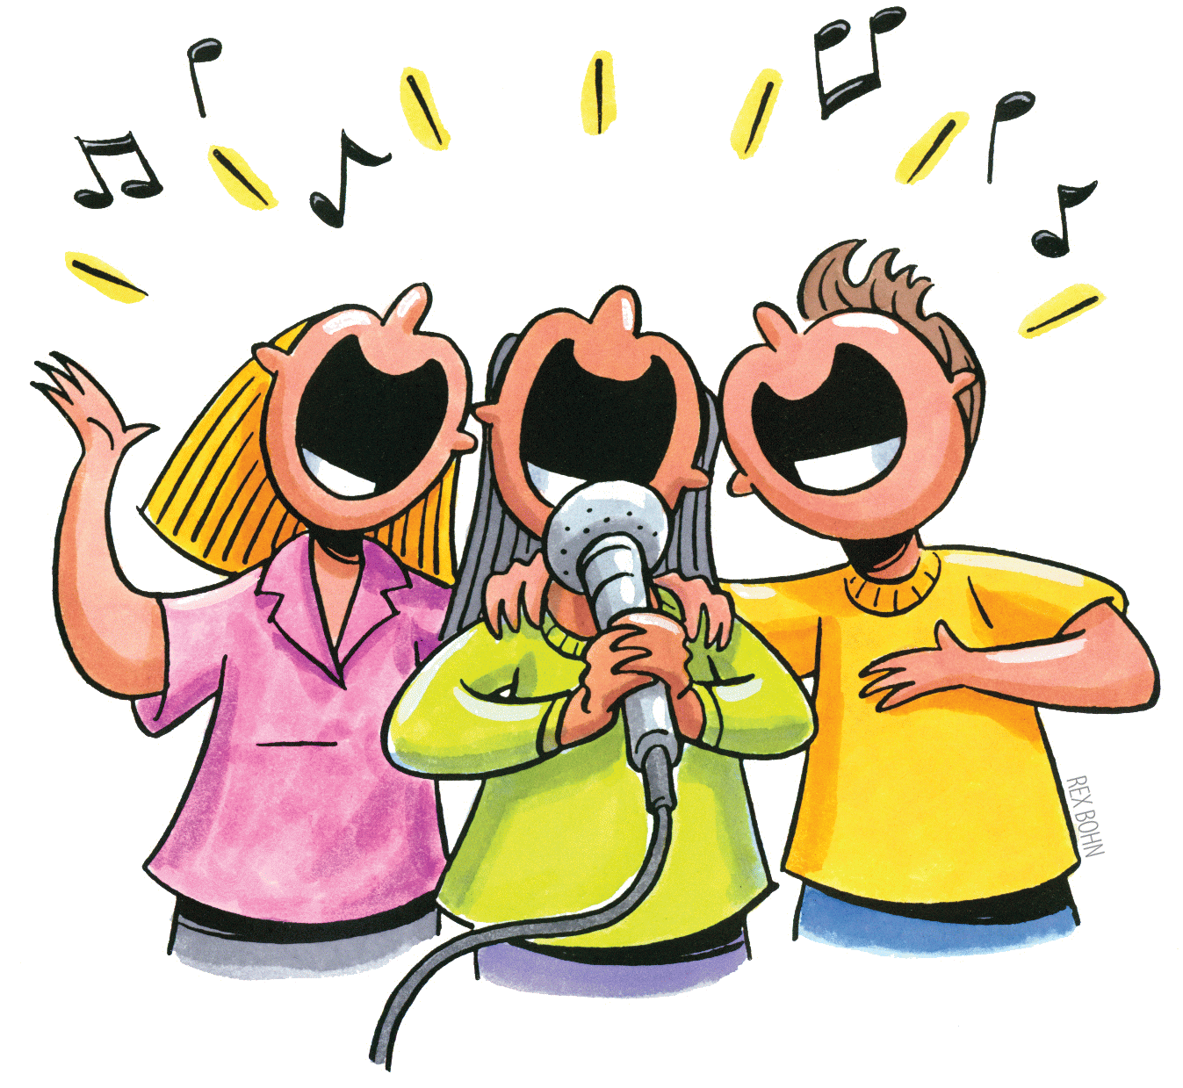
Click here to play the song

