Slide 1
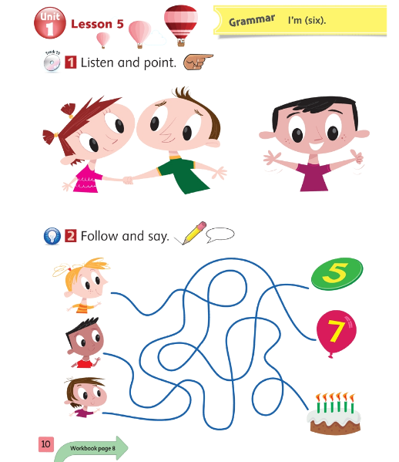
Tiếng Anh 1 - Macmillan Next Move
Unit 1- Lesson 5: I’m… (six)
Learning topic: Age
Class objectives: discover how to say their age
Class duration: 40 minutes
Vocabulary: one, two, three, four, five, six, seven, eight, nine, ten
Grammar: I’m.......(six)
Resources: Student Book P10
Songs: How old are you song, number song

Slide 2
Warm- up song: Number song

Slide 3
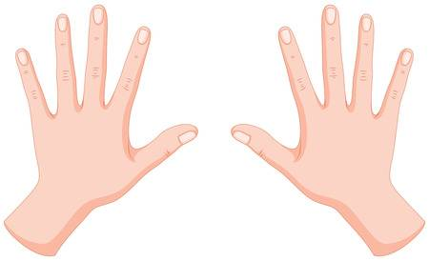
Let’s count together!

Slide 4
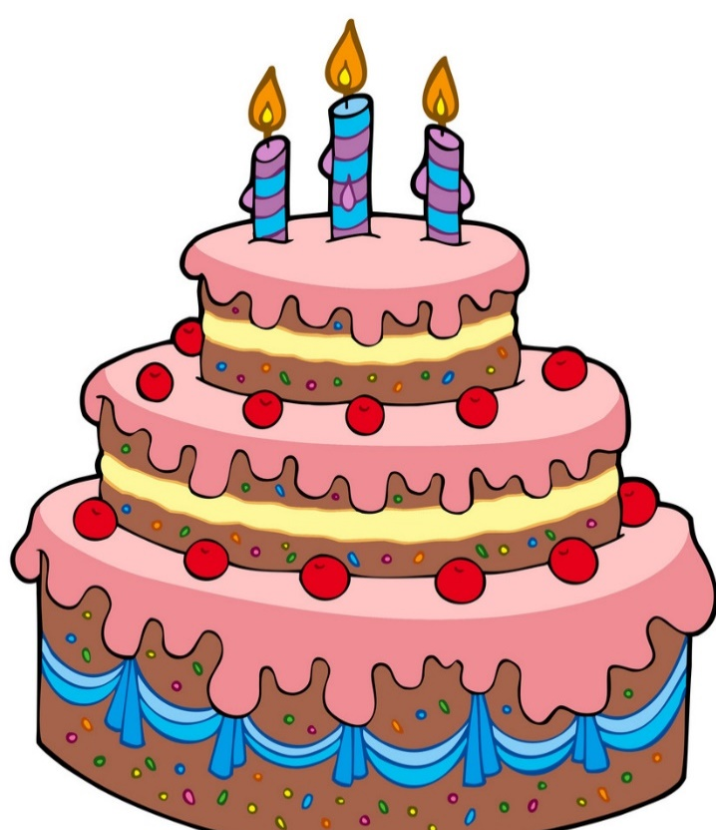
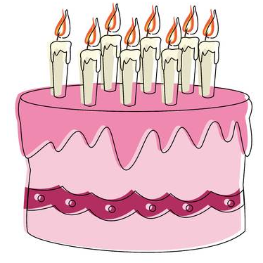
Let’s count the candles together!

Slide 5
Look and say the numbers
1
2
3
4
5
One
Two
Three
Four
Five
6
7
8
9
10
Six
Seven
Eight
Nine
Ten

Slide 6
Show me your fingers!
1
2
3
4
5

Slide 7
Show me your fingers!
Count with me!
6

Slide 8
Show me your fingers!
Count with me!
10

Slide 9
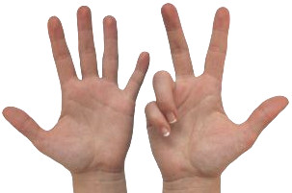
Show me your fingers!
Count with me!
8

Slide 10
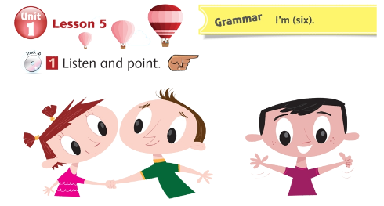
Fiona
Notes:
Ask students to look at the picture and guess How old the boy is by counting the fingers of the boy. Then play the CD for students to check

Slide 11
Fiona
Caleb
Hello, I’m Fiona.
Hello, I’m Caleb.
How old are you?
I’m six.

Slide 12
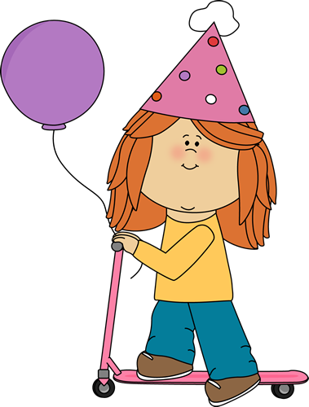
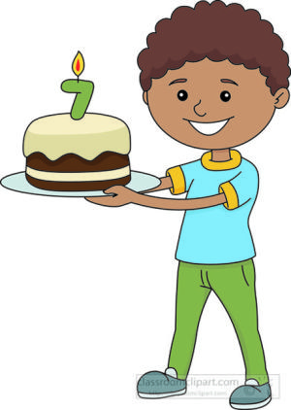
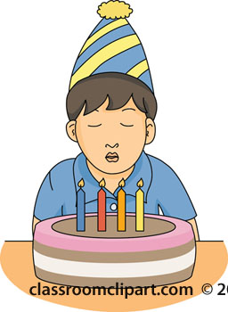
How old are you?
I’m four.
I’m seven.
I’m three.
3

Slide 13
Watch and remember!

Slide 14
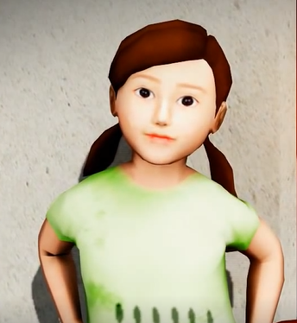
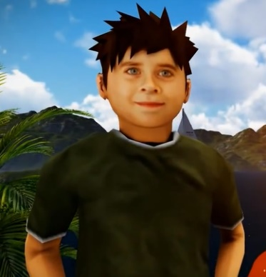
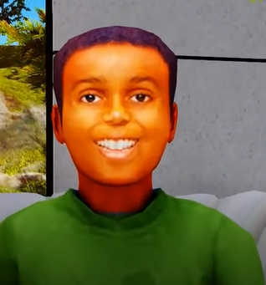
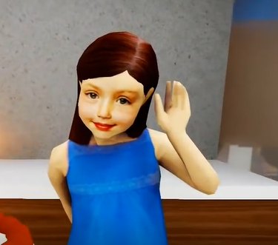
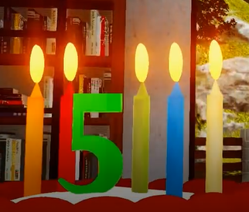
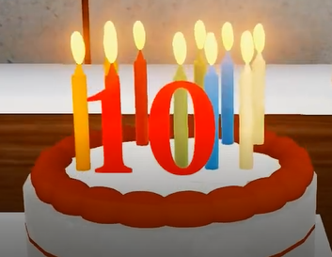
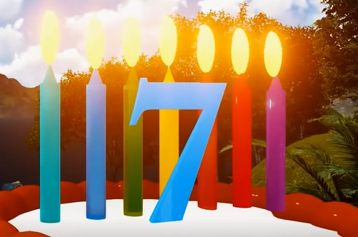

Slide 15
Work in pair
Anna
Tom
6
5
Hello, I’m Anna.
I am Six.
Hello, I’m Tom.
I’m five.
How old are you?

Slide 16
David
Mary
7
10
Hello, I’m David.
I am seven.
Hello, I’m Mary.
How old are you?
I’m ten.

Slide 18
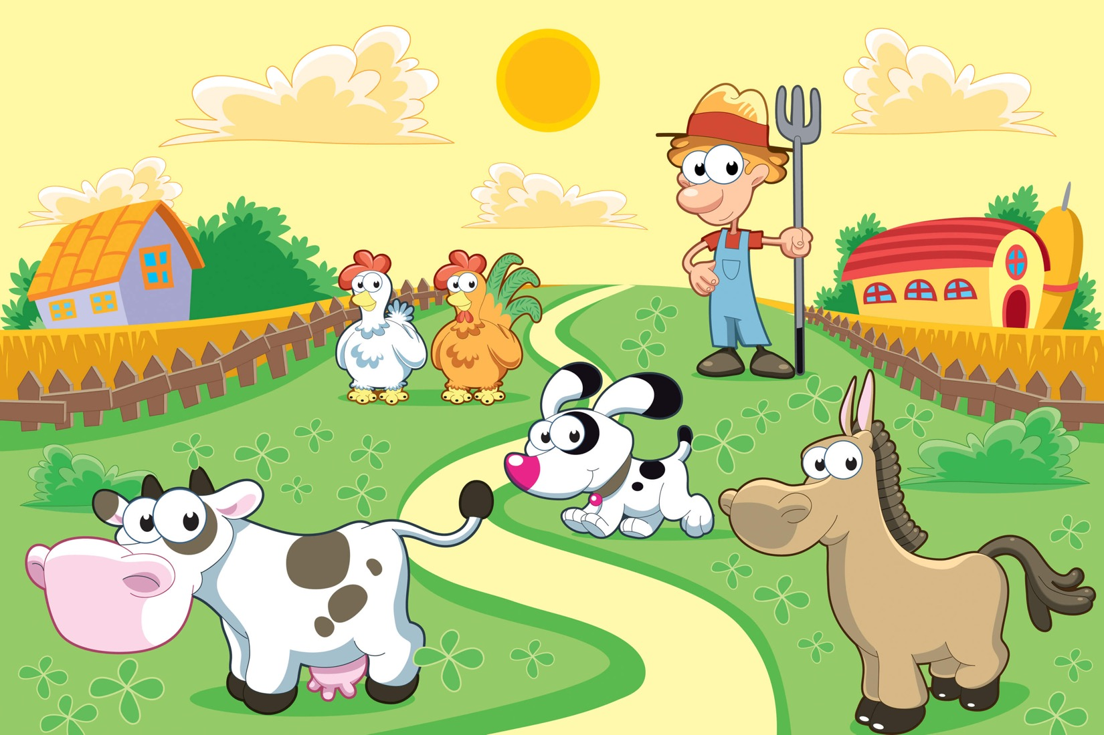
HAPPY FARM
Notes:
Ss play together.
Choose the number and answer the questions.
If Ss give the correct answer, they will have the animals to their farm.
When they finish six questions, they will have all animals.

Slide 19
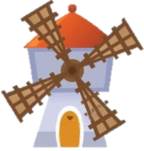
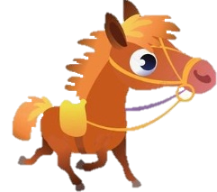
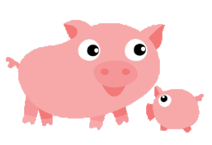
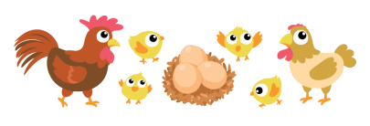
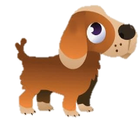
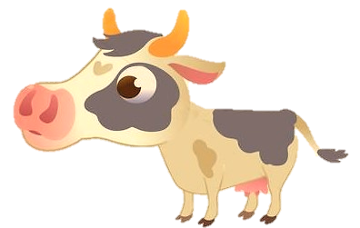
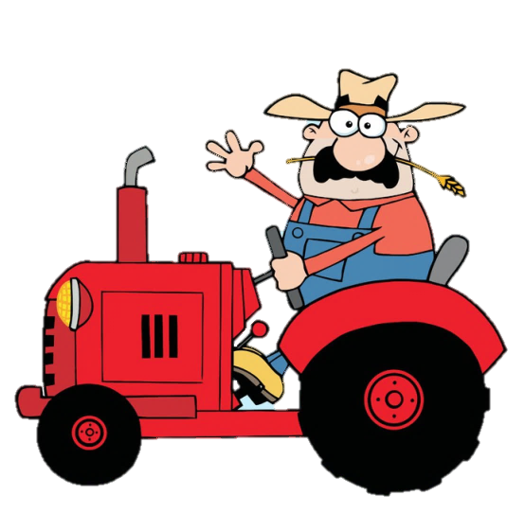

Slide 20
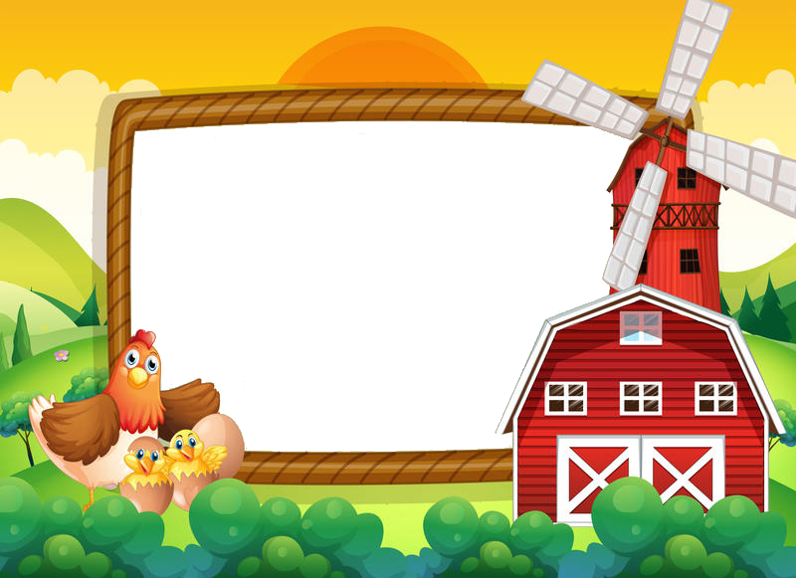
How old are you?

Slide 21
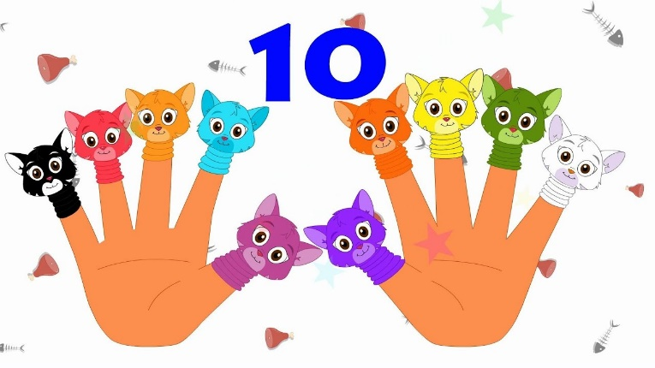
How old are you?

Slide 22
How old are you?

Slide 23
How old are you?

Slide 24
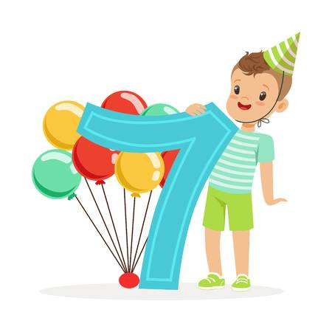
How old are you?

Slide 25
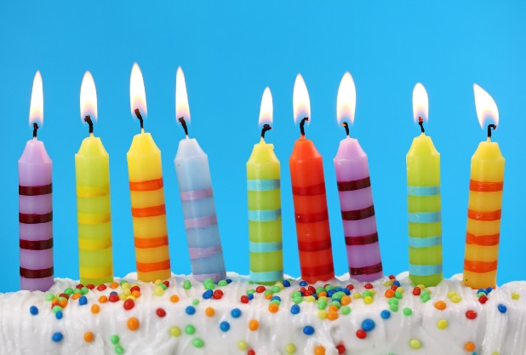
How old are you?

Slide 26
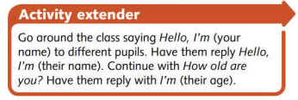
Practice with real situation
Go around the class saying Hello, I'm (your name,) to different children. Have them reply Hello, I'm (their name/ Continue with How old are you? Have them reply with I'm (their age)

Slide 27
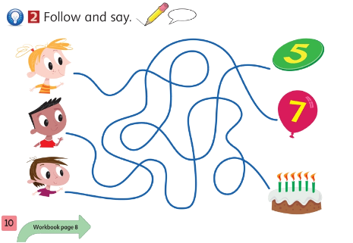
Note for teachers
Have the children look at the picture. Ask them what they think about the numbers and the cake with the candles represent (the children's ages). Demonstrate, following along one line with your finger. When you arrive at the end, say I'm (number). Give the children time to follow the line for each character on their own. Then have them work in pairs. The children take turns pointing to one of the faces. The other child follows the line to the age and says, e.g. I'm seven.
Teacher can call students to come and point to the screen of the TV, then follow and say.

Slide 29
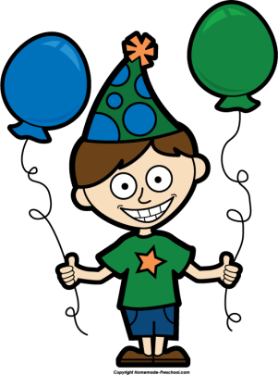
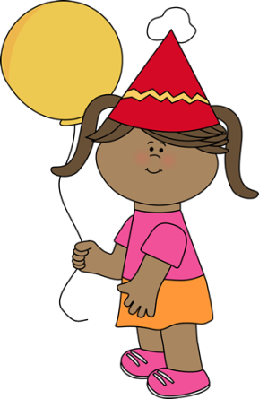
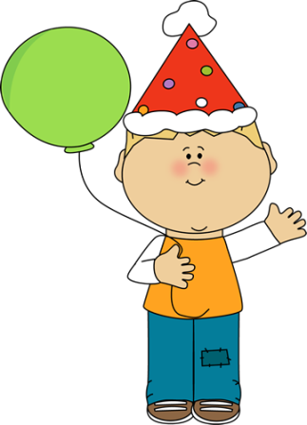
9
Game: Matching
7
5

Slide 30
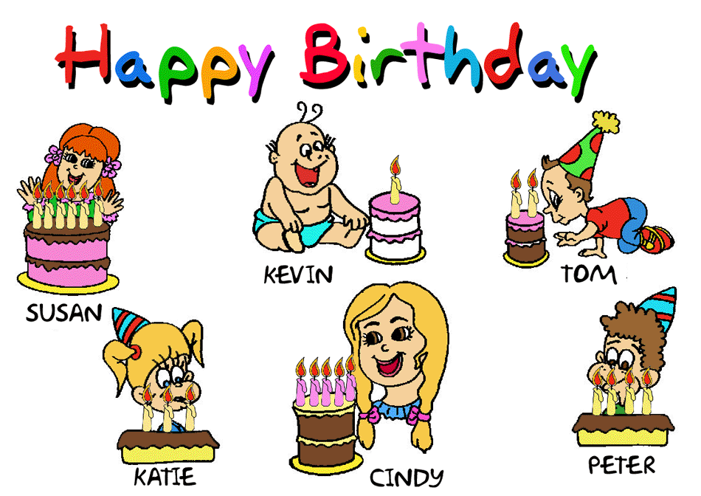
How old is he/she?

Slide 31
Game
Hot Potato Game!
Use a small ball, have Ss sit in a circle/ on their chairs and demonstrate how to play (pretend it’s very hot and pass it to the S next to you and show them how to do the same).
Play music while Ss are passing and whoever has the hot potato when the music stops will says a number!

Slide 32
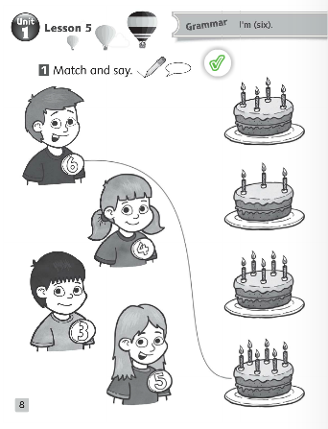
Workbook P8
Show Ss how to count candles & how to follow the line with their fingers - do on board & call for S to try if needed
Practice saying “He/she is ……. years old.”
Once Ss understand, pass out pencils and walk around to assist in pencil control or help
Rewards/ team points for job well done!

Slide 33
Start counting from one to ten and encourage the class to join in. Each time you reach ten, start again at one. Then call out Girls. The girls continue counting, the boys stay quiet. Repeat the activity with Boys. Continue, switching between boys and girls, until you call out Goodbye.

